Slide 1
PROSPECT
TIPS

Slide 2
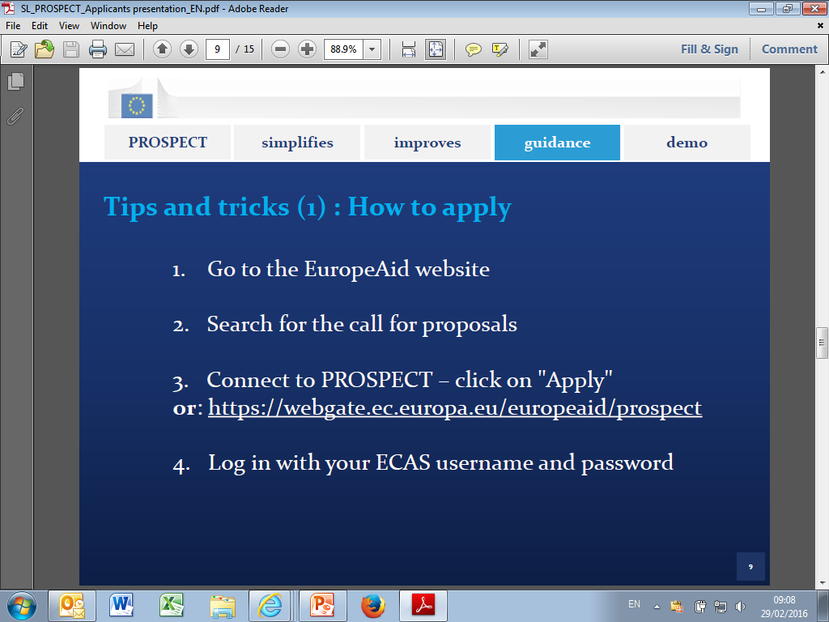

Slide 3
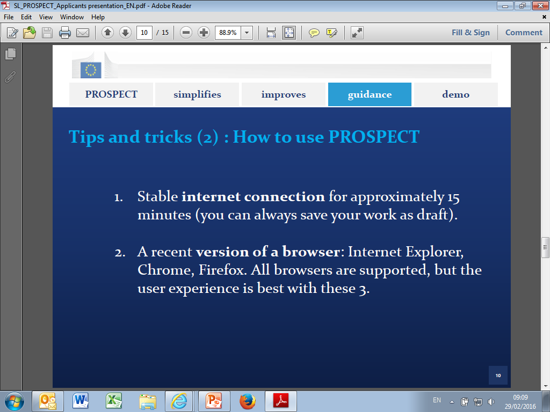

Slide 4
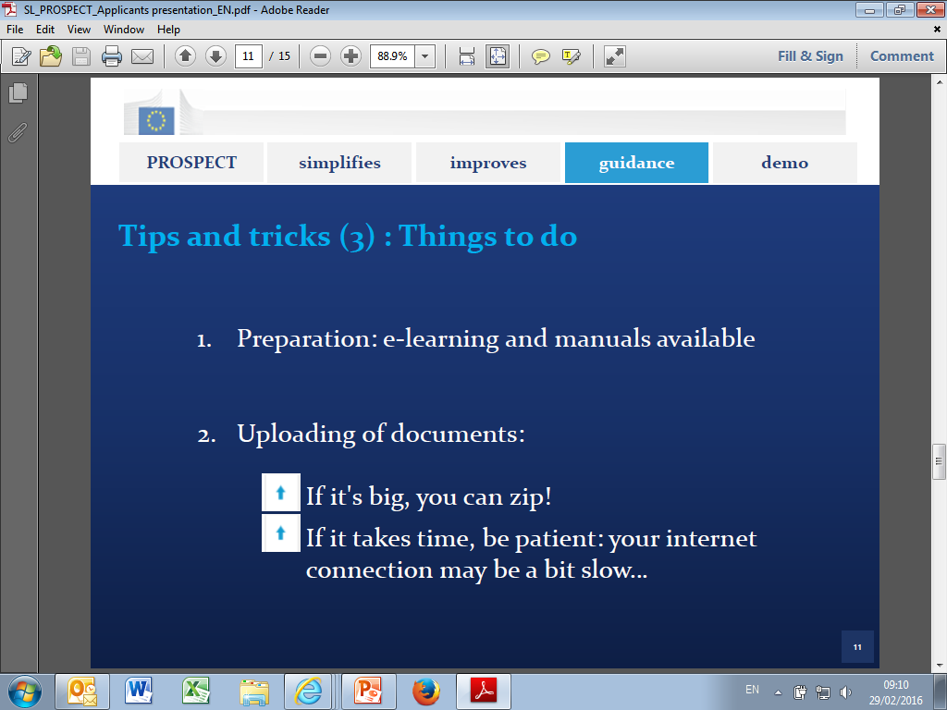

Slide 5


