Slide 1
Introduction to Professional Engineering Practice
Orientation for newly recruited Assistant Engineers of the local government service (LGS)
Ing. Michael Dedey, (SPE), GhIE
024-4230549

Slide 2
Content
Legal Framework for Engineering Practice (Act 819)
Occupational Health & Safety (Act 328, Act 651)
Professionalism (Engineering as a Global Practice)
The Engineer’s Role in Procurement
Engineering Works & Engineering Services
Ethics

Slide 3
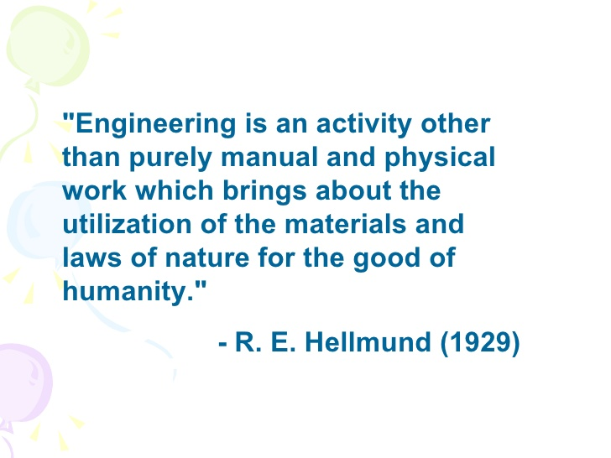

Slide 4
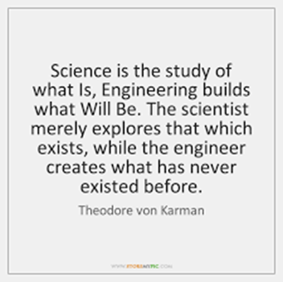

Slide 5
Legal Framework for Engineering Practice
{Engineering Council Act, 2011 (Act 819)} Section 3 – Functions
Regulate the practice of engineering
Determine and prescribe requirements for initial and continuing registration
Maintain and publish annually, registers for engineering practitioners in the Country;
Determine the limits to areas of engineering practice and operations
Monitor, evaluate and take corrective actions on the performance or engineering practitioners, firms and units
Collaborate with the National Accreditation Board and other bodies to certify programmes or education relevant for engineering practice
License relevant and appropriate engineering bodies to certify individuals and corporate bodies for initial and continuing registration
Prescribe, uphold and enforce professional standards, conduct and ethics of engineering practitioners;
Exercise disciplinary power over engineering practitioners in respect of the practice of their profession and works related to the practice of engineering;
Advise the Minister on engineering matters; and
Perform any other functions that are ancillary to the object of the Council

Slide 6
Engineering Council Act, 2011 (Act 819)
Section 13(1), 14 (1) and 20(1)
13. (1) A person shall not offer engineering services or practice engineering unless that person is registered in accordance with the Act.
14 (1) A person does not qualify to be registered to practice engineering unless that person is certified by a licensed body.
20 (1) An engineering firm shall not put itself out, solicit for or offer engineering services to the public or engage in engineering practice unless it is registered under this Act.

Slide 7
Summary of Legal Framework
Must be registered to practice engineering in Ghana
Must meet minimum requirements of Continuous Professional Development (CPD) annually
Pay required annual fees

Slide 8
Register of Engineering Practitioners
(Section 16)
Professional Engineers’ Register
Professional Engineering Technologists’ Register
Engineering Technicians’ Registers
Engineering Craftsmen’s Register

Slide 9
Occupational Health & Safety
(Act 328, Act 651)
Section 13 – 24 address requirements for an employer to maintain industrial Hygiene
Section 25 – 28 addresses issues of personnel safety
Section 34 – 53 addresses concerns about equipment and machinery safety, safety of premises and dangerous conditions
Section 118 of Act 651 makes provisions for the safety of employees.

Slide 10





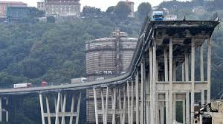
Professionalism
(Engineering is a Global Practice – Engineering Works & Services)

Slide 11

Professionalism
(Diligence, Quality and Integrity)
Engineering practice is global and engineering knowledge, works and services are comparable.
The quality of infrastructure and engineering services in Ghana is a judgment on engineering practitioners in Ghana.

Slide 12
Professionalism
(Punctuality, Attitude, Relations)
Punctuality is a hallmark of professionalism
Responsiveness and general attitude to work is a measure of professionalism
Effective communication and good human relations is a mark professionalism
Personal conduct and mannerism
Seeks expert opinion when not certain

Slide 13

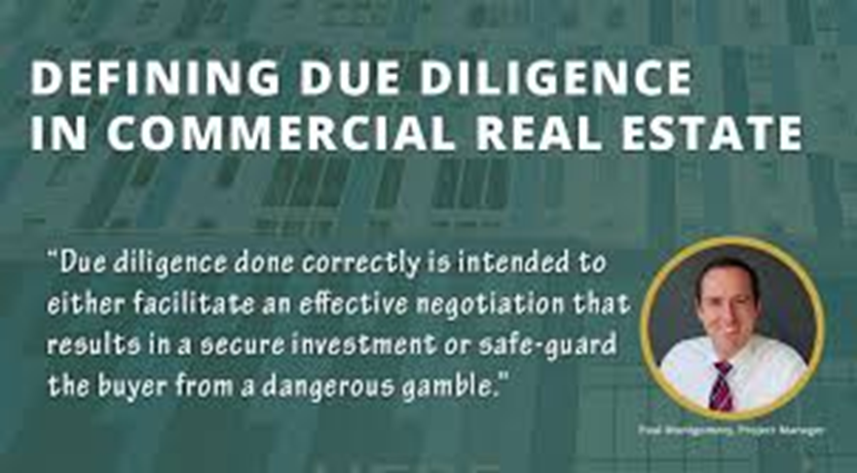
Diligence

Slide 14



Quality

Slide 15
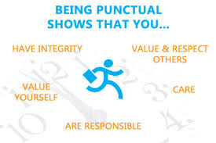
Punctuality

Slide 16


Integrity Quotes

Slide 17
The Engineer’s Role in Procurement
Evaluate suppliers and negotiate purchase agreements, as well as maintain the inventory of supplies
Provide specifications for the purchasing of technical goods and services for an industrial operation
Review technical information provided for engineering works or services

Slide 18
Examples of specifications
Tyres – Size, Speed, Temperature, Traction, Wear rating
Pumps – Head, discharge, pressure, temperature etc.
Vehicles – Engine size, passengers, control features etc.
Design for works – Engineering drawing, Bill of quantities
PPE – Hard hats, gloves, eye protection, foot protection etc.
Power tools – Angle grinders, drills, saws etc.

Slide 19
Engineering Works, Manufacturing & Engineering Services
Engineering Works - Is the design and construction of public and private works, such as infrastructure (airports, roads, railways, water supply, and treatment etc.), bridges, tunnels, dams, buildings
Manufacturing – Production of goods, equipment and machinery involving, molding, joining, machining, shearing and forming
Engineering Services – Provision of consultancy services

Slide 20
Ethics
Moral principles that govern a person's behaviour or the conducting of an activity
Or
It is a concept of moral philosophy informed by a set of principles to guide behavior. It may not necessarily be enforceable or punishable
Ethics is different from law. Sometimes the difference is not very obvious

Slide 21
Ethics
(Law or ethic?)
Being untruthful – lying to a colleague, family member, friend etc.
Cheating of on a partner
Being untruthful to a Policeman or any public official
Breaking a promise to your child, partner or friend

Slide 22
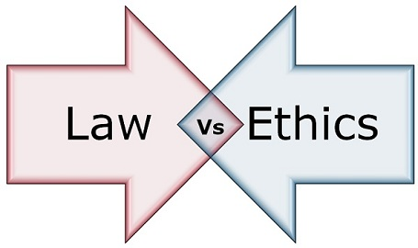
Law vs Ethics

Slide 23
Common Unethical Practices
Seeking sexual favours from subordinates in the workplace prior to promotions or granting demands/rights.
Giving inside information to competitors
Deliberately withholding information that is relevant for decision making

Slide 24
What Next?
How do we navigate the “Political Economy” within which we operate?
“There are no bad Contractors, only bad Engineers”

