Slide 1
GOG PAYROLL ADMINISTRATION
PRESENTED BY:
ELIZABETH OSEI
DIRECTOR PAYROLL - CAGD
ANITA HOTEL - KUMASI
0CTOBER 2018

Slide 2
OUTLINE
OBJCTIVE OF PRESENTATION
EXPECTATIONS AND FEARS
LEGAL FRAMEWORK GOVERNING GOG PAYROLL
OVERVIEW OF GOG PAYROLL PROCESSES
RESPONSIBILITIES OF HEADS OF DEPTS
RECENT PAYROLL INITIATIVES
COLLABORATION IN IMPROVING PAYROLL CREDIBILITY
OTHER BURNING ISSUES

Slide 3
OBJECTIVE OF PRESENTATION
To sensitize newly Engaged, HR Officers and other Officers of the LGS on the GoG Mechanized Payroll System.
To explain their roles as HR Officers on the GOG Payroll
To explain the Payroll Cycle
To discuss pertinent Issues relating to payment of salaries

Slide 4
EXPECTATIONS AND FEARS
EXPECTATIONS AND FEARS OF PRESENTER
EXPECTATIONS AND FEARS OF PARTICIPANTS

Slide 5
MY EXPECTATIONS
THE SESSION WOULD BE INTERACTIVE
ALL PARTICIPANTS WOULD PARTICIPATE
AT THE END OF THE PRESENTATION ALL PARTICPANTS WOULD APPRECIATE THE BUSINESS PROCESSES OF THE GOG PAYROLL

Slide 6
YOUR EXPECTIONS
? ??

Slide 7
WHAT DO YOU KNOW?
QUESTION TIME

Slide 8
LEGAL FRAMEWORK
THE CONSTITUTION
THE FINANCIAL MANAGEMENT ACT
FINANCIAL ADMINISTRATION REGULATIONS
OTHER ADMINISTRATIVE INSTRUCTIONS

Slide 9
Responsibilities of Heads of Depts.
Regulation 293(1) of the Financial Administration Regulation 2004 (LI 1802) requires every head of department to keep records of all personnel emoluments of staff employed in their departments, in a form that ensures that:
Payments are made as and when due
Overpayments are not made
All required deductions are made at the correct time
Authorized establishments are not exceeded
The rates authorized for payment are not exceeded
Payments are not made to staff who do not belong to the department or unit.

Slide 10
OVERVIEW OF GOG PAYROLL
  BASIC OPERATIONS OF GOG PAYROLL
  KEY PLAYERS
  ROLE OF PPS AND PPD
  TYPES OF INPUT FORMS
  PROCESSES

Slide 11
PROCESSES AND PROCEDURES
  PAYROLL CYCLE
  ROLE OF PPS AND PPD
  TYPES OF INPUT FORMS
  PROCESSES

Slide 12
Functions of the Personnel Processing Sections
Promotion and change of grade
Correction of date of birth
Change of name
Correction of wrongly spelt names
Insertion and correction of wrong SSNIT numbers
Change of bank details
Correction of grade/job
Posting and Transfer of names from one Management Unit to another

Slide 13
Functions of the Payroll Processing Directorate - PPD
Process Payroll and undertake Post Payroll Activities which include:
Processing of Salaries
Prepare and distribute Pay Schedule
Prepare and distribute monthly payroll time table to stakeholders
Loading of third - party deductions
Process allowances and deductions for GOG employees
Provide reports to stakeholders

Slide 14
THE TIMETABLE
To efficient deliver salaries on monthly basis PPD – CAGD publishes a monthly timetable for distribution to key stakeholders.
The timetable covers the entire Payroll Cycle
The Timetable is adhered to very strictly

Slide 15
THE PAYROLL CYCLE
Data Entry
Test Payroll Run
ESPV Validation (MDAs/MMDAs)
Test Report checking by PPS and PPD
Final Payroll Run
Distribution of Payroll Report to key stakeholders (BOG/ All Banks)

Slide 16
THE PAYROLL CYCLE – Contd,
Post Payroll Run activities
    Preparation of Third Party Remittance Schedule
    Submission of Final Mechanized Payment Vouchers (PV) electronically to the various MDAs/MMDAs.
    Checking and certification of PVs by the Heads of MDAs/MMDAs

Slide 17
PAYROLL REPORTS
DIFFERENT CATEGORIES OF PAYROLL FOR DIFFERENT STAKEHOLDER:
CAGD
PPS – Transactional Reports/ Exceptional Reports
EMPLOYERS – Electronic Salary Vouchers/ Payroll Cost Details
EMPLOYEES – Electronic Payslips

Slide 18
HOW TO CHECK TEST PAYROLL REPORTS
Transactional reports are a list of all entries made within a given period
This report must be checked with input forms processed to ensure that:
  the transaction is legitimate
  all entries are accurate
The exceptional reports detail out all outliers requiring further probing before salaries are approved for the month

Slide 19
INTERPRETING THE PAYSLIP

Slide 20
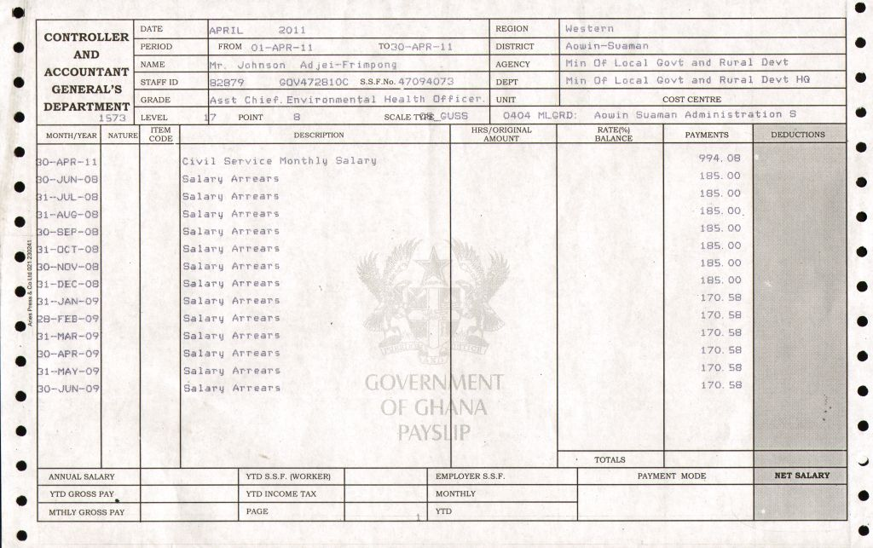

Slide 21
RECENT PAYROLL INITIATIVES
E- PAYSLIP
ESPV
TPRS
HRMIS
MOF BIOMETRIC
SSNIT RE-ENROLMENT
NO BUDGET NO PAY POLICY

Slide 22
BURNING ISSUES
Data Processing Period
Quality of Data Entry
Checking Period
Others
ARREARS
ESPV deletions

Slide 23
CUSTOMER CARE
WHAT IS IT?
THE S. E. C. Of CUSTOMER CARE

Slide 24
END OF PRESENTATION
THANK YOU

