Slide 1

LOCAL GOVERNMENT SERVICE (LGS)
“Protocols”
Presented by The Office of the Head of Local Government Service (OHLGS)

Slide 2
Presentation OUTLINE
PART –1 : DECENTRALIZATION, LG & LGS
DECENTRALIZATION – INTRODUCTION
LOCAL GOVERNMENT (LG) & LOCAL GOVERNMENT SERVICE (LGS)
BACKGROUND - THE ESTABLISHMENT OF THE DECENTRALIZED DEPARTMENTS AT MMDA
PART-2 LGS- PROTOCOLS
LGS - PROTOCOLS
CONCLUSION & WAY FORWARD

Slide 3

Part one
DECENTRALIZATION, LG & LGS

Slide 4
WHAT IS DECENTRALIZATION?
the process by which authority, responsibility, power, resources and accountability are transferred from the central level of government to the local levels.
the transfer of authority and responsibility for public functions from the central government to intermediate and local governments, subordinate or quasi-independent government organizations and/or the private sector.
The 1992 Republican Constitution, Section 2 of Article 240: “Parliament shall enact appropriate laws to ensure that functions, powers, responsibilities and resources are at all times transferred from central government to local government units in a coordinated manner”.

Slide 5
Decentralization Policy Frame work
(FIVE main inter-related pillars)
Political Decentralization and Legal Issues
Administrative Decentralization
Decentralized Development Planning & Budgeting (Composite Budgeting)
Fiscal Decentralization
Popular Participation and Accountability

Slide 6
ADMINISTRATIVE DECENTRALIZATION
The Local Governance Act, 2016 (Act 936) is the main legislation governing administrative decentralization
Administrative decentralization at the centre involves ministerial restructuring and at the local level involves the establishment of decentralized Departments of the RCCs and MMDAs
Eighteen sectors of the national level administration have been decentralised (first schedule of Act 936)

Slide 7
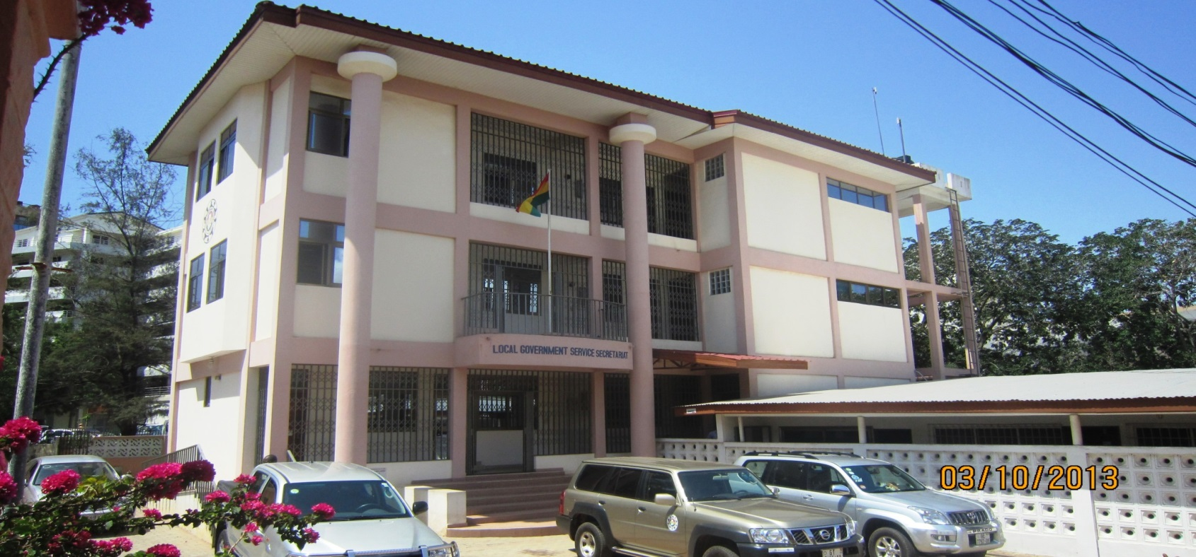
LOCAL GOVERNMENT Service

Slide 8
HISTORY OF THE LOCAL GOVERNMENT SERVICE
(LOCAL GOVERNANCE ACT, 2016 ACT 936 )
Article 192 (2) of the 1992 provides that the Civil Service, until provision is otherwise made by parliament, comprise service in both central and local government.
Local Government Service Act, 2003, Act 656 now replaced by the Local Governance Act, 2016 (ACT 936) created the Local Government Service out of the Civil Service.
In 2011 there was a transfer of nearly 33,000 staff from the Civil Service to the Local Government Service.

Slide 9
OBJECTIVE FOR THE ESTABLISHMENT OF THE LOCAL GOVERNMENT SERVICE (LGS)
  The objective for the establishment of the LGS is “to secure the effective administration and management of the decentralized local government system in the country”.(LG ACT 936, Section 51).
  The LGS is responsible for the Administrative Decentralization .

Slide 10


LGS LOGO
10 Regions, Gender
Republic of Ghana
“Kontire ne Akwan” elders of the state
“Tikro mmpam”
One head does not constitute an assembly
The
National Colours
MOTTO:
Decentralization. Democracy. Development

Slide 11
MEMBERSHIP OF LGS
Membership of the Service includes officers and staff of the following organizations:
Offices of the District Assemblies (MMDAs);
Departments of the District Assemblies;
Offices of the Regional Co-ordinating Councils (RCCs);
Departments of the Regional Co-ordinating Councils;
Offices of the Sub-Metropolitan District Councils, Urban, Town and Area Councils;
Office of the Head of the Local Government Service (OHLGS); and
Other persons as may be employed for the Service.

Slide 12
STRATEGIC DIRECTION OF LGS
VISION
A world-class, decentralized and client oriented service
MISSION
To support LG to deliver value for money services through the mobilization, harmonization and utilization of qualified human capacity and material resources to promote local and national development
MOTTO
Decentralization – Democracy - Development
CORE VALUES
Accountability, Client-oriented, Creativity, Diligence, Discipline, Equity, Integrity, Innovativeness, Loyalty, Commitment, Anonymity, Impartiality, Permanence, Timeliness and Transparency
Service Delivery Standards
Participation, Professionalism, Client Focus, Transparency, Efficient and Effective use of Resources and Accountability

Slide 13
FUNCTIONS OF THE SERVICE
provide technical assistance to District Assemblies, and Regional Co-ordinating Councils to enable the District Assemblies and the Regional Co-ordinating Councils effectively perform their functions and discharge their duties in accordance with the Constitution and the Local Governance Act, 2016 (Act 936)
conduct organisational and job analysis for the Regional Co-ordinating Councils and the District Assemblies;
conduct management audits for Regional Co-ordinating Councils and District Assemblies in order to improve the overall management of the Service;
design and co-ordinate management systems and processes for Regional Co-ordinating Councils and District Assemblies;
assist the Regional Co-ordinating Councils and the District Assemblies in the performance of their functions under the Local Governance Act, 2016 (Act 936) and under any other enactment;
perform such other functions incidental or conducive to the achievement of the objects of the Service.

Slide 14
ORGANOGRAM OF THE OFFICE OF HEAD OF
THE LOCAL GOVERNMENT SERVICE
LOCAL GOV’T SERVICE COUNCIL (LGSC)
SECRETARY TO COUNCIL
HEAD OF SERVICE
INTERNAL AUDIT
CHIEF DIRECTOR
LEGAL AFFAIRS
PUBLIC AFFAIRS
POLICY PLANNING, BUDGETING & M&E DIRECTORATE
MANAGEMENT & TECHNICAL SERVICES DIRECTORATE
HUMAN RESOURCE MANAGEMENT DIRECTORATE
HUMAN RESOURCE DEVELOPMENT DIRECTORATE
FINANCIAL MANAGEMENT DIRECTORATE
RESEARCH, STATISTICS & INFORMATION MANAGEMENT DIRECTORATE
ADMINISTRATION & GENERAL SERVICES DIRECTORATE
Policy
Performance Management
HR Planning
Training
Research & Statistics
General Admin.
GOG
Planning
Technical Services
Information Management
Transport
Recruitment & Selection
Career Development
Donor Support
Budget
Procurement
Organizational Development
Library & Document
M & E
Salary Admin
Performance Management
Stores
Quality Assurance Management
IPPD
Records
Estates
Security

Slide 15
RCC: ORGN. CHART OF REG. COORDINATING COUNCILS
REGIONAL COORDINATING
COUNCIL
REGIONAL MINISTER
OFFICE OF THE REGIONAL
COORDINATING COUNCIL
REGIONAL COORDINATING
DIRECTOR
REGIONAL PLANNING
COORDINATING UNIT
DECENTRALISED /
DE-CONCENTRATED
DEPT.
NON DECENTRALISED
DEPARTMENTS
ADMINISTRATIVE
SUPPORT SERVICES

Slide 16
COMPOSITION OF THE REGIONAL CO-ORDINATING COUNCILS
Regional Minister (Chairperson)
Deputy Regional Minister(s)
Metro/Municipal/District Chief Executives (MMDCEs) in the region
Presiding Members (PMs) in the region.
Two Chiefs from the Regional House of Chiefs.
Regional Heads of the decentralized Ministries as non voting members.
Regional Coordinating Director as Secretary

Slide 17
ROLE OF THE RCC
Monitor, coordinate and evaluate performance of the DAs in the region.
Monitoring the use of monies allocated and released to the DAs by central government and its agencies.
Review and coordinate public services in the region.
Maintenance of security and public safety in the Region.
Provide technical backstopping to DAs
Perform such other functions as assigned to it under any enactment.

Slide 18
KEY FUNCTIONS OF MMDAs
METROPOLITAN/MUNICIPAL/DISTRICT ASSEMBLIES (MMDAs)
  Exercise political and administrative authority in the district.
  Constitutes the planning authority for the district - Formulate and execute plans, programmes and strategies for the overall development of the district.
  Have deliberative, legislative and executive functions
  Responsible for the overall development of the district.
  Maintenance of security and public safety in the district.

Slide 19
3. LEGAL BACKGROUND & THE ESTABLISHMENT OF THE DECENTRALIZED DEPARTMENTS AT MMDA
  LOCAL GOVERNANCE ACT 936 (2ND,3RD AND 4TH SCHEDULES (FIRST SCHEDULE - DEPARTMENTS UNDER MMDA)
  L.I 1961 (OBJECTIVES & TWO SCHEDULES)
  ORGANIZATIONAL STRUCTURE (MMDA)

Slide 20
LG ACT 936, SECOND SCHEDULE (DEPARTMENT UNDER…)
 | METROPOLITAN ASSEMBLY |  | MUNICIPAL ASSEMBLY |  | DISTRICT ASSEMBLY
1 | CENTRAL ADMINISTRATION | 1 | CENTRAL ADMINISTRATION | 1 | CENTRAL ADMINISTRATION
2 | FINANCE | 2 | FINANCE | 2 | FINANCE
3 | EDUCATION, YOUTH AND SPORTS | 3 | EDUCATION, YOUTH AND SPORTS | 3 | EDUCATION, YOUTH AND SPORTS
4 | HEALTH | 4 | HEALTH | 4 | HEALTH
5 | AGRICULTURE | 5 | AGRICULTURE | 5 | AGRICULTURE
6 | PHYSICAL PLANNING | 6 | PHYSICAL PLANNING | 6 | PHYSICAL PLANNING
7 | SOCIAL WELFARE AND COMMUNITY DEVELOPMENT | 7 | SOCIAL WELFARE AND COMMUNITY DEVELOPMENT | 7 | SOCIAL WELFARE AND COMMUNITY DEVELOPMENT
8 | NATURAL RESOURCES CONSERVATION DEPT FORESTRY AND GAME & WILDLIFE DIVISION | 8 | NATURAL RESOURCES CONSERVATION DEPT FORESTRY AND GAME & WILDLIFE DIVISION | 8 | NATURAL RESOURCES CONSERVATION DEPT FORESTRY AND GAME & WILDLIFE DIVISION
9 | WORKS | 9 | WORKS | 9 | WORKS
10 | INDUSTRY AND TRADE | 10 | INDUSTRY AND TRADE | 10 | INDUSTRY AND TRADE
11 | DISASTER PREVENTION AND MANAGEMENT | 11 | DISASTER PREVENTION AND MANAGEMENT | 11 | DISASTER PREVENTION AND MANAGEMENT
12 | TRANSPORT | 12 | TRANSPORT
13 | URBAN ROADS | 13 | URBAN ROADS
14 | WASTE MANAGEMENT
15 | BUDGET AND RATING
16 | LEGAL

Slide 21
DISTRICT DEPARTMENTAL ORGANOGRAM (FUNCTIONAL)
DCE
11 Depts.
Internal Audit
DCD
  DPCU (DPO = Secretary)
  PAU (Public Affairs Unit)
Admin, Planning & Budget Sectors
Social Sector
Infrastructure Sector
Economic Sector
Environmental Sector
Financial Sector
Central Administration Dept.
Education, Youth & Sports Dept.
SW & CD Dept.
District Health Dept.
Works Dept.
Physical Planning Dept.
Trade, Industry & Tourism Dept.
Agric Dept.
Disaster Prevention Dept.
Natural Resources Conservation
Finance Dept.
Records
Building section (Works & R. Housing)
Water Section
Feeder Roads Section
Estate
SW Section
CD Section
Coop Section
Cottage Industry Section
Tourism Section
Treasury
Revenue Mobilization
Levies
Transport (Veh. Eq. Mgt.)
Internal Disaster
Refugee Section
Logistics
T&CP Section
P&G Section
Procurement
DMOH Section
Environ Health
HR Mgt.
Crop
Services Section
Administration
Education Section
Library section
R. Birth & Death Section
Agric Engineering Section
Forestry Section
Game &
Wildlife Section
Store
Youth Section
Women in Agric.
Animal Health and Production Section
Planning
Sports Section
Agric Extension Section
Fisheries Section
Budget & rating
Non-Formal Education Unit
MIS
Basic Education Unit
Statistic
Security

Slide 22
MUNICIPAL DEPARTMENTAL ORGANOGRAM (FUNCTIONAL)
MCE
13 Depts.
Internal Audit
MCD
  MPCU (MPO = Secretary)
  PAU (Public Affairs Unit)
Social Sector
Infrastructure Sector
Economic Sector
Environmental Sector
Financial Sector
Admin, Plan & Budget Sectors
Central Administration Dept.
Education, Youth & Sports Dept.
SW & CD Dept.
District Health Dept.
Works Dept.
Urban Roads Dept.
Physical Planning Dept.
Trade Industry & Tourism Dept.
Agric Dept.
Disaster Prevention Dept.
Natural Resources Conservation
Finance Dept.
Transport Dept.
Records
SW Section
CD Section
Building section (Works & R. Housing)
Water Section
Feeder Roads Section
Treasury
Revenue Mobilization
Levies
Estate
Coop Section
Cottage Industry Section
Tourism Section
Logistics
Internal Disaster
Refugee Section
Procurement
T&CP Section
P&G Section
HR Mgt.
DMOH Section
Environ Health
Administration
Store
Education Section
R. Birth & Death Section
Crop
Services Section
Agric Engineering Section
Forestry Section
Game &
Wildlife Section
Planning
Library section
Budget & Rating
Youth Section
Women in Agric.
Animal Health and Production Section
Sports Section
Agric Extension Section
Fisheries Section
MIS
Statistics
Basic Education Unit
Non-Formal Education Unit
Security
Transport (Ven. Eq. Mgt.

Slide 23
METROPOLITAN DEPARTMENTAL ORGANOGRAM (FUNCTIONAL)
MCE
16 Depts.
Internal Audit
MCD
  MPCU (MPO = Secretary)
  PAU (Public Affairs Unit)
Infrastructure Sector
Financial Sector
Admin, Plan. & Budget Sectors
Social Sector
Economic Sector
Environmental Sector
Central Administration Dept.
Education, Youth & Sports Dept.
SW & CD Dept.
District Health Dept.
Works Dept.
Urban Roads Dept.
Physical Planning Dept.
Trade, Industry &Tourism Dept.
Agric Dept.
Disaster Prevention Dept.
Waste Mgt. Dept.
Natural Resources Conservation
Finance Dept.
Budget & Rating Dept.
Legal Department
Transport Dept.
Records
SW Section
CD Section
Building section (Works & R. Housing)
Water Section
Feeder Roads Section
Treasury
Revenue Mobilization
Estate,
Coop Section
Cottage Industry Section
Tourism Section
Loges
Internal Disaster
Refugee Section
Procurement
T&CP Section
P&G Section
HR Mgt
DMOH Section
Environ Health
Administration
Education Section
Crop
Services Section
Agric Engineering Section
Forestry Section
Game &
Wildlife Section
Store
Youth Section
Library section
R. Birth & Death Section
Animal Health and Production Section
Planning
Sports Section
Women in Agric.
Agric Extension Section
Fisheries Section
MIS
Statistics
Basic Education Unit
Security
Non-Formal Education Unit
Transport (Ven. Eq. Mgt.

Slide 24
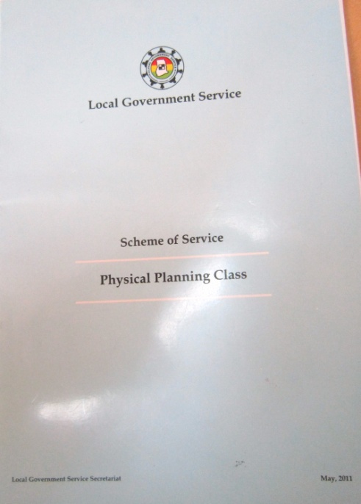
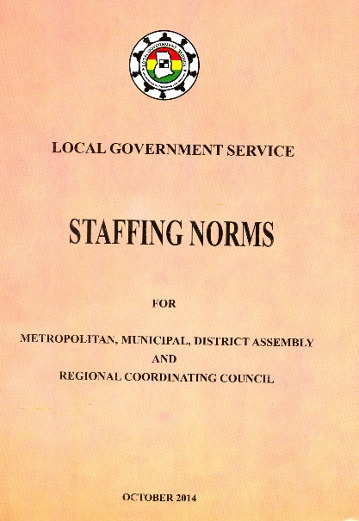
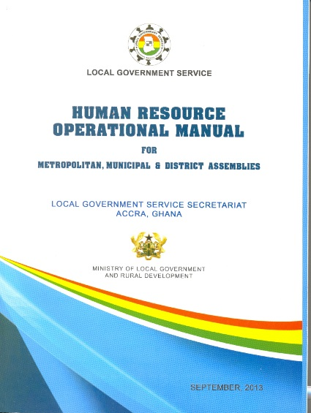
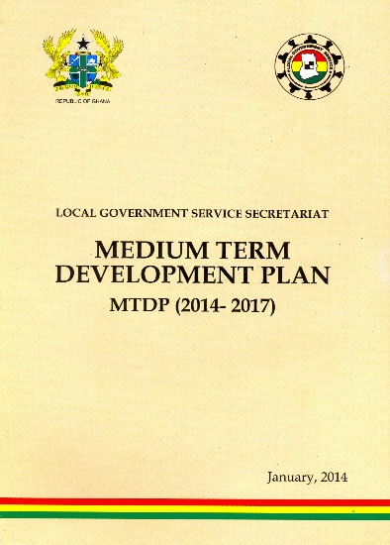
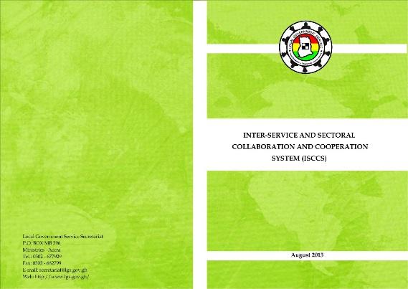
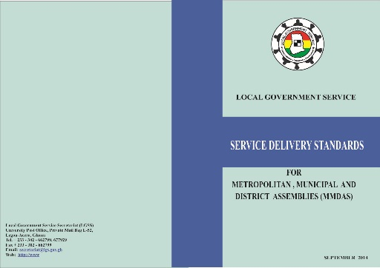


Part two - A
LGS – PROTOCOLS & CHALLENGES

Slide 25
4. LGS - protocols
Scheme of Service (SoS)
Conditions of Service (CoS)
Staffing Norms (SN)
HR Operational Manual (HROM)
Code of Conduct (CoC)
Reporting Relationship & Administrative Procedures
Planning, Reporting and M&E
Service Delivery Standards (SDS)
Performance Management System (PMS)
Inter-Service & Sectoral Collaboration & Cooperation System (ISCCS)
Capacity Building Framework
Communication Strategy

Slide 26
HR MANAGEMENT & DEVELOPMENT ISSUES
PROTOCOLS
HR Policy
Scheme of Service
Conditions of Service
Code of Conduct
Staffing Norms
Service Delivery Standards
Performance Management System
HR Management Information System (HRMIS)
Reporting Relationship
IT Policy
Communication Strategy
Inter-Service & Sectoral Collaboration & Cooperation
System (ISCCS)
HR MANAGEMENT OPERATIONAL MANUAL
Recruitment
Appointment / Filling Vacancies
Posting & Movements
Transfer and Secondments
Promotions
Working Hours
Leave / Study Leave
Training & Capacity Development
Rewards & Sanctions
Points of Entry/Salary Structure
Discipline
Leaving the Service
Retirements, etc.

Slide 27
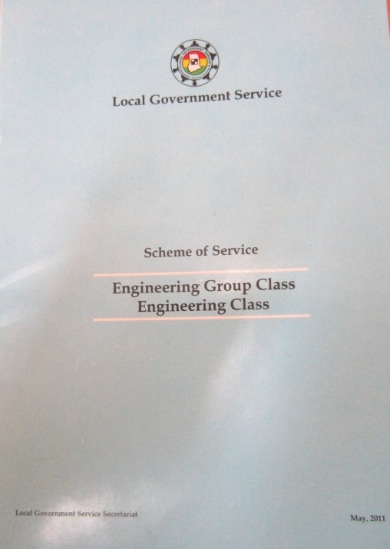
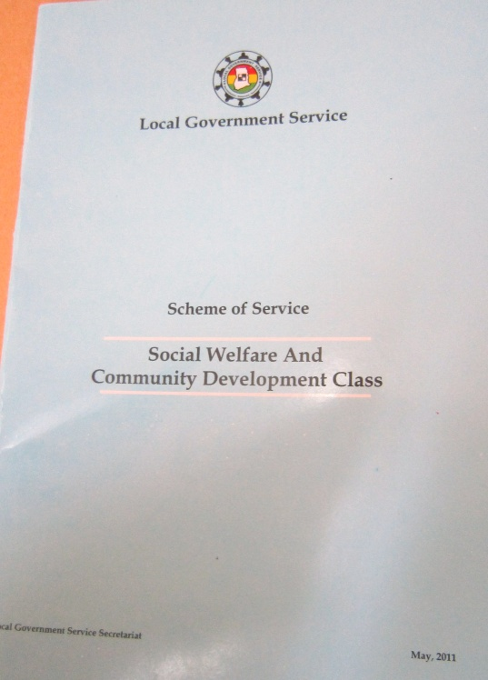
SCHEME OF SERVICE – LGS

Slide 28
OVERVIEW OF THE SCHEME OF SERVICE
The Scheme of Service is a management tool fashioned to provide a coherent framework to facilitate:
  recruitment
  Staff development and
  career progression
The relevance of such a document is so critical to the Local Government Service, as a distinct Public Service organization and in compliance with its mandate of ensuring administrative decentralization in the country.

Slide 29
PURPOSE OF SCHEME OF SERVICE
The purpose of the Scheme of Service is to provide the Local Government Service with a policy guideline which will ensure that all staff are:
  Highly motivated
  Disciplined
  Loyal and equipped with the relevant skills and knowledge.

Slide 30
CONTENTS OF A SCHEME OF SERVICE
Occupational Groups & Classes
Job title:
Grade level:
Job level:
Qualification and Experience:
Competencies:
Mode of Entering into the Service:
  Passive: through the ranks, Career progression
  Direct : through recruitment
Training Needs:

Slide 31
Scheme of Services - 28 Classes
Administrative Group Administrative Class Human Resource Class Secretarial & Receptionist Class Security Class Transport Class Auxiliary Class Supply And Materials Class Agricultural Class Births & Deaths Registry Class Cooperative Class Development Planning Class Engineering Group ** Engineering Class Architects Class Estate Management Class Quantity Surveyor Class Technical Class | Environmental /Public Health Engineer Class Finance Group Accounting Class Budget Class Revenue Class Management Information System (MIS) Class Physical Planning Class Rural Housing Loan Officers Class Social Welfare & Community Development Class 25. Statistics Class 26. Legal Class 27. Environmental Health Class 28. Internal Audit Class

Slide 32
SOS – ENV. HEALTH STRUCTURE
Professional Class
Chief Env. Health Analyst
Prin. Env. Health Analyst
Senior Env. Health Analyst
Env. Health Analyst
Assist. Env. Health Analyst
Sub-Professional Class
Chief Env. Health Officer
Prin. Env. Health Officer
Senior Env. Health Officer
Env. Health Officer
Assist. Env. Health Officer
Technical Class
Chief Env. Health Assist
Assist. Chief Env. Health Assist.
Principal Env. Health Assist.
Senior Env. Health Assist.
Env. Health Assist.

Slide 33
Job Summary (SoS) OF THE ENV. HEALTH
The objectives of the Environmental Sanitation Analyst Class are to:
▪ Develop and issue technical guidelines on Environmental Health Management and Services.
▪ Initiate and apply social techniques and concepts in the solution of Environmental Health problems.
▪ Promote Public Education on Environmental Health.
▪ Monitor and evaluate solid waste management services and advise on their improvement and sustainability.
▪ Monitor and evaluate the performance and utilization of water and sanitation facilities.
▪ Provide technical advice for the formulation of Environmental Health policies.
▪ Advise on all aspects of Environmental Health, Occupational or personal hygiene and environmental protection.
▪ Enforce compliance with standards of hygiene in all premises.
▪ Initiate vector-control programmes and strategies for preventing and controlling environmentally related diseases.
▪ Promote food and water hygiene programmes.
▪ Conduct research, collect data and document activities and issues on Environmental Health management.

Slide 34
CONDITIONS OF SERVICE - LGS

Slide 35
CATEGORIES OF POSTS (COS)
COS has been grouped into six (6) main sections for ease of administration
Categories | Grade of Staff
A1 | Head of Service, Chief Director, Regional Coordinating Directors
A2 | National Directors, Regional Directors, District Coordinating Directors, District Departmental Directors
B | Deputy Directors and Analogous Grades at the National Headquarters, Regional and District levels
C | Middle level management and support grades
D | Junior support service staff
E | Sub-technical/auxiliary grades
F | Utility grades

Slide 36
CONDITIONS OF SERVICE (COS)
COS focuses on:
a) Recruitment procedures for entry into the Service;
b) Promotion procedures for officers of the Service;
c) Disciplinary & grievance procedures;
d) Transfer and posting procedures for staff of the service.
e) Institutional co-operation between the Local
Government Service and other public services.
f) Learning, Training & Development procedures
g) Leave, Staff Welfare, Remuneration etc.
CoS shall apply to:
All Local Government Service Personnel,
Officers on secondment,
Attachment.

Slide 37
APPOINTMENTS AND ACTING POSITION
Conditions for acting assignment are as follows:
No officer shall be appointed to act in a position which is more than one step above his/her present grade;
The officer holding the acting assignment shall be paid the difference between his/her salary and the entry salary point of the grade for which he/she has been appointed to act;
No acting assignment shall exceed a period of one year;
An acting assignment is not subject to confirmation;
Allowances/benefits attached to the position shall be paid to the officer occupying the acting position.
Acting position may be made under the following circumstances:
Upon the death of the substantive officer;
When the substantive officer resigns, or retires, or vacates his/her post;
When the substantive officer proceeds on course, duty overseas or leave without pay;
When the substantive officer is dismissed, removed, suspended or interdicted from duty.

Slide 38
DEPARTMENTAL AND GRADE TRANSFERS
Transfer of officers in the Service from one Class to another (conversion)or the transfer of officers from one cadre in the same occupational group to another cadre (upgrading) may be considered by the relevant appointing authority.
Officers requesting for UPGRADING or CONVERSION may after obtaining the necessary clearance from their Head of Department or occupational group shall submit an application to the Head of Service through their Assembly and the relevant RCC for consideration.

Slide 39
HOURS OF WORK
The standard working hours shall be:
Forty (40) hours per week
Eight (8) hours a day.
Working hours starts from 8:00 am to 5:00 pm
with a one (1) hour break 12:30pm & 1:30pm
Senior staff may be required to work beyond normal working hours if need be. This extra work will not attract overtime allowance.

Slide 40
PROMOTIONS
General Conditions For Promotions:
The procedure for promotions shall be in accordance with the relevant Scheme of Service and subject to the availability of vacancies in the grade.
Promotions shall be based on merit and in accordance with the approved Scheme of Service:
  efficiency;
  qualification and experience in the area of work;
  attitude towards work and general behaviour;
  leadership qualities and satisfactory performance;
  seniority shall be taken into consideration when all things taken are the same.
  Availability of vacancy and funds
  minimum number of years on current grade

Slide 41
TRAINING AND DEVELOPMENT
The Service has structured in-service training programmes at all levels with a view to promoting sustained improvement in quality of services by nurturing a high level of performance.
Sponsorship for training shall cover both in-service training and post basic/post-graduate training programmes approved by the Service.
It will also cover both approved local and external training programmes as defined in the approved Service Training Priorities and Plans.
Officers who are sponsored for training programmes including those on study leave with pay lasting beyond six (6) months shall enter into bonds to complete the courses and return to the Service to serve in any establishment they may be posted for the periods specified in their bonds.

Slide 42
STUDY LEAVE WITH PAY (BOND PERIODS)
COURSE DURATION | BOND PERIOD (LOCAL PROG.) | BOND PERIOD (FOREIGN PROG.)
Less than one (1) year | 12 Months | 18 Months
One year but less than two (2) years | 24 Months | 30 Months
Two (2) years or more | 48 Months | 60 Months
Three (3) years | 72 Months | 84 Months

Slide 43
POSTINGS AND MOVEMENTS WITHIN THE SERVICE
Generally all grades of staff within the Local Government Service shall be subject to posting to any part of the country subject to the exigencies of the Service.
Forms/Types of Postings:
Inter-regional postings
Intra-regional postings
Intra-district/municipal/metropolitan assembly postings

Slide 44
TRANSFER AND SECONDMENT
Eligibility and Conditions for Transfer from the Local
Government Service:
Consideration for transfer of personnel of the Local Government Service into any of the Public Services of Ghana may be given subject to the following conditions:
the applicant shall have done at least five (5) years in the Local Government Service;
the organization to which the applicant wishes to transfer shall be responsible for the salary and other conditions of the transferred member of staff;
while on transfer, the officer will not be eligible for promotion within the Local Government Service;
an officer returning from transfer shall apply for re-entry into the Service through his/her Head of Department. Such an application for re-entry shall be forwarded to the appropriate appointing authority

Slide 45
POINTS OF ENTRY/SALARY STRUCTURE
The salary payable to any employee shall be in accordance with the approved salary structure in this case the Single Spine Salary Structure (SSSS);
The point of entry in the salary structure of a newly appointed staff shall be fixed by the Local Government Service and the Fair Wages and Salaries Commission (FWSC);
In determining the point of entry, experience and qualifications relevant to the post shall be taken into account as defined in the Scheme of Service;
All salaries shall be paid monthly direct into any bank in Ghana nominated by the employee;
Remittances or allotments to home countries outside Ghana shall be made at the employee’s own expense and in accordance with the government regulation in force.

Slide 46
LEAVE
Types of leave:
Annual Vacation Leave
Maternity Leave
Sick Leave
Study Leave (with/without pay)
Disembarkation Leave
Casual Leave
Compassionate Leave
Examination Leave
(Refer to LGS - WEBSITE: HR Operational Manual)

Slide 47
DISCIPLINE
POLICY:
The policy of the Service on discipline is to deter employees from committing infractions of rules and to reform them in order to effect improvement in their conduct and make them more productive thereafter.
Personnel of the Local Government Service shall obey the rules of conduct and procedures established within the Service.
MISCONDUCT:
Any act done by an employee without reasonable cause constitutes misconduct if it:
amounts to failure to perform in a proper manner any duty imposed on him/her; or
contravenes any enactment relating to the Local Government Service; or
is otherwise prejudicial to the efficient conduct of the functions of the Local Government Service; or
tends to bring the image of the Local Government Service into disrepute.

Slide 48
LEAVING THE SERVICE
Employees of the Service may leave the service under the following circumstances:
Retirement on medical grounds
Premature retirement
Compulsory retirement
Termination of appointment
Dismissal
Resignation/resignation without approval
Vacation of post
Death

Slide 49
Staffing norms
The Staffing Norms for LGS is based on the following:
Ensuring that staffing at all levels is in line with:
  LGS Act 936 and L.I 1961;
  Organizational Structures; and
  Scheme of Service (SoS);
Ensuring that staff are effectively utilized taking into account the workload;
Ensuring that all levels have the requisite personnel with the right mix and skills;
Distributing available staff equitably between urban and rural areas;
Enhancing HR Management & Development.

Slide 50
The need for a code of conduct
The Code of Conduct for public officers including the LGS staff has the following benefits:
Increases the probability of public office holders to behave in certain acceptable ways;
Focuses public officers on actions that result in doing the right things for the right reasons;
Calls public officers to a greater purpose of committing to specific sets of moral principles and standards

Slide 51
What is Public Office?
A position of authority or service involving responsibility to the public, especially within the government.
By inference as a staff of LGS you hold a public office and hence a public servant.
Therefore, the ultimate loyalty of such officers shall be to the public interests of their country as expressed through the democratic institutions and government.

Slide 52
THE CODE of conduct document
The code of conduct document is the expression in behavioral terms the values, vision and motto of the Service.
It seeks among others:
To contribute to the promotion of a high standard of ethics in the LGS;
To ensure that officers are accountable to the people and shall discharge their duties with utmost responsibility, integrity, competence and loyalty.

Slide 53
Uniqueness of the lgs code of conduct
The LGS Code of Conduct is customized and different;
The Code takes its source from the 1992 Republican Constitution of Ghana, the values of the Service and the generic code of conduct developed by the CHRAJ for Public Service Workers;

Slide 54
Content of the code conduct document
Part I Canons (Principles)
Part II Statement of Principles/Standards of Conduct
Part III Reporting Procedures
Part IV Disciplinary Procedures/Penalties
Part V Interpretation of Legal and other Provisions relating to the Code of Conduct
PART VI Protocol for Relations Between District Assembly Members and Employees in District Assemblies

Slide 55
CANONS (PRINCIPLES)OF THE CODE.
Anonymity and Permanence
Client-orientation, Loyalty and Commitment
Transparency and accountability
Diligence, Discipline and Timeliness
Creativity and Innovativeness
Equity and Impartiality
Integrity

Slide 56
THREE MAJOR AREAS
Under every canon in this code of conduct, there are three major areas:
1. STATEMENT OF PRINCIPLE
2. MINIMUM STANDARDS OF CONDUCT
3. THE TEST TO THE CANON

Slide 57
CANON ONE (1): ANONYMITY AND PERMANENCE
ANONIMITY TEST – In the discharge of your duties, do you draw attention to your contribution by styling your designations in written or oral communications beyond your official capacity for discharging the said duty; and would it appear to any reasonable mind that you wish to be acknowledged as having been the author of the said work or the brain behind the achievement of outcomes?

Slide 58
PERMANENCE TEST –
Do you discharge your functions, roles and tasks in such a way as to deepen the systems, functions, objectives and image of the Local Government Service as a public service institution or would your conduct create the perception in reasonable minds that the Local Government Service exists to support the interest of any political, social, ethnic or other group other than the interest of only the state and the entire community?
Would your action or inaction create the perception that the Local Government Service would lose effectiveness and relevance if an interest group lost its influence or power in the society?

Slide 59
CANON TWO (2): client orientation test
Would your conduct create an impression in the minds of neutral parties that you have selectively provided a better service to one resident of the community than another in the discharge of your official duties?

Slide 60
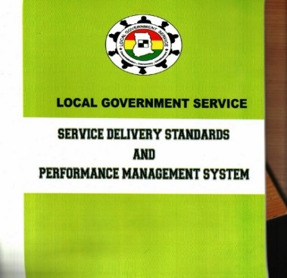
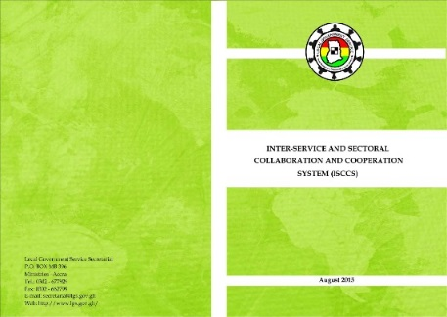
Part two – B
LGS - REPORTING RELATIONSHIP
  PERSONNEL REPORTING LINES :INTRA-MMDA
  MMDA & THE STRUCTURES AT REGIONAL AND NATIONAL LEVEL
  CHANNEL OF COMMUNICATION
  REPORTING RELATIONSHIP: EXAMPLE
  (AGRICULTURAL DEPARTMENT)
SERVICE DELIVERY STANDARDS & PMS
ISCCS
Challenges

Slide 61
PERSONNEL REPORTING LINES :INTRA-MMDA
The Departments functions shall be channeled through the Metropolitan/Municipal/District Coordinating Director (MMDCD) to the Metropolitan/Municipal/District Chief Executive (MMDCE).
The MMDCE is the Political & Administrative Head of the Assembly.

Slide 62
MMDA & THE STRUCTURES AT REGIONAL AND NATIONAL LEVEL
Matters relating to human resource management and development (including personnel administration), capacity-building, Performance Management/ Service Delivery Standards reporting, MMDAs shall, acting through the MMDCE, report to the OHLGS through the RCCs.
On issues relating to inter-Service and Sectoral collaboration and cooperation, MMDAs shall, acting through the MMDCE, report to the OHLGS through the RCCs.

Slide 63
MMDAs AND THE REGIONAL/NATIONAL STRUCTURES CONT.
In matters relating to district development plans and budget, as and when required, MMDAs shall, acting through the MMDCE, report to the NDPC through the RCCs.
In matters relating to Sector Policy, RCC (HoD) will collate and report to the appropriate MDA through the MMDCE as case may be.
In matters relating to local government and decentralization policy, legislation and finance, including the district composite budget, as and when required, MMDAs shall, acting through the MMDCE, submit reports to the MLGRD, MoF and OHLGS through the RCCs

Slide 64
CHANNEL OF COMMUNICATION
Communication from Heads of Ministries, Departments and Agencies at the national intended for the Departments of the MMDAs shall be addressed to the RCC (Decentralised Regional Department) where it relates to policy, operational and management issues as the case may be.
Such communication shall then be forwarded to the relevant MMDCEs by the RCC( Decentralised Department)
Copies of such communication shall be addressed to the Metropolitan/ Municipal/ District Head in charge of the relevant Department. The MMDCE shall issue directives indicating the appropriate course of action to be taken.

Slide 65
CHANNEL OF COMMUNICATION CONT
To enable the MMDCE harmonize the activities of the de-concentrated departments, state-owned organizations and other central government agencies in the district with those of the MMDA, all communication addressed to the District Officer in charge of those non-MMDA Departments shall be copied to the MMDCE for his information.
In matters relating to a specific Assembly or Assemblies and areas where the MDAs ask for reports, statistical data and related information, communication will be addressed directly to the MMDCEs and copied to the RCCs
The MMDCE will, in such cases, address the responses direct to the MDA with a copy to the RCC.

Slide 66
PLANNING, Reporting & M&E (GENERAL)
HoD - to understand and carry out periodically:
Planning (GoG- NDPC Guidelines)
  MTDPs
  Composite Budgeting
  Annual Action Plans (Department, Section, Unit)
  Monthly work plans (Department, Section, Unit)
  Weekly work plans (Department, Section, Unit)
Reporting – Progress & Financial Reports (GoG Procedure)
M&E (GoG – NDPC Guidelines)

Slide 67
COMPOSITE BUDGET
Composite Budget is an aggregation of projected revenue and expenditure of the Departments and institutions of the MMDAs. It has been defined under “Section 122 (a) (b) of the Local Governance Act, Act 963, 2016”
(a) ‘the aggregate revenue and expenditure of the Office of the District Assembly, the Departments of the District Assembly; and
(b) ‘the budget of the annual development plans and programs of the Departments of the District Assembly.’

Slide 68
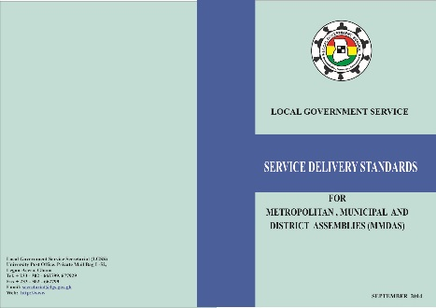
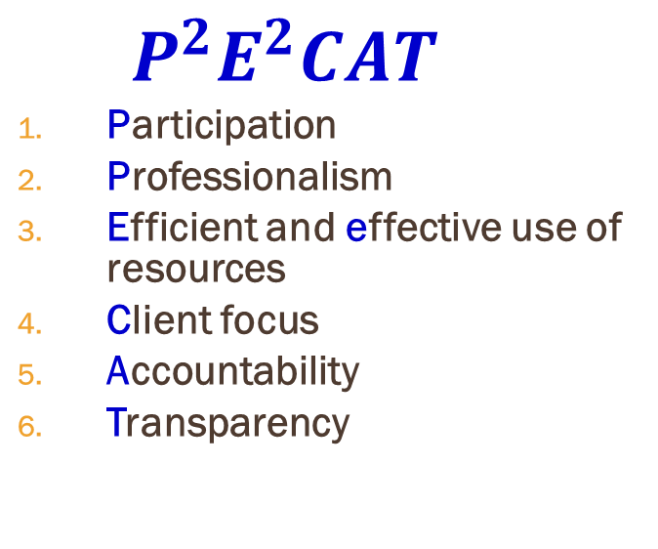
LGS- Service delivery standards
$${ P}^{2}E^{2}CAT$$
Participation
Professionalism
Efficient and effective use of resources
Client focus
Accountability
Transparency
SERVICE DELIVERY STANDARDS
Participation
Professionalism
Efficient & Effective Use of Resources
Client Focus
Accountability
Transparency
“Service Delivery Standards are the minimum level of expected services in terms of quality, time and cost that the Service Provider commits to deliver to its clients”

Slide 69

  1. PARTICIPATION
Participation is the involvement of relevant stakeholders including Civil Society Groups, Media, NGOs, Private Sector and Community Members in the planning, implementation, monitoring and evaluation of service delivery.
Measurement of Participation:
Some measurement indicators for assessing “Participation” include ensuring that MMDAs:
involve all stakeholders in the annual fee-fixing resolutions;
organize community hearings to include the views of all stakeholders during the planning and budgeting process;
conduct annual surveys to ascertain the level of community knowledge on agreements reached during service delivery consultations;
involve relevant stakeholders, beneficiary departments and communities in quarterly and annual monitoring of projects.

Slide 70
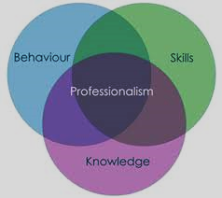
  2. PROFESSIONALISM
Professionalism is the demonstration of requisite skills and competencies, and the ability to adapt best practices in the delivery of services to the satisfaction of the client whilst adhering to ethical standards
Measurement of Professionalism:
Some measurement indicators for assessing “Professionalism” include ensuring that MMDAs:
conduct Performance Appraisals with staff within intervals of six months or yearly;
prepare and implement staff development plan for staff on an annual basis;
ensure that the output of staff is measured in reference to standards stipulated in the Code of Conduct for the Service bi-annually;
conduct annual in-service training for the professional development of staff;
establish annual award schemes for staff who demonstrate professionalism in the performance of their duties.

Slide 71


  3. CLIENT FOCUS
Client focus is using client requirements to prioritize and consistently develop affordable and accessible Services in a timely manner.
Measurement of Client Focus:
Some measurement indicators for assessing “Client Focus” include:
establish functional Client Service Centres in all MMDAs by mid 2015;
publish and disseminate a Client Service Charter by the end 2015;
establish a mechanism (suggestion box, etc.) for the receipt of complaints from clients on a weekly basis and to provide feedback to clients effectively within five (5) working days of the receipt of a complaint;
acknowledge and respond to correspondences effectively within Seven (7) working days upon receipt;
organise annual beneficiary surveys.

Slide 72


  4. TRANSPARENCY
Transparency is providing all stakeholders with the understanding of how LGS operates, and furnishing them with easy access to adequate and timely information regarding decisions and actions taken by the Service.
Measurement of Transparency:
Some measurement indicators for assessing “Transparency” include:
establish a Procurement Committee and ensure that all procurement activities are carried out in conformity with the Public Procurement Act, Act 663;
update and display monthly revenue and expenditure charts on MMDAs’ notice boards and at other vantage places;
publish and display MMDAs’ audit report on Assembly’s and Area Councils’ notice boards within one week of receipt of the report;
disseminate draft budget estimates to Assembly members two weeks before the General Assembly meeting and publish the approved budget on the Assembly’s notice boards;
adopt the Social and Public Expenditure Financial Accountability (SPEFA) format for reporting on MMDA to key stakeholders yearly;
publish General Assembly meeting minutes on Community notice boards and other public designated areas (such as the reception) in the MMDA quarterly.

Slide 73
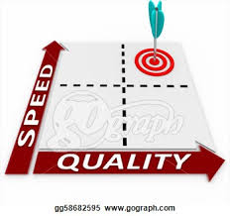

  5. EFFICIENT AND EFFECTIVE USE OF RESOURCES
Efficient and Effective use of Resources is the optimal use of resources (including time, human resources, natural resources, financial resources, etc.) to provide services and products that satisfy the requirements of users in a timely manner.
Measurement of Efficient and Effective use of Resources:
Some measurement indicators as presented for assessing “Efficient and Effective use of Resources” include:
procure goods, works and services in conformity with the Public Procurement Act and on time;
ensure that financial transactions are in line with the Financial Administration Act, Financial Regulations and the Financial Memoranda and that transactions are done in a timely manner;
organise monthly Financial & Audit review meetings to discuss the financial transactions of the Assembly;
ensure that at least 90% of activities, projects and programmes implemented are within the Annual Action Plan and Budget;
provide all clients with timely services.

Slide 74


  6. ACCOUNTABILITY
Accountability is taking responsibility for one’s actions and/or in-actions in rendering services and informing citizens on the use of public resources.
Measurement of Accountability:
Some measurement indicators for assessing “Accountability” include:
organize stakeholders’ public budget hearing in the local dialect most widely spoken within an Assembly (Twi, Gonja, Dagbane, Ga, etc.) on an annual basis;
publish and implement comments contained in the annual Audit Reports within two weeks of receipt;
publish monthly financial statements by the 20th of the ensuing month on MMDAs ‘notice boards, Community Information Centres, etc.;
provide information on programmes, projects, revenue and expenditure to the public using local radio/FM stations on a monthly basis;
organise four (4) quarterly Audit Report Implementation Committee (ARIC) meetings to discuss and act on Audit Reports.

Slide 75

Performance Management Systems (PMS)
A systematic process for improving performance by developing the performance of individuals and teams.
It aims at having in place predictable, effective and efficient systems for planning, implementation, monitoring, evaluation and reporting on employees’ performance.
The overall objective of PMS is to create a high performance culture where staff are aware of the need to perform well and behave accordingly in order to meet or exceed expectations

Slide 76
Performance contract & Performance appraisal
LGS-PMS will use the following documents (PC & PA):
Performance Contract (PC):
  Between Hon. Reg. Ministers & RCDS / CDS
  Between MMDCES & MMDCDS
  Between HOS & CD, DIRECTORS
Performance Appraisal (PA):
  All LGS staff except above
Element of PC & PA:
  Key Performance Area (KPA), Key Performance Indicator (KPI), Weighting, Service Delivery Standard (SDS), Competency & Rating Scales.

Slide 77
Performance Appraisal: Four phases of performance management process
Phase One – Performance Planning (Plan, Agree & DO)
Planning and setting of individual performance targets through work plans derived from the LGSS’s/ RCC’s/ MMDA’s Strategic Plans and objectives set at the directorate, departmental and unit levels. The indicators /target setting process must be a top-down approach; preferably the first two weeks in January should serve as the period for setting of targets for the year.
Phase Two – Progress Reviews (mid-year review) (Check, Monitor & Review)
Discussion and communication between appraiser and Appraisee on progress of work, and adjustment of indicators /targets if necessary, through the provision of formal feedback.
Phase Three – Review and Appraisal end of year evaluation) (Act & Evaluate)
Evaluation of Appraisee’s performance at the end of the performance management period.
Phase Four- Decision–Making (Report & Decision)
Deciding on courses of action, i.e. recognition/reward, training plans, promotion prospects, career development plans, counselling and sanctions.
“All phases are operating within the PMS Cycle”

Slide 78
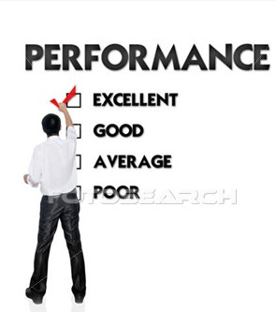
Performance Management Cycle
Plan and agree on what needs to be done (this is viewed as performance contracting);
Doing what has been agreed upon;
Check and Monitor performance information and identifying opportunities for improvement;
Review what has gone well, and not so well; what needs to be developed
Act on the information and making any necessary changes; and;
Report on the progress and outcomes.
Plan & Agree
Do
Check & Monitor
Act & Evaluate
Report & Decision
Review

Slide 79
ANNUAL ASSESSMENT DECISION (BY APPRAISER & APPRAISEE)
EXPLANATION ON CRITERIA FOR RATING OVERALL PERFORMANCE The following criteria will be used to rate the overall performance of the Appraisee: Mark “X” in the appropriate box Excellent (4): 80-100% (Outstanding) Appraisee has fully met and exceeded the agreed indicators and time lines and has produced results of excellent quality. The Officer is a model of excellence in terms of the results achieved and the means by which they were achieved. (publicize his/her outstanding performance and recommend him/her for appropriate reward) Very Good (3): 70-79% (Exceeds the requirement) Appraisee has achieved most of the agreed indicators and has produced results of good quality within agreed time lines. (Recognize his/her very good performance & encourage him/her through Coaching, Mentoring, training, etc.) Good (2): 60-69% (Meets the requirement= 60%) Appraisee has achieved the minimum number of agreed indicators and provided adequate supporting rationale/reasons for not achieving all of the specified targets. (Encourage him/her through Coaching, Mentoring, training, etc. for further improvement) Unsatisfactory (1): Below 60% (Does not meet the requirement) Appraisee’s performance does not meet the standard expected for the job i.e. Appraisee has not achieved most of the agreed indicators within the time frame provided and is unable to provide reasons or provides unacceptable reasons for unachieved targets. (Apply appropriate sanction and necessary counseling)

Slide 80
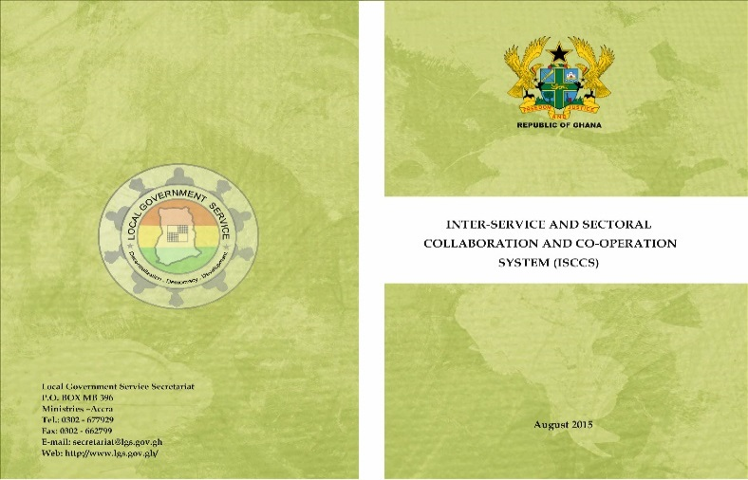
Inter-Service & sectoral collaboration & cooperation system (ISCCS): Basic Principles And Focus Areas
Vision:
Excellent and sustainable collaboration among key stakeholders for effective and efficient service delivery.
Purpose for the Collaborative Effort:
to facilitate unity of effort, achieve common objectives, provide common understanding and development of an effective local platform to work.
Guiding Principles:
closer working relationships characterized by interdependence, commitment, mutual understanding, trust and respect;
participatory decision making;
open and frequent communication;
complementarity in terms of resources and skills;
strong and shared leadership.

Slide 81
  Inter-Service & sectoral collaboration & cooperation system (ISCCS): Focus Areas
Organogram for the Operation of the Decentralised Departments and Reporting Relationships with MMDAs;
System of Work and Relationships of the Decentralised / De-concentrated / Non-decentralised Departments, State-Owned Enterprises (SOEs) and Public Corporations at the District Level;
System of work and relationships of the Decentralised / De-concentrated / Non-decentralised Departments, SOEs and Public Corporations at the Regional Level;
System of work and relationships of the Decentralised / De-concentrated / Non-decentralised Departments, SOEs and Public Corporations at the National Level.

Slide 82
5. General CHALLENGES
Attitudinal / Bureaucratic Resistance to Change
Resources for MMDA Level Capacity – Infrastructure (offices), Human & Logistics/Finance etc
Implementation of the establishment of departments for MMDAs under LI 1961
Inadequate HR (Managerial and Technical) capacity at the MMDA level
Stakeholders have different interests: (Ministries, Departments and Agencies, DPs, bureaucrats and public sector workers)
Implementing the Integrated District Budget (Composite Budget)

Slide 83


END OF PRESENTATION
TEL: + 233 – 302 – 677929
FAX: + 233 – 302 – 662799
EMAIL: ohlgs@lgs.gov.gh
WEB: http://www.lgs.gov.gh/

