Slide 1

MODULE 2
PROCUREMENT ROLES AND RESPONSIBILITIES
Prepared by GIMPA Consultancy
MODULE 2
Public Procurement Authority (PPA), Ghana

Slide 2
MODULE OBJECTIVES
By the end of this module, participants will be able to:
  Describe the roles and responsibilities of each stakeholder in the public procurement system
  Explain the importance of professionalism in procurement and continuous professional development for procurement staff
Prepared by GIMPA Consultancy
MODULE 2
Public Procurement Authority (PPA), Ghana

Slide 3
INTRODUCTION
Stakeholders in the public procurement system include:
  The Public Procurement Authority (PPA)
  Procurement Entities
  The Private Sector
  Oversight bodies
  Civil Society Organizations (CSOs),
  Media
  Developmental Partners
MODULE 1
Prepared by GIMPA Consultancy
MODULE 2
Prepared by GIMPA Consultancy
Public Procurement Authority (PPA), Ghana
Public Procurement Authority (PPA), Ghana

Slide 4
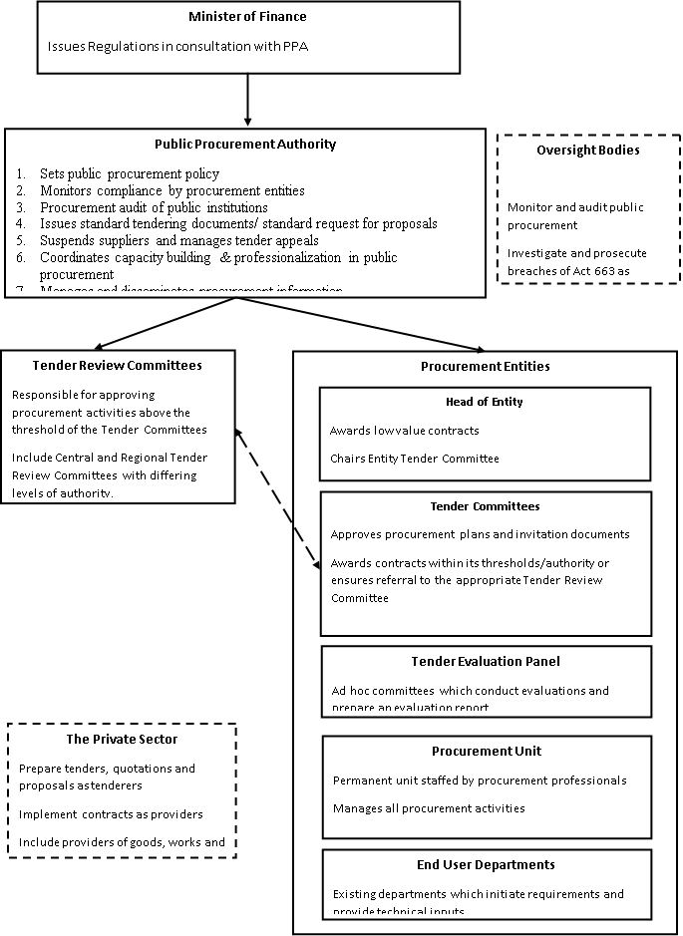
DIAGRAM: PROCUREMENT ROLES AND RESPONSIBILITIES

Slide 5
THE PUBLIC PROCUREMENT AUTHORITY (PART I, SECTIONS 1-13 OF ACT 663 AS AMENDED)
The Act establishes the Public Procurement Authority as the regulatory body for public procurement in Ghana.
This body is not involved in conducting procurement in any way, with the exception of approving the use of single source procurement and restricted tendering.
MODULE 1
Prepared by GIMPA Consultancy
MODULE 2
Prepared by GIMPA Consultancy
Public Procurement Authority (PPA), Ghana
Public Procurement Authority (PPA), Ghana

Slide 6
FUNCTIONS OF PUBLIC PROCUREMENT AUTHORITY
Policy:
  Make proposals for the formulation of policies on procurement;
  Ensure policy implementation and human resource development for public procurement
  Hold an annual forum for consultations on public procurement and other related issues;
  Advise Government including Metropolitan, Municipal and District Assemblies on issues relating to public procurement
  Plan and co-ordinate technical assistance in the field of public procurement;
MODULE 1
Prepared by GIMPA Consultancy
MODULE 2
Prepared by GIMPA Consultancy
Public Procurement Authority (PPA), Ghana
Public Procurement Authority (PPA), Ghana

Slide 7
FUNCTIONS OF PUBLIC PROCUREMENT AUTHORITY (Cont’d)
Monitoring and Evaluation:
  Monitor and supervise public procurement and ensure compliance with statutory requirements;
  Have the right to obtain information concerning public procurement from contracting authorities;
  Assess the operations of the public procurement processes and submit proposals to the Board for improvement of the processes;
MODULE 1
Prepared by GIMPA Consultancy
MODULE 2
Prepared by GIMPA Consultancy
Public Procurement Authority (PPA), Ghana
Public Procurement Authority (PPA), Ghana

Slide 8
FUNCTIONS OF PUBLIC PROCUREMENT AUTHORITY (Cont’d)
Information Management and Dissemination
  Establish and implement an information system relating to public procurement;
  Publish by the end of each month a Public Procurement Bulletin which shall contain information germane to public procurement, including proposed procurement notices, notices of invitation to tender and contract award information;
  Present annual reports to the Minister on the public procurement processes;
  Maintain a register of procurement entities and members of and secretaries to tender committees of public procurement entities;
  Maintain a data base of suppliers, contractors and consultants and a record of prices to assist in the work of procurement entities;
MODULE 1
Prepared by GIMPA Consultancy
MODULE 2
Prepared by GIMPA Consultancy
Public Procurement Authority (PPA), Ghana
Public Procurement Authority (PPA), Ghana

Slide 9
FUNCTIONS OF PUBLIC PROCUREMENT AUTHORITY (Cont’d)
Capacity-Building and Professional Development
  Facilitate the training of public officials involved in public procurement at various levels;
  Develop, promote and support training and professional development of persons engaged in public procurement, and ensure adherence by the trained persons to ethical standards;
  Assist the local business community to become competitive and efficient suppliers to the public sector;
MODULE 1
Prepared by GIMPA Consultancy
MODULE 2
Prepared by GIMPA Consultancy
Public Procurement Authority (PPA), Ghana
Public Procurement Authority (PPA), Ghana

Slide 10
FUNCTIONS OF PUBLIC PROCUREMENT AUTHORITY (Cont’d)
Regulations and Standards
  Develop rules, instructions, other regulatory documentation on public procurement and formats for public procurement documentation
  Organise and participate in the complaints and administrative review procedures
  Investigate and debar from procurement practice under this Act, suppliers, contractors and consultants who have seriously neglected their obligations under a public procurement contract, have provided false information about their qualifications, or offered inducements of the kind referred to in section 32;
  Maintain a list of firms that have been debarred from participating in public procurement and communicate the list to procurement entities on a regular basis;
MODULE 1
Prepared by GIMPA Consultancy
MODULE 2
Prepared by GIMPA Consultancy
Public Procurement Authority (PPA), Ghana
Public Procurement Authority (PPA), Ghana

Slide 11
COMPOSITION OF PPA’S GOVERNING BOARD
A person competent and experienced in public procurement, as the chairperson;
Four persons from the public sector:
  One representative of the Attorney General and
  Three other persons nominated by the Minister (Finance), one of whom is a woman and each of whom is a person who has experience in public procurement and is familiar with governmental and multilateral agency procurement procedures;
Three persons from the private sector who have experience in procurement, at least one of whom is a woman; and
The Chief Executive Officer of the Authority.
Prepared by GIMPA Consultancy
MODULE 2
Public Procurement Authority (PPA), Ghana

Slide 12
PROCUREMENT ENTITIES (SECTIONS 15-16 OF ACT 663 AS AMENDED)
The term “procurement entity” is defined as any entity conducting public procurement under Act 663 as amended (Section 98).
Procurement Entities include various bodies and officers with different roles and responsibilities, including the:
  Head of Entity;
  Entity Tender Committee
  Tender Evaluation Panel; and
  Procurement Unit
MODULE 1
Prepared by GIMPA Consultancy
MODULE 2
Prepared by GIMPA Consultancy
Public Procurement Authority (PPA), Ghana
Public Procurement Authority (PPA), Ghana

Slide 13
PROCUREMENT ENTITIES – HEAD OF ENTITY
Functions of the Head of Entity:
Being responsible and accountable for ensuring procurement is conducted in accordance with the Act as amended
Chairing the Entity Tender Committee meetings;
Ensuring disposal of public stores, vehicles and equipment
Referring to Entity Tender Committee for approval of procurement above his/her threshold
Establishing a procurement unit with qualified staff
Empaneling competent and qualified evaluation panels
Facilitating contract administration and ensuring compliance with the reporting requirements under Act 663 as amended
Awarding contracts up to a specified threshold; and
Investigating complaints submitted by tenderers.
MODULE 1
Prepared by GIMPA Consultancy
MODULE 2
Prepared by GIMPA Consultancy
Public Procurement Authority (PPA), Ghana
Public Procurement Authority (PPA), Ghana

Slide 14
PROCUREMENT ENTITIES – ENTITY TENDER COMMITTEE
Sections 20-20D of Act 663 as amended, requires an Entity Tender Committee(ETC) to be established in every procurement entity.
ETCs main responsibility is to ensure that the procurement entity’s procurement activities are conducted in compliance with the Act and Regulations.
The Head of Entity is the Chairperson of the Entity Tender Committee which
has a membership of 7 – 9 members depending on type of Procurement Entity.
Quorum consists of the Chairman and 3 other members with the precise composition specified in the First Schedule of Act 663 as amended.
Head of Procurement Unit is Secretary to the Entity Tender Committee meetings
ETC meetings to be held at least once a quarter and notice of such meetings shall be 2 weeks before the date of the meeting
MODULE 1
Prepared by GIMPA Consultancy
MODULE 2
Prepared by GIMPA Consultancy
Public Procurement Authority (PPA), Ghana
Public Procurement Authority (PPA), Ghana

Slide 15
PROCUREMENT ENTITIES – ENTITY TENDER COMMITTEE (Cont’d)
The functions of the Entity Tender Committee include:
  Ensure procurement is compliant with Act 663 as amended and Regulations
  Review and approve procurement plans
  Confirm costs and match with available funds
  Ensure necessary concurrent approvals are obtained from the appropriate tender review committee
  Facilitate contract administration and ensure compliance with reporting requirements
  Assist Head of Entity in disposal of stores, vehicles and equipment
  Approve invitation documents – tenders, RFQs, RFPs and pre-qualification
  Review of procurement schedules and specifications and terms of references
  Review evaluation reports and award contracts up to their threshold
  Approve contract amendments
MODULE 1
Prepared by GIMPA Consultancy
MODULE 2
Prepared by GIMPA Consultancy
Public Procurement Authority (PPA), Ghana
Public Procurement Authority (PPA), Ghana

Slide 16
PROCUREMENT ENTITIES – EVALUATION PANEL
Section 20E of Act 663 as amended requires the formation of Tender Evaluation Panels within each PE to evaluate tenders and proposals and assist the Entity Tender Committee in its work.
It is an ad hoc body. It is constituted to evaluate specific procurements and after the evaluation process has been completed, the Panel is dissolved.
Membership requirement include:
  Relevant technical skills
  End user representation
  Procurement and contracting skills
  Financial management or analytical skill
  Legal expertise
MODULE 1
Prepared by GIMPA Consultancy
MODULE 2
Prepared by GIMPA Consultancy
Public Procurement Authority (PPA), Ghana
Public Procurement Authority (PPA), Ghana

Slide 17
PROCUREMENT ENTITIES – PROCUREMENT UNIT
Each PE has a Procurement Unit
Its responsible for managing all procurement activities of the PE, subject to the approval of the Head of Entity.
The size and structure of the unit and the numbers and grades of staff depend on the procurement workload of the PE.
The Head of procurement unit who should be qualified procurement person, shall be the Secretary to the Entity Tender Committee.
MODULE 1
Prepared by GIMPA Consultancy
MODULE 2
Prepared by GIMPA Consultancy
Public Procurement Authority (PPA), Ghana
Public Procurement Authority (PPA), Ghana

Slide 18
PROCUREMENT ENTITIES – PROCUREMENT UNIT (Cont’d)
The functions of the Procurement Unit include the following:
  Procurement planning
  Recommending procurement methods
  Coordinating the preparation of specifications and terms of reference
  Preparing solicitation documents, notices & shortlists
  Managing the tendering process, including tender opening
  Participating in negotiations when permitted
  Managing evaluations and recommending contract award
  Preparing contract documents and amendments
  Preparing notification of awards and contracts
  Preparing procurement reports
  Issuing Tender rejection and debriefing letters
  Maintaining database of service providers
  Managing contracts or overseeing contracts management
MODULE 1
Prepared by GIMPA Consultancy
MODULE 2
Prepared by GIMPA Consultancy
Public Procurement Authority (PPA), Ghana
Public Procurement Authority (PPA), Ghana

Slide 19
The Role of User Departments
Forecast procurement needs
Initiate requirements and pass to the PU for action
Provide technical inputs and represent the end user
Manage contracts or assist the contract manager

Slide 20
PROCUREMENT ENTITIES – TENDER REVIEW COMMITTEES (TRCs)
The Act also establishes Tender Review Committees (TRCs) (Section 20F-20G) of Act 663 as amended at central and regional levels.
The tender review committee of Ministries, Departments and Agencies (MDAs) is the Central Tender Review Committee (CTRC).
The tender review committee of Metropolitan Municipal and District Assemblies (MMDAs) is the Regional Tender Review Committee (RTRC).
Members of CTRC are appointed by the Minister of Finance in consultation with PPA Governing Board.
Members of RTRC are appointed by the Regional Minister in consultation with the Minister of Finance.
MODULE 1
Prepared by GIMPA Consultancy
MODULE 2
Prepared by GIMPA Consultancy
Public Procurement Authority (PPA), Ghana
Public Procurement Authority (PPA), Ghana

Slide 21
PROCUREMENT ENTITIES – TENDER REVIEW COMMITTEEs (Cont’d)
The functions of TRCs include:
  Review activities at each stage of the procurement cycle, leading to the award of a contract
  Give concurrent approvals
  Furnish PPA with reports
  Participate in public procurement fora
  Review decisions of heads of entity regarding complaints
Note: Section 20G (3) provides that a tenderer or procurement entity that is dissatisfied with a decision of the Governing Board of the PPA may seek redress in court.
MODULE 1
Prepared by GIMPA Consultancy
MODULE 2
Prepared by GIMPA Consultancy
Public Procurement Authority (PPA), Ghana
Public Procurement Authority (PPA), Ghana

Slide 22
THE PRIVATE SECTOR
The private sector is a critical part of the public procurement system
It encompasses the companies which participate in public procurement as tenderers and providers of goods, works and services.
The private sector will prepare tenders, proposals and quotations and implement awarded contracts.
MODULE 1
Prepared by GIMPA Consultancy
MODULE 2
Prepared by GIMPA Consultancy
Public Procurement Authority (PPA), Ghana
Public Procurement Authority (PPA), Ghana

Slide 23
OVERSIGHT BODIES
Oversight bodies are those which monitor the public procurement system.
They include various bodies, both within the public sector and in civil society.
Their roles differ, ranging from monitoring and audit, which enables them to report and prosecute any breaches of the Act including non-compliance, fraud and corruption.
MODULE 1
Prepared by GIMPA Consultancy
MODULE 2
Prepared by GIMPA Consultancy
Public Procurement Authority (PPA), Ghana
Public Procurement Authority (PPA), Ghana

Slide 24
QUESTIONS & DISCUSSIONS
MODULE 2 – EXERCISE:

