Slide 1
OVERVIEW OF NETWORKING
BY
WILFRED A. GLOVER-AKPEY

Slide 2

Contents
What is Networking?
Logical and Physical Networks
Types of Networks
Classification of Networks
Hardware that makes up a Network
Protocols of a Network
Network Management

Slide 3
What is Networking?
A Computer Network is a group of devices that are connected via a communication links, where data is sent and received between devices.
Logical and Physical Networks
Physical Components – Cables, Network hardware devices (Switches, Routers, APs, etc)
Logical Components – frames and data carried by and across the network

Slide 4
Types of Networks
There are two basic types of networks
LAN
  Limited geographic area, e.g. office building
  High data transfer speeds
  Generally less expensive to implement
WAN
  Not restricted to a particular geographic area, interconnection, within a town, city, country, continents
  Generally more expensive technology
  More sophisticated to implement than LANs
  Multiple interconnected LANs

Slide 5

LAN
LAN Topologies (Star, Bus, Ring)
LAN Transmission Modes (Unicast, Multicast and Broadcast transmission)
LAN Infrastructure Devices
Repeaters
Bridges
Hubs
Switches
Router

Slide 6
HARDWARE THAT MAKE UP A NETWORK
Repeater
Bridges
Hubs
Switches
Routers
Firewalls
Printers
Cables (Fibre, CAT X, etc)
Other electronic devices

Slide 7
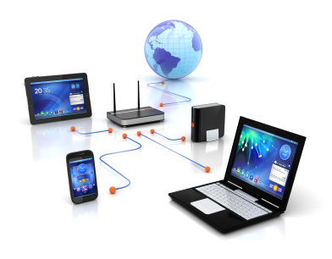

COMMUNICATION LINKS
Wireless (Networks)
Wired (Networks)

Slide 8
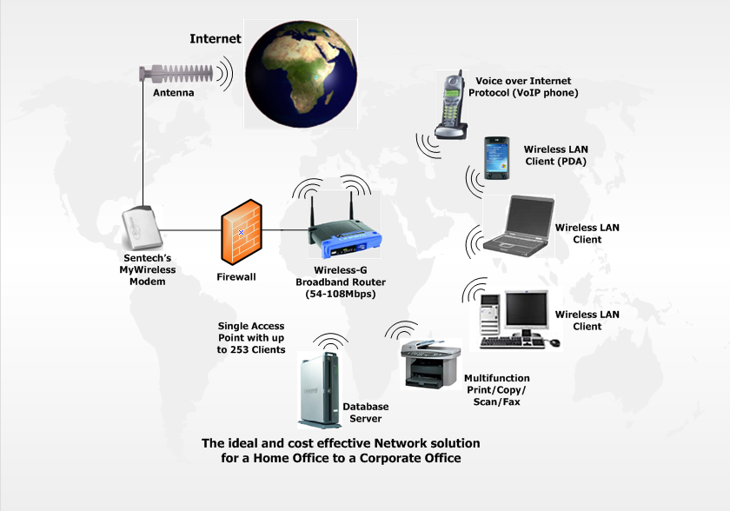
WIRELESS NETWORKS

Slide 9
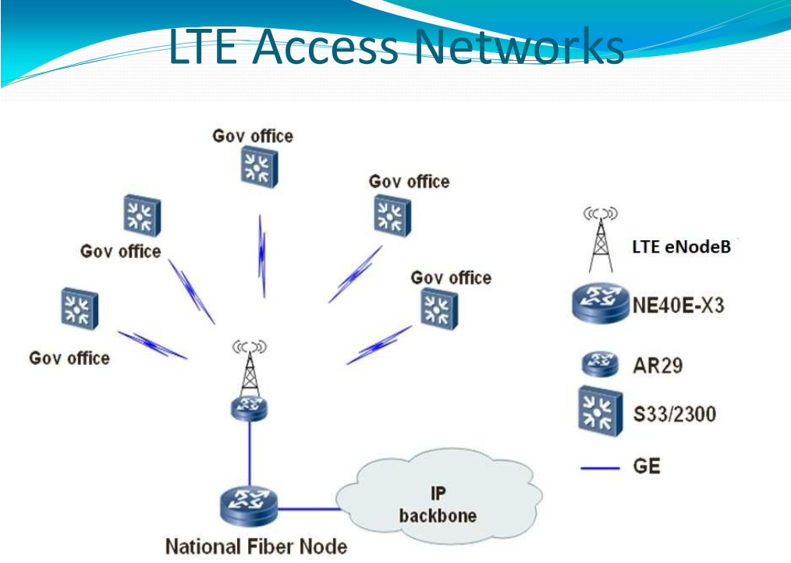
WIRELESS NETWORKS

Slide 10
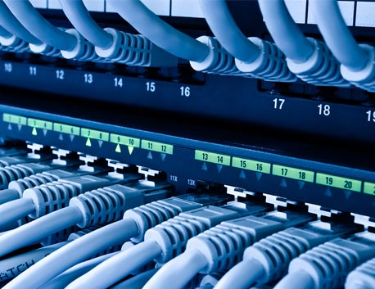
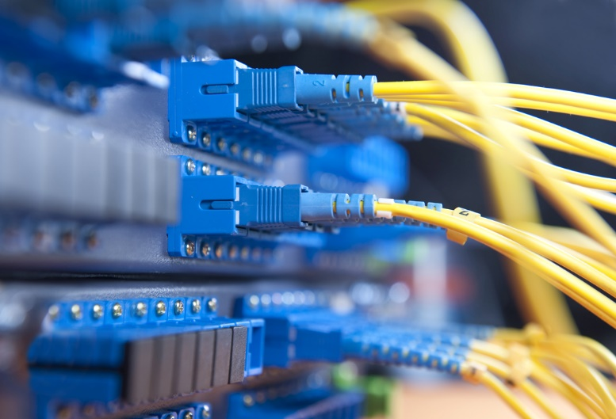
WIRED NETWORKS
Fibre
Ethernet

Slide 11
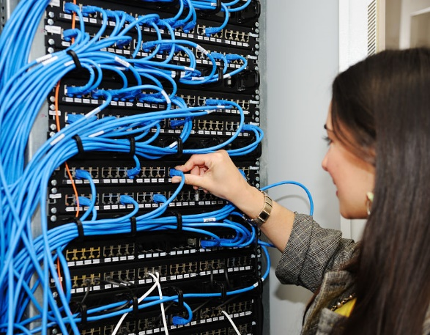
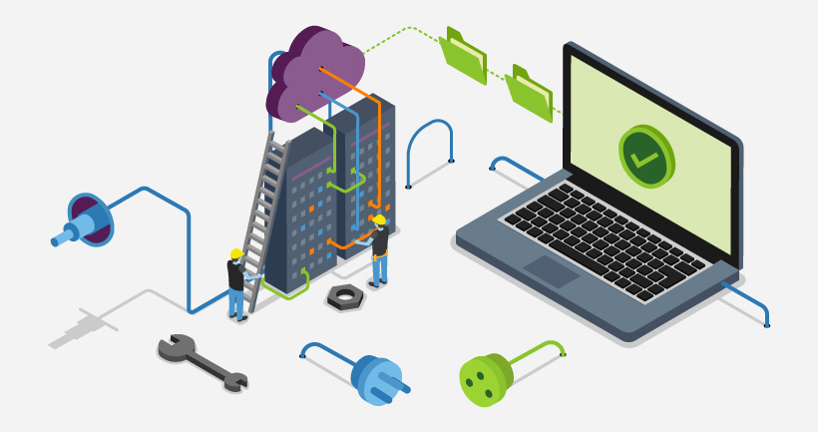
WIRED NETWORKS

Slide 12
Summary of Advantages and Disadvantages of the two (2) Networks
 | Activity / Category | Wireless Network | Wired Network
1. | Freedom of movement of Users | Users can access network anywhere within range | Users are limited by the need to use a cable and/or connect to a port.
2 | Sharing files | Easier with wireless network as you do not need to be cabled to network, though the transfer speeds may be slower. | Generally, less convenient as you have to be cabled in, but transfer speeds are often faster.
3 | Cables | Far less complicated. You don’t have to deal with disruptive or untidy cabling. | Lots of cable and ports needed which can be a headache
4 | Connection speeds | Usually slower than wired | Usually faster than wired
5 | Security | Less secure than wired. Both bandwidth and information can sometimes be accessed. | Usually more secure than wireless
6 | Set up | Upgrading to a wireless network can be difficult and expensive. | Can also be difficult and expensive to setup.
7 | Reliability | Wireless networks are susceptible to interference (e.g. office walls). And if you’re connecting near the edge, the connectivity is slower. | Wired networks are more reliable, if the cables are well made and connected.

Slide 13
Protocols of a Network
Network Protocol is a set of rules that governs the communications between electronic devices on a network.
OSI Model is a conceptual model that characterizes and standardizes the communication functions of a computing system.

Slide 14
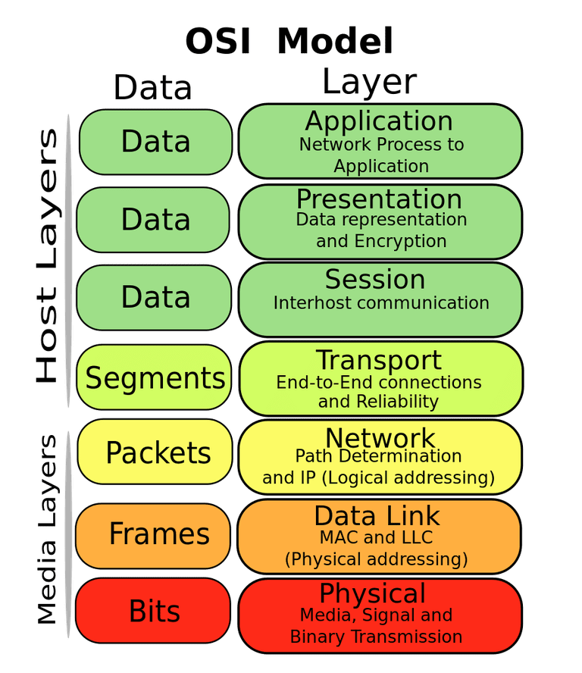

Slide 15
Protocols Design
A network Protocol connects one layer to the same layer on another device.
Each layer adds control information to the message.
Physical layer ultimately carries a stream of bits containing the message.

Slide 16
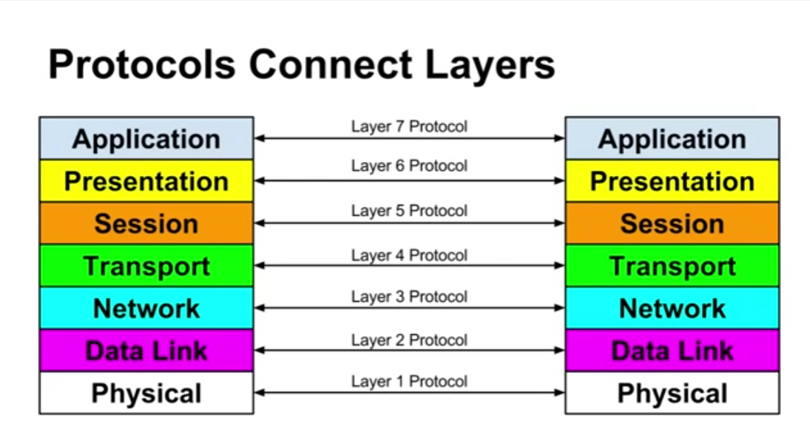
Protocols Design

Slide 17
Protocols Stack
Each network device has an implementation of each protocol at each layer
Messages are wrapped in, then extracted from, these protocols

Slide 18
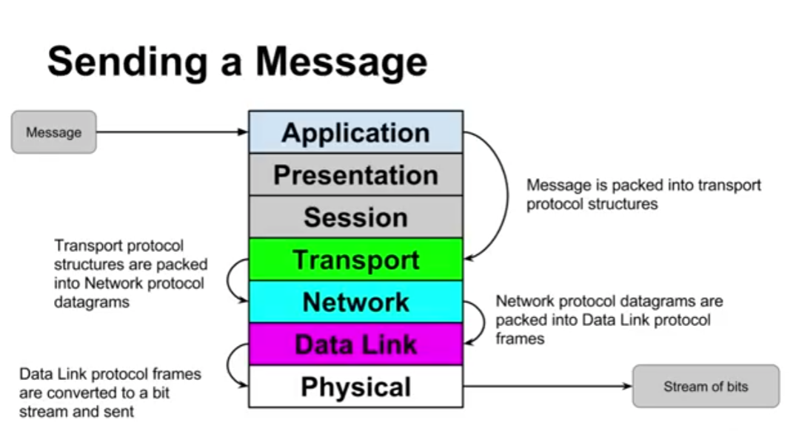
Protocols Stack

Slide 19
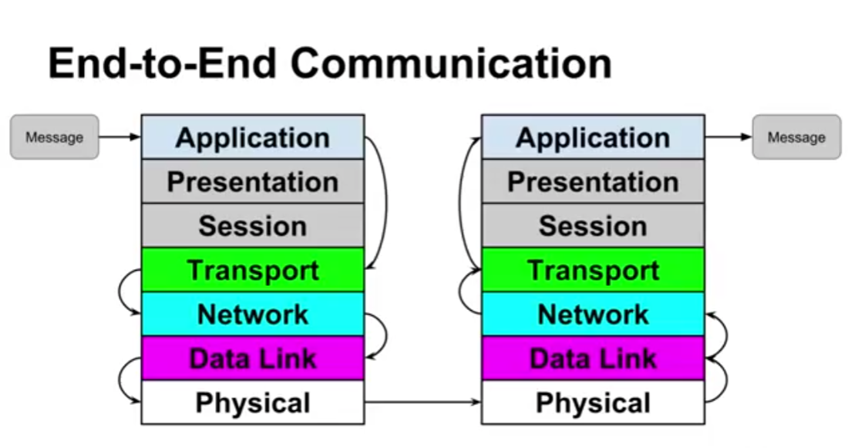
Protocols Stack

Slide 20
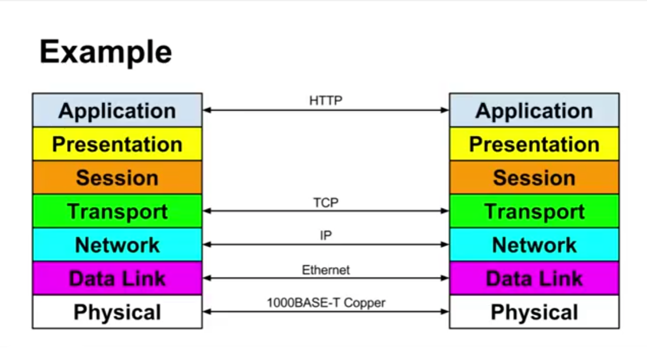
Protocols Stack

Slide 21
TCP/IP
Transmission Control Protocol
A set of rules that govern the connection of computer systems to the internet.
Internet Protocol
It is the conceptual model and set of communications protocols used on the internet and similar computer networks.
TCP/IP
The Transmission Control Protocol/ Internet Protocol, is a suite of communication protocols used to interconnect network devices on the internet. It can also be used as a communication protocol in a private network.

Slide 22
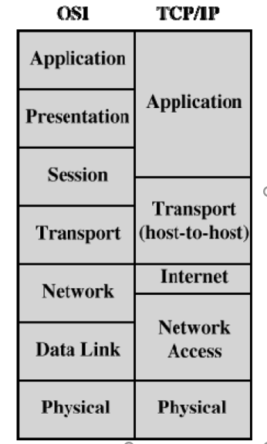
OSI vs TCP/IP

Slide 23
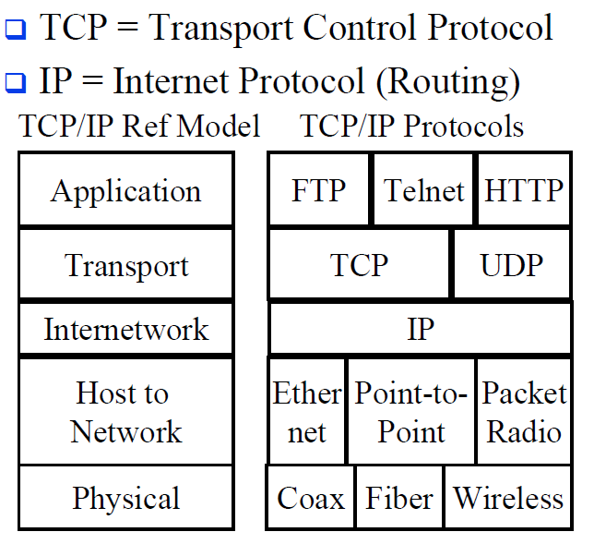
TCP/IP REFERENCE MODEL

Slide 24
NETWORK MANAGEMENT
What is a network management system (NMS) ?
NMS functions:
- identifies,
- configures,
- monitors,
- updates and
- troubleshoots network devices
Displays the performance data collected from each network component, allowing IT officers/engineers to make changes as needed.

Slide 25
NETWORK MANAGEMENT
What is Network Management?
It’s a broad range of functions including activities, procedures, methods and the use of tools to administer, operate and reliably maintain computer network systems.
Is the process of administering and managing computer networks.

Slide 26
NETWORK MANAGEMENT
Network Monitoring tools?
Cacti : it is an open-source, web-based network monitoring and graphing tool. It allows users to poll services a predetermined intervals and graph the resulting data.
Nagios : It is a free open source computer application that monitors systems, networks and infrastructure. Nagios offers monitoring and alerting services for servers, switches, applications and services.
Solarwinds Network Performance Monitor

Slide 27
NETWORK MANAGEMENT
What is Network Management?
Network Administration
Network Operation
Network Maintenance
Network Provisioning

Slide 28
How to be Efficient and Effective in the work environment
Standard operating procedure (SOP)
Analytic Skills
Communication - stakeholders, feedback
Build Professional Relations
Multitasking
Build yourself, technically
Innovate & Research

Slide 29
THANK YOU

Slide 30
QUESTIONS / COMMENTS

