Slide 1
RELEVANCE OF OPEN SOURCE DATA SYSTEMS
BY
WILFRED A. GLOVER-AKPEY

Slide 2
CONTENT
Brief History
Definitions
Advantages
Disadvantages
Applications

Slide 3
Brief History
The ‘Open Source’ Label was invented in 1998.
Later that year, a meeting called the ‘Free Software Summit’ was held with several founding figures of several projects such as Apache, Linux and Perl.
A vote was passed to promote the term ‘Open Source’.

Slide 4

What is Open Source?
Open means anyone can freely access, use, modify and share for any purpose.
Open source hardware is hardware whose design is made public so that anyone can study, modify, distribute, make and sell the design or hardware based on that design.
For it to work the information/data must be clear, complete and instructive and permissions must be explicit to allow people to do with it as they see fit.
The term used to describe software that is free of charge, along with the original source code used to create it so that anyone can modify it to improve it and work in ways that reflect their own preferences.

Slide 5
What is Open Source?
These are thoughts from IT professionals about what Open Source means to them…
Open source is a model that allows you to share content and software collaboratively and publicly.
Open source means that I can see what’s going on in my computer, whenever I’m running a particular program, so I know what it is doing, I know how it is doing it,….
Open source means having the ability to control the software that you’re using, it does what you want , and you can change it to serve whatever purpose that you want it to serve.
Other people can use your work and share freely.
You learn with another person, allows you to step into a group

Slide 6
What is Open Source?
These are thoughts from IT professionals from Globe about what Open Source means to them…
It a means of bridging the digital gape between developing countries and the developed countries.
You need to have the correct license that allows it to be used and remixed by other people
Communities can form around open source.
If you want to develop your own software, you’re not alone

Slide 7
What is Open Source?
1. Publish
  Design Files
  Recipes
  Tutorials
  Source code
  Parts Lists
  Datasets

Slide 8
What is Open Source?
  2. User Accessible, Open formats and components that are compatible with a wide range of tools
  Share editable files. E.g. : .csv, .odt, .svg, .stl, .xml
  Accessible hardware
  3. Access, Share, Modify

Slide 9
Data Systems
What is a Data System?
It is a term used to refer to an organized collection of symbols and processes that may be used to operate on such symbols.
Hence, any organized collection of symbols and symbol manipulating operations can be considered a Data System.

Slide 10

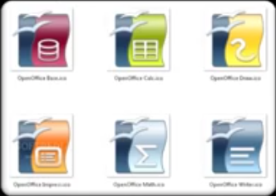



Open Source Software Applications
Open Office Suite is a alternative to MS Office
Linux Ubuntu is an alternative to MS Windows OS and the MAC OS
GIMP – GNU image manipulation program is an alternative to Photoshop Photo Editing software.
MySQL – highly secure and scalable database management system
Apache – free open source cross platform web server
PHP – widely used general purpose scripting language

Slide 11

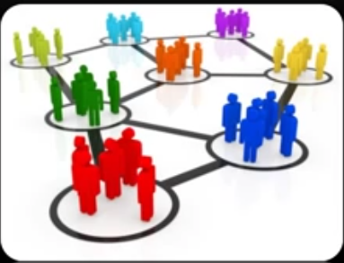
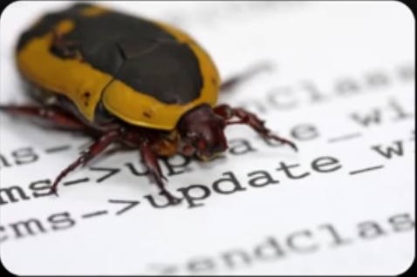
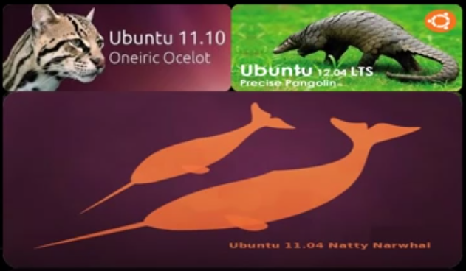
Advantages
Learn, experiment, adapt
It can be use to suite a specific need
Unrestricted distribution. Redistribution of the source is also encourage
Bug detection and correction. Bug fixes can be redistributed instantly without having to wait for a newer release.
Because of the nature of open source, it is generally free.
Because of the large base of developers, there’s rapid enhancement and release of new versions

Slide 12


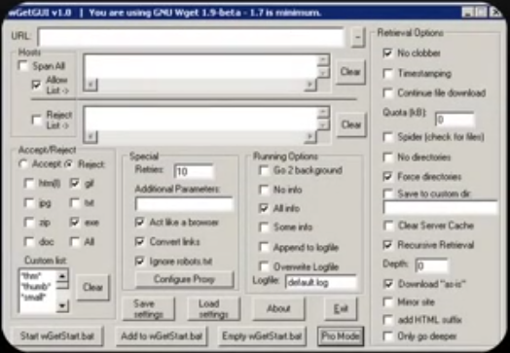
Disadvantages
Rapid enhancements ; difficult to know which version is update due frequent releases
There’s no guarantee of updates
Possibility of incompatibilities arises with many different people coding
Typically the interface of open source software is not user friendly

Slide 13
Applications
LGS should have Massive database on societal indices
  Agricultural data
  Address data
  Occupational data
  Census data
  Financial data
    What are the income levels?
  Birth & Death data
  Taxation data
  Educational data
    What are the number of schools in the area, and what type of schools are they?
  Pension data
  Health data
    Including health Insurance data

Slide 14
Applications
Data Processing Center
Designing Database management Systems using Open source software
  Cross Platform - Allows both proprietary and non proprietary software to access these data system
Collaboration with other government institutions like the DVLA, Immigration, Statistical Service, RGD, GRA, NIA
Using APIs for stakeholder access.
Cost associated with implementation – Licensing issues
Trend Analysis Tools
  Forecasting

Slide 15
THANK YOU

Slide 16
QUESTIONS / COMMENTS

