Slide 1
BASICS OF DATA MANAGEMENT AND STORAGE
BY
WILFRED A. GLOVER-AKPEY

Slide 2
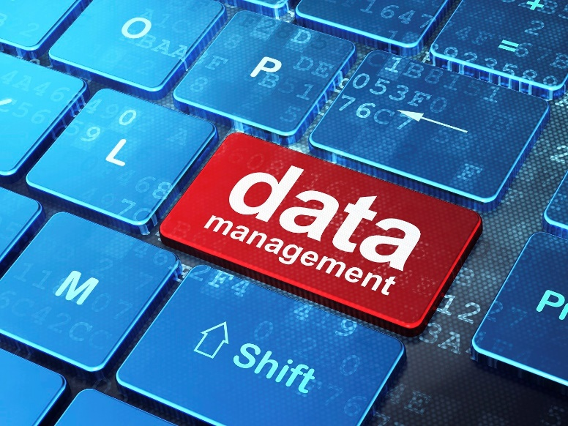
Contents
What is Data Management?
What is Storage (Management)?
Why is Data Management Important
What is Big Data?

Slide 3
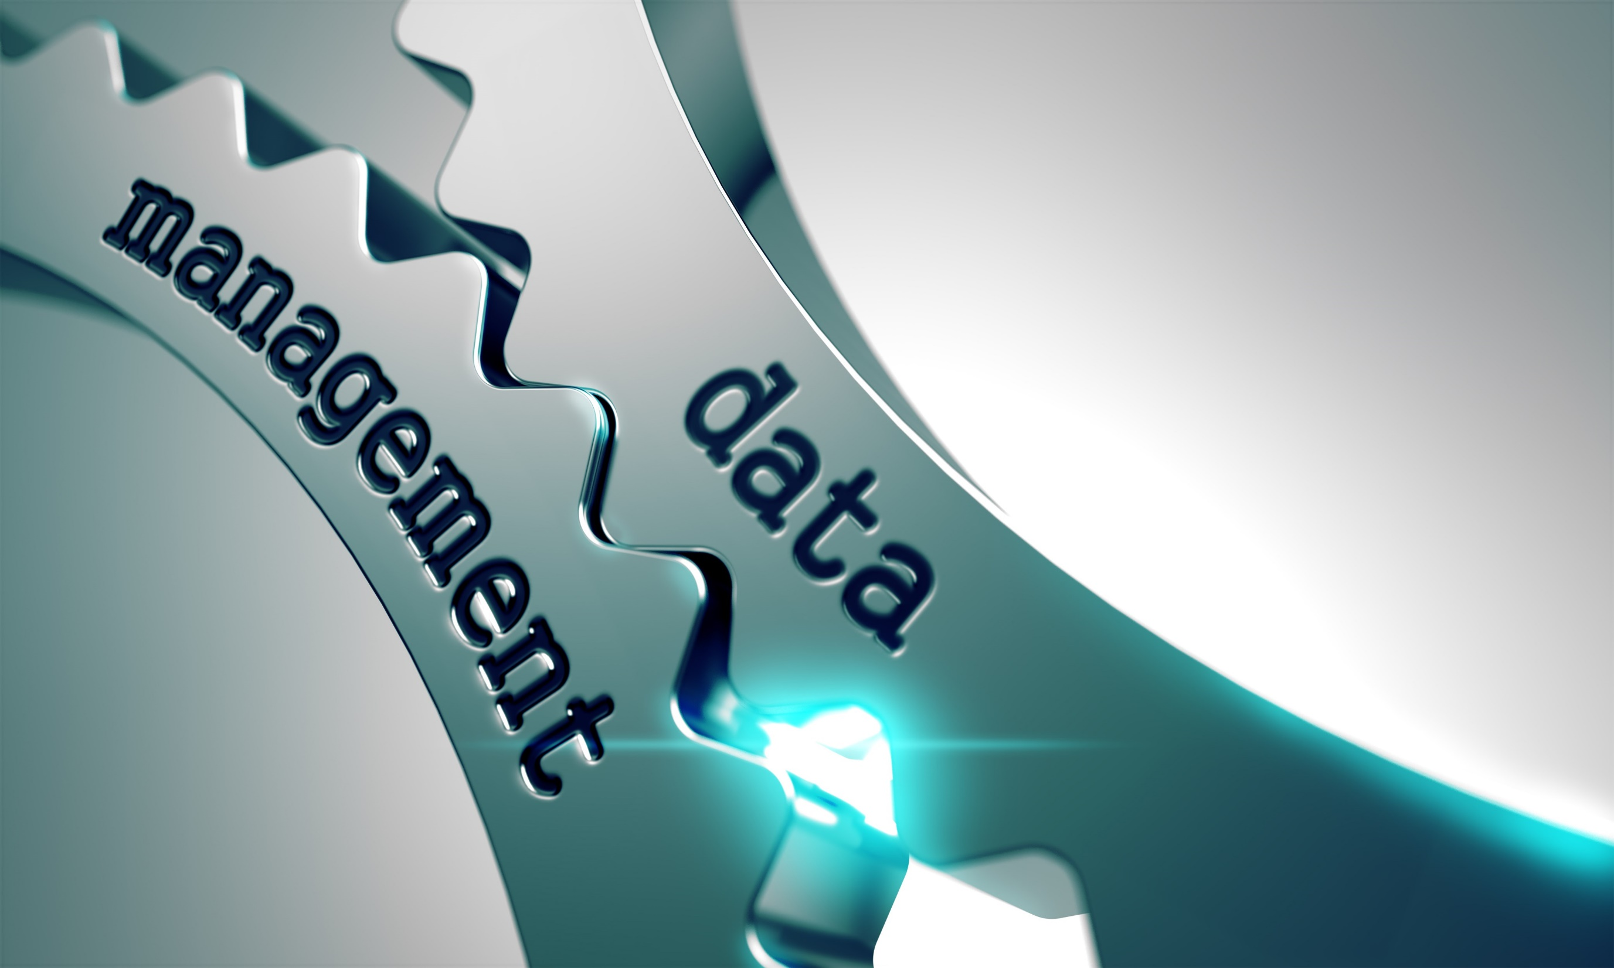
What is Data Management?
Data management refers to an organization’s management of information and data for secure and structured access and storage.
Data management tasks include :
The creation of data government policies, analysis and architecture;
database management system(DMS) integration;
data security and data source identification, segregation and storage.

Slide 4
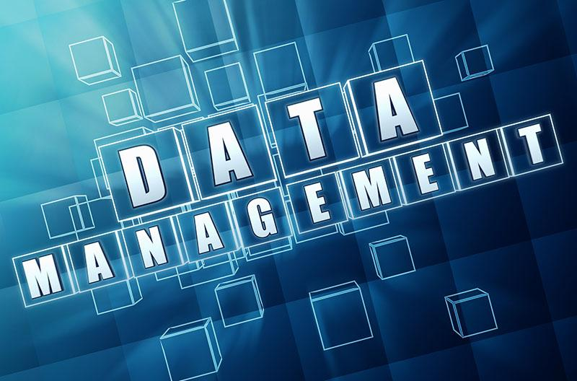
What is Data Management?
Quality Data Has Five Distinct Metrics
Availability
Usability
Reliability
Relevance
Readability

Slide 5
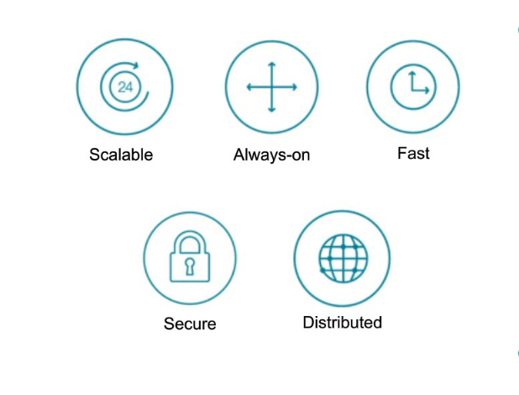
Well Managed Data is ….
In the right place
  Moves efficiently between multiple systems
Is available at the right time
In the right format
  Validated, standardized or enriched; data is made useable
For all (authorized) users
  Usage is governed
5 Key Ingredients for Data Management

Slide 6

Why is Data important ?
Data Management is important because the data that the Local government Service creates is a valuable resource.
Productivity
Cost Efficiency
Operational Nimbleness
Security Risks
Reduced Data Loss
Accurate Decision

Slide 7
The Five ‘C’s of Data Management
Culture / Change
  Culture is about deeply entrenched behaviours.
  Data management requires a big change from “my data” to “our data”
Capability
  Do you have operational capabilities across office units to perform effective data/information management.
Commerce
  How do you drive your business? If you invest time and money ‘here’ is it going to help us increase our IGF?
Communicate
  Involve all stakeholders, feedback, etc.
Cooperate
  Work with one another to achieve your orgainzations objective.
  Not just yours…

Slide 8
STORAGE
A Storage (device) a piece of computer equipment on which information can be stored.
Data Storage is the recording of information in a storage medium. E.g. Magnetic Tape, optical discs are examples of storage media.
Information is stored either temporarily or permanently

Slide 9
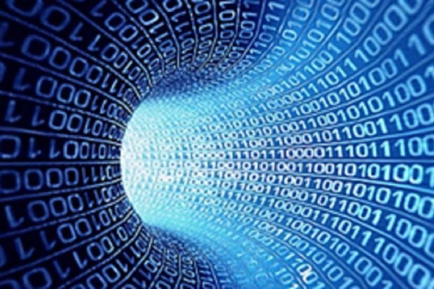
STORAGE
Types of Storage devices :
External Hard drive
Solid State Drive (SSD)
Network Attached Storage
USB thumb drive or Flash drive
Optical Drive (CD/DVD)
Cloud Storage

Slide 10
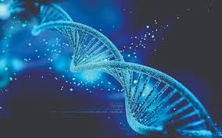
What is Big Data?
Big Data is a term that describes large volumes of data – both structured, semi-structured and unstructured. That inundates businesses on a day to day basis.
It has the potential to be mined for information.
“They are simply very large data sets that can be analyzed computationally to revel Trends, Pattern and associations, etc.”

Slide 11

What is Big Data?
You will need high end machines to be able to analyze all these large volumes of data (Data Sets).
An algorithm will need to be developed to do this.
  The time of spreadsheets may to drawing to an end.
Big Data Analysis will revel patterns and connections that will vastly improve most human activities.
How do we turn all these data into knowledge?
Think Out of the Box

Slide 12
What is Big Data?
Traditional data processing application software is usually not be adequate to deal with it.
It is so large that it is difficult to process using traditional database and software techniques.

Slide 13
THANK YOU

Slide 14
QUESTIONS / COMMENTS

