Slide 1

Online HR Software Application for
Office of the Head of Local Government Service (OHLGS)
For Newly Recruited Staff of the
Ghana Local Government Service
AH Hotel
Accra
02-10-2018
Bernard A. Arthur (MGIP)
C.E.O
NIEWTREE GH.LTD32

Slide 2
TERMS OF REFERENCE
The Terms of Reference provided for this assignment essentially aimed at providing the Office of the Head of Local Government Service (OHLGS) the indication that policies and procedures on HR as set are being followed with a high level of accountability within real time. Specifically:
  To ensure that the OHLGS, Regional Coordinating Councils (RCCs) and Metropolitan, Municipal and District Assemblies (MMDAs) are more competent and able to deliver on their mandates with a software to manage recruitment, retention, training and development, HR planning, compensation and benefits and complement the existing HRMIS
  To develop and deploy a simple but efficient Human Resource System for OHLGS to run all of its MMDAs and partners
  Establish a comprehensive human resource system that will serve the entire Human Resource-Operations (right from entry to exit) with features for business intelligence and analytics in the form of dashboards for reporting and greater insight/visibility into current operations.
  Deploy a cutting-edge human capital management solution, comparable to those used by many blue-chip entities.

Slide 3
METHODOLOGY
The team used a number of approaches in undertaking this assignment and that included
  Desktop reviews
  Surveys
  Meetings
  Interviews based on an agreed questionnaire
  Inter-personal discussions with appropriate officials in selected Regional Coordinating Councils, Metropolitan, Municipal and District Assemblies.

Slide 4
SCOPE
The scope of work was intended to cover a maximum of 12 weeks duration, as detailed in the proposal:
Scoping exercise to establish the system parameters and levels of integration
The design and development of the Human Capital Management Solution Software and
Activities related to module test run, demonstration and validation exercises.
  Unit testing
  Functional testing
  Usability testing
  Acceptance testing
  Beta testing

Slide 5
OUR UNDERSTANDING OF THE ASSIGNMENT
We understand that, the Local Government Service intends to fully scale up its Human Resource system from the current paper-based system to a more credible on-line based system which would offer almost a near real time system devoid of the numerous inconsistencies currently bedeviling the Service.
Objectives
  To give the OHLGS the indication that policies and procedures on HR as set are being followed with a high level of accountability within real time.
  To establish a comprehensive human resource system that will serve the entire Human Resource-Operations (right from entry to exit) with features for business intelligence and analytics in the form of dashboards for reporting and greater insight/visibility into current operations.
  To help the OHLGS to run a simple but efficient human resource system for all of its MMDAs and partners
Our Understanding
  The system as discussed with both entities was to have the following features:
  To capture data for the entire human resources and capacity development interventions of the Local Government Service (LGS)
  To streamline and standardize Human Resources processes such as entry, movements and exit as well as provide accurate forecasting into the future for human resource planning
  To generate timely statistic and dynamic reports for management decisions
  To provide platforms for tracking activities at all levels including events and business intelligence cues

Slide 6
Our Approach
Our understanding of the assignment per the ToR, juxtaposed against the conceptual framework identified and the methodology envisaged for this work as well as lessons from international practices gleaned, our approach to the assignment would entail the Input, Process and Output syndications.
INPUT
Establishment Data: This is to capture and store information as set up data including, service scheme and service group, units and activities, organizational structure, standard position, actual position, job description, postings, key result areas and the required logistical resources of the position.
Personal Record: This is to capture and store basic biodata of staff including, name, personal and family particulars, language proficiency, academic qualifications, date of birth, department, and work experience prior to joining the service and awards received.
Separation Module: This module provides a comprehensive process to manage the exit of officers from the service through compulsory retirement, early retirement, resignation, death, dismissal, and so on. It also enables officers to prepare task handover notes and exit interviews before leaving the service.

Slide 7
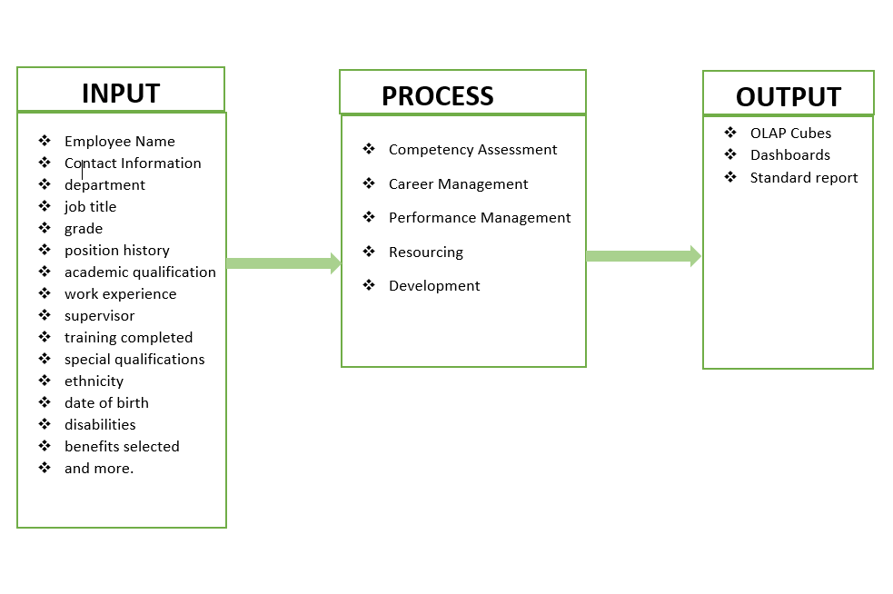
CONCEPTUAL FRAMEWORK

Slide 8
TECHNICAL ASPECT
NEW SYSTEM
CURRENT SYSTEM
The Software Requirements were discussed and detailed to include:
Microsoft SQL Server 2012 - 11.0.2218.0 (X64) Enterprise Edition
Microsoft Visual Studio 2012 for the front end
Crystal Report 2010 Static reports generation
Microsoft Analysis Services for dynamic Reporting
Microsoft Excel for OLAP Cubes
Microsoft Power BI for dashboards
Microsoft Visual C Sharp programming language.
The Hardware Requirements were also intended to have the following features:
Dell or HP Server
Windows Server 2008/2012 R2 Enterprise Operating System
Phoenix BIOS 4.0 Release 6.0
128 GB RAM
Intel(R) Xeon(R) CPU E5-2670 v2 @ 2.50GHz (32 CPUs), ~2.5GHz Processor
Software Requirements
  Microsoft Office Access database
  Microsoft Office Access Forms
  Microsoft Office Access Reporting Forms
  Limited database capacity (2 GB)
  Multi-user deficiency
  Static setups
Hardware Requirements
  Standard Desktop computers

Slide 9
WORK DONE / STATUS OF WORK
Interactions to shape work and gain deeper understanding
Interactions with OHLGS Project Coordinator
Submission of inception report
Requirements gathering
  Sample personnel data forms
  Conditions of service document
  Sample leave request and approval form
  Sample posting form
Discussion and Partial Demonstration of software to
  Management of OHLGS
  IMCC and Decentralization Steering Committee
  Presentation to selected HR and IT staff from the regions concluded
  Presentation made to joint OHLGS management and IMCC
Software design completed and ready for installation – April, 2018
Awaiting Approval of proposal for Training of Head Office staff, MMDCDs, HR, IT staff on the use of the software

Slide 10

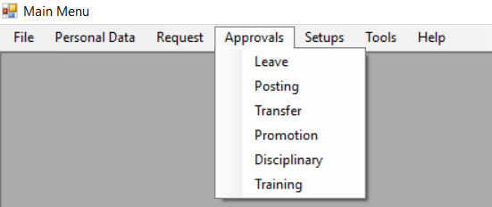
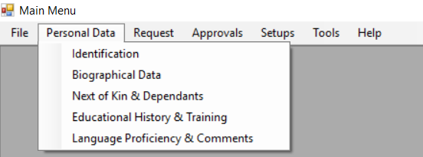
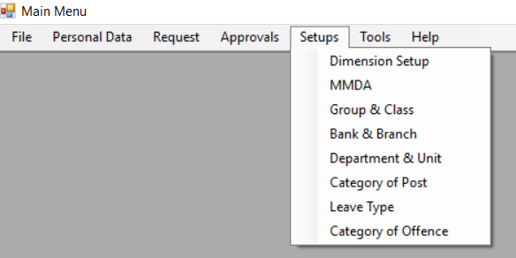
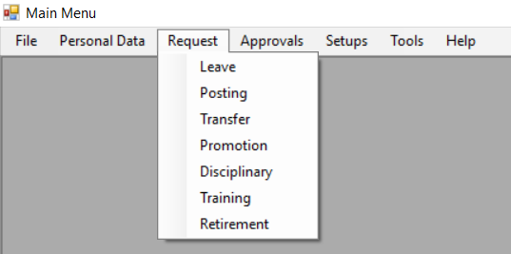
WHAT HAS BEEN DONE SO FAR
MAIN MENUS
PERSONAL DATA MENU
REQUEST MENU
APPROVALS MENU
SETUPS MENU

Slide 11
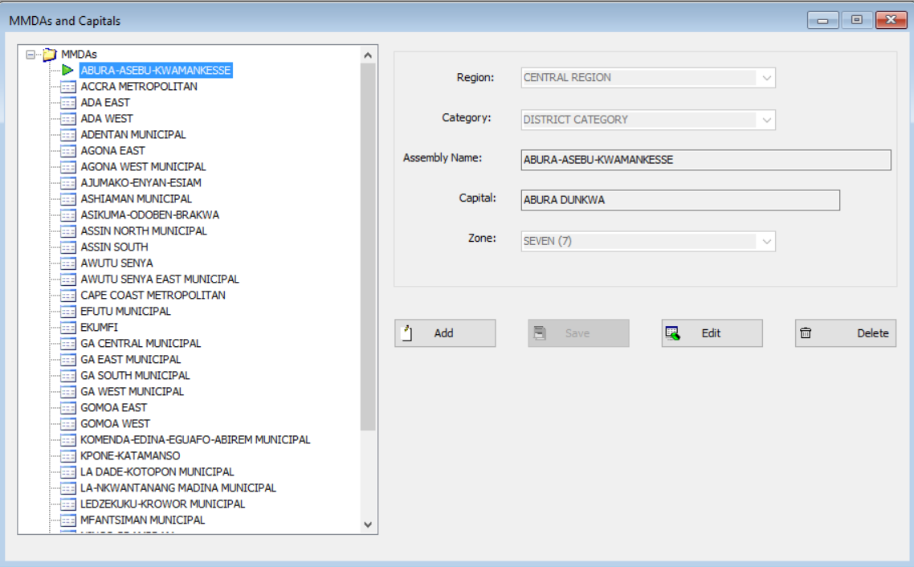
MMDA SETUP MODULE

Slide 12
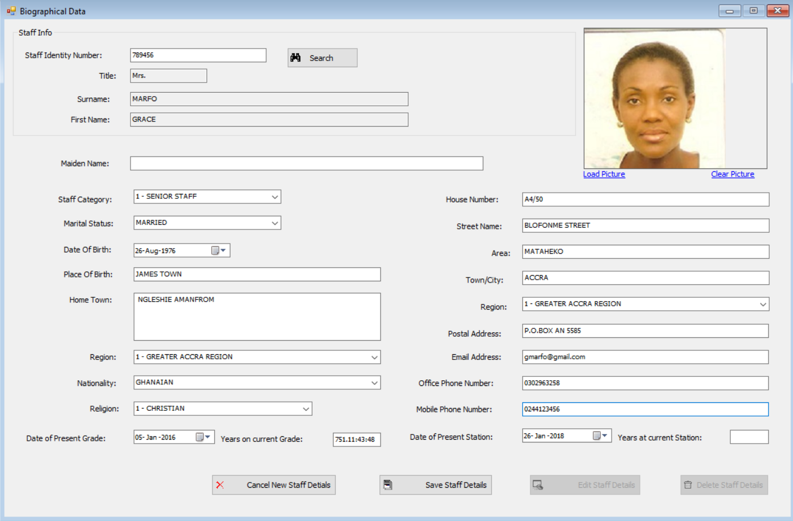
IDENTIFICATION AND BIO DATA MODULE

Slide 13
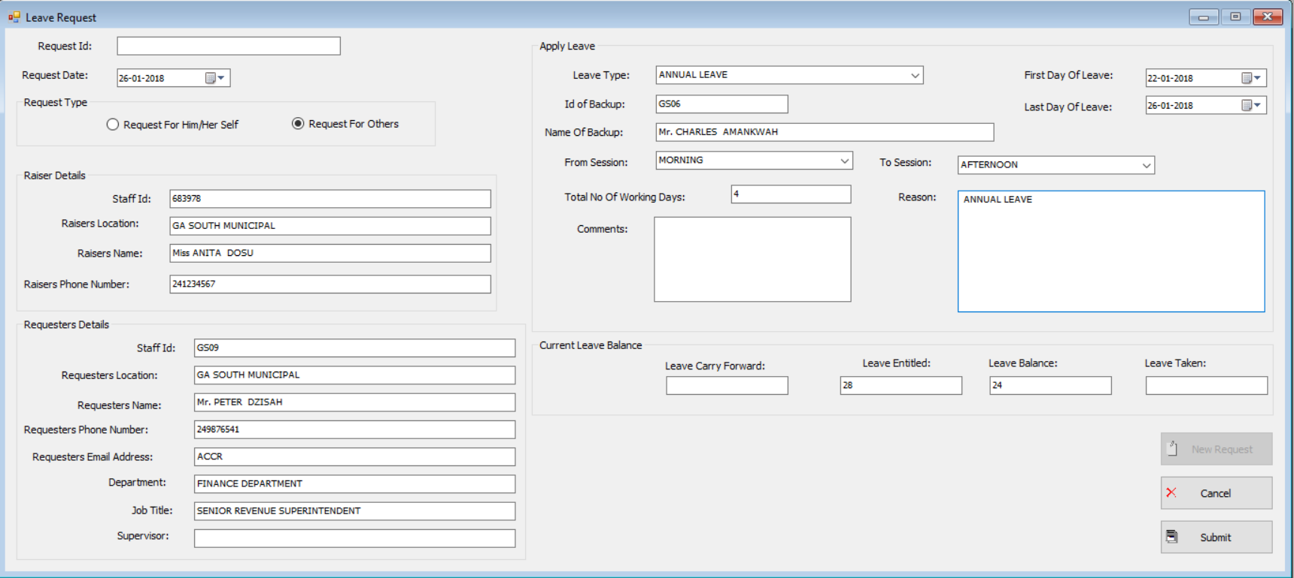
LEAVE REQUEST MODULE

Slide 14
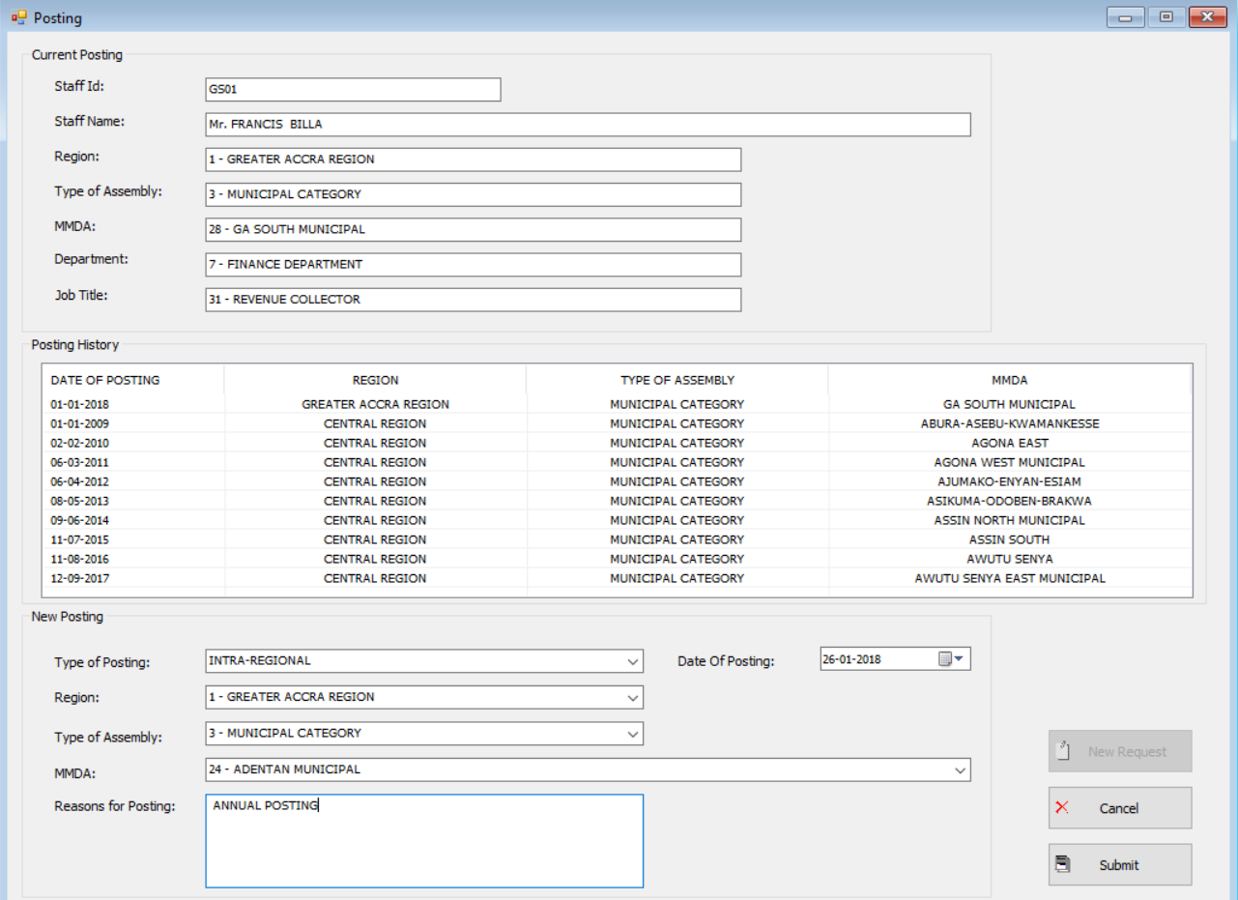
POSTING REQUEST MODULE

Slide 15
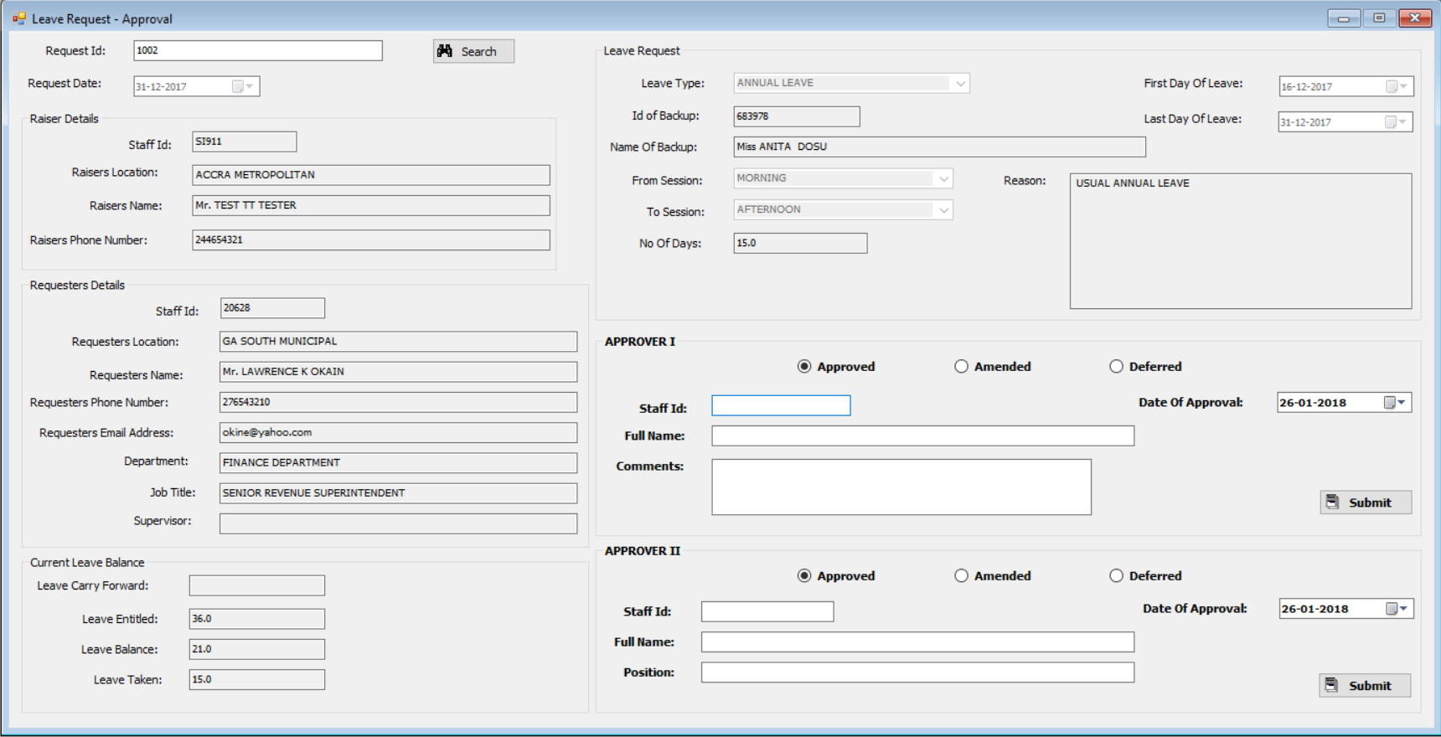
LEAVE REQUEST – APPROVAL MODULE

Slide 16
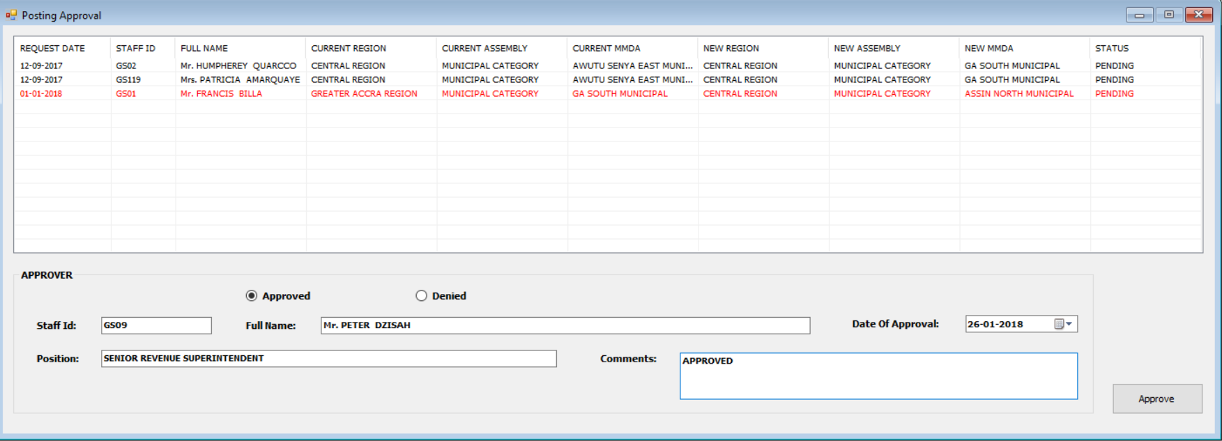
POSTING APPROVAL MODULE

Slide 17
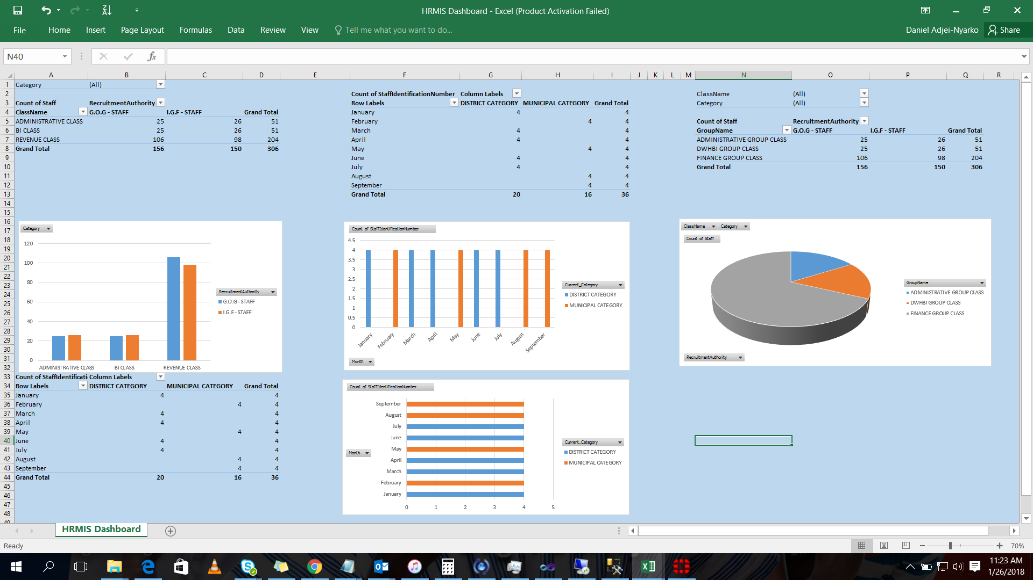
OUTPUT MODULE – DASHBOARD

Slide 18
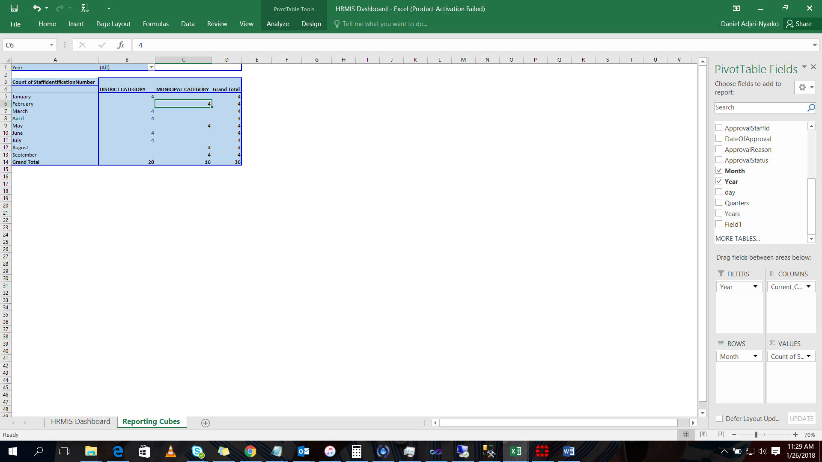
OUTPUT MODULE – OLAP CUBE

Slide 19
OUTSTANDINGS
Migration of current data into the new HRMIS application (Additional issues to be discussed – Need to clean current data before migration)
Server and network/internet availability (Discussion with NITA for hosting a Virtual Server completed)
Installation and training of staff at Head Office, RCC and Metros (Proposed and awaiting approval by OHLGS)
Integration between Capacity Building framework and HRMIS
Software has been completed
Test-Run to be commenced at three (3) levels – Head Office, RCC and Metro/Municipal
Full deployment in July – All MMDAs
OHLGS to procure fast-speed Internet connectivity at all levels (including wifi installation)
Activation of a secure website and email address for all relevant staff
Back-Stopping programme for the next 6 months after installation
  Training for HR/MIS Department at Head office
  Training all HR Heads in the use of the software
  Training all MIS staff in the use of the software
  Hands-on training at 4 centres (Northern, Middles, Eastern and Western)

Slide 20

HRMIS Next Steps
Questions and wrap-up

