Slide 1

Data Requirements for Monitoring the SDGs and Agenda 2063
BY
GHANA STATISTICAL SERVICE
OCTOBER, 2018

Slide 2
Outline
Introduction
Agenda 2063 linkages with the SDGs
Linking the data needs
Data determination process
SDG indicators classification
Outcome of review process
Data Roadmap and key priorities
Some actions to increase data production
SDGs and selected Indicators
Conclusion

Slide 3
Introduction
The post 2015 development agenda process provided a unique opportunity for Ghana and indeed Africa not only to ensure alignment of its challenges and priorities but also to influence the content of the global development agenda
The goals chart out a universal, holistic framework that help set the world on a path towards sustainable development
Data requirement for monitoring the 17 SDGs and 169 targets places great responsibility on all data producers and users

Slide 4
Introduction
At the 47th UNSC Session in New York in March 2016, an initial set of 232 SDG indicators submitted by the IAEG-SDG were adopted and will require an unprecedented amount of data to be produced and analyzed
The process leading to the adoption of the Sustainable Development Goals (SDG) in September 2015 and the indicators in March 2016, has been one that is all inclusive and reflects the aspirations contained in the AU Agenda
Agenda 2063 “The Africa We Want” represents the aspirations of Africans and is in sync with “The World We Want”

Slide 5

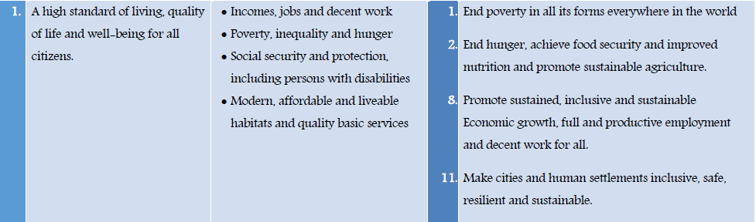

Slide 6
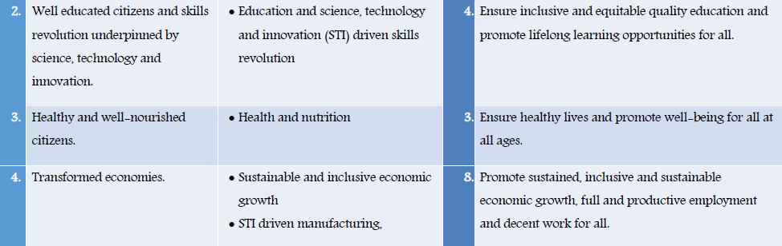

Slide 7
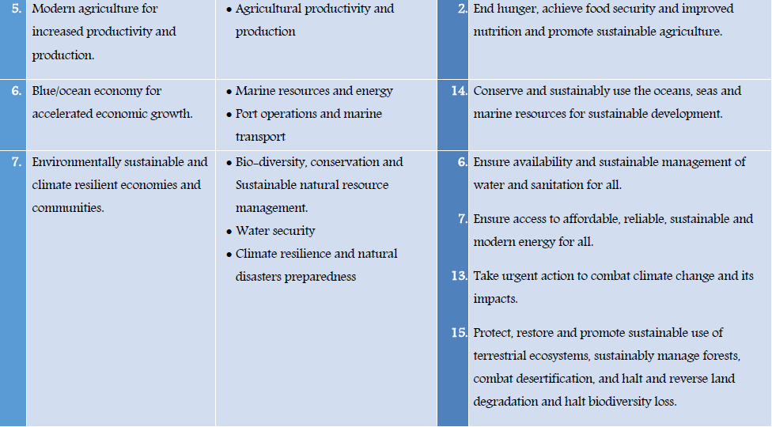

Slide 8
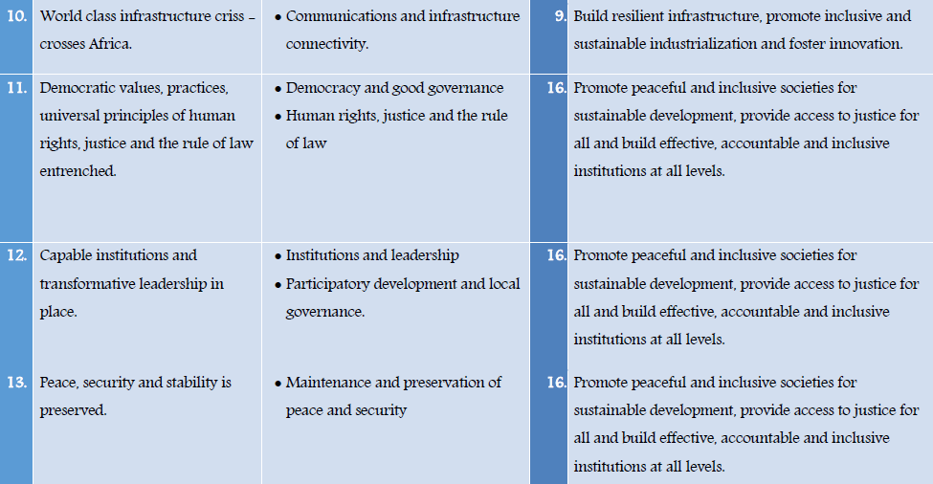

Slide 9
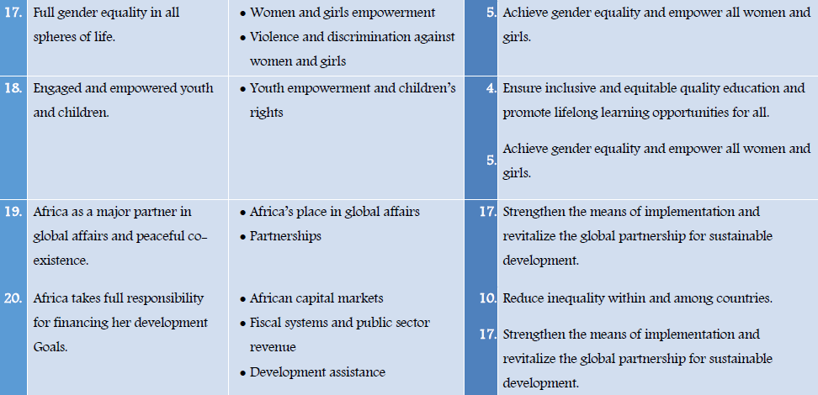

Slide 10
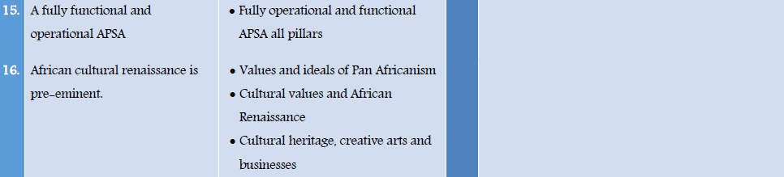
Specific to the African region
Requires localized indicators for monitoring

Slide 11
Linking the data needs
Given Ghana’s decision to incorporate the SDGs into the National Development Plan and the fact that many of the targets of Agenda 2063 are already captured by the SDGs
The indicators had to be aligned to ensure data is systematically produced for all
GSS initiated a process in April 2016 to review the global set of indicators
SDGs
Agenda 2063
National Development Framework

Slide 12
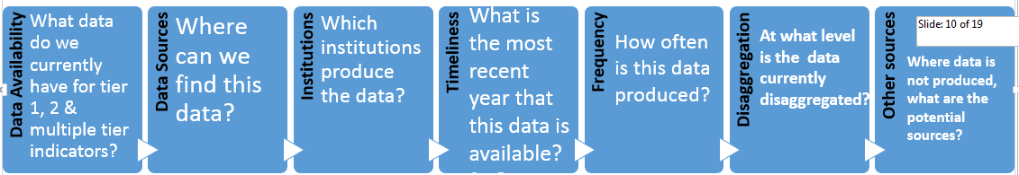
National Monitoring Capacity Assessment

Slide 13
Indicator Classification
Based on their level of methodological development and overall data availability, the indicators contained in the set of 232 global indicators are classified as:
(a) Tier I: Indicator conceptually clear, established methodology and standards available, data regularly produced by countries
(b) Tier II: Indicator conceptually clear, established methodology and standards available, but data not regularly produced by countries
(c) Tier III: Indicator for which an internationally agreed methodology has not yet been developed
Work still on-going for Tier III indicators

Slide 14
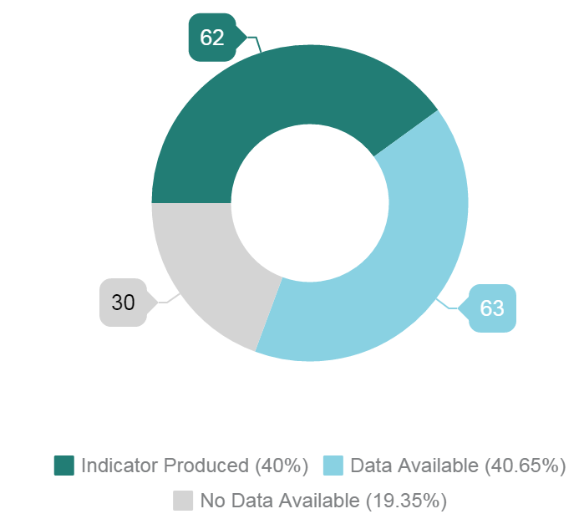
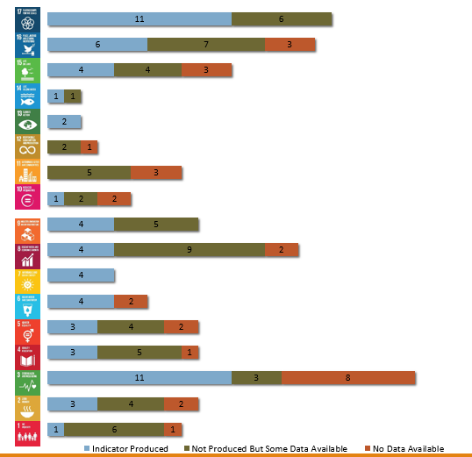
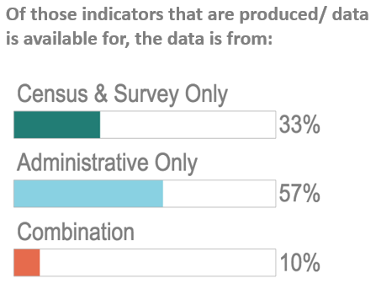
Results of assessment

Slide 15
Key challenges
Data Disaggregation
  Gender
  Location
  Socio-economic grouping
  Disability status, etc.
Timeliness of Data
Data on new thematic areas
Multi-stakeholder data production
Limited use of data for decision-making
Alignment of demand and supply of data
Notes:
The SDGs, and their underpinning resolution to Leave No One Behind, bring a number of key challenges for data production in Ghana. Chief among these, are the demands of data disaggregation along the lines of gender, location, socio-economic grouping, disability status and other categories. This type of data cannot be produced from censuses and surveys alone, the sample sizes required would be too large to be feasible, and there is a need to invest in the administrative data system in order to meet this challenge. For example, producing gender statistics requires not only disaggregating by sex, but also producing new knowledge about the lived experience of women and men, boys and girls in the country.
Producing data in a timely manner will not only aid SDG reporting but is also crucial to provide decision makers with up to date information on which to base key policy and investment decisions with the aim of achieving the SDGs.
Moreover, with the SDGs being more wide reaching than their predecessors, data is now required in new thematic areas- one of which we will focus on in tomorrow’s parallel sessions is environmental data for example though there are other areas which similarly will require attention.
Each of these will require a multi-stakeholder approach to data production which is a departure from previous methods of managing data production.
Finally, with their focus on being data driven, data production will need to be much more connected to decision-making processes to aid in policy programming, allocation of resources and tracking of progress.

Slide 16
Challenges with data in Ghana
  Low content and area coverage in sample surveys, largely due to cost
  National survey/census programme not often adhered to due to funding challenges
  Challenges with administrative data – coverage, gaps, problems with concepts and definitions, frequency of compilation, etc.
  Absence of robust M&E systems as part of all social intervention programmes
  Low statistical capacity in MDA statistics units
  Non existence of statistics department in MMDAs with mandate to undertake statistical activities

Slide 17

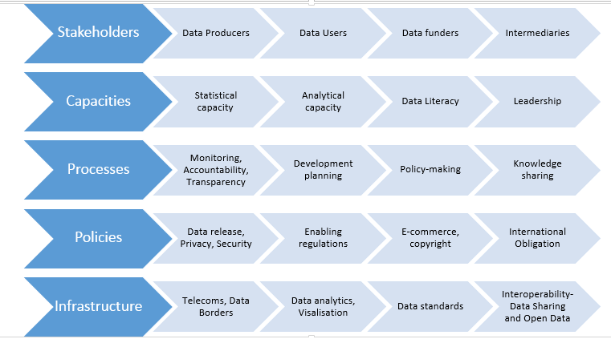





Key Priority Areas for Action from Roadmap Forum
Filling data gaps
Encouraging data use
Strengthen entire data ecosystem
Strengthening
Censuses and Surveys
Building effective
administrative data
system
Exploring new sources
and types of data
Make data more open
for reuse
Better communication
and visibility of data
Ensure data connects
to decision-making and
meets user needs
Ensure that data is
interoperable and harmonized
Notes:
To ensure we mitigate the challenges identified for meeting Ghana’s data needs, GSS joined the Global Partnership for Sustainable Development Data (GPSDD) in December 2016.
With the support of GPSDD, we organized a national data roadmap forum in April 2017, with about 150 national and international experts. Key priorities identified are presented above.

Slide 18
Strengthening the data ecosystem - NSO Partnerships
Statistics Denmark: Partnership on Administrative Data
  MoU signed
  Initial funding to start process approved by Danish Foreign Ministry
  Scoping mission engaged stakeholders on priorities
  Discussions underway for pilot with data from GIS, GHS, NIA
Office for National Statistics UK: Partnership on Data Science Capacity and other areas
  Scoping mission held October 2017 – draft report submitted
  Funding from DfID for expected to focus on areas for quick wins, 2018-2020
  Second scoping mission completed Feb. 5-9, 2018
  Partnership agreement signed March 5, 2018 in New York
  Initial activities agreed and a technical advisor starts work in Ghana in October 2018
Statistics South Africa
    Development of a Data Quality Assurance Framework to provide common standards for data from multiple sources, including MDAs, civil society and private sector for monitoring development agendas
  Funding being sought to take off

Slide 19
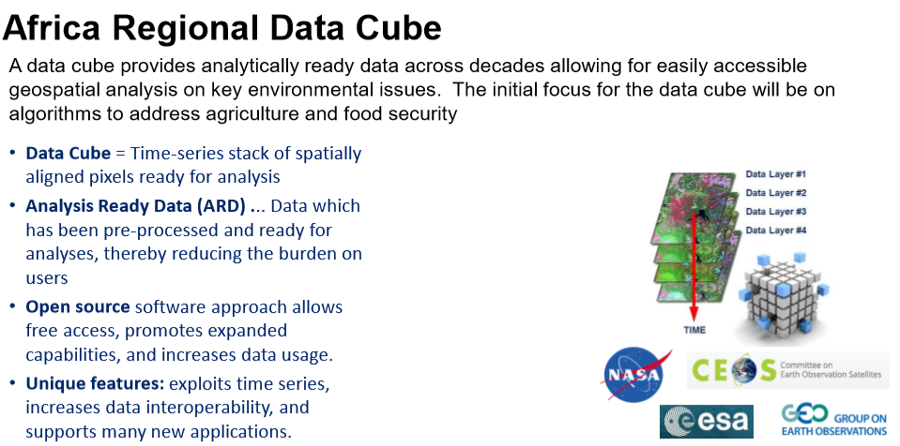
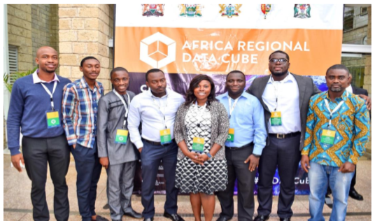

Slide 20
Projects to fill data gaps – data innovation
Call Detail Records (CDRs) to produce indicators for monitoring SDGs
Partners: GSS; Flowminder: Vodafone Ghana;
Funders: Vodafone Foundation; Hewlett Foundation (co-funding)
Focus: Health, migration, access to basic services
Progress:
  Funding secured - $ 650,000 for two years
  Project launched by Vodafone Group Feb 2018
Next Steps
  Agreement to be signed between all parties
  Set up of Steering Committee
  Scoping mission and stakeholder engagement in 2018

Slide 21
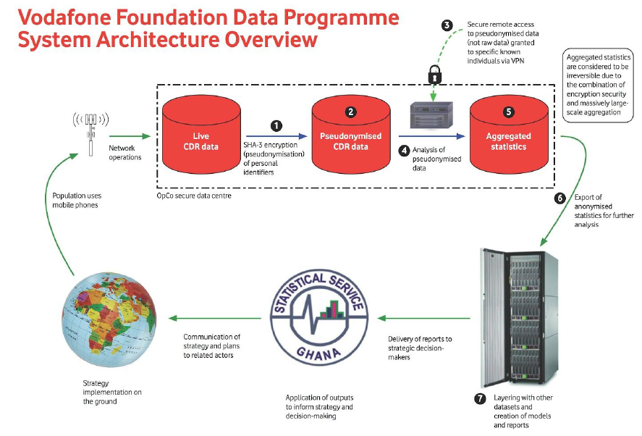

Slide 22
THE 17 GOALS
(with some selected indicators)
Goal 1. End poverty in all its forms everywhere
  1.2.1 Proportion of population living below the national poverty line, by sex and age
  1.3.1 Proportion of population covered by social protection floors/systems, by sex, distinguishing children, unemployed persons, older persons, persons with disabilities, pregnant women, newborns, work-injury victims and the poor and the vulnerable

Slide 23
THE 17 GOALS
(with some selected indicators)
Goal 2. End hunger, achieve food security and improved nutrition and promote sustainable agriculture
    2.1.1 Prevalence of undernourishment
    2.5.2 Proportion of local breeds classified as being at risk, not-at-risk or at unknown level of risk of extinction

Slide 24
THE 17 GOALS
(with some selected indicators)
Goal 3. Ensure healthy lives and promote well-being for all at all ages
  3.3.2 Tuberculosis incidence per 1,000 population
  3.3.3 Malaria incidence per 1,000 population

Slide 25
THE 17 GOALS
(with some selected indicators)
Goal 4. Ensure inclusive and equitable quality education and promote lifelong learning opportunities for all
  4.4.1 Proportion of youth and adults with information and communications technology (ICT) skills, by type of skill
  4.a.1 Proportion of schools with access to: (a) electricity; (b) the Internet for pedagogical purposes; (c) computers for pedagogical purposes; (d) adapted infrastructure and materials for students with disabilities; (e) basic drinking water; (f) single-sex basic sanitation facilities; and (g) basic handwashing facilities (as per the WASH indicator definitions)

Slide 26
THE 17 GOALS
(with some selected indicators)
Goal 5. Achieve gender equality and empower all women and girls
  5.5.1 Proportion of seats held by women in national parliaments and local governments (Suggestions from UN Women and IPU: "As indicated, this indicator includes Tier 1 and Tier III elements. Therefore, we would suggest modifying the indicator name slightly in the following way ""Proportion of seats held by women in (a) national parliaments and (b) local governments"" and classifying the sub- components as Tier I and Tier III, respectively.)
  5.5.2 Proportion of women in managerial positions

Slide 27
THE 17 GOALS
(with some selected indicators)
Goal 6. Ensure availability and sustainable management of water and sanitation for all
  6.1.1 Proportion of population using safely managed drinking water services
  6.2.1 Proportion of population using safely managed sanitation services, including a hand-washing facility with soap and water

Slide 28
THE 17 GOALS
(with some selected indicators)
Goal 7. Ensure access to affordable, reliable, sustainable and modern energy for all
  7.1.1 Proportion of population with access to electricity
  7.1.2 Proportion of population with primary reliance on clean fuels and technology

Slide 29
THE 17 GOALS
(with some selected indicators)
Goal 8. Promote sustained, inclusive and sustainable economic growth, full and productive employment and decent work for all
  8.7.1 Proportion and number of children aged 5‑17 years engaged in child labour, by sex and age
  8.10.1 Number of commercial bank branches and automated teller machines (ATMs) per 100,000 adults

Slide 30
THE 17 GOALS
(with some selected indicators)
Goal 9. Build resilient infrastructure, promote inclusive and sustainable industrialization and foster innovation
  9.1.2 Passenger and freight volumes, by mode of transport
  9.2.2 Manufacturing employment as a proportion of total employment

Slide 31
THE 17 GOALS
(with some selected indicators)
Goal 10. Reduce inequality within and among countries
  Has a lot of Tier 3 indicators or mostly at the international level
  10.3.1 Proportion of the population reporting having personally felt discriminated against or harassed within the previous 12 months on the basis of a ground of discrimination prohibited under international human rights law (Tier 3)

Slide 32
THE 17 GOALS
(with some selected indicators)
Goal 11. Make cities and human settlements inclusive, safe, resilient and sustainable
11.1.1 Proportion of urban population living in slums, informal settlements or inadequate housing
11.3.1 Ratio of land consumption rate to population growth rate

Slide 33
THE 17 GOALS
(with some selected indicators)
Goal 12. Ensure sustainable consumption and production patterns
  12.2.2 Domestic material consumption, domestic material consumption per capita, and domestic material consumption per GDP
  12.4.2 Hazardous waste generated per capita and proportion of hazardous waste treated, by type of treatment

Slide 34
THE 17 GOALS
(with some selected indicators)
Goal 13. Take urgent action to combat climate change and its impacts
  13.1.2 Number of deaths, missing persons and persons affected by disaster per 100,000 people

Slide 35
THE 17 GOALS
(with some selected indicators)
Goal 14. Conserve and sustainably use the oceans, seas and marine resources for sustainable development
    14.4.1 Proportion of fish stocks within biologically sustainable levels

Slide 36
THE 17 GOALS
(with some selected indicators)
Goal 15. Protect, restore and promote sustainable use of terrestrial ecosystems, sustainably manage forests, combat desertification, and halt and reverse land degradation and halt biodiversity loss
  15.1.1 Forest area as a proportion of total land area
  15.1.2 Proportion of important sites for terrestrial and freshwater biodiversity that are covered by protected areas, by ecosystem type

Slide 37
THE 17 GOALS
(with some selected indicators)
Goal 16. Promote peaceful and inclusive societies for sustainable development, provide access to justice for all and build effective, accountable and inclusive institutions at all levels
  16.2.2 Number of victims of human trafficking per 100,000 population, by sex, age and form of exploitation
  16.3.1 Proportion of victims of violence in the previous 12 months who reported their victimization to competent authorities or other officially recognized conflict resolution mechanisms

Slide 38
THE 17 GOALS
(with some selected indicators)
Goal 17. Strengthen the means of implementation and revitalize the Global Partnership for Sustainable Development
(FINANCE, TECHNOLOGY, CAPACITY BUILDING, TRADE, SYSTEMIC ISSUES)
  17.1.2 Proportion of domestic budget funded by domestic taxes
  17.6.2 Fixed Internet broadband subscriptions per 100 inhabitants, by speed
  17.9.1 Dollar value of financial and technical assistance (including through North-South, South-South and triangular cooperation) committed to developing countries
  17.11.1 Developing countries’ and least developed countries’ share of global exports
  17.18.3 Number of countries with a national statistical plan that is fully funded and under implementation, by source of funding

Slide 39
CONCLUSION
Given the breadth of the 2030 Agenda, there are many other indicators for which data are not yet available
In some cases, work on the statistical standards and methodologies still being developed
In other cases, data production needs to be increased or reporting mechanisms must be improved
Meeting the data needs of SDGs will invariably meet most of the data needs of Agenda 2063, COP21, Ghana’s NDP
The National Statistical System is well aware of the intense work ahead and is therefore urging all stakeholders to position themselves to meet the challenge
Strategic planning and increased resources will be required to ensure that Ghana has adequate data to follow up and review the SDGs, Agenda 2063, to ensure that no one individual, country or region is left behind
Ghana is selected for the National Voluntary Review (VNR) in July 2019 at the UN

Slide 40
We need to Identify strategies and build partnerships to harness the benefits of integrating non-traditional data producers and the private sector
Your view may present a better opportunity for data production to ensure “no one is left behind”
Please share it!!!
Thank you

