Slide 1
INTERPRETATING TABLES AND GRAPHS
BY
GHANA STATISTICAL SERVICE
OCTOBER, 2018

Slide 2
Outline of Presentation
Introduction
Five-Step Framework for Interpreting Tables and Graphs
Interpreting Tables
Interpreting Graphs (e.g. bar, charts, line)
When to use Tables or Graphs
Using Text to present Data
Explaining what the Data reveals
Tips on writing on Tables and Charts

Slide 3
Introduction
Earlier Wallman (1993) in her presidential address to the American Statistical Association described Statistical Literacy as:
‘’the ability to understand and critically evaluate statistical results that permeate our daily lives -coupled with the ability to appreciate the contributions that statistical thinking can make in public and private, professional and personal decisions’’.

Slide 4
Five-Step Framework for Interpreting Tables and Graphs
Step 1: Getting Started
Look at the title, axes, headings, legends, footnotes and source to find out the context and expected quality of the data.
Take into account information on the questions asked in surveys and polls, sample size, sampling procedures and sampling error.
Step 2: WHAT do the numbers mean?
Make sure you know what all the numbers (percentages, ‘000s, etc.) represent. Look for the largest and smallest values in one or more categories or years to get an impression of the data.
Step 3: HOW do they differ?
Look at the differences in the values of the data in a single data set, a row or column or part of a graph. This may involve changes over time, or comparison within a category, such as male and female at any time.

Slide 5
Five-Step Framework for Interpreting Tables and Graphs (cont’d)
Step 4: WHERE are the differences?
  What are the relationships in the table that connect the variables? Use information from Step 3 to help you make comparisons across two or more categories or time frames.
Step 5: WHY do they change?
  Why are there differences? Look for reasons for the relationships in the data that you have found by considering social, environmental and economic factors. Think about sudden or unexpected changes in terms of state, national and international policies.

Slide 6
Things to Note
As You Read
Take notes on the data you found in the chart, table, or graph.
This will help you keep the information organized.
After You Read
Analyze the data you gathered and determine what conclusions you can draw based on the data.

Slide 7
Interpreting Tables (1/6)
Data are presented in a variety of contexts in tabular form. Koschat (2005), identified three main advantages in using tables for providing information.
  First, a table presents data, or a summary of that data, in numerical form. (as absolute numbers or percentages)
  Secondly, people can easily use the data and convert to other forms such as a graph or a model if they wish to do so, but this is not easy in reverse.
  Thirdly, it can quite often be the case that the reader wants to see and interpret the actual numbers

Slide 8
Interpreting Tables (2/6)
When you read a table, be sure to:
  Read the title, the column headings, and the row headings.
  Read down the far left column first to determine how the table is organized.
  Determine the meaning of abbreviations or symbols used.
  Determine the timeframe of the table.

Slide 9
Interpreting Tables (3/6)
To find specific information you are looking for, read down the left column until you come to a description of your data; then read across to the column that contains the specific information you need.
Analyze the patterns you see in the table and the differences from one column to the next.
Check how the data is arranged in the table – is it ROW totals or COLUMN totals

Slide 10
Example: Birthplace by duration of residence of migrants (Eastern Region)
Birthplace | Number | Duration of residence(%)
 |  | Less than 1 year | 1-4 years | 5-9 years | 10-19 years | 20+ years
Total | 45,482 | 13.5 | 30.5 | 17.2 | 18.6 | 20.2
Born elsewhere in the region | 26,532 | 12.7 | 29.7 | 17.5 | 19.3 | 20.8
Born elsewhere in another region:
Western | 1,527 | 15.8 | 32.9 | 19.4 | 19.3 | 12.6
Central | 1,895 | 13.8 | 35.2 | 16.1 | 17.0 | 17.8
Greater Accra | 4,601 | 18.1 | 35.8 | 16.3 | 16.8 | 13.0
Volta | 4,639 | 11.7 | 25.6 | 15.8 | 17.9 | 29.0
Eastern | - | - | - | - | - | -
Ashanti | 3,043 | 15.1 | 33.3 | 17.5 | 17.1 | 17.1
Brong Ahafo | 830 | 15.2 | 30.2 | 18.8 | 18.4 | 17.3
Northern | 735 | 11.8 | 30.6 | 18.1 | 17.0 | 22.4
Upper East | 612 | 18.6 | 25.5 | 16.8 | 17.5 | 21.6
Upper West | 164 | 16.5 | 22.0 | 14.0 | 25.6 | 22.0
Outside Ghana | 904 | 12.3 | 34.8 | 14.0 | 16.9 | 21.9

Slide 11
Interpreting Tables (5/6): Row Totals
Example: Marital Status by Region – 12years and older
Region | Marital Status |  |  |  |  |  | Number
 | Married | Consensual union | Separated | Divorced | Widowed | Never married
Ghana | 39.4 | 7.1 | 2.1 | 3.4 | 5.6 | 42.3 | 18,056,829
Western | 38.6 | 8.1 | 3.0 | 3.1 | 4.3 | 42.8 | 1,620,170
Central | 38.9 | 7.2 | 2.2 | 5.0 | 5.7 | 41.0 | 1,602,554
Greater Accra | 36.2 | 7.1 | 2.9 | 3.5 | 4.7 | 45.7 | 3,152,917
Volta | 41.5 | 6.0 | 2.8 | 2.3 | 6.8 | 40.6 | 1,517,618
Eastern | 35.1 | 11.1 | 1.3 | 5.4 | 6.7 | 40.3 | 1,921,803
Ashanti | 36.4 | 8.3 | 2.6 | 4.0 | 5.9 | 42.8 | 3,594,938
Brong Ahafo | 36.2 | 7.8 | 1.5 | 3.8 | 5.1 | 45.6 | 1,760,579
Northern | 53.5 | 3.7 | 0.6 | 1.0 | 4.8 | 36.3 | 1,638,466
Upper East | 49.4 | 1.7 | 1.1 | 1.0 | 7.5 | 39.2 | 732,598
Upper West | 45.7 | 0.9 | 0.8 | 0.7 | 7.3 | 44.7 | 515,186

Slide 12
Interpreting Tables (6/6)- Column totals
Table 3: Distribution of households by presence of parent
Presence of parent | Locality |  |  |  |  | Total
 | Accra (GAMA) | Other urban | Rural Coastal | Rural Forest | Rural Savannah
No parent | 39.5 | 35.2 | 36.7 | 31.0 | 17.8 | 32.7
Only father | 3.2 | 2.6 | 2.1 | 3.0 | 2.1 | 2.7
Only mother | 18.1 | 22.9 | 22.6 | 17.7 | 12.7 | 19.4
Both parents | 39.2 | 39.3 | 38.6 | 48.2 | 67.4 | 45.2
Total | 100.0 | 100.0 | 100.0 | 100.0 | 100.0 | 100.0

Slide 13
Interpreting Graphs/Charts (1/4)
Graphs are often seen in all forms of media, printed and electronic.
We need to know the appropriate use of graphs for specific purposes such as showing trends or proportions, for discrete and continuous data and to have some knowledge of what the shape of a graph can convey

Slide 14
Interpreting Graphs/Charts (2/4)
information within large data Charts are:
    easy to understand than tables,
    often more effective for highlighting important sets for readers who are less apt with numbers.

Slide 15
Interpreting Graphs/Charts (3/4)
Charts are especially useful for:
  showing patterns and comparing trends,
  are more visual and attractive than tables, they can help in presentations.

Slide 16
Interpreting Graphs/Charts (4/4)
On the other hand, charts are not suitable for communicating more detailed and precise data, and can be time-consuming and expensive to design or construct.

Slide 17
Bar Graph (1/5)
Bar graphs show relationships between groups or categories of information.
  The data is represented by color or shade-coded bars.
  These graphs show data for only one point in time.

Slide 18
Bar Graph (2/5)
A bar chart displays data as rectangular bars with lengths proportional to the values that they represent.
Bar charts are useful for comparing two or more values, such as the employment by industry in example on the next slide

Slide 19
Employment by industry

Slide 20
Bar Graph (4/5)
The bars can be vertically or horizontally oriented
Horizontal bar charts are often used when there are many bars and each bar requires a long label, which would overlap or be truncated in vertical bar charts

Slide 21
Bar graph (5/5)
When you read a bar graph, be sure to:
  Read the labels on each axis of the graph.
  Read the markings on each axis to determine the numeric values represented.
  Determine the value or amount that each bar represents.
  Analyze the relationships among all the lines by determining how they compare/contrast to one another.

Slide 22
Pie Chart (1/8)
A Pie chart is a circle divided into sections, which are often shown in different colors.
The sections show percentages, relative sizes, or proportions of specific data as it relate to the whole pie, or 100 percent

Slide 23
Pie Chart (2/8)
When you read a pie chart, be sure to:
  Read the labels for each section of the pie.
  Analyze the relationships between the parts and the whole.
  Notice the different colors and what they represent.

Slide 24
Pie Chart (3/8)
When you read a pie chart, be sure to:
  Think about the significance of the size of each section of the circle.
  How do the sections relate to each other?
  How do they correspond to the written data?
24

Slide 25
Pie Chart (4/8)
Pie charts are useful for illustrating percentage distributions of components within a total and are therefore suitable for presenting overviews of data.
  e.g. the breakdown of the annual education budget by types of expenditure is a good example of information that can be presented clearly using a pie chart
The area of each slice of the pie is proportional to the relative share, or frequency, of each item that makes up the total.

Slide 26
Pie Chart (5/8)
The pie chart however is not suitable for displaying data with a high degree of accuracy.
This is especially true when an item represents a very small share of the total, in which case its slice may be very thin and difficult to measure.

Slide 27
Pie Chart (6/8)
It can also be difficult to see the difference between two items with similar but slightly different shares of the total.
Do not include too many data items on the same pie chart.
Too many slices, especially thin slices or slices of a similar size, may make a pie chart difficult to interpret.
A maximum of 5 or 6 slices is optimal.

Slide 28
Pie Chart (7/8):
A good pie chart

Slide 29
Pie Chart (8/8):
A bad pie chart

Slide 30
Line Graph (1/5)
A line graph shows continuing data or changes in data over time.
Line graphs are used to show rates of change or market trends.
They can also compare data for more than one product or contrast performance or growth.

Slide 31
Line Graph (2/5)
When you read a line graph, be sure to:
  Read the labels for the horizontal (X) axis. The X-axis shows you the time periods.
  Read the labels for the vertical (Y) axis. The Y-axis shows you what is being measured.
  To read a line graph, start at the bottom left. Read up and then across to the right.
  Analyze the relationships among the data

Slide 32
Line Graph (3/5)
A line graph is a simple way to show time-series or trends.
A single graph can display multiple lines, with one line for each data series or sub-population, such as the number of students by sex, or gross and net enrolment ratios for boys and girls over time (see example 8 below).

Slide 33
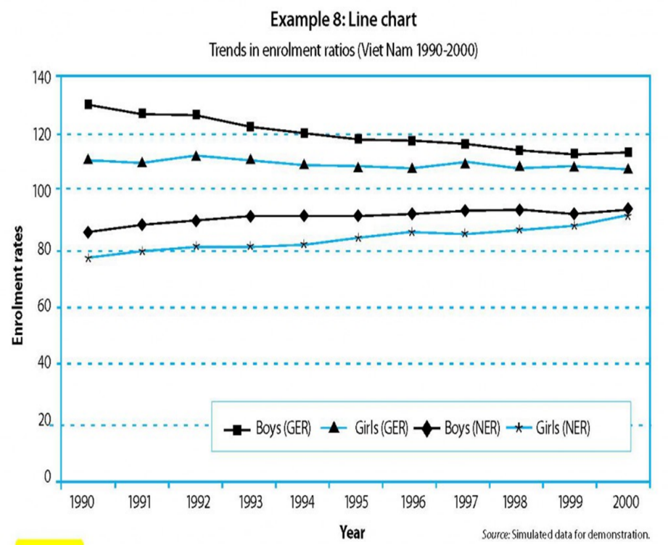
Line Graph (4/5)

Slide 34
Line Graph (5/5)
Horizontal grid- lines make it easier for the eye to follow the plotted lines, to identify the data values along the data series, and to get a clearer picture of the trend and changes in the values for different data series.
It is generally not advisable to label every data point in a line chart, unless it is important to show precise values that are quoted in the accompanying text.

Slide 35
When to use a table or a chart (1/8)
Tables:
  Have columns and rows of information.
  Tables interact primarily with our verbal system.
  Information in tables are processed in a sequential fashion, reading down columns or across rows of numbers, comparing this number to that number, one pair at a time.

Slide 36
When to use a table or a chart (2/8)
Tips for choosing tables
  Tables work best when the data presentation:
    contains many data series for cross-analysis
    is used to look up or compare individual values
    requires precise values
    contains values that involve multiple units of measurement

Slide 37
When to use a table or a chart (3/8)
Charts:
Charts are perceived by our visual system.
They give shape and form to numbers. To see patterns and relationships is a natural function of visual perception.
A single chart can convey important features of the data more vividly and memorably than columns of data.

Slide 38
When to use a table or a chart (4/8)
TIPS for choosing chart
Graphs work best when the data presentation:
  is used to identify patterns and trends
  is used to communicate a message that can be highlighted in the shape of the graph
  is used to visually reveal relationships among several values

Slide 39
When to use a table or a chart (5/8)
Sometimes, we need to present information about changes over time.
To present time-series data, we use summary tables and charts that effectively show changes in values from one time period to the next in chronological order.

Slide 40
When to use a table or a chart (6/8)
As long as the definition of the data and the collection methods were consistent over time, we can use tables and charts to study past trends and estimate future values.
Example 17 shows two time-series lines in the same graph – one for students and one for teachers. The two time-series have been combined, with different scales on the left and the right side of the graph.

Slide 41
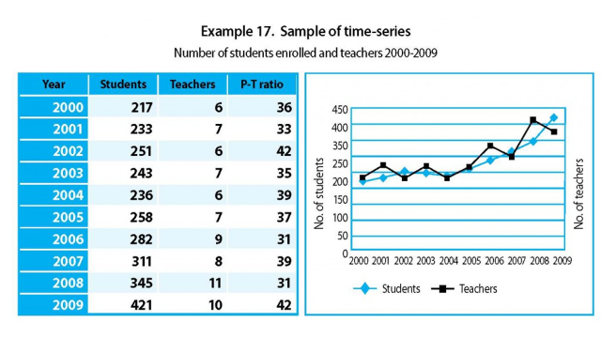
When to use a table or a chart (7/8)

Slide 42
When to use a table or a chart (8/8)
It is interesting to see that the two trends generally overlap but the lines crisscross over each other.
This can be interpreted as overall correspondence in the availability of teachers in relation to the number of students over the years, although there have been noticeable fluctuations, or instability.

Slide 43
Using text to present data (1/6)
Tables and charts are often accompanied by descriptive text that highlights the
  findings,
  patterns,
  issues and
  implications of the data.
Textual descriptions and discussions play a crucial role in almost every kind of data presentation, especially for people who are not familiar with data, tables and charts.

Slide 44
Using text to present data (2/6)
Many people even prefer plain textual descriptions to tables and charts, or at least need some clear and simple explanations to help them understand the data and important points presented in the tables and charts.

Slide 45
Using text to present data: basic rules (3/6)
One of the important functions of text is to provide a verbal description of the data in tables and charts.
5 basic rules when drafting a text to describe a table or chart:
  Try to capture the readers’ interest by highlighting key findings and meanings.
  Take time to write clearly and succinctly – draft and re-draft to clearly and unambiguously describe the data.

Slide 46
Using text to present data: basic rules (4/6)
  Ensure consistency of language and style throughout the report or presentation –
    Often sections of a single piece are written separately for each table or chart, so a final check to ensure consistency is advisable.

Slide 47
Using text to present data: basic rules (5/6)
  Avoid unnecessary repetition – if parts of the report or presentation are written separately, contents get repeated. Review the written text to eliminate unnecessary repetitions and to harmonize the texts.

Slide 48
Using text to present data: basic rules (6/6)
  Focus on the main points and minimize unnecessary details – Present the most important information first, and add details only if absolutely necessary.

Slide 49
Explaining what the data reveal (1/3)
A verbal summary should simply accompany the table or chart to explain what the data reveal.
Keep the summary short – never allow the verbal summary to expand into an itemized account of each entry in the table or chart.
Position the summary in the text close to the table or chart to which it refers. Quoting directly the key reference numbers is the best way. For example: “From Table 2, 46 percent of girls (6-15) were out of school in 2001.”

Slide 50
Explaining what the data reveal (2/3)
Use ‘emotional’ descriptions and wording sparingly:
  Sensational messages can be effective with a non-technical audience, but they can communicate biases or lead to biased interpretations.
  For example: “Education expenditure per student in Adaklu rose by 10 per cent” may be better than: “Education expenditure per student in Adaklu shot up by 10 per cent!”.

Slide 51
Explaining what the data reveal (3/3)
Be cautious when attributing causality to a factor
  E.g. some erratic movements in a data series may be due to changes in definitions or measurement unit, rather than actual changes in the underlying event.
Do not jump to conclusions that ‘this caused that’, unless there is ample evidences to justify it.

Slide 52
Tips on writing on tables and charts(1/5)
Avoid long sentences. Short, sharp sentences are more effective.
Paragraph breaks provide the reader with a short rest, and are necessary to maintain the reader’s interest.
On the other hand, having too many short paragraphs may ruin the flow of the text and make it confusing and uninteresting.

Slide 53
Tips on writing on tables and charts (2/5)
Commas provide pauses within a sentence, but, if over-used, may be bothersome and misleading.
Minimize the use of brackets.
  When several pairs of brackets are used in the same sentence or section, the reader may become confused and lose track of the central theme.

Slide 54
Tips on writing on tables and charts (3/5)
Avoid repeating the same wording in close proximity. It looks careless and may be distracting. To avoid this problem, try to search for and use synonyms.
Avoid unnecessary words and phrases. These give the reader extra work and may distract them from the central theme or main findings.

Slide 55
Tips on writing on tables and charts (4/5)
Keep the language simple. Readers are usually more impressed by clear language than by words that they do not fully understand.
Be logical. Ensure that the structure is sequential and that the conclusions reflect the body of the text. This reduces the chances of the readers becoming confused.
Ensure that the use of articles is clear. Whenever words such as ‘it’ or ‘that’ are used, be sure that the reader has no doubt about what these pronouns refer to.

Slide 56
Tips on writing on tables and charts (5/5)
Adopt conventions and keep to them throughout.
  Conventions can include headings, numbering, use of abbreviations and acronyms, or other matters of style such as the use of digits and written numbers.
  If necessary, these should be spelt out by the writer or writing team. If conventions are maintained throughout, the report will be clearer and better received.

Slide 57
THANK YOU

