Slide 1


ORIENTATION PROGRAMME FOR NEW STAFF OF LOCAL GOVERNMENT SERVICE
TOPIC: DECENTRALIZATION AND LOCAL GOVERNANCE IN GHANA
BY
INSTITUTE OF LOCAL GOV’T STUDIES
OCTOBER, 2018

Slide 2

QUIZ
1. How many MMDAs are in Ghana?
Notes:
Note to Facilitator: Give 5mins for participants to answer the questions. Give no answers. Same questions repeated at the end of the presentation. Participants to answer again. Let each compare his/her pre-and post presentation answers. Anything learnt?

Slide 3
Example
Society must put in place a system (structure, process, rules, etc.) to meet these needs:
  A group of people (with authority) to mobilise and manage resources (Government)
  Determine how the needs should be met (policy)
  Put administrative system in place
  Deliver on the needs of the people
  Account for the use of the resources vis a vis targets
  Keep improving because of competitive needs, dynamic external and internal environmental factors
  (E.g. 1992 Constitution of Ghana sets up public service)

Slide 4
What is Decentralization?
Transfer of power, functions, resources and competence from central government to sub-national levels
Especially to local authorities

Slide 5
Important
Decentralisation is an administrative approach to better meet the needs of the people instead of relying on only the centralized approach

Slide 6
Legal Framework
1992 Constitution of Ghana
Article 240(1) states that: “Ghana shall have a system of local government and administration which shall, as far as practicable, be decentralized.”
  Parliament to ensure the transfer of functions, powers, responsibilities and resources from central government to local government units.
  to provide for the capacitation of local government authorities to plan, initiate, coordinate, manage and execute policies for its area of jurisdiction.
  Establishment of sound financial base for each local government unit.

Slide 7
THE NEW LOCAL GOVERNMENT SYSTEM ARRANGEMENTS
Regional Coordinating Council (10)
Metropolitan Assembly (6)
(min pop of 250,000)
Municipal Assembly (101)
(min pop of 95,000)
District Assembly (147)
(min of 75,000)
Sub-Metropolitan District
Councils
Town/Area Councils
(pop. above 50,000)
Zonal Councils
(pop above 3,000)
Urban/Town/Area
Councils
(pop 5,000-15,000)
Unit Committees
Rural Areas: pop 500-1,000
Urban Areas: pop of 1,500
and above
Notes:
The power to create a region is vested in the President by the Constitution of Ghana (Article 5 (1))
Act 462 gives the President power to create a district. The key consideration for the creation of a district includes the following:
Population
Geographical contiguity
Economic viability which refers to the ability of an area to provide the basic infrastructural and other developmental needs from the monetary and other resources generated in the area.

Slide 8
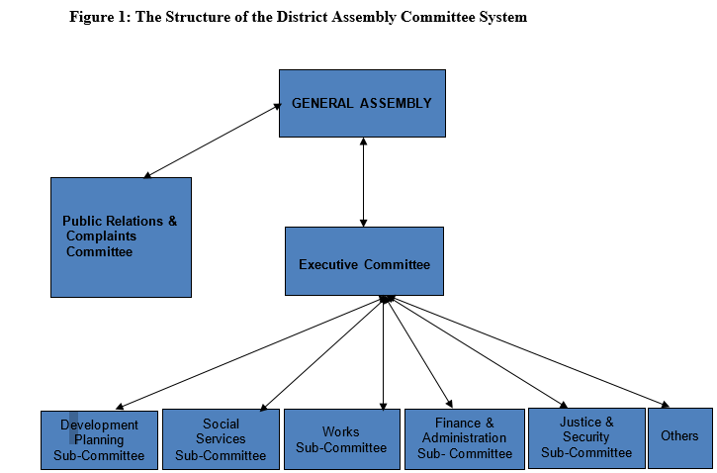
The District Assembly

Slide 9
Two Arms of the Assembly
The Political Side – General Assembly
The Implementation Arm - Bureaucracy

Slide 10
Functions of a District Assembly
The Assembly exercises deliberative, legislative and executive functions including:
  exercising political and administrative authority in the district;
  promoting local economic development; and
  providing guidance, giving direction to and supervising other administrative authorities in the district as may be prescribed by law.

Slide 11
Further, the Assembly is charged with the
  responsibility for the overall development of the district;
  formulation and execution of plans, programs and strategies for the effective mobilization of the resources necessary for the overall development of the district;

Slide 12
LEADERSHIP AND MANAGEMENT OF LOCAL GOVERNMENTS

Slide 13
MMDAs Ultimate Result
  All the elements of the organisation (MMDA) are to be deployed in order to improve on the quality of life and dignity of the local people.

Slide 14
Recruits: What is Your Job/Role?
Operational
Responsiveness/ No delay
Time Consciousness
Guidance required (Don’t be full of yourself)
Quality Work

Slide 15
Leadership
In MMDAs, leadership can be conferred:
by position
by deeds
It is not necessarily wrong to say that the leader of an Assembly is the Chief Executive. That is leadership by position because certain leadership qualities are germaine to the position. E.g.

Slide 16
Visionary
Results -oriented
Drive and Initiative
Honesty
Reliability
Team player, etc.

Slide 17
Leadership Beyond Position
Everybody has some leadership qualities in him or her which must be used to the benefit of the Assembly

Slide 18
Leadership Styles
As new staff, you will experience super-ordinates with the following leadership styles:
Autocratic Style
  Acts in unilateral command and control fashion
Human Relation Style
  Emphasizes people over tasks
Democratic Style
  Encourages participation with an emphasis on both task accomplishments and development of people
Laissez-faire Style
  Is low on both tasks and people

Slide 19
GROOMING / ETIQUETTE
PROFESSIONAL IMAGE

Slide 20

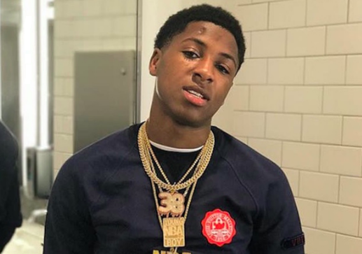
Who is a Doctor?

Slide 21
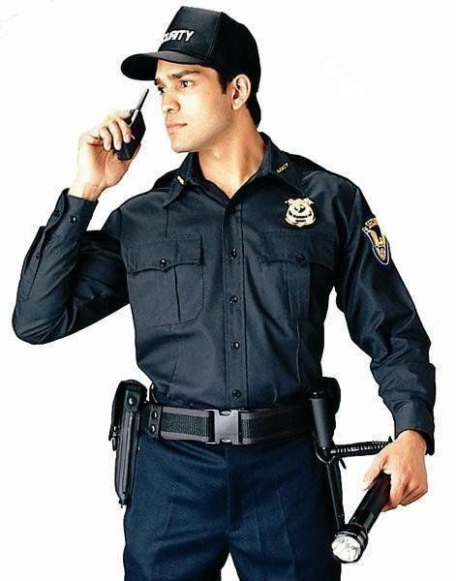
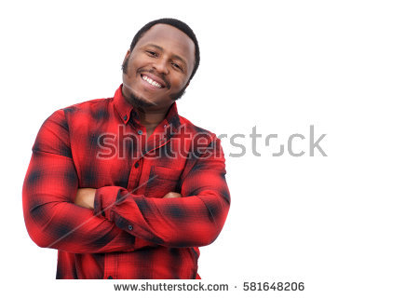
Who will you Hire as a Security?

Slide 22
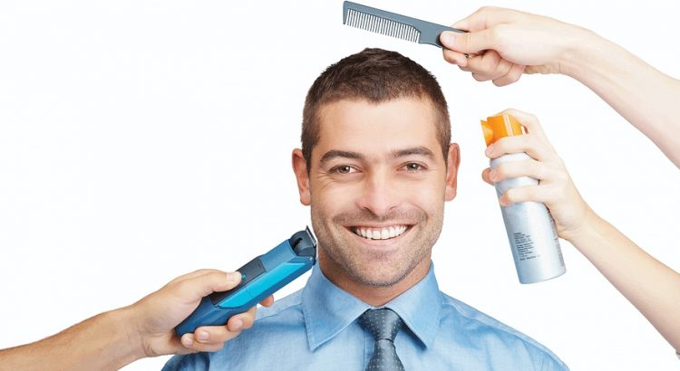
What is Grooming
Grooming is the process of making yourself look neat, attractive and presentable.
Cultivating an attractive and presentable presence.
In simple words the things which you do to make yourself and your appearance tidy and pleasant.
It projects:
– skilled behavior
– Builds reputation.
– Makes up stand out

Slide 23
Deal Breaker
The most important fact is that your appearance influences the opinions of everyone around you.
Your Professionalism, intelligence and the trust people form in you depends on your appearance.

Slide 24

What is Etiquette
Etiquette simply means how to behave in various situations.
Etiquette relates to a code of behavior among people within an organization, group or society. (Hello, Welcome, Please, Thank you.)
Finally it is about building the confidence to be comfortable with yourself so that others may be comfortable with you as well.
It projects:
Knowing/respecting people’s customs and traditions
observing certain behavior and actions when in a group of people
observing appropriate manners

Slide 25


Slide 26
Deal Breaker
Always remember:
Your behavior and manners should consistently correspond with your well groomed image

Slide 27


