Slide 1
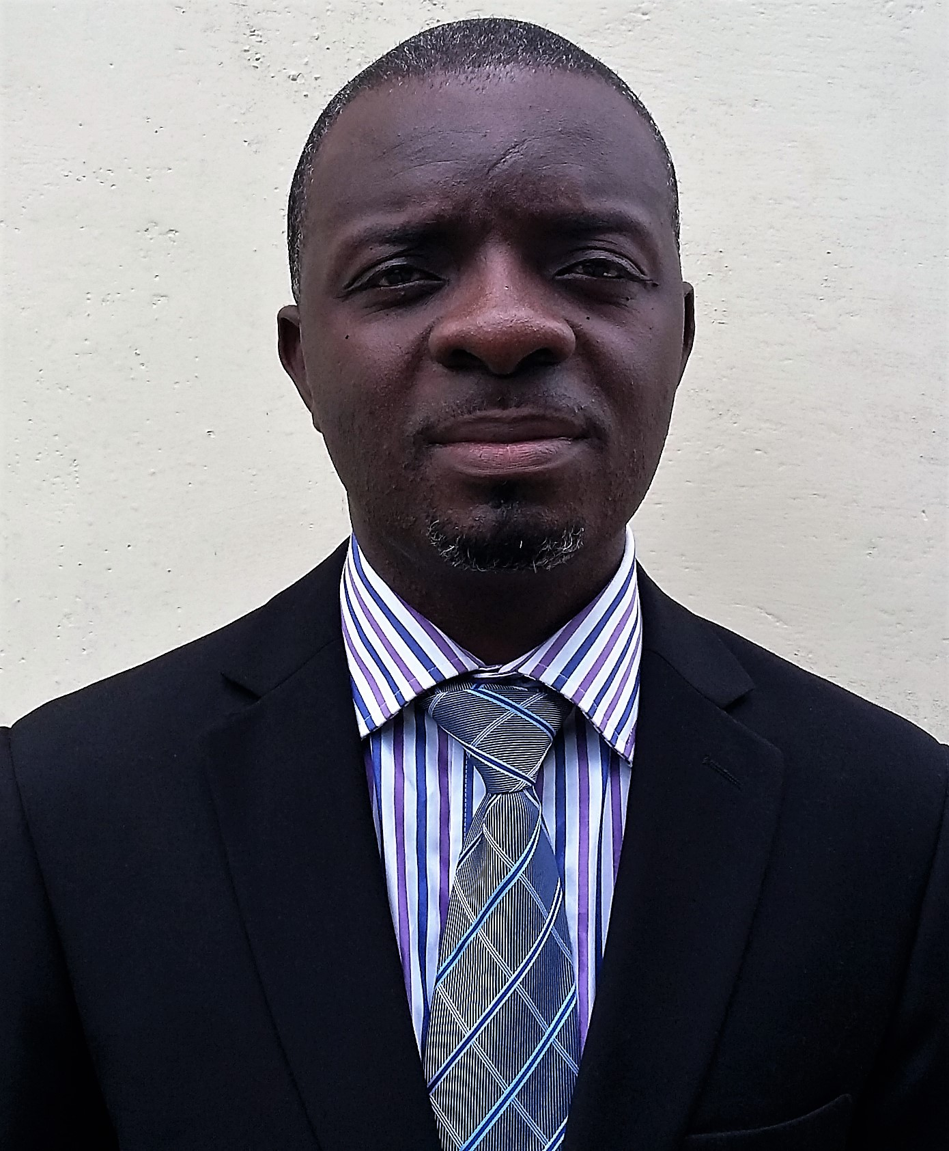
TOPIC:
Introduction to Professional Engineering & Ethics
About the Presenter
Ing. Joseph Kwesi ODDEI
Chair, Civil Technical Division, GhIE
(F.GhIE, P.Eng, M.IER, Am.SAICE. Aff. ASCE)

Slide 2
Content
Professionalism
Engineering & Professionalism in Ghana
This presentation session will focus on
Engineering ethics
Introduction to Engineering projects
Roles of Eng. Technician in public works

Slide 3
Activity
What do you expect in the service?
Job description?
What do you know about the local gov’t from engineering point of view?
1
2
3
Participants are expected to share their views.

Slide 4
Professionalism
Profession
A profession is a number of individuals in the same occupation voluntarily organized to earn a living by openly serving a moral ideal in a morally permissible way beyond what law, market, morality, and public opinion would otherwise require.
Socratic defn?
“Philosopher Michael Davis”
Notes:
Services include provision of water, hospitals, roads etc.

Slide 5
Professionalism
Features
A profession cannot be composed of only one person. It is always composed of individuals
A profession is something that people enter into voluntarily and that they can leave voluntarily
Advocates for public interest
Professionals must pursue a morally praiseworthy goal by morally permissible means
A profession involves a public element. One must openly ‘‘profess’’ to be an engineer
Profession
Notes:
Services include provision of water, hospitals, roads etc.

Slide 6
Professionalism
Characteristics
Extensive training
Control of services
Autonomy in workplace
Claim to ethical regulations
Vital knowledge & skills
Profession
Notes:
Control of services – monopoly over area of competency to the community; how do we do it? claim to be a professional engineering pract. requires appreciable guided training via accredited school, inst; persuade the community that there is a license system for those who want to enter the system – no license it is illegal to practice ; .

Slide 7
Professionalism
Engineering profession
Satisfies social needs
Requires trust, discretion, judgment
Applies skills & knowledge not possess by public
Promotes professional ideas
Employs code of ethics
Has standard of admission
Engineering as a profession.

Slide 8
Engineering & Professionalism in Ghana
The practice of engineering is strictly under Act 819, known as the Engineering Council Act, 2011
Establish a Council
objective
Which law regulates engineering?.
To secure the highest professional standards
Instrument
Engineering Regulations
Notes:
Services include provision of water, hospitals, roads etc.

Slide 9
Engineering & Professionalism in Ghana
Council
Individuals
Firms/Dept/Eng products
Educational Units
Licensed Bodies
Temporary Practitioners
Engineering Regulations
Focus: Individuals
Notes:
Licensed bodies – discuss the route to membership for GhIE; check regulations for schedule

Slide 10
Relationship between Engineering Practitioners
Prof. Engineer
Prof. Eng. Technologist
Technician Eng.
Craftsman
Conceptualization of projects
Research and Development requiring the application of mathematics and science
Analysis and Design (involving calculations, science, data analysis, etc.) and development of systems, products
Review and critique of engineering designs and works
Review and development of systems
Life-cycle management
Application of specific engineering technology, processes or techniques
Review the practice or methods in the application of specific engineering technology
Perform specific specialized tasks
Conduct and interpret the results of a study
Implementation of various specific areas of engineering technology
Specific skilled task requiring literacy or numeracy skills
Routine activities
Practical work with creative skills
Measure, record values, monitor processes
Performing specific set of skilled operations routinely.
Performing basic arithmetic tasks involving measuring and calculating volumes, areas etc.
Diagnosis (troubleshooting) maintenance and repairs activities.
Measuring, recording values, monitoring processes etc.
Operate complex tools or equipment to form objects, produce an item or test an item

Slide 11
Engineering Practice
Use of the title Prof Eng. Pract. or eng.
The use of stamp or seal
Signing report/drawings designs etc.
Peer review of eng. work of public concern
Approval of eng. works
Attestation issuance; CPD
Code of ethics
Use of standards/codes
Engineering & Professionalism in Ghana
Individual Professional Practice.
Code the ethics
Notes:
Services include provision of water, hospitals, roads etc.

Slide 12
Engineering Ethics (Regulations in Ghana)
Adherence to health, safety
Adherence to welfare of public
Protection of the environ.
Undertake assign. in the area of competency/practice
Faithful agent to client and employers
Conduct of integrity, fairness, equity, etc.
Present to client/employers about eng. consequences
Report to relevant body about any misconduct
Some code of ethics expected

Slide 13
Engineering Ethics
Stop & think
Clarify goals
Determine the fact
Develop options
It prevents rush decision
A more thoughtful judgment
What are your aims?
Determine your wants and “diswant”
Have adequate info
Know the people giving info
List actions from fact
Talk to someone for new choices
Ethical decision making
Monitor and Modify
Choose
Consider consequences
Filter your choices
Eliminate unethical options
Identify who will be affected by the decision
Make a decision
Remember to treat others the way you want to be treated
Monitor effects of your decision
Reassess if undesirable

Slide 14
Engineering Ethics
Is it honest
Is it fair and balance
Does it fit the mission of my organ./profession?
Does it fit my professional moral conscience
Can I justify it publicly
How to pass the ethics test
In all these, think about….
Career
Family
Reputation
Time and Money

Slide 15
Introduction to Engineering projects
Mention some engineering projects often undertaken by local authority?.
Public works are infrastructure projects financed and constructed by gov’t…… using public funds
What are your roles in the implementation of public works?.

Slide 16
Some Essential duties & Responsibilities of Eng. technicians
Identify and troubleshoot process, material, or equipment problems to minimize down time and recommend engineering solutions
Develop, assemble, procure or modify existing and new tooling, fixtures, and equipment to ensure efficient production methods.
Assist the Engineers and Technologist with revisions and improvements to engineering methods and procedures, including writing change orders and deviations
Assist with hands on training of craftsmen on new products, tooling, equipment and process revisions
Schedule, complete, and document routine maintenance on applicable manufacturing and test equipment.
Read schematics, assembly drawings, data sheets, and process sheets to perform testing, build fixtures, checkout and trouble-shoot equipment
Perform tests, gather data, and write results/reports with assistance from Engineers and technologists, utilizing various types engineering standards etc.
Computer literacy
Comply with policies, guidelines and regulatory requirements for engineering activities
Introduction to Engineering projects

Slide 17
Role of Engineering Technicians in Public works
Planning
Developing of scope
Design based on specification/performance
Construction/building – Supervision
Monitoring
Maintenance
Procurement
Health & Safety
Environmental sustainability

Slide 18



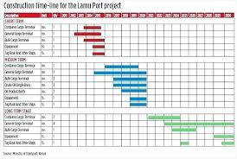
Planning
Liaison Officer (primary point of contact)
Schedule preparation
(identify and list project activities, assign duration)
How is it going to be done?
Resource allocation
(human, financial, plant, materials, etc. to influence project budget)

Slide 19
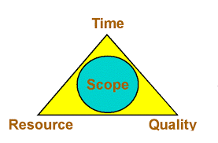
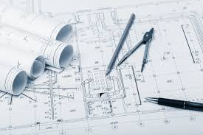
Develop Scope
Determine, document specific project goals, deliverables (other features include functions, deadlines) – the aim is to produced a content that leads to what must be done and achievement
Understand the type of project (for e.g. road, bridges, dams, etc.)
What are your responsibilities?

Slide 20
Design
Drafting
Data collection
Design Revision
Experimentation of design
Supervision
Preparation of design schedules
Cost Estimates
Maintaining design documents
As a designed technician, I will assist in….

Slide 21

Supervision
Review as As-built
Physical Inspection
Evaluate work on site
Perform survey at site
Ensure work according to specs.
Arrange for testing of construction materials
Keep time scales
As a designed technician, what will I have to do during project implementation

Slide 22
Monitoring
Budget
scope
Scheduled resources
Tasks
As a designed technician, I must know the moving parts of projects!!
My key responsibility is to collect information

Slide 23
Maintenance
Core duties
Optimization of facilities, preparation of main. schedules;
Analysis of repetitive failures; assess required tools etc. needed
Estimation of maintenance cost and provide alternatives
Forecast spare parts; assessing the required personnel, etc.
The philosophy is to apply engineering concept to optimize facilities for better reliability

Slide 24
Procurement
Logical order
Procurement plan (approved by ETC, to include budget)
Plan how to do it (sole sourcing, NCT, ICT, selective…)
Invite bidders & select the best
Sign contract
I must procure based on procurement plan and procedures set.
Caution!! Remember Public procurement Act (Amendment) Act 914

Slide 25
Health & Safety
Identify all possible potential sources risk/hazard
Develop checklist to serve as a guide on site (e.g. assessing a workshop)
Develop a guide manual on health and safety
Attitude for house cleaning after each day’s job
Make provision for health and safety protective items
Acquire health and safety policies, regulations, etc.
An engineering requirement to ensure and control the impact of risk
An activity!!

Slide 26
Environmental Sustainability
Life cycle analysis
Design for the environment
Design for recycling
Design for disassembling
Choice of technology for construction, operation and maintenance
Always think of….
Material management
Waste reduction
Pollution prevention
Product enhancement
The characteristics of an engineering practitioner is to ensure that projects do not impact severely to the environment to affect negatively the future use

Slide 27
Thank you!!
0244726164

