Slide 1
GOG PAYROLL ADMINISTRATION
PAYROLL MANAGEMENT

Slide 2
OUTLINE
OBJECTIVE OF PRESENTATION
LEGAL FRAMEWORK
RESPONSIBILITIES OF HEADS OF DEPTS
OVERVIEW OF GOG PAYROLL PROCESSES
2019 APPROVED 10% SALARY INCREMENT
RECENT PAYROLL INITIATIVES
OTHER BURNING ISSUES
COLLABORATION IN IMPROVING PAYROLL CREDIBILITY

Slide 3
OBJECTIVE OF PRESENTATION
To sensitize Heads of MDAs / MMDAs and Validators on the GOG Mechanized Payroll System.
To explain their roles on the GOG Payroll
To discuss pertinent Issues relating to payment of salaries

Slide 4
LEGAL FRAMEWORK
THE CONSTITUTION
THE PUBLIC FINANCIAL MANAGEMENT ACT
FINANCIAL ADMINISTRATION REGULATIONS
OTHER ADMINISTRATIVE INSTRUCTIONS

Slide 5
Responsibilities of Heads of Depts.
Regulation 293(1) of the Financial Administration Regulation 2004 (LI 1802) requires every head of department to keep records of all personal emoluments of staff employed in their departments, in a form that ensures that:
Notes:
Pmt when due: eff date of reactivation, backdating promotion/new ent
Overpmt: what causes overpayment on payroll (quest)
Authorised est: budget control

Slide 6
Responsibilities of Heads of Depts.
Payments are made as and when due
Overpayments are not made
All required deductions are made at the correct time
Authorized establishments are not exceeded
The rates authorized for payment are not exceeded
Payments are not made to staff who do not belong to the department or unit.
Notes:
Pmt when due: eff date of reactivation, backdating promotion/new ent
Overpmt: what causes overpayment on payroll (quest)
Authorised est: budget control

Slide 7
OVERVIEW OF GOG PAYROLL
  THE IPPD
  KEY PLAYERS (PPS, PPD & HRMIS)
  ROLE OF PPS AND PPD
  TYPES OF INPUT FORMS

Slide 8
Role of Personnel Processing Sections
Key functions of PPS include the following:
Mechanize and update personnel data onto the payroll system
Register submitted input form
Check submitted input form (sign, attachment, stamp)
Submit copies of input form processed to PPD for validation
Check Transactional Report
Check and validate Test Report and effect correction

Slide 9
Functions of the Personnel Processing Sections
The following are examples of entries, updates and corrections made by PPSs
New Entrant
Re-instatement
Promotion and change of grade or Up-grading
Posting and Transfer of names from one Management Unit to another

Slide 10
Functions of the Personnel Processing Sections
The following are examples of entries, updates and corrections made by PPSs
Correction of wrongly spelt names
Change of name
Correction of date of birth
Insertion and correction of wrong SSNIT numbers
Change of bank details
Correction of grade/job

Slide 11
Functions of the Payroll Processing Directorate - PPD
Some of the functions of PPD include:
Processing of Salaries
Prepare and distribute Pay Schedule
Prepare and distribute monthly payroll time table to stakeholders

Slide 12
Functions of the Payroll Processing Directorate - PPD
Some of the functions of PPD include:
Validation of payroll Input forms
Process allowances and deductions for GOG employees
Validation of third - party transactions
Provide reports to stakeholders

Slide 13
PROCESSES AND PROCEDURES
  PAYROLL CYCLE (Timetable)
  PROCESSES

Slide 14
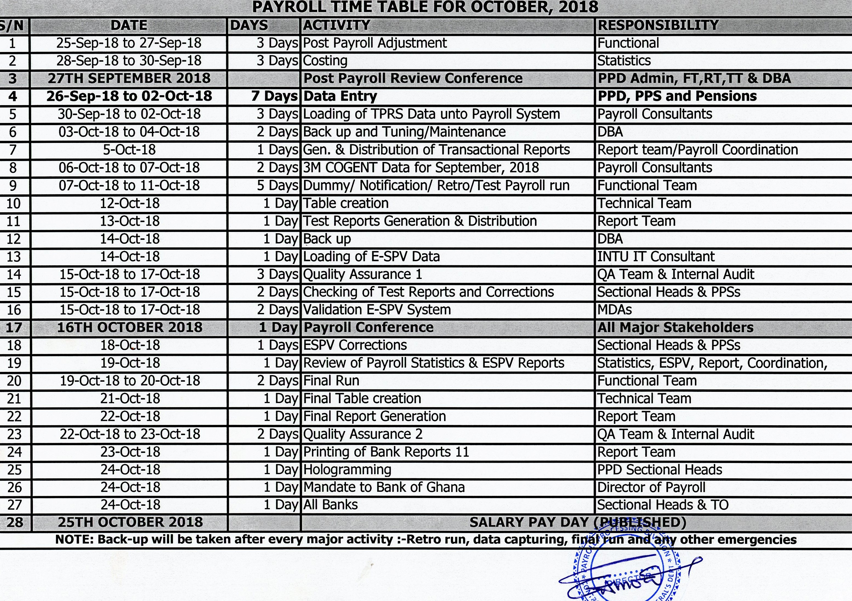

Slide 15
THE PAYROLL CYCLE
Data Entry
Test Payroll Run
ESPV Validation (MDAs/MMDAs)
Test Report checking by PPS and PPD
Final Payroll Run
Distribution of Payroll Report to key stakeholders (BOG/ All Banks)

Slide 16
THE PAYROLL CYCLE – Cont’d..
Post Payroll Run activities
    Preparation of Third Party Remittance Schedule
    Submission of Final Mechanized Payment Vouchers (PV) electronically to the various MDAs/MMDAs.
    Checking and certification of PVs by the Heads of MDAs/MMDAs

Slide 17
PAYROLL REPORTS
DIFFERENT CATEGORIES OF PAYROLL REPORTS FOR DIFFERENT STAKEHOLDERS:
CAGD
PPS – Transactional Reports/ Exceptional Reports / Test Report
EMPLOYERS – Electronic Salary Vouchers/ Payroll Cost Details
EMPLOYEES – Electronic Payslips

Slide 18
SALARY STOPPAGE AND REACTIVATION
REASONS FOR SALARY STOPPAGE (Deletion, Suspension)
HOW TO REPORT STOPPAGE (choosing the right instruction)
REACTIVATION PROCESS
Notes:
Stoppage: deletion (retirement, vacation post, deceased), Suspension (temporal), Sanctions, Study Leave, ) Double mech
Reactivation: Restoration (temporal stop, letter state eff date, ESPV Unverified – letter to CAGD and input to PPS)
Reactivation (restore separated staff due to error – DoB, judicial order

Slide 19
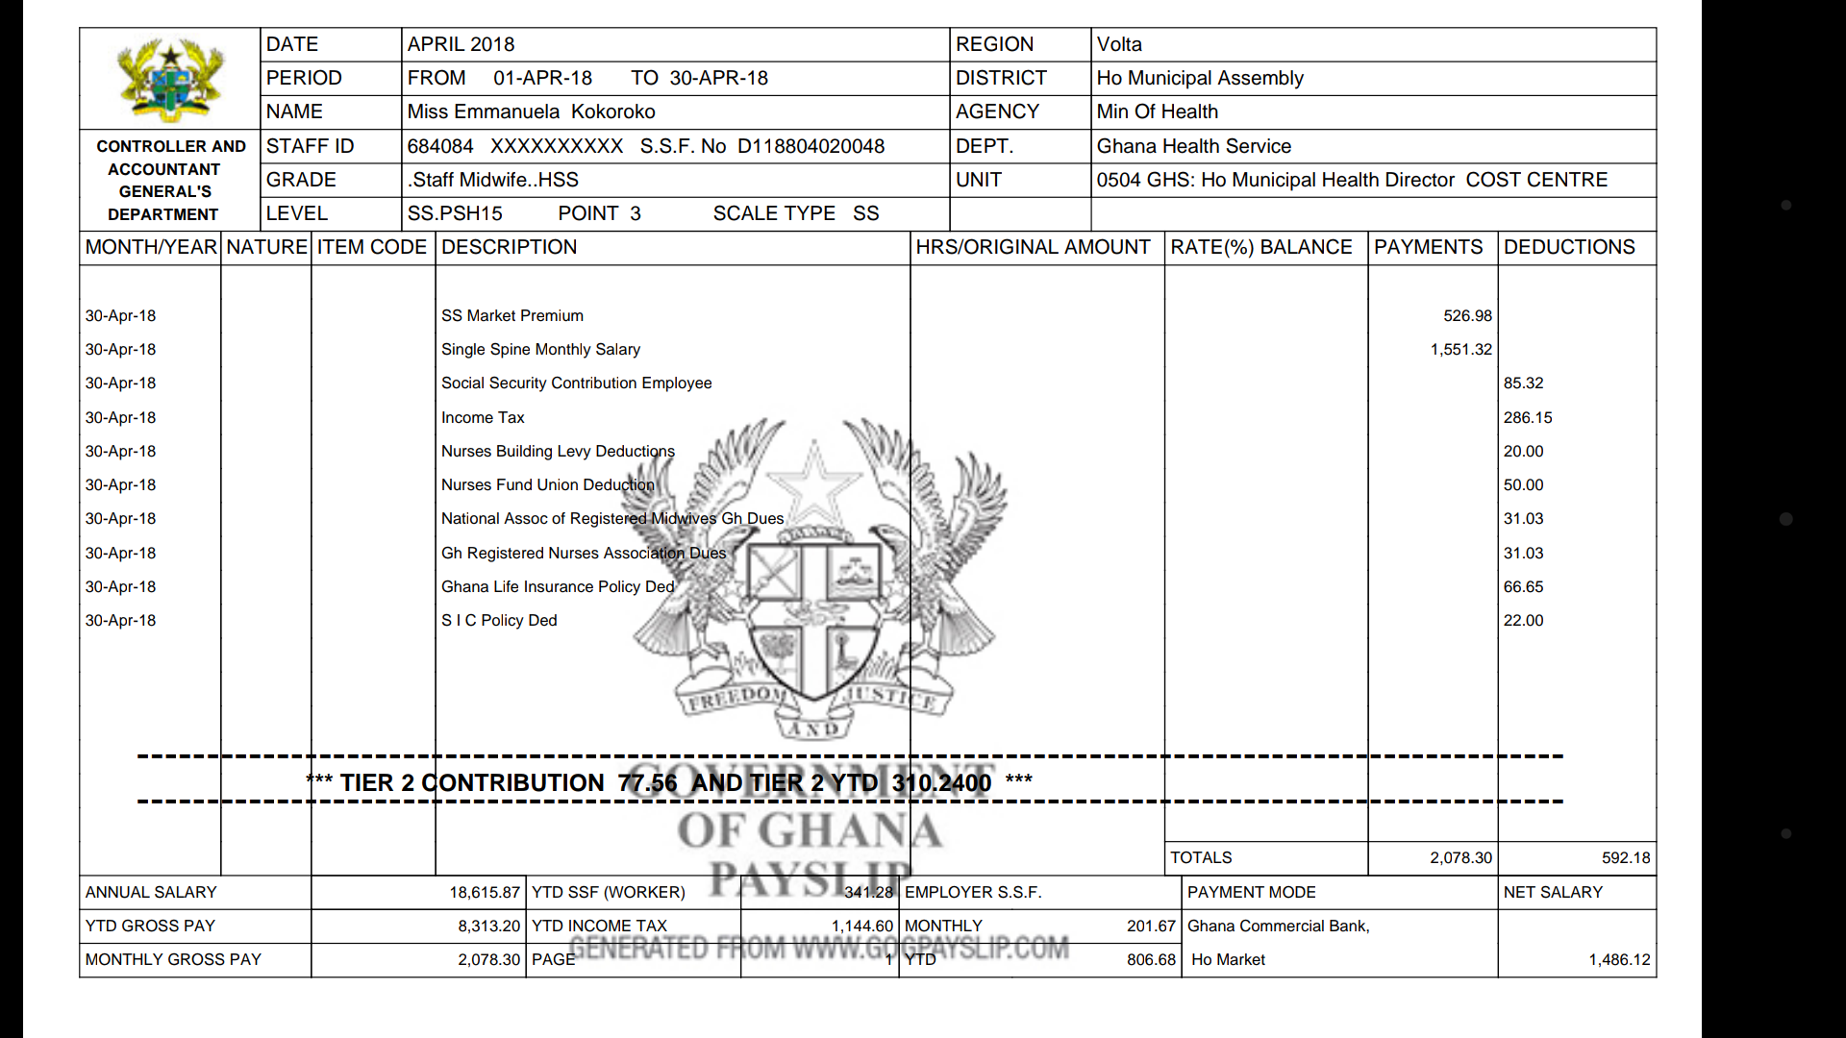
INTERPRETING THE PAYSLIP

Slide 20
2019 Approved Single Spine Salary Structure
10% across-board-salary increment
effective Jan 1, 2019
No effect on Interim Market Premium (absolute amount calculated on 2012 single spine base salary)

Slide 21
RECENT PAYROLL INITIATIVES
TPRS
HRMIS
Budgetary Control & Management of Payroll Cost

Slide 22
BURNING ISSUES
ARREARS
Management Unit Creation (PV)
MoF Biometric Registration
SSNIT Re-Enrolment
Payroll Frauds

Slide 23
END OF PRESENTATION
THANK YOU

