Slide 1


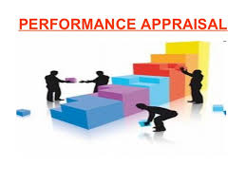
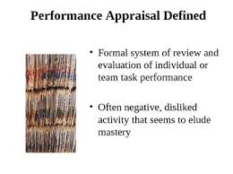


REPUBLIC OF GHANA
Local Government Service
PERFORMANCE MANAGEMENT SYSTEM
“PERFORMANCE CONTRACT” & “PERFORMANCE APPRAISAL”
BY: OFFICE OF THE HEAD OF THE LOCAL GOVERNMENT SERVICE (OHLGS)

Slide 2
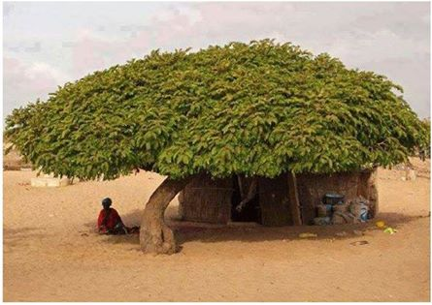
Contents
LEGAL BACKGROUND ON PERFORMANCE STANDARDS
  CONSTITUTION, DECENTRALIZATION, MISSION STATEMENT OF LGS & SERVICE DELIVERY STANDARDS
SERVICE DELIVERY STANDARD (SDS)
  THE SPECIFIC OBJECTIVES FOR DEVELOPING SERVICE DELIVERY STANDARDS
  LGS – SIX SERVICE DELIVERY STANDARDS
PERFORMANCE MANAGEMENT SYSTEM (PMS)
  Objectives and Definition of Performance Management
  Performance Management Vs. Performance Appraisal
  Performance Management Process
PERFORMANCE CONTRACT & PERFORMANCE APPRAISAL (PC & PA)
  Performance Contract
  Performance Appraisal

Slide 3
Legal background on performance standards
(National level)
LOCAL GOVERNANCE SERVICE Act, 2016 (Act 936)
Functions of the Council: (54. B,G)
set performance standards within which the District Assemblies (DAs) and Regional Coordinating Councils (RCCs) shall carry out their functions and discharge their duties;
monitor and evaluate performance standards of the District Assemblies and Regional Coordinating Councils.
The Head of Service shall: (63:4– a & b)
provide leadership and guidance in the performance of the functions of the Service and the implementation of the decisions of the Council;
ensure the effective organization and development of training programmes consistent with the sectoral requirements of the Service;

Slide 4
Legal background on performance standards
(Regional level)
LGS Act, 2016 (Act 936)
Office of the Regional Coordinating Council (LGA 936, Section 193)
The Regional Coordinating Director shall ensure the effective and efficient performance of the office of the Regional Coordinating Council.
ACT 936, THE LOCAL GOVERNANCE ACT, 2016, Section 142—Functions of Regional Coordinating Councils
Regional Coordinating Council shall: (142-1a)
monitor, co-ordinate and evaluate the performance of the District Assemblies in the region;

Slide 5
Legal background on performance standards
(District level)
Local Governance Act, 2016, ACT 936: 20
The District Chief Executive (DCE)
is responsible for the day-to-day performance of the executive and administrative functions of the Assembly;
is responsible for the supervision of the departments of the Assembly; and
is the chief representative of the Government in the district.
Functions of the OFFICE OF THE District Assembly (lga 936, Section 74)
The Office of the District Assembly is responsible to the District Assembly in the performance of its functions

Slide 6


What is service delivery standard?
“Service Delivery Standards are the minimum level of expected services in terms of quality, time and cost that the Service Provider commits to deliver to its clients”

Slide 7
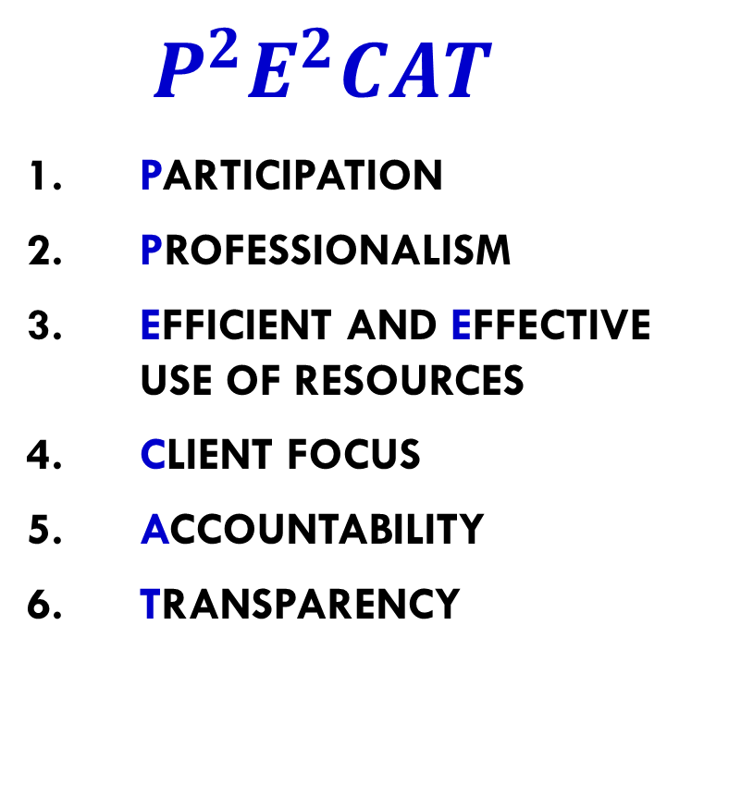
our Six sds & How WE can remember them
$${ P}^{2}E^{2}CAT$$
Participation
Professionalism
Efficient and effective use of resources
Client focus
Accountability
Transparency
SERVICE DELIVERY STANDARDS
Participation
Professionalism
Efficient & Effective Use of Resources
Client Focus
Accountability
Transparency

Slide 8

  1. PARTICIPATION
Participation is the involvement of relevant stakeholders including Civil Society Groups, Media, NGOs, Private Sector and Community Members in the planning, implementation, monitoring and evaluation of service delivery.
Measurement of Participation:
Some measurement indicators for assessing “Participation” include ensuring that MMDAs:
involve all stakeholders in the annual fee-fixing resolutions;
organize community hearings to include the views of all stakeholders during the planning and budgeting process;
conduct annual surveys to ascertain the level of community knowledge on agreements reached during service delivery consultations;
involve relevant stakeholders, beneficiary departments and communities in quarterly and annual monitoring of projects.

Slide 9
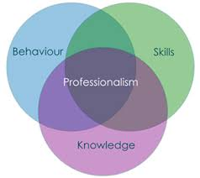
  2. PROFESSIONALISM
Professionalism is the demonstration of requisite skills and competencies, and the ability to adapt best practices in the delivery of services to the satisfaction of the client whilst adhering to ethical standards
Measurement of Professionalism:
Some measurement indicators for assessing “Professionalism” include ensuring that MMDAs:
conduct Performance Appraisals with staff within intervals of six months or yearly;
prepare and implement staff development plan for staff on an annual basis;
ensure that the output of staff is measured in reference to standards stipulated in the Code of Conduct for the Service bi-annually;
conduct annual in-service training for the professional development of staff;
establish annual award schemes for staff who demonstrate professionalism in the performance of their duties.

Slide 10


  3. CLIENT FOCUS
Client focus is using client requirements to prioritize and consistently develop affordable and accessible Services in a timely manner.
Measurement of Client Focus:
Some measurement indicators for assessing “Client Focus” include:
establish functional Client Service Centres in all MMDAs by end of the year;
publish and disseminate a Client Service Charter by the end of the year;
establish a mechanism (suggestion box, etc.) for the receipt of complaints from clients on a weekly basis and to provide feedback to clients effectively within five (5) working days of the receipt of a complaint;
acknowledge and respond to correspondences effectively within Seven (7) working days upon receipt;
organise annual beneficiary surveys.

Slide 11


  4. TRANSPARENCY
Transparency is providing all stakeholders with the understanding of how LGS operates, and furnishing them with easy access to adequate and timely information regarding decisions and actions taken by the Service.
Measurement of Transparency:
Some measurement indicators for assessing “Transparency” include:
establish a Procurement Committee and ensure that all procurement activities are carried out in conformity with the Public Procurement Act;
update and display monthly revenue and expenditure charts on MMDAs’ notice boards and at other vantage places;
publish and display MMDAs’ audit report on Assembly’s and Area Councils’ notice boards within one week of receipt of the report;
disseminate draft budget estimates to Assembly members two weeks before the General Assembly meeting and publish the approved budget on the Assembly’s notice boards;
adopt the Social and Public Expenditure Financial Accountability (SPEFA) format for reporting on MMDA to key stakeholders yearly;
publish General Assembly meeting minutes on Community notice boards and other public designated areas (such as the reception) in the MMDA quarterly.

Slide 12
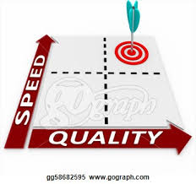
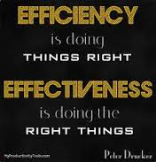
  5. EFFICIENT AND EFFECTIVE USE OF RESOURCES
Efficient and Effective use of Resources is the optimal use of resources (including time, human resources, natural resources, financial resources, etc.) to provide services and products that satisfy the requirements of users in a timely manner.
Measurement of Efficient and Effective use of Resources:
Some measurement indicators as presented for assessing “Efficient and Effective use of Resources” include:
procure goods, works and services in conformity with the Public Procurement Act and on time;
ensure that financial transactions are in line with the Financial Administration Act, Financial Regulations and the Financial Memoranda and that transactions are done in a timely manner;
organise monthly Financial & Audit review meetings to discuss the financial transactions of the Assembly;
ensure that at least 90% of activities, projects and programmes implemented are within the Annual Action Plan and Budget;
provide all clients with timely services.

Slide 13


  6. ACCOUNTABILITY
Accountability is taking responsibility for one’s actions and/or in-actions in rendering services and informing citizens on the use of public resources.
Measurement of Accountability:
Some measurement indicators for assessing “Accountability” include:
organize stakeholders’ public budget hearing in the local dialect most widely spoken within an Assembly (Twi, Gonja, Dagbane, Ga, etc.) on an annual basis;
publish and implement comments contained in the annual Audit Reports within two weeks of receipt;
publish monthly financial statements by the 20th of the ensuing month on MMDAs ‘notice boards, Community Information Centres, etc.;
provide information on programmes, projects, revenue and expenditure to the public using local radio/FM stations on a monthly basis;
organise four (4) quarterly meetings to discuss and act on Audit Reports.

Slide 14

Performance Management Systems (PMS)
A systematic process for improving performance by developing the performance of individuals and teams. It aims at having in place predictable, effective and efficient systems for planning, implementation, monitoring, evaluation and reporting on employees’ performance.
The overall objective of PMS is to create a high performance culture where staff are aware of the need to perform well and behave accordingly in order to meet or exceed expectations

Slide 15
Performance Management & Performance Appraisal
Performance Management and Performance Appraisal are often USED INTERCHANGEABLY
The key difference is the fact that the Performance Appraisal forms part of the Performance Management CYCLE.
Performance management is:
a holistic process bringing together many activities which collectively contribute to the effective management of individuals and teams in order to achieve high levels of organisational performance.
strategic in that it is about broader issues and long term goals and integrated in that it links various aspects of the organisation, people management, individuals and teams.

Slide 16
Performance Appraisal
Performance appraisal is an important part of performance management. it is one of the range of tools that can be used to manage performance.
The performance appraisal or review is essentially an opportunity for the individual and those concerned with their performance – most usually their line manager - to get together to engage in a dialogue about the individual’s performance, development and the support required from the manager.
Performance appraisal is operational, short to medium term and concerned only with the individual, their performance and development.
It is one of the tools of performance management and the data produced can feed into other elements of performance management but in itself can never be performance management.
Note: however, an easy terminology AS “performance appraisal” instead of “performance management” is frequently used .

Slide 17
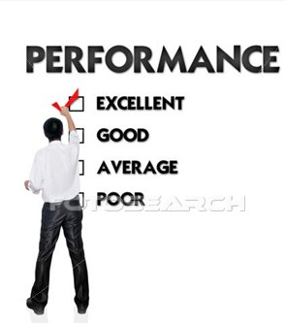
Key Elements of a Performance Management System
Plan and agree on what needs to be done;
Doing what has been agreed upon;
Check and Monitor performance information and identifying opportunities for improvement;
Review what has gone well, and not so well; what needs to be developed
Act on the information and making any necessary changes; and;
Report on the progress and outcomes.
Plan & Agree
Do
Check & Monitor
Act
Report
Review

Slide 18
Performance contract & Performance appraisal
LGS-PMS will use the following documents (PC & PA):
Performance contract (PC):
  Between Hon. Reg. ministers & rcds / cds
  Between mmdces & mmdcds
  Between hos & Cd, directors
Performance appraisal (PA):
  All lgs staff except above
The contents of PC & pa are more or lEss the same

Slide 19
Key Performance Area (KPA)
Key Performance Areas (KPAs) refer to general areas of outcomes for which a job is responsible for . A consideration of KPAs needs to include the areas of a job for which the employee is responsible for producing results.
To identify KPAs, individuals should be asked by their supervisor to answer questions such as:
  What do you think are the most important things you have to do?
  What do you believe you are expected to achieve in each of these areas?

Slide 20
Key Performance Indicators (KPI)
Key Performance Indicators (KPIS) describe the performance dimension that is considered key or important in measuring performance. They are used as measuring criteria for evaluating performance. KPIs include:
  Quality: How well?
  Quantity: How many or much?
  Timeliness: By when?
  Cost Efficiency: At what expense?
  Competency: The essential knowledge, skills and abilities a jobholder must possess and demonstrate in order to be successful at work
Key Performance Indicators should be written to meet SMART criteria: Specific, Measurable, Achievable, Relevant, Timeliness/ Time-bound
Minimum 2 KPIs and maximum 4kpis per kpa

Slide 21
Weightings
Weightings show the relative importance of one KPA against another KPA.
The purpose of the weightings is to show employees what the most important Key Performance Areas are in their work.
100 percent of the weightings are allocated to the KPAs. No weightings are allocated to competencies. competencies are rated separately for developmental purpose only.

Slide 22
Competency
An exclusive emphasis on just Key Performance Areas can give a skewed or incomplete picture of employee performance. So, competencies, or how well a job is done, are an important component of the planning phase.
Competency refers to what people have to know and be able to do to perform well.
technical knowledge and skills, behavioural attributes or attitudes and managerial skills are critical in determining how results will be achieved.
Example of competencies are: Leadership, Decision Making, Interpersonal Skills, etc…..
Competency are for purposes of personal development, not for scoring

Slide 23
PA:
STAFF PERFORMANCE PLANNING, REVIEW AND APPRAISAL
(for lgs staff)

Slide 24
Introduction with key words/ Terms & definitions
TERMS | DEFINITIONS & EXPLANATION
Appraisal | Process to assess worth, value, quality or performance. It requires the employee (Appraisee) and his/her reporting officer (Appraiser) to plan the performance of the Appraisee at the beginning of the year, both review the performance after six months, analyse the factors affecting the performance, discuss developmental needs, have performance counselling and share the rating at the end of the period.
Appraisee | Staff / employee being assessed
Appraiser | Officer conducting the Appraisal
Review | Assessment of performance what has gone well, and not so well; what needs to be done/ developed.
Evaluation | A systematic determination of a subject's merit, worth and significance, using criteria governed by a set of standards. It provides credible and useful information which enables reflection and assist in the identification of future change.
Competencies | Competency refers to what people have to know and be able to do to perform well. Also, competency is an ability based on behaviour and it is defined as “a behavioural characteristic or attribute that is necessary for the satisfactory performance of a given job”.

Slide 25
PA: Four phases of performance management process
Phase One – Performance Planning
Planning and setting of individual performance targets through work plans derived from the OHLGS/ RCC/ MMDA Strategic Plans and objectives set at the directorate, departmental and unit levels. The indicators /target setting process must be a top-down approach; preferably the first two weeks in January should serve as the period for setting of targets for the year.
Phase Two – Progress Reviews (mid-year review)
Discussion and communication between appraiser and Appraisee on progress of work, and adjustment of indicators /targets if necessary, through the provision of formal feedback.
Phase Three – Review and Appraisal end of year evaluation)
Evaluation of Appraisee’s performance at the end of the performance management period.
Phase Four- Decision–Making
Deciding on courses of action, i.e. recognition/reward, training plans, promotion prospects, career development plans, counselling and sanctions.

Slide 26
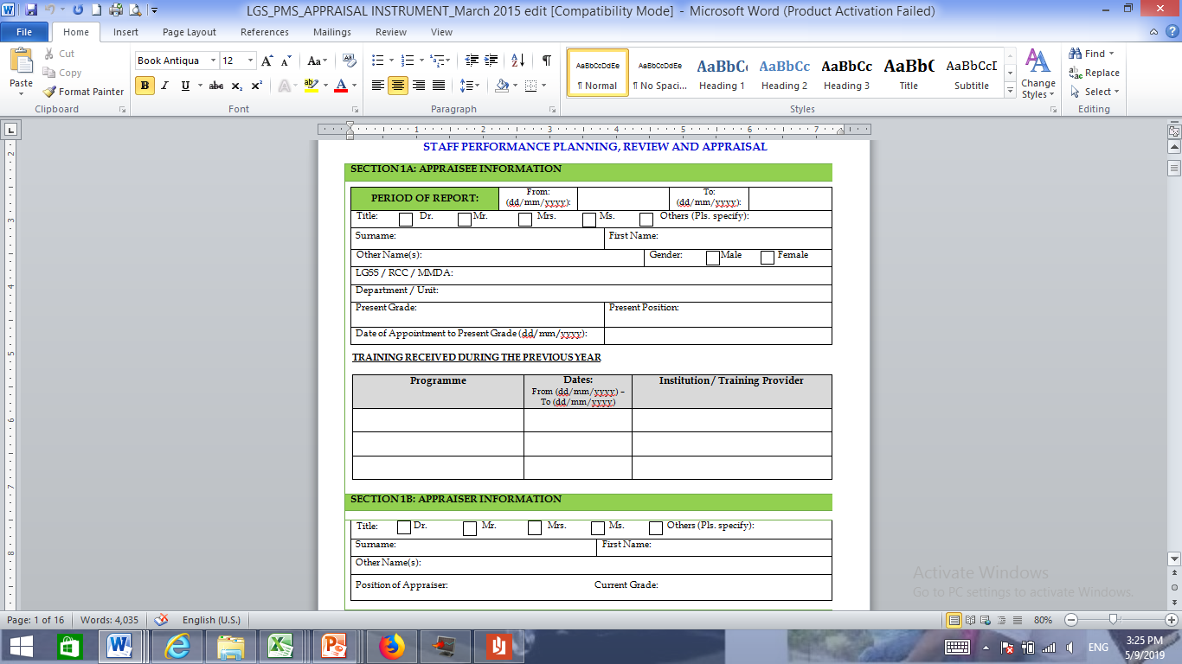
GENERAL INFORMATION

Slide 27
PA: PERFORMANCE PLANNING (Sample)
No. | KEY PERFORMANCE AREA (KPA) (3 to 5 KPAs - To be drawn from employee’s Job Description) | WEIGHT (%) for each KPA | KEY PERFORMANCE INDICATOR (KPI) (indicators should be SMART: Specific, Measurable, Achievable, Realistic and Time-framed) (2 to 4 KPIs to be stated for each KPA) | SERVICE DELIVERY STANDARD(s) (if Applicable)
To be agreed between the Appraiser and the Appraisee at the start of the annual appraisal cycle or when a new employee/ staff commences work.

Slide 28
Personal Development Plan
NO | COMPETENCIES | SELECTED ( √ ) | EXPECTED OUTCOMES & HOW THEY WILL BE ATTAINED
1 | ORGANISATION AND MANAGEMENT
2 | INNOVATION AND STRATEGIC THINKING
3 | LEADERSHIP AND DECISION- MAKING
4 | ORGANIZATIONAL DEVELOPMENT AND IMPROVEMENT
5 | COMMUNICATION (ORAL, WRITTEN & ELECTRONIC)
6 | JOB KNOWLEDGE AND TECHNICAL SKILLS
7 | SUPPORTING AND COOPERATING
8 | MAXIMISING AND MAINTAINING PRODUCTIVITY
9 | DEVELOPING / MANAGING BUDGETS AND SAVING COST
10 | ABILITY TO DEVELOP STAFF

Slide 29
Section 3A: MID-YEAR PERFORMANCE REVIEW FORM
KPA NO. | KEY PERFORMANCE INDICATOR(S) KPIs ( Brief Statement derived from Section 2A, KPI Column) | PROGRESS REVIEW | REMARKS

Slide 30
SECTION 3B: MID-YEAR REVIEW FORM (COMPETENCY)
NOT FOR SCORING (PERSONNEL DEVELOPMENT PURPOSE)
NO. | COMPETENCY | PROGRESS REVIEW | REMARKS
1 | ORGANISATION AND MANAGEMENT ABILITY TO PLAN, ORGANISE AND MANAGE WORK LOAD ABILITY TO WORK SYSTEMATICALLY AND MAINTAIN QUALITY ABILITY TO MANAGE OTHERS TO ACHIEVE SHARED GOALS
2 | INNOVATION AND STRATEGIC THINKING SUPPORT FOR ORGANISATIONAL CHANGE ABILITY TO THINK BROADLY DEMONSTRATING CREATIVITY IN THINKING
3 | LEADERSHIP AND DECISION-MAKING ABILITY TO INITIATE ACTION AND PROVIDE DIRECTION TO OTHERS ACCEPTANCE OF RESPONSIBILITY AND DECISION-MAKING ABILITY TO EXERCISE GOOD JUDGEMENT
4 | ORGANIZATIONAL DEVELOPMENT AND IMPROVEMENT COMMITMENT TO ORGANIZATIONAL DEVELOPMENT COMMITMENT TO CUSTOMER SATISFACTION COMMITMENT TO THE DELIVERY OF QUALITY SERVICES AND PRODUCTS
5 | COMMUNICATION (ORAL, WRITTEN & ELECTRONIC) ABILITY TO COMMUNICATE DECISIONS CLEARLY ABILITY TO NEGOTIATE AND MANAGE CONFLICT EFFECTIVELY ABILITY TO RELATE AND NETWORK ACROSS DIFFERENT LEVELS AND DEPARTMENTS
6 | JOB KNOWLEDGE AND TECHNICAL SKILLS DEMONSTRATION OF RELEVANT JOB EXPERTISE DEMONSTRATION OF CROSS-FUNCTIONAL AWARENESS BUILDING, APPLYING AND SHARING OF NECESSARY EXPERTISE AND TECHNOLOGY

Slide 31
SECTION 4A LGS- PMS / PA: EVALUATION OF PERFORMANCE (SAMPLE CALCULATION)
(Note: In the formula “Sum of Ws /4 * 100”, 4 is a constant and represents the maximum rating scale)
KPA | Weight per KPA =(W)% | KPI(s) per KPA | SCORE (S) RATING PER KPI (1-2-3-4)= (S) | AVG. SCORE (Sa) = Sum of Scores for N indicators / No. of KPIs per KPA | WEIGHTED SCORES (Ws) = Weight per KPA (W) * Avg. Score per KPA (Sa)
A | B | C | D | E = Sum of D / No. KPIs ; (per KPA) | F = E*B ; (per KPA)
1 | 40% | 1.1 | 3 | 3+2+3 = 8/3 = 2.67 (N=3) | 2.67*40% = 1.07
 |  | 1.2 | 2
 |  | 1.3 | 3
2 | 30% | 2.1 | 3 | 3+4 = 7/2 = 3.50 (N=2) | 3.50*30% = 1.05
 |  | 2.2 | 4
3 | 30% | 3.1 | 2 | 2+3+4+3 = 12/4 = 3.00 (N=4) | 3.00*30% = 0.90
 |  | 3.2 | 3
 |  | 3.3 | 4
 |  | 3.4 | 3
Total | 100% |  |  | Overall Score = Sum of Ws = | 1.07+1.05+0.90 = 3.02
 |  |  |  | Sum of Ws /4 * 100 = | 3.02/4*100 = 75.50 %

Slide 32
SECTION 4B: ANNUAL APPRAISAL: EVALUATION OF COMPETENCIES
(NOT FOR SCORING, FOR EVALUATION OF PERSONNEL DEVELOPMENT)
No. | COMPETENCIES | (1-2-3-4) By marking circle (See Rating Scale below) | COMMENTS & RECOMMENDATION
1 | ORGANISATION AND MANAGEMENT ABILITY TO PLAN, ORGANISE AND MANAGE WORK LOAD ABILITY TO WORK SYSTEMATICALLY AND MAINTAIN QUALITY ABILITY TO MANAGE OTHERS TO ACHIEVE SHARED GOALS | 1 – 2 – 3 - 4 1 – 2 – 3 - 4 1 – 2 – 3 - 4
2 | INNOVATION AND STRATEGIC THINKING SUPPORT FOR ORGANISATIONAL CHANGE ABILITY TO THINK BROADLY. DEMONSTRATING CREATIVITY IN THINKING | 1 – 2 – 3 - 4 1 – 2 – 3 - 4 1 – 2 – 3 - 4
3 | LEADERSHIP AND DECISION-MAKING ABILITY TO INITIATE ACTION AND PROVIDE DIRECTION TO OTHERS ACCEPTANCE OF RESPONSIBILITY AND DECISION-MAKING ABILITY TO EXERCISE GOOD JUDGEMENT | 1 – 2 – 3 - 4 1 – 2 – 3 - 4 1 – 2 – 3 - 4
4 | ORGANIZATIONAL DEVELOPMENT AND IMPROVEMENT COMMITMENT TO ORGANIZATIONAL DEVELOPMEN COMMITMENT TO CUSTOMER SATISFACTION COMMITMENT TO THE DELIVERY OF QUALITY SERVICES AND PRODUCTS | 1 – 2 – 3 - 4 1 – 2 – 3 - 4 1 – 2 – 3 - 4
5 | COMMUNICATION (ORAL, WRITTEN & ELECTRONIC) ABILITY TO COMMUNICATE DECISIONS CLEARLY ABILITY TO NEGOTIATE AND MANAGE CONFLICT EFFECTIVELY ABILITY TO RELATE AND NETWORK ACROSS DIFFERENT LEVELS AND DEPARTMENTS | 1 – 2 – 3 - 4 1 – 2 – 3 - 4 1 – 2 – 3 - 4
6 | JOB KNOWLEDGE AND TECHNICAL SKILLS DEMONSTRATION OF RELEVANT JOB EXPERTISE DEMONSTRATION OF CROSS-FUNCTIONAL AWARENESS BUILDING, APPLYING AND SHARING OF NECESSARY EXPERTISE AND TECHNOLOGY | 1 – 2 – 3 - 4 1 – 2 – 3 - 4 1 – 2 – 3 - 4

Slide 33
EXPLANATION (EVALUATION OF COMPETENCY)
RATING SCALE
4 | Excellent | Has consistently demonstrated this behaviour competency and always encouraged others to do same. Four (4) or more examples can be evidenced to support this rating.
3 | Very Good | Has frequently demonstrated this behaviour competency and sometimes encouraged others to do same. Three (3) examples can be evidenced to support this rating.
2 | Good | Has demonstrated this behaviour competency at least two (2) examples can be evidenced to support this rating. Meets expectation on this behaviour competency requirement.
1 | Unsatisfactory | Has not at all demonstrated this behaviour competency and three (3) or more examples can be evidenced to support this rating. Demonstration of requirements of this behavioural competency was unacceptable and did not meet any expectation.

Slide 34
Section 5 and 6
Comments by appraiser and appraisee

Slide 35
ASSESSMENT OF INDICATORS
RATING SCALE |  | DEFINITION OF ACHIEVEMENT ON KEY PERFORMANCE INDICATORS (KPI)
4 | Excellent : 80-100% | Appraisee has fully met and exceeded the agreed indicators and time lines and has produced results of excellent quality. The Officer is a model of excellence in terms of the results achieved and the means by which they were achieved.
3 | Very good: 70-79% | Appraisee has achieved most of the agreed indicators and indicators and has produced results of good quality within agreed time lines.
2 | Good: 60-69% | Appraisee has achieved the minimum number of agreed indicators and provided adequate supporting rationale/reasons for not achieving all of the specified targets.
1 | Unsatisfactory: Below 60% | Appraisee’s performance does not meet the standard expected for the job i.e. Appraisee has not achieved most of the agreed indicators within the time frame provided and is unable to provide reasons or provides unacceptable reasons for unachieved targets.

Slide 36
SECTION 7: ASSESSMENT DECISION (BY APPRAISER AND APPRAISEE)
BASED ON SECTION 4A & 4B
CRITERIA FOR RATING OVERALL PERFORMANCE The following criteria will be used to rate the overall performance of the Appraisee: Mark “X” in the appropriate box (Refer to Section 4) Excellent (4): 80-100% (Outstanding) Appraisee has fully met and exceeded the agreed indicators and time lines and has produced results of excellent quality. The Officer is a model of excellence in terms of the results achieved and the means by which they were achieved. (publicize his/her outstanding performance and recommend him/her for appropriate reward) Very Good (3): 70-79% (Exceeds the requirement) Appraisee has achieved most of the agreed indicators and has produced results of good quality within agreed time lines. (Recognize his/her very good performance & encourage him/her through Coaching, Mentoring, training, etc.) Good (2): 60-69% (Meets the requirement= 60%) Appraisee has achieved the minimum number of agreed indicators and provided adequate supporting rationale/reasons for not achieving all of the specified targets. (Encourage him/her through Coaching, Mentoring, training, etc. for further improvement) Unsatisfactory (1): Below 60% (Does not meet the requirement) Appraisee’s performance does not meet the standard expected for the job i.e. Appraisee has not achieved most of the agreed indicators within the time frame provided and is unable to provide reasons or provides unacceptable reasons for unachieved targets. (Apply appropriate sanction and necessary counseling)

Slide 37
SECTION 8: CAREER DEVELOPMENT
(TO BE COMPLETED BY THE APPRAISER IN DISCUSSION WITH THE APPRAISEE)
Training and Development - Comments and Plan

Slide 38
SECTION 9: HEAD OF DIRECTORATE / DEPARTMENT/ UNIT COMMENTS
NAME AND SIGNATURE OF HEAD OF DIRECTORATE / DEPARTMENT/ UNIT & DATE (DD/MM/YYYY)

Slide 39

End of presentation
Thank you very much!

