Slide 1
Strategies In Managing Training And Capacity Building for HR Managers
Training of RCCs and MMDAs HR Managers
13th – 31st May 2019

Slide 2
1.1 Understanding Key Terms & Concepts in CB
Training: the process of imparting specific knowledge and developing skills of staff to make them perform their jobs effectively.
Development: the process of preparing staff not only to perform their present jobs better but to be able to take up future responsibilities.
Learning: the process whereby individuals acquire knowledge, skills and attitudes through experience, reflection, study or instruction.

Slide 3
2.1 Policy on Capacity Building
Administering and implementing any type of training, development or learning activity is done in accordance with the strategic vision/mission of Local Government Service.
Provide suitable job-related training for all staff in order to facilitate greater competency in the job performance and develop the potential of staff
Create a learning organization to facilitate staff training and development at all levels

Slide 4
2.2 Policy Objective
The main objective of training, development and learning in the Local Government Service is to help develop key competencies which enable individuals to perform current or future jobs successfully.
Specific Objectives:
Upgrading the knowledge and job skills of staff;
Inculcating positive attitudes/mindsets in the staff;
Improving operational efficiency and productivity; and/or
Developing the potential of staff for maximizing mutual benefit to individuals and the Local Government Service.

Slide 5
2.3.Pillars/Features of the CBF
It is national in character and links National, Regional and MMDA levels
Systems focus and approach levels individual, departmental &Organisational
Approved strategies and measurable standards
Performance: identities gaps; addresses them using potentials & opportunities
Resource Mobilisation & Utilisation
Clarifies institutional roles and responsibilities
In-built systems for planning, implementation , M&E
Documentation and reporting
Communication and knowledge management
Shared leadership and multi-stakeholders
Dynamic and responsive to changes in the environment
Futuristic

Slide 6
2.4 An Overview of Capacity Building
Capacity Building in the context of local governance is defined in Ghana’s Decentralization Policy Framework (2010) as activities that enhance the ability of an organization to meet its intended objectives.
Capacity is linked to performance improvements. It may include:
  human resource development in a broader sense,
  organizational and institutional development,
  process improvements,
  logistics and resource enhancements,
  motivational and change management interventions that impact desirable change on the environmental, institutional and individual front.

Slide 7
2. 5 CAPACITY BUILDING FRAMEWORK

Slide 8
Importance of the LGS, RCCs and MMDAs capacity building framework
It informs resources allocation and transfer.
Service standards will be set and followed.
Quality service with a high level of accountability.
Timely delivery on their mandates.
Complementary to local government legislations.
Institutional building needed for effective local government.
Enable local government staff & other local governance players to enhance their knowledge, skills & attitudes for the effective performance of local government functions.

Slide 9
Levels of capacity building
CBF emphasizes capacity at three level::
Organisational level assessment
  Establish congruence between MMDAs as an Organisation
  Structure management, input, transformation processes, results and outputs against overall vision/mission goals and objectives
Individual or staff assessment
  Individuals, departments and wider organisation
Environmental assessment
  Internal and external

Slide 10
2.8 Organisational Capacity Assessments
Capacity building interventions: designed to address organisational deficiencies and individual competency gaps at the institutional and individual levels, respectively.
Organisational capacity assessments: relate to the continuous process of measuring output effectiveness and efficiency in the delivery of the overall mandate of local authorities.
Individual staff capacity assessments: deals with the continuous process of identifying, measuring, & developing the performance of individuals & aligning performance with the strategic goals of LAs

Slide 11
CAPACITY BUILDING PROCESS
It is a planned activity that must go through key stages as follows:
Performance Management System (Organisational and Individual)
Capacity Needs Assessment
Capacity Building Plans
Procurement of Service Providers
Delivery of Capacity Building Interventions
Documentation, Evaluation and Reporting
Stakeholder Communication

Slide 12
Figure 2: Capacity Building Process

Slide 13
Performance Management: Organisational Level
Capacity building (CB) must be geared towards the fulfilment of mandates and functions of local governments
The 1992 Constitution and Local Government Act 462 of 1993, as well as LI 1961, Act 936 spelt out the mandates.
CB of local authorities must be aligned to what they are required to do.
Performance contract

Slide 14
Organizational Assessment
An organizational assessment is a systematic process for obtaining valid information about the performance of an organization and the factors that affect performance. It differs from other types of evaluations because the assessment focuses on the organization as the primary unit of analysis.
It serves as the contributor of resources to the organisation and also the recipient of the organisation’s final product. It is a dynamic environment with features that are interacting by the day. Its constituents include legal and regulatory framework, administrative policies, socio-cultural and economic factors, technology, politics and diverse stakeholder interests

Slide 15
Organisational Performance: It is the input transformation process that yields effectiveness, efficiency, financial viability, and process acceptability. These areas are interlinked and constitute the basis for describing an organization as high performing or otherwise.
Organizational Motivation: It includes the vision, mission, goals, culture, ethics and incentives/rewards prevalent in the organization. Depending on how they are applied, staff can be motivated to contribute their utmost towards the realization of set targets.

Slide 16
Organizational Capacity:
  Management and Organisation
  Transparency, Openness and Accountability
  Human Resources
  Functionality of Sub Structures
  Auditing
  Fiscal Capacity and Revenue Management
  Infrastructure
  Environmental Sanitation and Management
  Social Accountability
  Strategic Leadership
  Structure/ Hierarchy
  Organisational Process Management

Slide 17
Organizational Functional Capacity Assessment Chart

Slide 18
4 Training/ Capacity Needs Assessment
Is a series of activities conducted to identify problems or situations in the work environment, & to determine if training is an appropriate response based on the gap analysis.
Applicable at: organisational and individual levels.
Seeks to determine and validate performance gaps in RCCs/ MMDAs.
Should be done properly, to ensure the intervention becomes well targeted, tailored and customised to meet the organisational goals.

Slide 19
Tools for the organisational needs assessment
The following are tools for the organisational needs assessment:
  information gathering using the OFCA Template (Annex3)
  Client satisfaction surveys with tailored questions
  Performance league table using both quantitative and qualitative indices
  Citizens score cards
  Annual performance review meetings and reports

Slide 20
Methods of Identifying Training Needs (Sample)
 |  |  | LEVEL OF ANALYSIS |  |  |  | FOCUS OF THE ANALYSIS |  |  |  | SOURCES OF DATA | SOURCES OF DATA
 | LEVEL 1: |  |  |  |  | Statutory requirements |  |  |  | • | Government publications | Government publications
 | Legislative needs |  |  |  |  | • Legislation current and planned in Ghana |  |  |  | • | Investors in People (IiP) | Investors in People (IiP)
 | (meeting the legal requirements) |  |  |  |  | • | Regulatory requirements |  |  | • | Training and Enterprise Councils | Training and Enterprise Councils
 |  |  |  |  |  | • | Standards |  |  | • | Training Records | Training Records
 | LEVEL 2 |  |  |  |  | • Whole organisation’s business goals |  |  |  | • | Capability | Capability | requirements | requirements |  |  | of | of | new | new
 | Organisational Needs |  |  | whole |  | • | Organisational climate |  |  |  | technology or structural changes | technology or structural changes
 | (Raising the performance needs of the |  |  |  |  | • Future market place changes and trends |  |  |  | • | Manpower | Manpower | or staffing | or staffing | plan | and |  | and | future | future
 | organisation)
 |  |  |  |  |  | • Current capability of the people in quantity, |  |  |  |  | forecasts | forecasts
 |  |  |  |  |  |  | range and variety |  |  | • | Skills and knowledge audit of all the | Skills and knowledge audit of all the
 |  |  |  |  |  | • Current levels of performance |  |  |  |  | people | people
 |  |  |  |  |  |  |  |  |  | • Productivity |  |  |  | and efficiency |  |  |  | indicators,
 |  |  |  |  |  |  |  |  |  |  |  | balanced scorecard
 |  |  |  |  |  |  |  |  |  | • Business plans and strategies
 |  |  |  |  |  |  |  |  |  | • |  | Organisational |  |  |  | climate/employee
 |  |  |  |  |  |  |  |  |  |  |  | satisfaction surveys
 |  |  |  |  |  |  |  |  |  | • Customer or client feedback and reviews
 |  |  |  |  |  |  |  |  |  | • Internal requests from staff and managers
 |  |  |  |  |  |  |  |  |  | • Evaluation of current training

Slide 21
Methods of Identifying Training Needs (Sample)
 |  | LEVEL OF ANALYSIS |  | FOCUS OF THE ANALYSIS | FOCUS OF THE ANALYSIS |  | SOURCES OF DATA
 | LEVEL 3 |  | • | Range of jobs or groups of jobs | Range of jobs or groups of jobs | • | Job descriptions and person specifications
 | Job Needs |  | • | Task needed with required standard of | Task needed with required standard of | • | Objectives, standards and targets
 | (raising the performance of groups of people with |  |  | performance | performance | • | Tactical priorities and objectives
 | the same job)
 |  |  | • Skills, knowledge and attitudes required |  |  | • | Observations or shadowing
 |  |  | • |  | Professional qualifications | • | Expert interviews or focus groups
 |  |  |  |  |  |  | Customer or client feedback
 |  |  |  |  |  | • | Professional institute membership
 | LEVEL 4 |  | • |  | Profile of persons in terms of their skills, | • | Performance or annual appraisal
 | Individual Needs |  |  |  | knowledge and attitude | • | Personal Development Plans
 | (raising the performance of small teams or |  | • Standard required of person to perform |  |  | • | Observations and Shadowing
 | individuals)
 |  |  |  |  | tasks to required level | • | Interviews and questionnaires with
 |  |  | • |  | Career and promotions |  | individual and their manager
 |  |  |  |  |  | • Customer or client feedback

Slide 22
Forms of training, learning & development
The forms of training, development and learning include the following:
a) Orientation and Induction;
b) Scheme-of-Service training;
c) Internship/Attachments;
d) Coaching, Mentoring/Preceptoring, etc.
e) Study Tours;
f) Job Rotation;
g) Conferences/Seminars/Retreats/Workshops

Slide 23
Figure 4: Performance Gap Assessment Tool

Slide 24
5. CAPACITY BUILDING PLAN
A capacity building plan shows the general structure of CB activities for the RCC/MMDA within a given period
  Prioritise training topics and scope
  Develop training objectives and expected outcomes
  Schedule sequence of training programmes
  Select trainees
  Collect information and select appropriate Resource Persons
  Prepare training budget
  Discuss and seek approval for the training outlay
  Design training programme
  Develop training reference material
  Develop training evaluation forms

Slide 25
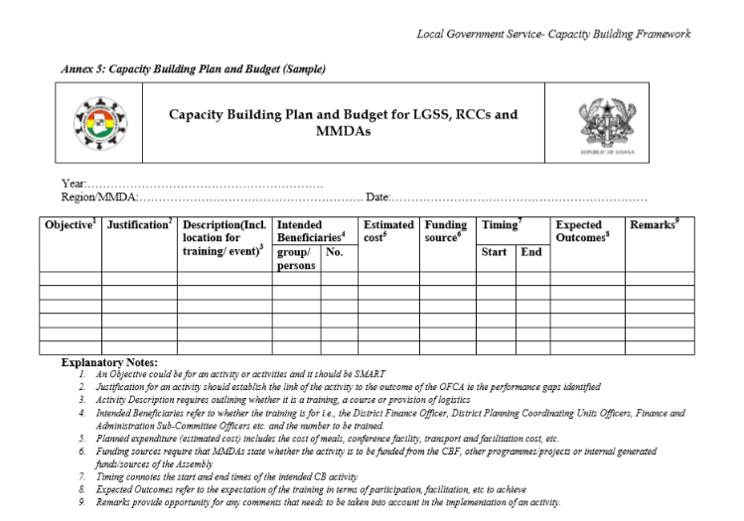
A sample format capacity building Plan

Slide 26
6. TRAINING EVALUATION
Four key reasons why learning and development should be evaluated. These are to:
Prove the value of the training to find out whether or not it has worked and achieved what it was supposed to achieve ,
Control the training to ensure that it is achieving value for money , is fitting with the organisations priorities and is of a consistent standard
Improve the quality of the training so that standard of administration or training delivery are improved
Reinforce the learning as a part of the learning process itself
(adapted from CIPD, 2014c).

Slide 27
6.1Training Evaluation
The Donald Kirkpatrick’s (1959) Four-Level Training Evaluation Model is designed to objectively measure the effectiveness of training as follows:
Reaction.
Learning.
Behaviour.
Results.
By analyzing each level, you can gain an understanding of how effective a training initiative was, and how

Slide 28
6.4 Level 1 Reaction
Questions to ask trainees include:
Did you feel that the training was worth your time?
Did you think that it was successful?
What were the biggest strengths and weaknesses of the training?
Did you like the venue and presentation style?
Did the training session accommodate your personal learning style?
Were the training activities engaging?
What are the three most important things that you learned from this training?
From what you learned, what do you plan to apply in your job?

Slide 29
Levels 2: Learning & 3: Behaviour
Level 2: Learning
Before the training begins, test your trainees to determine their levels in knowledge, skill and attitudes.
When the training is finished, test trainees a second time to measure what they have learned, or measure their learning with interviews or verbal assessments.
Level 3: Behaviour
Questions to ask include:
Did the trainees put any of their learning to use?
Are trainees able to teach their new knowledge, skills or attitudes to other people?
Are trainees aware that they've changed their behaviour?
One of the best ways to measure behavior is to conduct observations and interviews.
Another is to integrate the use of new skills into the tasks that you set your team, so that people have the chance to demonstrate what they know.

Slide 30
Level 4
Here are some outcomes to consider, depending on the objectives of your training:
Increased employee retention.
Increased production.
Higher morale.
Reduced waste.
Increased sales.
Higher quality ratings.
Increased customer satisfaction.

Slide 31
6.2 M& E Guidelines
M&E of CB activities should focus on key questions that that would provide useful information on what works and the underlying reasons.
Key Questions for CB M&E include:
  • Have CB outputs for individual, organizational and systems contributed to improved performance and impact?
  • What combination of CB activities (individual, organizational and system) and what specific interventions are most effective in improving performance?
  • Have programme quality and integrity been maintained and how can they be sustained?
  • What is the impact of CB costs on performance over the short to long term?

Slide 32
6.3 Evaluation Plans for CB Activities include:
• Integration of the evaluation plan at programme design stage.
• Baselines (to be taken prior to programme inception).
• Qualitative/Qualitative methods that generate the most credible evidence given available resources.
• Effective participation of stakeholders in design and implementation of the evaluation.
• Demonstration of accountability for priority programme areas through external evaluation.
• Transparent and timely allocation of resources including funds.

Slide 33
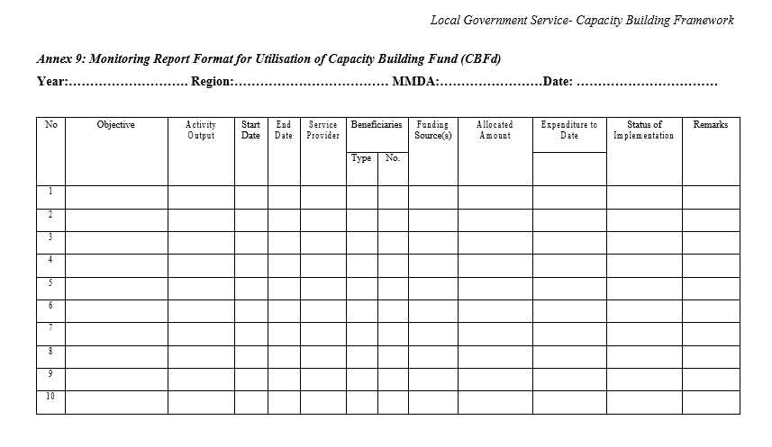
Insert M&E Table/Format

Slide 34
7.0 Reporting on training and capacity building (HR Persons)
Background and objectives of training
Target group and attendance
Participants disaggregation male and female (absolute/percentages)
Coverage
Methodology
Service providers/consultants
Duration and training period, delivery period
Out puts linked to specific objective
What was achieved skills that was transferred
Observations and Recommendation and way forward
outstanding issues/What can be Done better or differently

Slide 35
8.0 THE FACILITATION ROLE OF HR
Let participants brainstorm on facilitation
Who is a facilitator
What is his/her role in capacity building
What processes are involved
What mix of skills are required to optimize functioning

Slide 36
8. 1 Role of HR Manager as a Facilitator of
Adult Learners Training and Capacity building
The role of the facilitator was created to help groups work effectively by:
Providing process to structure conversations
Helping members define needs and expected outcomes
Surfacing and testing assumptions
Fostering buy-in and commitment
Helping group members communicate clearly
Creating an atmosphere in which ideas can be shared
Keeping discussions on track
Making accurate notes that reflect the views of members
Giving and receiving developmental feedback

Slide 37
8.2 Mix of facilitation skills for HR officers
Observation skills
Communication
Leadership
Change management skills
OD skills
Analytical skills
Team work
Conflict management skills
Multi cultural competence
Diversity
Emotional intelligence

