Slide 1
Strengthening Delivery of
Integrated Social Services:
A proposal for joint practice & learning
2022

Slide 2
Overview
Why are we talking about integrated social service delivery?
Objectives & Approach
Proposed initial components for strengthening integrated social service delivery

Slide 3
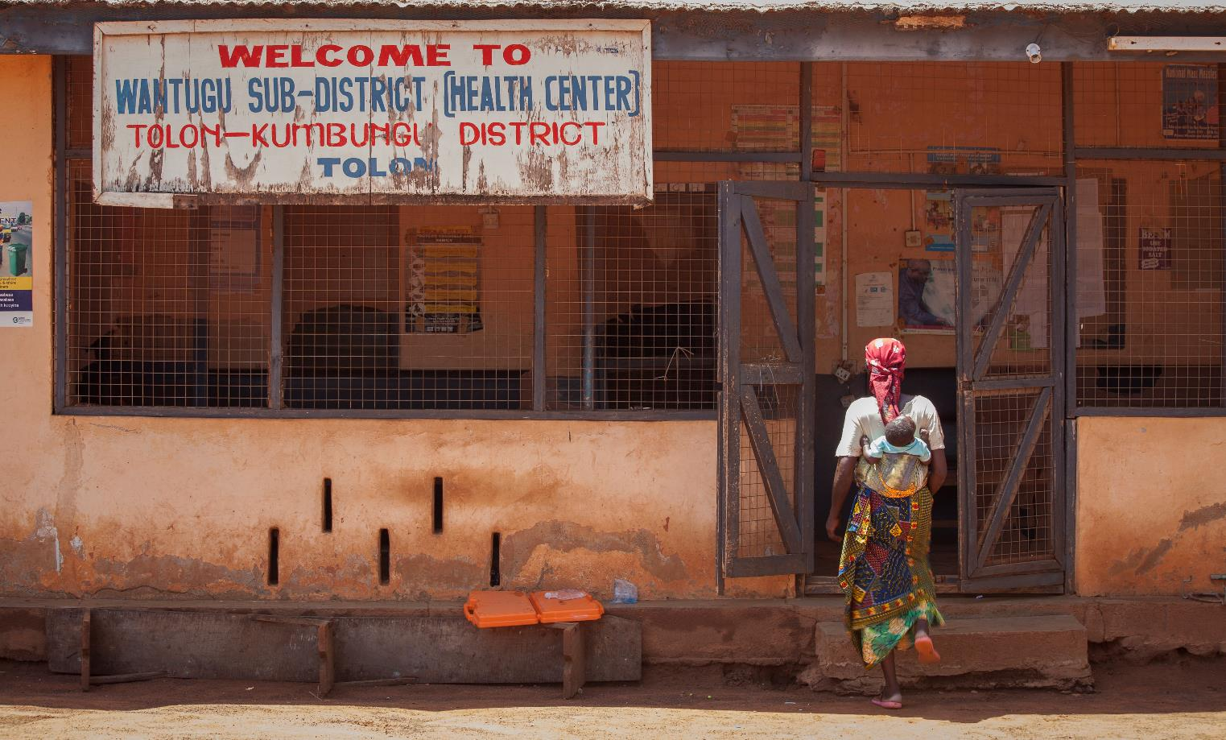
Why are we talking about integrated social service delivery?
© UNICEF/GHANA2016/Grifi

Slide 4
Many Ghanaians face multiple vulnerabilities
Recent GLSS7 and MICS 2017-18 show increasing inequality and clear disparities in access to services
Multidimensional poverty is extremely high - 7 in 10 Ghanaians don’t have access to three or more key services
Stunting – national average 18% of children under 5 stunted; but 25% among poorest vs 9% among richest quintile
17% of children do not live with biological parents
High rates of gender-based violence: more than 1 in 3 girls 15-19 report at least one act of sexual violence

Slide 5
Programmes and services tend to address these vulnerabilities as separate..
…But they are not separate in people’s lives
“I think what I have seen to be the cause (of sickness) is poverty. Sometimes the blood shortening [anemia] is (due to) not eating enough food. If I am supposed to feed my children twice or thrice in a day and I am not able to, it can make them lose some nutrients in their body.. and if they don’t eat well it will lead to fever”
- Woman with 3 children, in Karaga
Sector outcomes – nutrition, child marriage, etc. – have multiple determinants
→Requires multi-sector response!
Notes:
Quote from LEAP 1000 impact evaluation study

Slide 6
Commitment to coordination..
National Decentralisation Policy Framework 2015-2019 / Decentralisation Act 2016: Make all services, including social services responsive and accessible at the local level and closer to the people
Child and Family Welfare Policy: Ensure effective coordination of the child and family welfare system at all levels. Specifically includes coordination between child protection and social protection programmes
National Social Protection Policy 2016: aims to deliver a “well-coordinated, inter-sectoral social protection system thereby enabling people to live in dignity through income support, livelihoods empowerment and improved access to systems of basic services”
National Health Policy(draft): recognizes importance of socio-economic determinants of health
  Sub-objective on Family and social support, including social protection

Slide 7
…but challenges in practice
Many programmes and services achieve impacts, but limited complementarity
  lost opportunities to achieve greater or faster sector outcomes through collaboration
Certain protocols and systems are in place for coordination but often not functioning well
Different degrees of decentralization across different sectors and services
Overburdened frontline workers
Sector specific incentives, plans, data systems and reporting
Insufficient and/or unpredictable resources and capacity

Slide 8
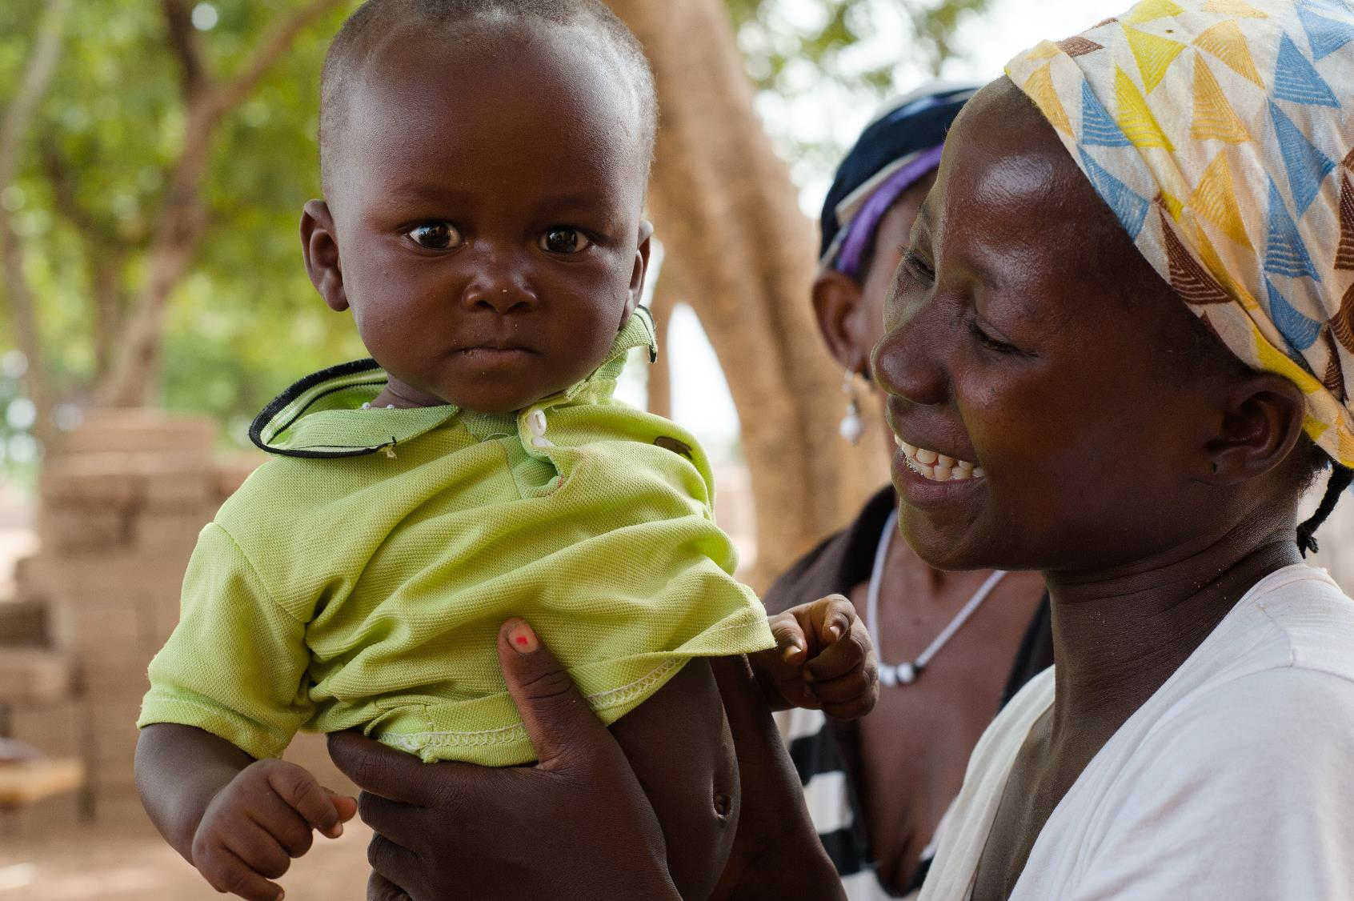
Objectives
& Approach

Slide 9
Goal & Objectives
Goal:
Poverty and vulnerability of children and families is reduced through increased access to an integrated set of social services.
Objectives
Strengthen capacity, coordination, and systems for delivery of integrated services with a focus on child protection, social protection and health services.
To learn and document how social services can best be delivered in a more coordinated manner.

Slide 10











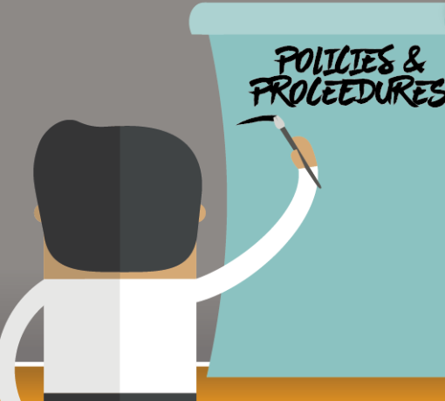



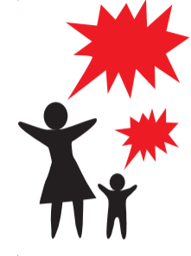


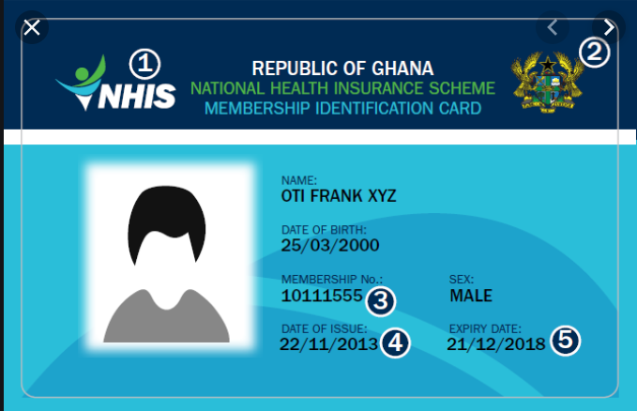



Strengthening Integrated Social Services
Identify Individuals with Multiple Vulnerabilities & Needs
Provide and link Social Protection Programmes
Increase access to basic social services
Improve efficiency of district services
Strengthen outreach & coordination of district services
Identify tools and processes to maximise district resources
Poverty and vulnerability reduction
Identified through district Social Services (DSWO, CHPS, GES, GPS, DOVVSU)
Basic income through LEAP cash transfer programme
Access to health through NHIS
Continue to Monitor families and individuals
Case management & referrals to track most vulnerable and ensure service access

Slide 11
Approach to strengthening Integrated Social Services
Build on existing initiatives and services, but focus on how to make multi-sector coordination and referrals best work in different realities in country
Use iterative cycle of learning from practice
  Identification of key questions
  Documentation and lessons learned, including supporting decentralized staff to learn from each other
  Reapply lessons
Focus on testing approaches within districts
  Including financing at MMDA level, and building case for allocation of resources
  In line with decentralization policy
Bringing lessons to national level and putting in place national systems, protocols, etc. to facilitate linkages

Slide 12
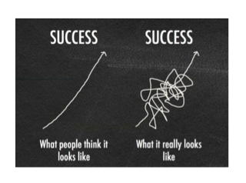
Approach to strengthening Integrated Social Services
Iterative Learning from Practice
Nothing is perfect the first time - Learning by doing
Test things in practice, reflect and learn with others, apply lessons back into practice
People working closest to the ‘frontline’ often have key knowledge on what is working, challenges, and potential solutions
  Important to capture and learn from this experience

Slide 13
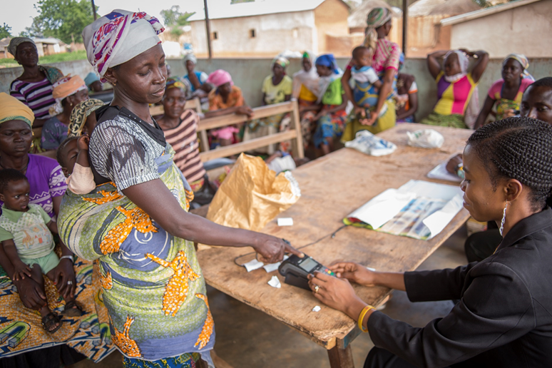
Initial components for strengthening Integrated Social Service delivery
© UNICEF/GHANA2016/Grifi

Slide 14
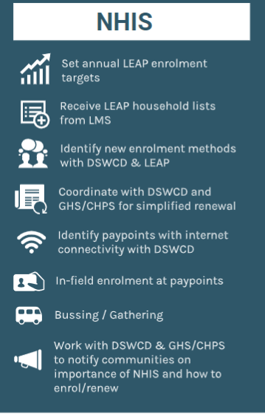
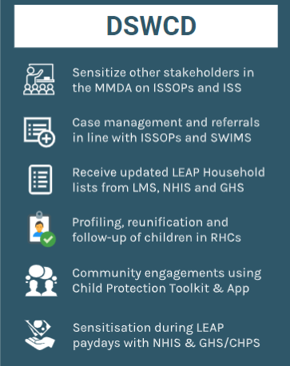
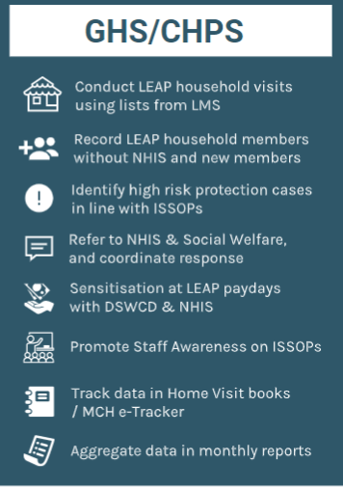
Potential contributions of district services
- for discussion
Notes:
For discussion over the next sessions…

Slide 15
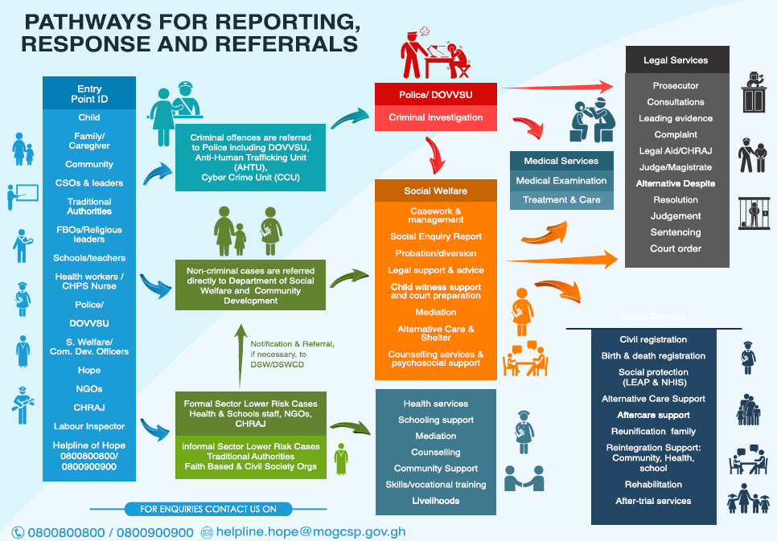

Slide 16
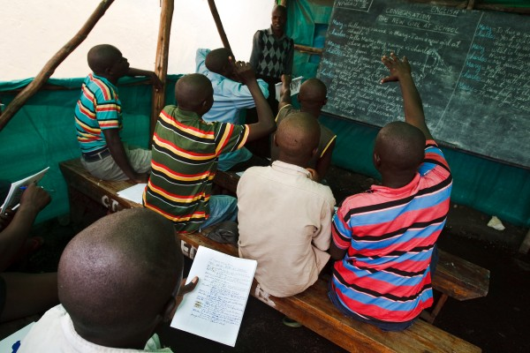
Thank you!

