Slide 1
ORIENTATION OF 60 NEW MMDAs - 2022
INTEGRATED SOCIAL SERVICES DELIVERY (ISS)

Slide 2
OUTLINE
INTRODUCTION
FLOW OF FUNDS
SUBMISSION OF REQUEST FOR FUNDS
RELEASE OF FUNDS & IMPLEMENTATION
REPORTING/LIQUIDATION
ISS TEMPLATES
EXPERIENCES FROM PREVIOUS IMPLEMENTATION
CONTACTS

Slide 3
INTRODUCTION
Under the Integrated Social Services (ISS) Initiative, MLGDRD is mandated to facilitate the transfer of UNICEF funds for DSWCD to beneficiary MMDAs. This is in line with 2022 ISS Guidance Note (see folder) which defines the roles and responsibilities of all stakeholders.

Slide 4
FLOW OF FUNDS
MLGDRD submits request to UNICEF based on Request for Funds collated from all ISS MMDAs.
UNICEF processes request and credits account of MLGDRD.
MLGDRD sends request to Bank of Ghana to credit the Sub CF Accounts of MMDAs
MLGDRD officially communicates to MMDAs about the release (letter of release of funds).
Implementation period is 3 months, starting from the date of release.
MMDA immediately releases funds to DSWCD for ISS implementation.
After 3 months, DSWCDs submit liquidation and new request for next tranche of funds.

Slide 5
SUBMISSION OF REQUEST FOR FUNDS
MLGDRD sends an official communication to ISS MMDAs for them to submit request for funds.
DSWCD complete the request forms with activities drawn from AAP
    Heads of DSWCD submit workplan of the MMDA within 2 weeks upon request from MLGDRD
    Heads of DSWCD to submit draft workplans for review (using Cover Letter, FACE Form and Itemized Cost Sheet)
    Final workplan, endorsed by the MMD Coordinating Director will be addressed to the Ministry via : The Chief Director
    MLGDRD, Accra
    Attn: Head, Budget
    NB:

Slide 6
RELEASE OF FUNDS & IMPLEMENTATION
DSWCDs must access funds from DSWCD, through GIFMIS.
In case of any issues with GIFMIS, Finance/Budget Officers should report issue and seek support through appropriate channels and inform MLGDRD.
Coordinating Directors are responsible for ensuring timely release of funds to DSWCDs for implementation.
DSWCDs have 3 months to utilize funds in line with request submitted.
All progress should be captured in ISS Activity Report. Planning Officers should ensure consistency with data reported in APR.

Slide 7
REPORTING / LIQUIDATION
MLGDRD sends an official communication, two weeks before end of 3-month implementation period, to notify MMDAs and request for financial and activity reports.
    Heads of DSWCD are expected to retire funds by submitting scanned copies of the following documents to the Ministry:
      Itemized Cost Sheet
      Face form
      Receipts
      ISS Activity report (scanned signed copy and excel copy)
      Cover letter

Slide 8
FORMS FOR REQUEST FOR FUNDS
FACE Form
Itemized Cost Sheets
Cover letter on the Assembly’s letter head
NB: All signed and stamped by the Coordinating Director

Slide 9
FORMS FOR REPORTING/LIQUIDATION
FACE Form
Itemized Cost Sheet
ISS Activity Report (signed scanned copy and excel copy)
Scanned copies of receipts
Cover letter on the Assembly’s letter head
NB: All signed and stamped by the Coordinating Director

Slide 10
SAMPLES OF REQUEST TEMPLATES

Slide 11
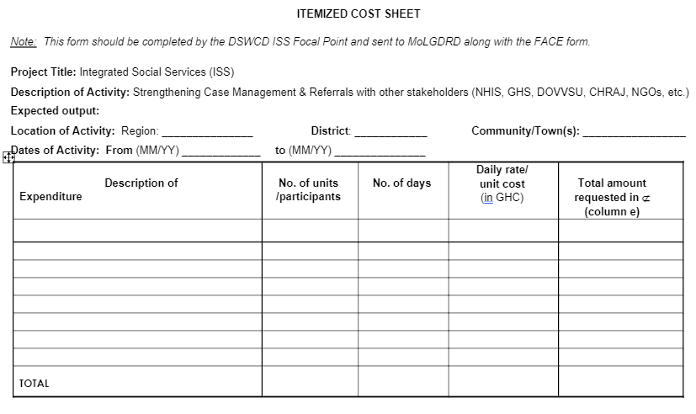
REQUEST - ITEMIZED COST SHEET

Slide 12
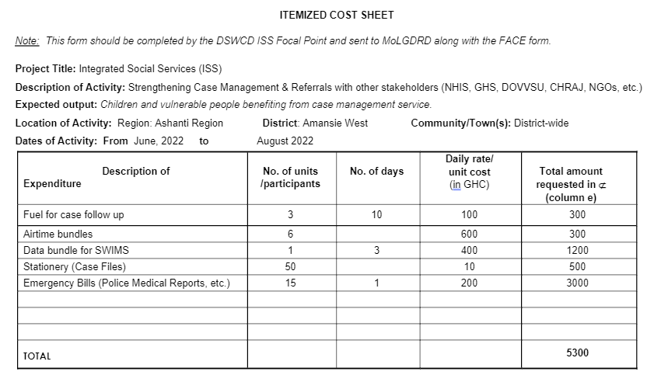
ITEMIZED COST SHEET (EXAMPLE OF FILLED REQUEST)

Slide 13
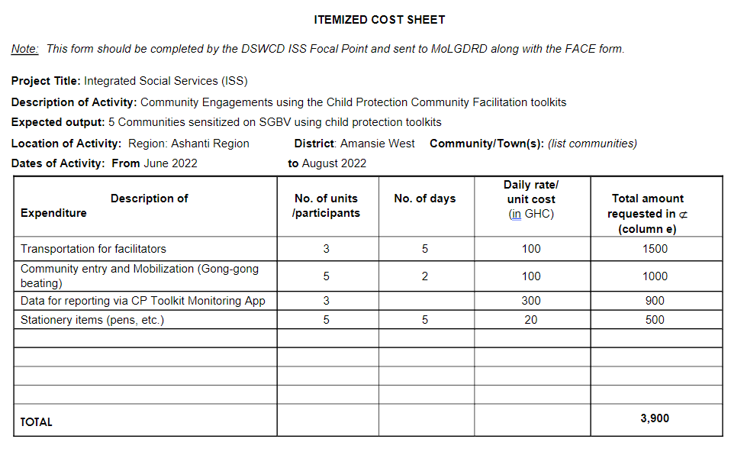
ITEMIZED COST SHEET (EXAMPLE OF FILLED REQUEST)

Slide 14
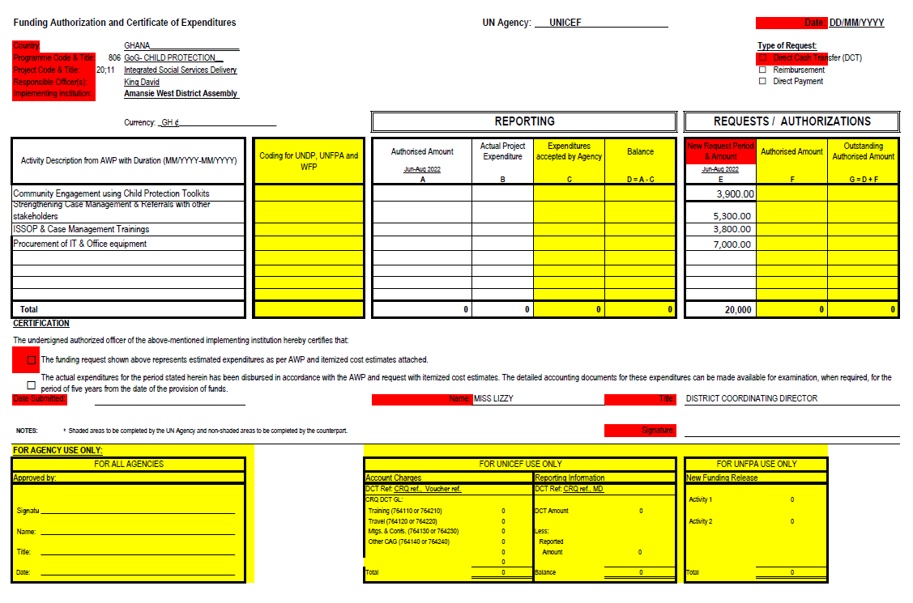
FACEFORM (REQUEST)

Slide 15
SAMPLES OF REPORTING/LIQUIDATION TEMPLATES

Slide 16
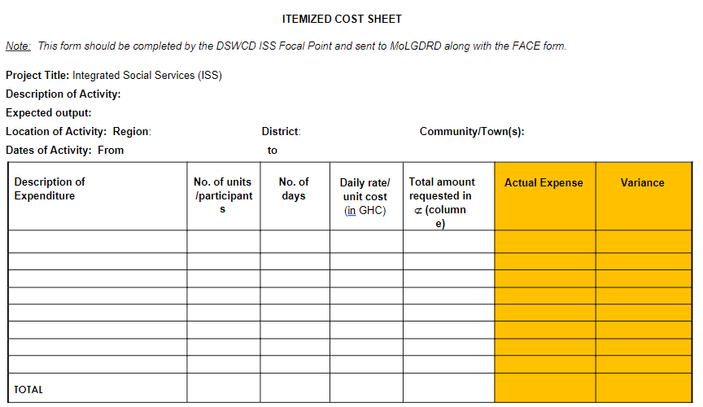
ITEMIZED COST SHEET (REPORTING/LIQUIDATION)

Slide 17
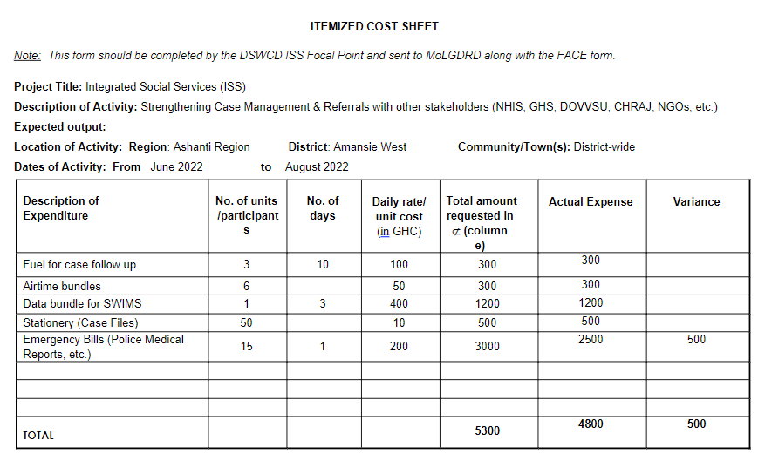
ITEMIZED COST SHEET
(REPORTING/LIQUIDATION)

Slide 18
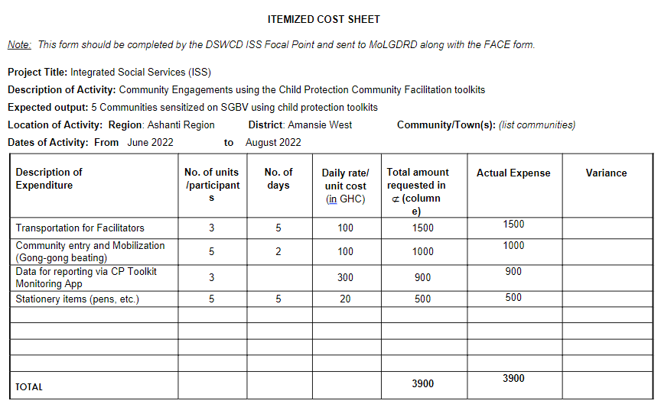
ITEMIZED COST SHEET (REPORTING/LIQUIDATION)

Slide 19
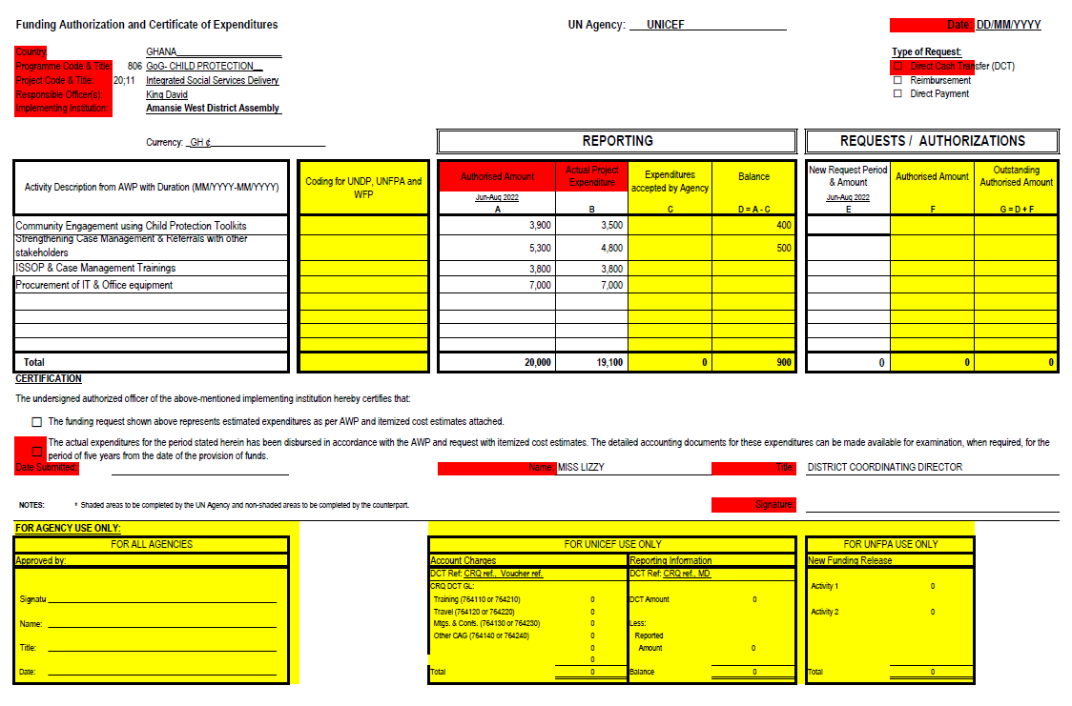
FACEFORM (LIQUIDATION/REPORTING)

Slide 20
ACTIVITY REPORT (COVER PAGE)

Slide 21
ACTIVITY REPORT (PROGRESS REPORT)

Slide 22
EXPERIENCES FROM PREVIOUS IMPLEMENTATION
SUCCESS STORIES
Through ISS :
SWCD has reached out to more communities and hence, children and the vulnerable.
SWCD has received and managed more cases
Service delivery has been strengthened through acquiring the right office equipment
CHALLENGES
Late release of funds (both national and district level)
Inadequate briefing of Management of the Assemblies by Heads of Department
Inadequate knowledge sharing
Inadequate collaboration among other units of the Assembly e.g., Planning and Budget Units

Slide 23
CONTACT
    All ISS documents are required to be sent to the email below:
    swcd.childprotection@gmail.com
    For further clarification, DSWCD may contact the MLGDRD-ISS team via:
    Elizabeth Annang : 0262255012
    David Akrasi : 0545757786
    Fredrick Ofasi : 0279397464

