Slide 1
Integrated Social Services
2022
Monitoring, Reporting and Learning Framework

Slide 2
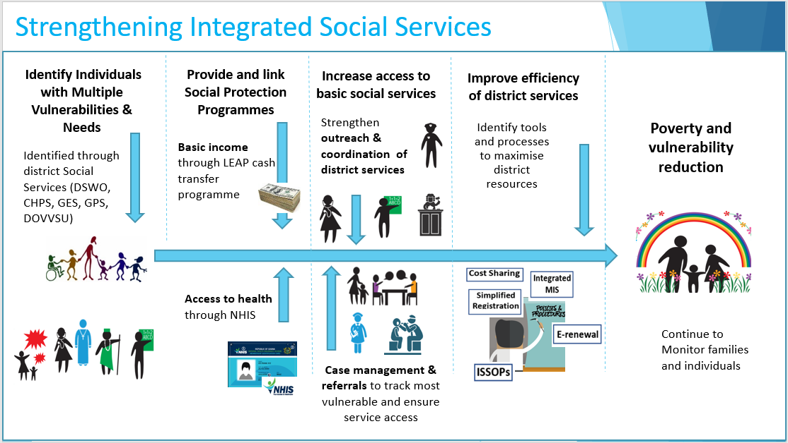
ISS Initiative – Theory of Change
Specific objectives:
Strengthening capacity, coordination, and systems at local and national level with a focus on child protection, social protection and health services.
To learn and document how social services can best be coordinated and delivered, to effectively address the needs of vulnerable children and families.

Slide 3
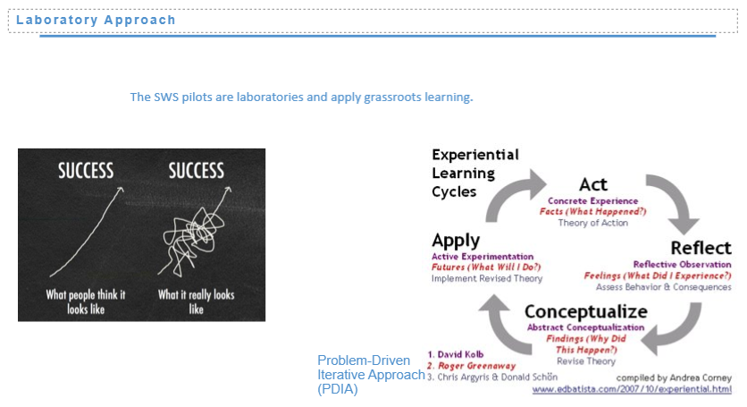
Remember our approach to learning…
  Iterative approach at the decentralized level in response to local needs and challenges
  Capture and share learnings, bottlenecks and progress made through ISS activities
  Integrating ISS learning outcomes in existing reporting structures and tools as far as possible
  For further re-application in ISS districts, and to inform discussions for gradual scale-up
  Towards this end, ISS M&E Framework as a guideline to inform efforts to collect data and extract lessons for stakeholders at various levels, with a focus on MMDA-level.

Slide 4
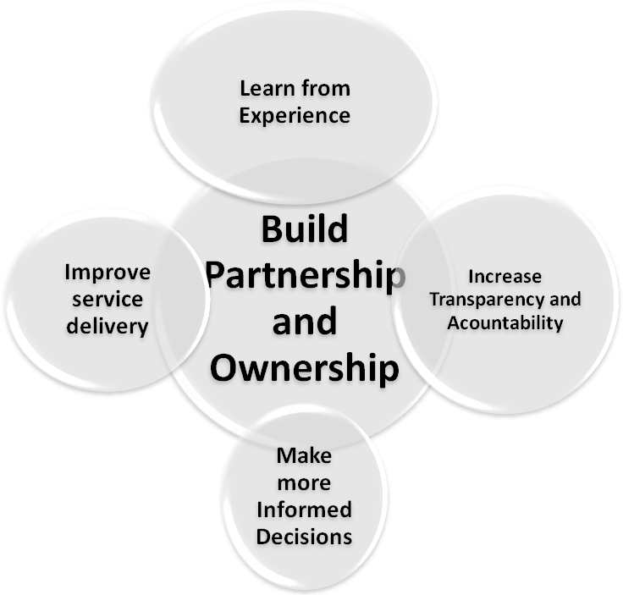
Core Values of M&E and Reporting

Slide 5

TEAM WORK, PARTNERSHIP AND COLLABORATION

Slide 6
Intended Learning Outcomes
1. Sector-Specific Linkages at MMDA levels
a. SW/CD Linkages
b. GHS Linkages
c. NHIA-LEAP Linkages
d. Other sector Linkages
2. ISS Coordination, Monitoring and Reporting
a. MMDA ISS Coordination
b. MMDA level planning and budgeting
c. Reporting and Learning
d. Regional Monitoring Visits and Technical Support
3. Upstream Processes
a. Identify bottlenecks and best practices at MMDAs
b. Update inter-sector protocols and MoUs
c. Implement technological innovations
Learning outcomes at three main levels
Distinction between “business as usual” vs. ISS-specific activities and outcomes
Focus on latter to minimize burden of M&E efforts
Integration with existing reporting structures and tools explored with NDPC and specific sectors
ISS indicators for each major linkage (e.g. LEAP-NHIS) and activities thereunder
Focus on operation and process outcomes (#2 and #3)

Slide 7
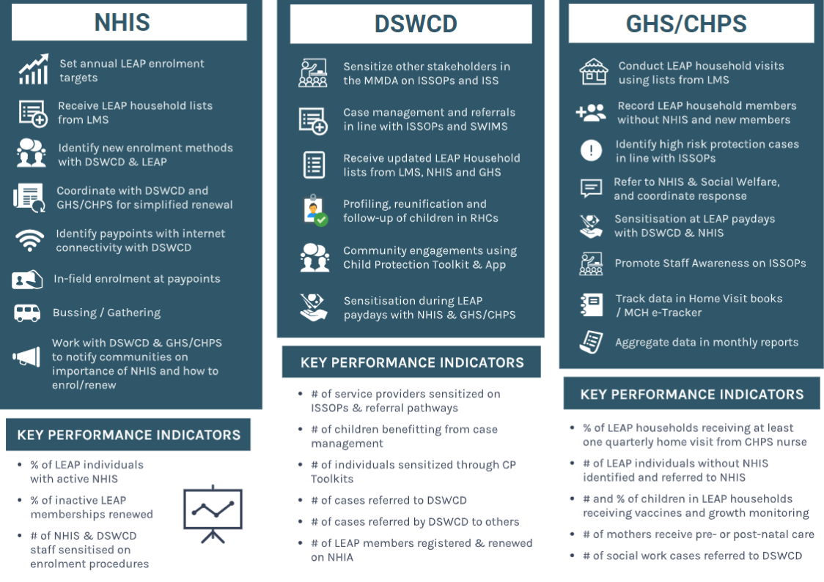
Examples of Activities & Sector-Specific Indicators under ISS

Slide 8
Main Tools for Data Collection
TOOL & Frequency
Annual Progress Report (quarterly / annual)
ISS Activity Reports to MoLGDRD
DHIMS (monthly / quarterly)
CHPS Home Visits Register and Quarterly Reports
CHPS e-tracker (4 regions)
LEAP Household Lists
NHIS-MIS (quarterly)
LEAP E-MIS (quarterly)
SWIMS (quarterly / on-demand)
CP Toolkit Reporting Application ( real time/on demand/quarterly)
Regional Monitoring Reports (annual)
National monitoring reports (quarterly)
Surveys (ad-hoc)
Phone calls (select MMDAs) (Monthly)
Review Meeting (Annual)
LEAP-ISS Impact Evaluation 2021-2022
SOURCE
NDPC / MMDAs
DSWCD / MMDAs
GHS – MMDA and Regional
GHS
GHS
GHS
NHIA
LMS / DSWOs
Social Welfare / Department of Children + UNICEF
Department of Children/GACA Secretariat + UNICEF
RCC, Regional GHS, NHIS, DSW teams
National steering committee team + UNICEF
National steering committee team + UNICEF
National steering committee team + UNICEF
National steering committee team + UNICEF
Social Protection Sector DPs + MoGCSP

Slide 9
Monitoring, learning and reporting strategy in a nutshell
The main tool for data collection is the APR – Annual Progress Report prepared by MMDAs under guidance of NDPC.
In addition, specific sectors have their own monitoring tools that collect further operational and output monitoring data.
ISS will try to build on, and strengthen, existing monitoring protocols.
As we are strengthening inter-sectoral collaboration, there will be joint monitoring missions from the regional and national level to participating MMDAs. For these, there will be sector-specific regional monitoring checklists (see in folder).
Let’s now look at some of the indicators in the APR, and in sector-specific monitoring tools

Slide 10
The Annual Progress Report (APR)
Key instrument for reporting on the progress made towards achievement of the goals and objectives of the DMTDPs and the Policy framework on an annual basis
It serves as a single source of information on progress being made and assists in identifying weaknesses and constraints to the attainment of the goals and objectives of the DMTDPs and the policy framework. It also makes recommendations to help address the bottlenecks.
It presents the status of indicators and targets that were adopted by stakeholders for tracking the achievements of key policy objectives, programmes and projects of the DMTDPs

Slide 11
Core APR Indicators relevant for Indicator
Proportion of Population with Valid NHIS Cards
Total number of recorded cases of child trafficking and abuse
Number of Operational Health Facilities
Besides Core Indicators, sectors have important specific indicators for linkages

Slide 12
Analysis on core and district specific indicators (ISSOPs)
 | INDICATORS | Baseline (2017) | Target 2018 | Actual 2018 | Target 2019 | Actual 2019 | Target 2020 | Actual 2020 | Target 2021 | Actual 2021
 | Number of girls and boys who have suffered from abuse, neglect, exploitation and violence benefiting from case management services
 | Number of cases of girls and boys referred to other services and followed up – health, social welfare, education, police, justice, safe temporary shelter, etc.
 | Number of LEAP household members referred to NHIS (for registration / renewal)
 | Number of girls, boys, women and men reached with child protection and SGBV information (Child Protection Toolkit)
 | Number of children placed in foster care Number of children reunified with their families Number of sub-standard residential homes for children (orphanages) closed down

Slide 13
INNOVATIVE STRATEGIES FOR PREPARING THE ANNUAL PROGRESS REPORTS
District Chief Executive Officers, Coordinating Directors and Heads of Departments should be committed to the implementation of the District Medium-Term Development Plan (Road Map for Development)
Create awareness on core and district specific indicators and other reporting requirements among Heads of Departments and other key stakeholders in the district
Assign relevant indicators to Heads of Departments and co-opted members of the District Planning Coordinating Unit (DPCUs)
Heads of Departments should demand data on indicators from their subordinate periodically
The DPCU should organize periodic review meetings for heads of departments to discuss progress using these indicators as basis
Collate and validate data from heads of departments for the period
Seek assistance on some indicators from the RCC and other relevant national coordinating authorities or secretariats
Prepare and share report with key stakeholders

Slide 14
CONCLUSION
NDPC and RPCUs should work with MMDAs to improve on the quality of subsequent reports
Regional Directors should demand data on indicators from their District Directors
RCCs should demand data on indicators from Regional Directors for decision making
NDPC and RPCU should organise periodic monitoring visits to ascertain validity of information provided in the district annual progress reports
District Coordinating Directors and Planning Officers should discuss indicators with District Directors of Departments and Agencies

Slide 15
DISCUSSION
What is the importance of monitoring for sectors?
How does it help integrated social services?
What is the role of regions?
What are some of the challenges?

