Slide 1
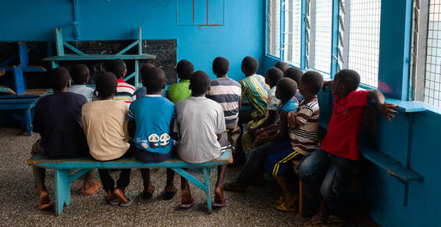


GUIDELINES FOR DE-INSTITUTIONALIZATION OF RESIDENTIAL HOMES FOR CHILDREN

Slide 2
OUTLINE
What is De-Institutionaliation (DI)?
Why de-institutionalize?
Family-based Care Alternatives
DI Steps/Process
  STEP #1
  STEP #2
  STEP #3
  STEP #4
  STEP #5
  STEP #6
  STEP #7
  STEP #8
Sharing Strategies

Slide 3

WHAT IS DE-INSTITUTIONALISATION (DI)?
Institutional Care = forms of residential care without a parent/guardian catering for a number of children.
In Ghana - Residential Homes for Children (RHC)
DI is a policy-driven process to reform alternative care system by:
Decreasing reliance on institutional care (aka RHCs in Ghana)
Increasing family + community-based care options
Preventing family separation/new placements
Preparing for transition and inclusion of care leavers to alternate care / independent living

Slide 4
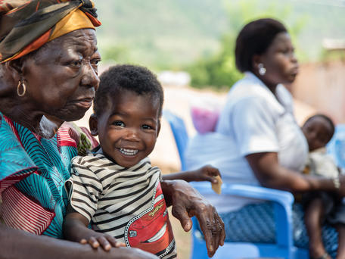
Why de-institutionalize?
INTERNATIONAL
90% of children in institutions are not orphans
Evidence on detrimental effects of residential care on children
Particularly unsuitable for infants in early childhood (0-3 years)
Child’s right to family care
Violence in institutions – neglect, abuse, poor staff ratios
GHANA
2006 DSW study- 80% of children living in RHCs had families - could have been supported with family/ community-based care
Majority RHCs unlicensed

Slide 5
Family-based Care Alternatives
Short-term or long-term placement of a child into a family environment, with at least one consistent caregiver.
Focus on placing children in biological, foster, adoptive families
+
Strengthening families to prevent separation / effective “gatekeeping”

Slide 6
Family-based Care Alternatives
Continuum of Care
Reintegration into family of origin, where possible
Reintegration of CwDs
Extended family / kinship care
Foster care
Adoption
Other community-based care models
Supported independent living
Notes:
CwD = Children with Disabilities

Slide 7
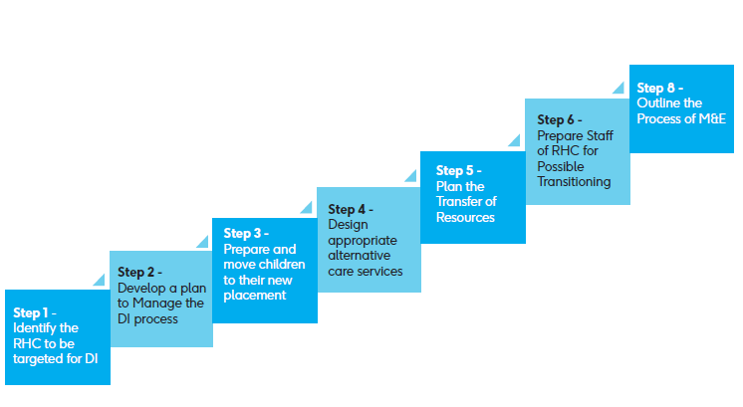
STEPS FOR D.I IN GHANA
Derived from international best practice
At the Regional and District levels

Slide 8
Step #1: Identification of RHC for DI
Identify RHCs for (a) licensing (b) licensing upon compliance (c) closure
Initial Assessment by DSW - number RHCs in region/district, staff, children and their vulnerability, range of alternative services available, etc.
Timeline for closure to prioritize poorer quality RHCs
Detailed evaluation of RHC identified – profiling of all children and their family situation, institutional resources, etc.
Stock and flow analysis of the RHC
FLOW = admissions and discharges
To project alternate services required for transition
Early consultation with RHC managers to tackle resistance/hostility and ensure cooperation through transition
STOCK = number and characteristics of children present in RHC

Slide 9
Step #1: Identification of RHC for DI
Awareness raising among key stakeholders is key.
At Community, RHC and national level
To understand stakeholder attitudes towards institutional care
What are initiatives from the community/local partners?

Slide 10
Step #2: Plan to Manage DI Process
Set up a Steering Committee to ensure collaborative, multi-stakeholder DI response
  Membership: DSWCD, SP agencies, DOVVSU, CHRAJ, GPS, GES, local councils, NGO/CSO partners, donors, private sector, legal advisors, accountants
  Collaboration = added resources
Project management team to oversee practical implementation of DI plan
  Membership: case manager, Regional & District DSW members, RHC member and psychologist, accountant, administrator

Slide 11
General DI Strategy
  Family reunification + Closure/Transformation of RHCs for other service provision:
    Catering for children with special needs
    Develop roadmap to place children aged 0-3 years in kinship/formal foster care.
    Transformation of long-term care into short term care facilities
  Overall emphasis on reducing size to 30 children as per standard
  Regions with high concentrations of RHCs – prevent new RHCs, prioritize closure, strengthen alternate care services
  DSWO to support case management process

Slide 12

Step #3: Prepare and move Children to new placement
Most important and complex aspect
Child-centered case work – to prepare child, and minimize trauma
  Conduct Child assessment
  Conduct Family Tracing and/or Family Assessment
  Plan for alternative care if needed
Official placement decided by relevant authorities
Gatekeeping – ensuring care decisions for children out of parental care are appropriate, in best interest of child
  Long term goal – permanency
  “Necessity principle” - alternative care is genuinely needed
  “Suitability principle” – appropriate care is provided

Slide 13
Step #3: Prepare and move Children to new placement
Preparing children and families for transition
  Supported by case manager
  Discussing with children in an age-appropriate manner
  Managing expectations
  Sharing child background information and needs with caregivers/family
  Family visits to child, where possible
  Assessment and redressal of family needs through referral and access to services (e.g. LEAP, day care, etc.) and training resources (e.g. Manual for caregivers of Children with Disabilities, Manual for Foster parents)
Develop individual care plans for children
  Children with disabilities (CwD) and special needs should not be left behind.

Slide 14
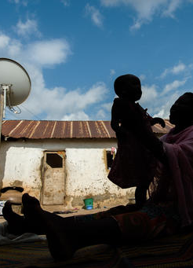
Step #4: Design appropriate alternate care service
Understand the primary causes of family separation – poverty, SGBV, disability, illness, parental death, etc.
Project which care services may be required:
Prevention services for child at risk of separation
Reintegration into the family
Placement in extended family
Substitute families (foster care, adoption)
Specialist Residential care (e.g. small family homes)
Therapeutic services (e.g. children in need of psychosocial support)
Transition to Supported Independent Living

Slide 15
Step #4: Design appropriate alternate care service
Keep in mind principles of better practice in caring for children while designing alternative care services
Some key concepts:
  Package of care as opposed to ‘one placement fixes all’ approach
  Work in partnership with families – empower families to problem-solve and access resources
  Know range of available services to choose from for placement and social service support
  Child-centered decision making

Slide 16
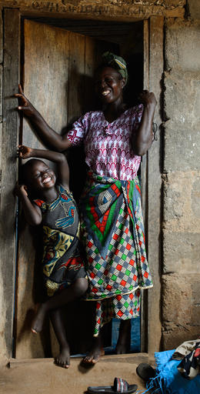
Step #5: Plan for transfer of resources
Current budget and funding arrangements
Projection of running costs for new service
Building Partnership for Management of resources
Reallocation of resources (buildings, fixed assets) for alternative services
Engaging donors, ministry partners, volunteers

Slide 17
Step #6: Prepare RHC staff for transition
Partnering with RHC staff and volunteers:
- Transparency
- Address staff concerns
Preparing staff for transition: support alternative roles and capacity-building where possible
Tackle resistance to DI: Turn into agents of positive change.
- e.g. Enroll in next steps where possible
Maintain interests of child as primary

Slide 18
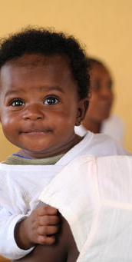
Staffing in New/ Alternate Services
Factors to consider:
Professionalization of services
Reduction of unnecessary posts
Service location close to demand
Remember existing staff and their needs, potential to change
Identify any abusers
Staff with special relationships with children
Evaluation of current staff performance by an independent team
Opportunities for additional training / retraining

Slide 19
Step #7: Address the Logistics Needed
Proposing timescale based on action plan of Steering Committee
  Closure in a phased manner to allow for provision of adequate placement and post-placement support
Preparation and movement of children
Phased selection, training and movement of staff
  To correspond with movement of children
Opening of new services
  Ensure new services are ready and functional prior to moving

Slide 20
Strategic External Partnership development
Various external partners can be engaged:
Government agencies with mandate to protect children
NGOs with high quality services for children
Community members and CBOs
Local churches, ministries – address attitudes within community, support recruitment of foster parents, etc.
Private sector

Slide 21

Step #8: Outline the M&E Process
What does M&E of the DI process entail?
  Collection of baseline data on each child, assessment/care plan, etc.
  Monitoring child placements – case monitoring, case closure, follow up for youth leaving care
  Programme monitoring – have objectives of overall DI plan been met?
  M&E captured in periodic progress reports
  Documenting Lessons Learnt
  Progress reports

Slide 22
Success Story - Rwanda
DI Programme launched in 2010 by the Ministry for Gender and Family Promotion.
Conducted survey of children in institutions: 3,323 children living in 33 institutions
  Over 70% had at least one parent or living relatives.
12 Homes closed and 1,032 children successfully reintegrated.
On the average, 18 months for closure.
Homes closed are transformed into other services. E.g. Community hubs
Strong political will.

Slide 23
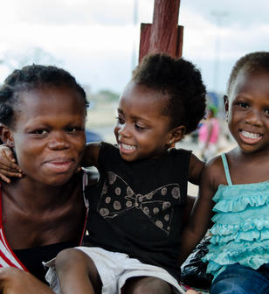
What are some useful DI strategies in your experience?

Slide 24


