Slide 1
Inter-Sectoral Standard Operating Procedures (ISSOPs) for Child protection and Family Welfare Casework

Slide 2

PRESENTATION UTLINE
Background
What do we intend to achieve
Intended users
Categorization of Child Protection Cases
Key Roles and Responsibilities Shared by all Stakeholders
Category of Risks and vulnerability
Referral Pathways
conclusion

Slide 3
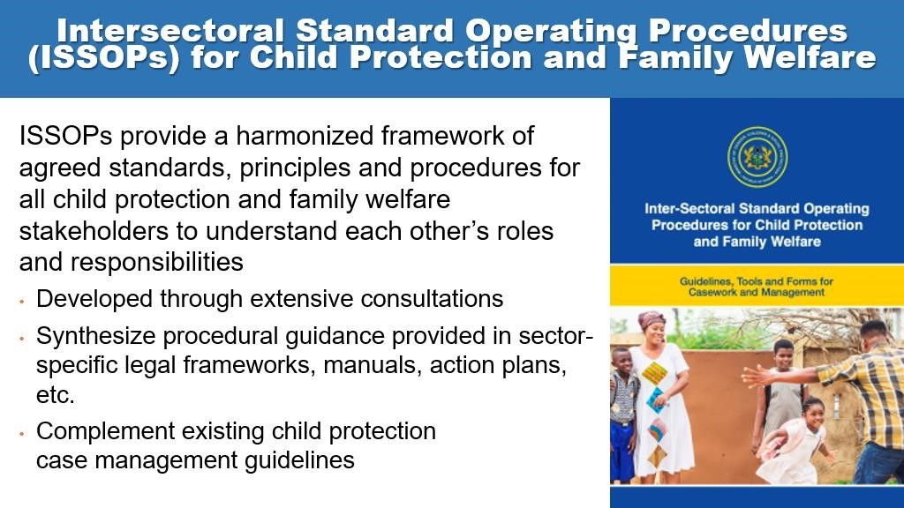

Slide 4


The following policies promote
effective coordination at various level
in protecting our children and the
vulnerable:
•
Child and Family Welfare Policy
BACKGROUND
•
Justice for Children Policy
•
National Social Protection Policy
•
National Decentralization Policy
•
National Health Policy
•
National Gender Policy
etc.
33

Slide 5
BACKGROUND
but challenges in practice
Many programmes achieve impacts, but have limited complementarity – lost opportunities
Certain protocols and systems are in place for coordination but not functioning well, especially at decentralized level
Different degrees of decentralization for different sectors
Overburdened frontline workers
Insufficient and/or unpredictable resources and capacity
No Standardized forms, no coherent steps and procedures in place

Slide 6
  WHAT DO INTEND TO ACHIEVE WITH THE ISSOP
Improve accountability
Improve Inter-sectoral And Multi-disciplinary Coordination
Unburden frontline staff through proper Case Management Cost Sharing
Promote early risk and vulnerability identification, reporting and support
Observe Ethical Standards

Slide 7
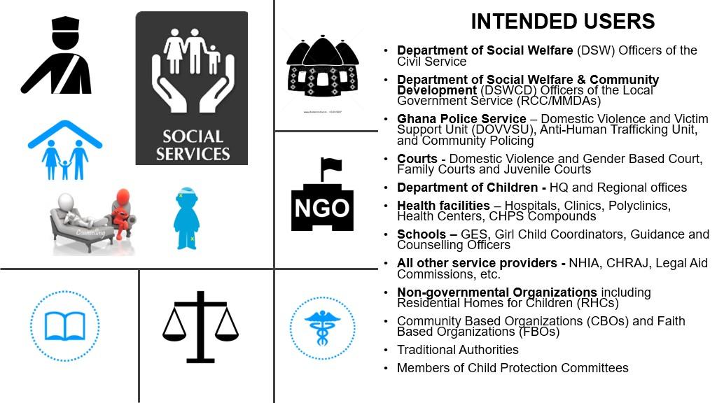










INTENDED USERS
INTENDED USERS
Department of Social Welfare
•
(
DSW) Officers of the Civil
Service
•
Department of Social Welfare & Community
Development
(
DSWCD) Officers of the Local Government
Service (RCC/MMDAs)
Ghana Police Service
•
–
Domestic Violence and Victim
Support Unit (DOVVSU), Anti
-
Human Trafficking Unit, and
Community Policing
Courts
•
-
Domestic Violence and Gender Based Court,
Family Courts and Juvenile Courts
Department of Children
•
-
HQ and Regional offices
Health facilities
•
–
Hospitals, Clinics, Polyclinics, Health
Centers, CHPS Compounds
•
Schools
Non
•
-
governmental Organizations
including residential
Homes for Children
•
Community Based Organizations (CBOs) and Faith Based
Organizations (FBOs)
•
Traditional Authorities
•
Members of Child Protection Committees
37

Slide 8
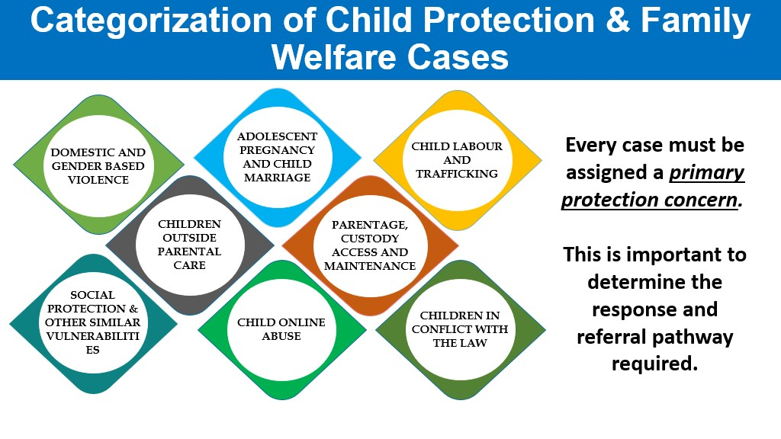

Slide 9
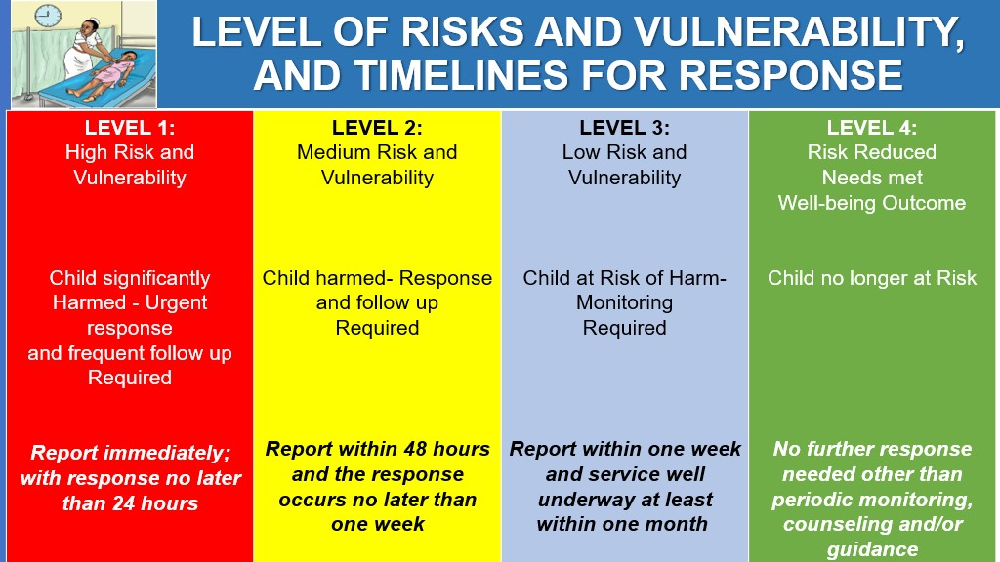

Slide 11
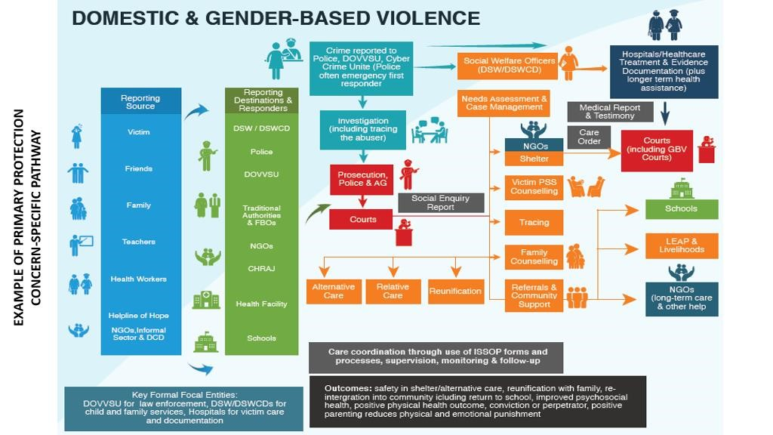

Slide 12
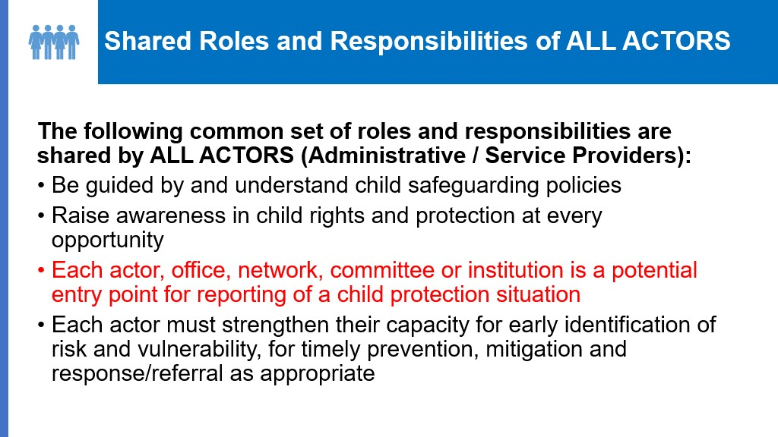

Slide 13
THANK YOU

