Slide 1
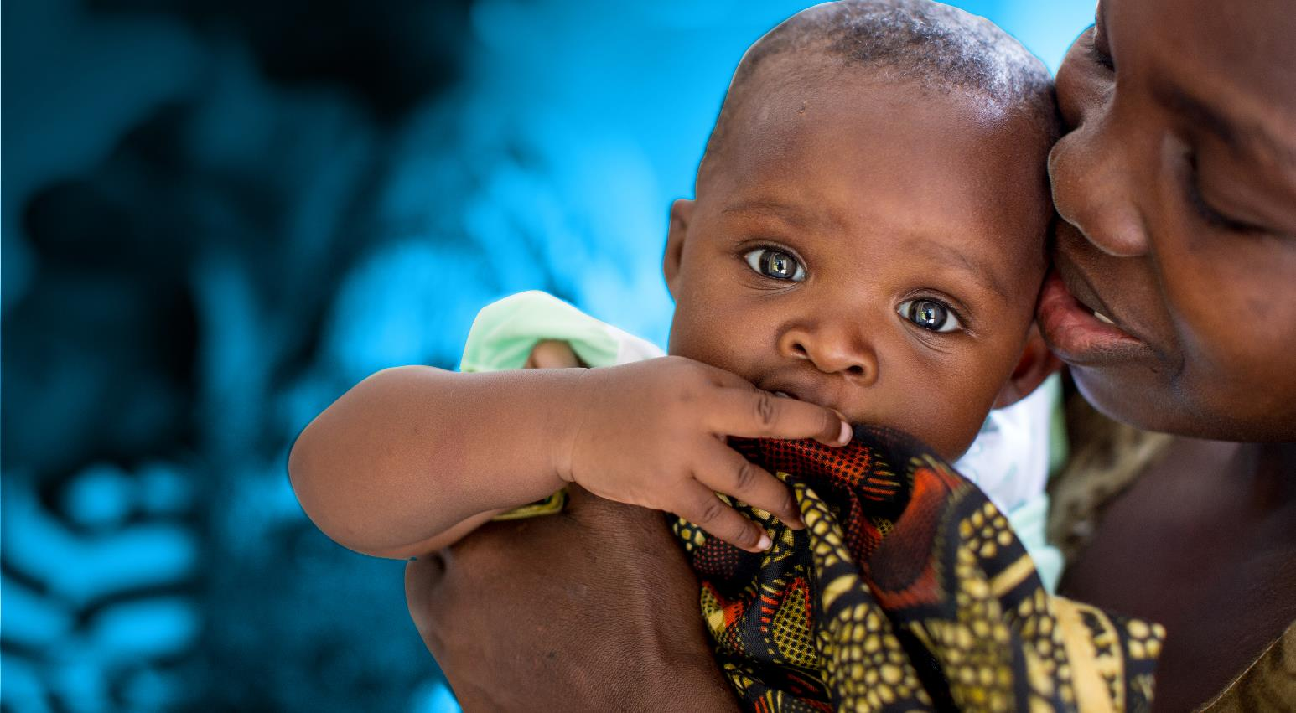



Introduction to Case Management
for Child Protection
© UNICEF/UNI197921/Schermbrucker

Slide 2

Objectives
By the end of the day, participants will be able to :
Describe what is case management
Identify the guiding principles of case management
Describe the key steps of case management
Describe the principle of alternative care
Understand the importance of case documentation

Slide 3

Session 1: What is Case Management?

Slide 4
Background of Case Management in Ghana
  Different SOPs (child labor, child trafficking, Police, health guidelines, GBV, etc.)
  No Standardized forms
  No coherent steps and procedures in place
DSW with support from UNICEF:
  Developed a Case management Standard Operating Procedures and related tools for children in need of care and protection
  For Social Welfare and Community Development Officers (SWCDOs)
  Incorporated global best practice
  Contextualized for Ghana

Slide 5

Who are children in need of protective services?

Slide 6
Child in need of care and protection
The Children’s Act, 1998 defines a child in need of care and protection:
  Is an orphan or is deserted by his relatives;
  Has been neglected or ill-treated by the person who has the care and custody of the child;
  Has a parent or guardian who does not exercise proper guardianship;
  Is destitute;
  Is under the care of a parent or guardian who, by reason of abuse of substance, is unfit to have the care of the child; (Children’s Amendment Act, 2016, Act 937)
  Is under the care of a parent or guardian who by reason of a criminal conviction, particularly in relation to child abuse is unfit to have the care of the child. (Act 937)
  street children or begging
  Is a person in relation to whom an offence has been committed or attempted under section 314 of the Criminal Code, 1960 (Act 29) on slave dealing;
  Is below the age of criminal responsibility under the Criminal Code, 1960 (Act 29) and is involved in an offence other than a minor criminal matter; or
  Is otherwise exposed to moral or physical danger.
Notes:
Children = 0-18 years old

Slide 7
Quiz – How much do you know?
The Children’s Act, 1998 (Act 560) applies to vulnerable children only? Yes/No
Notes:
Answer. No. The act applies to all children. Children in need of care and protection and in conflict with the law have special measures provided in the Act, but the Act is relevant for every child who is in Ghana. The Act is the overriding legislation for all children in need of care and protection

Slide 8
Case Management is…
The process of providing
Protection and support to
Individual children and their families
Who are vulnerable to certain risks,
Directly or through referral services,
And following that process through
Until goals are met.
Notes:
(Child Protection Working Group. 2014. Inter-agency Guidelines for Case Management and Child Protection)
In other words, statutory case management is the process that must be followed when a child is found to be in need of care and protection by a social worker.

Slide 9
Goal of Case Management
The goal of case management is to empower the adult or child client and, where appropriate, the child’s caregiver by:
giving them increased awareness of choices, they have in dealing with the problem, and
assisting them to make informed decisions about what to do about the problem.

Slide 10
The Role of Case Workers/Managers
Applying confidentiality protocols to reflect the limits of confidentiality;
Assessing a client’s immediate health, safety, psychosocial and legal/justice needs;
Identifying strengths and needs to engage the client in a strength-based care and treatment process;
Proactively engaging non-offending caregivers throughout case management;
Having the ability to function independently and collaborate with other service providers to provide needed services; and
Documenting the case.

Slide 11
What are the Guiding principles of Case Management?

Slide 12
Guiding principles
Best interest of the child
Preference for child to be kept with parent, guardian or relative
Empower children, adolescents and families to build on their own strengths
Non discrimination
No harm
Confidentiality
Age and gender sensitive
Coordinate and collaborate

Slide 13
Important Tips!
The CFWP has as its foundation the preservation and strengthening of families.
Prevention and early intervention are central to managing children’s issues.
Children and adolescents have a right to stay in family-based care.
Case management has a role in preserving family life and preventing harm to the child.
When a child has to be removed, the case management process seeks to ideally support the child’s return to the family or, where it is not possible, a permanent family-based option where possible or a supervised independent living arrangement (eg. case of older adolescents).

Slide 14
Is it the SWCD Officers’role to strengthen and preserve families?

Slide 15
Answer: Yes (but not exclusively).
Family preservation services empower families in order to keep children together.
Family preservation services should empower parents, guardians and caregivers with necessary opportunities, skills, support and guidance to raise their children successfully.
The CFWP makes provision for kinship care to ensure that a child is still within the family environment

Slide 16
In summary
Case management is a process, not a single act
This definition focuses on prevention as well as response
It is individually customised for each child and family
It relies on many actors
It continues until the child and family no longer need support.

Slide 17

Session 2: Key steps of case management

Slide 18
Case Management Steps
Case identification and intake
Assessment
Case planning
Case implementation
Case Review/Monitoring
6. Case closure.

Slide 19
Step 1: Case identification and disclosure
Refers to the initial contact with a child/adolescent who is thought to need care and protection.
Can be done through clients presenting themselves to the case manager, through case managers’ outreach, or through case being referred by another service provider.
It is the case manager’s first chance to establish rapport with the client and begin to develop the basis for a trusting relationship.

Slide 20
Quiz – How much do you know?
It is mandatory for any person to report to the nearest SWCD if they have a concern regarding the protection or welfare of a child?
Notes:
Answer: Yes. The Children’s Act, 1998 (Act 560) Section 17 stipulates that any person with information on child abuse, or a child in need of care and protection shall report the matter to the Department of Social Welfare.
This means the identification and reporting of actual and suspected child protection cases is the responsibility of all Ghanaians including family members, community members, religious leaders, traditional leaders, police, teachers, health care workers and social service professionals.

Slide 21
Answer: Yes. The Children’s Act, 1998 (Act 560) Section 17 stipulates that any person with information on child abuse, or a child in need of care and protection shall report the matter to the Department of Social Welfare.
This means the identification and reporting of actual and suspected child protection cases is the responsibility of all Ghanaians including family members, community members, religious leaders, traditional leaders, police, teachers, health care workers and social service professionals.

Slide 22
Open a case file
A register of child protection cases referred to the Department or identified by the SWCDOs should be maintained by each District.
Case Intake refers to the opening of a case of a child who has been identified as having been abused or at risk of abuse. It involves collecting basic information on the child, the responsible adults in the household, and other significant caregivers, and a statement of the problem or reason for referral.
At this stage, the District Head decides which SWCDO to allocate the case to according to their current caseload.
FORM 1 can be applicable

Slide 23
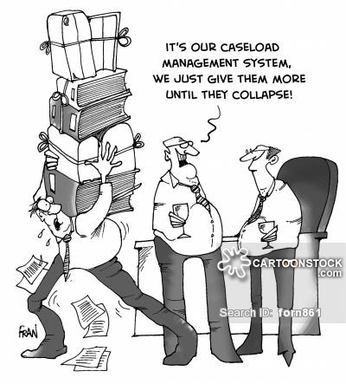
Plenary
What is an optimal case
load for a SWCDO?

Slide 24
Typology of Cases
Cases that must be investigated by the SWCDO with the police
Cases where police involvement not required, only SWCDO
Defilement and Attempted defilement, child rape
Sodomy and Incest
Child trafficking, child sexual exploitation
Child stealing and Unlawful removal of child
Abduction
Exposing child to harm and Child abuse
Exploitative of child labour
Non-maintenance
Child marriage
Others crimes
Emergency food need/severe malnutrition/ health care needs
Child Labour
Children out of school
Lack of Birth registration
Need for school fees
Child participation issues
Need for school uniforms
Notes:
important to clarify that this involve engaging in sex with someone that is below the age of 16 which in Ghana is the age for consent to sex

Slide 25
Plenary
What are the cases handled by the traditional authorities without the involvement of SWCDO or Police?

Slide 26
Step 2 – Assessment
Safety assessment is to determine whether the child is safe or unsafe and in need of care and protection services
Gathering information or data for the purpose of making an appropriate safety decision about a course of action.
In cases of imminent danger, develop a safety plan and make safety arrangements (e.g. temporary emergency shelter/ safe home) prior to conducting case planning.

Slide 27

What we see and learn at intake

Slide 28

What we discover at social investigation

Slide 29
Safety decision
Safe: No safety threats are identified at this time. | The decision can be made to either close the case or refer to non-child protection services.
Safe: Threats are present, but child is not vulnerable | Safety plan is required for the child to remain in the home.
Safe: Presence of threats with vulnerable child, but sufficient protective capacities exist | Safety plan is required for the child to remain in the home
Unsafe | Remove the child. Placement with a “fit person” in temporary alternative care is the only protecting intervention possible for one or more children. The Children’s Act requires the Department to obtain a care order authorizing this removal within seven (7) days of removal. This requires submitting a Social Enquiry Report (SER) to the Family Tribunal for the issuing of a care order which places the child under Section 21 (1) of Act 560.

Slide 30
Safety Interventions
Direct service intervention by SWCDO: providing information about positive parenting and child abuse laws; emergency material aid such as food and clothes; assistance to obtain restraining orders; planning return visits to the home to check on progress, psychosocial support, counseling, and referral to services.
Use of extended family, neighbours, community elders, or other individuals in the community as safety resources
Use of community agencies or services as safety resources
Caregiver appropriately protects the victim from the alleged perpetrator (in cases of abuse)
Alleged perpetrator leaves the home, eithervoluntarilyy or in response to the consideration of legal action.
Non-offending caregiver moves to a safe environment with the child
Legal intervention planned or initiated - child remains in the home
Caregiver voluntarily enters an agreement to place the child outside the home e.g. with relatives
Child placed with “fit person” because interventions 1-9 do not adequately ensure the child’s safety
Forms 1 & 2 can be applicable

Slide 31
Child and gender friendly approach to interviews
Staff trained in the special needs and rights of children should interview potential children.
When appropriate, children should be interviewed by interviewers of the same sex.
Interview space is private and age/gender appropriate, possibly containing toys, books, or games.
Sit at eye level with the child; smile and speak gently.
Greet the child and introduce yourself, your role, and what the interview is about.
Use mother-tongue and child-friendly language.
Begin with open-ended questions, avoid leading questions.
Do not press for details
Conduct interviews in the presence of a parent or guardian, unless they are perpetrators.
End the interview in a way that reassures the child that he/she has done well
Notes:
Same sex interviewers: certain topics are very sensitive (e.g. sexual violence), there might be need to assess physical injuries/ disclose personal details (some of this things are taboo in ghanian culture from a gender perspective)
children/adolescent themselves can also suggest whether there is anyone in particular that they would like to be present

Slide 32
Step 3 – Case Planning
Informed by the initial screening assessment and the comprehensive assessment
The case plan includes the overall goal of the case e.g. family strengthening, reintegration, long-term foster care or adoption.
If the child is placed in alternative care, a care plan needs to be developed in addition to case plan.
For every problem identified during the assessment, there should be a plan to address it.
The plan should be specific and should say WHO should do WHAT by WHEN.
Form 5 can be applicable

Slide 33
Step 4 – Case Implementation
• Case managers need to provide direct interventions, including psychosocial interventions;
• Refer to the appropriate services for follow-up and support;
• Advocate (if required) in accessing the required services;
• Accompany the client with social, medical, and legal services and provide support in accessing these services;
Case Managers to follow-up on the implementation.
Important to have directory of services (mapping of service providers)
Form 5, 6,7,8, 9

Slide 34
Step 5 – Case Follow-up
Monitoring and follow-up to ensure the response is efficient and effective.
Frequency of follow ups will depend on the situation of the client, their specific needs and the risk level of the case.
Follow-up can be in the form of:
  Scheduled home visits.
  Ad hoc home visits.
  Phone calls.
  Meeting with the client.
  Confirmation from service providers that the client received the services.
Based on information gathered during follow-up, the case manager can review the action plan with the client and make necessary adjustments or close the case.
Form 5, 6,7,8, 9

Slide 35
Step 6 – Case Closure
Case is closed following case review if needs have been met successfully.
Most often cases are closed when:
• The goals as outlined in the case plan have been met.
• The client is safe, and their care and well-being is being supported.
• There are no additional concerns.
• In the event the client has died.
• If the child/caregiver no longer wants support and there are no grounds for going against their wishes (the child is safe) then the case can be closed.
Form 8, 9

Slide 36
Case closure
If a child goes missing and you can no longer manage their case as a result, it may be useful to mark the case inactive rather than open or closed so that you can more easily organize and manage your open files and so that you continue to actively look for the child, which you would not do if the case was closed.
Cases can be reopened at any time when new info becomes available or the child’s situation changes
This stage can also include case conferencing if/when required/appropriate, with the consent of the client.
Notes:
Case conferences are meetings held to review individual cases requiring an inter-agency response, with focus on addressing any immediate protection problems and coordination response actions for each individual case. Case conferencing is sometimes needed and is more formal than case planning or review meetings. It is usually only used in very complex cases. It attempts to explore multi-sector / interagency service options and to make formal decisions in the best interest of the client. Minutes are taken and the client can be invited to participate in some meetings but not all.

Slide 38
Session: 3 Documentation
What is documentation?
Is a process that involves the systematic interaction of people, events, and documents to create the professional records of a client.
Documentation serves as a permanent record of client information and care.
Documents are discrete packages of recorded information and tools/ materials of quality assurance
Notes:
:

Slide 39
Documentation-What does it involve?
It involves some of the following:
Case Register – used by DSW Officers as a permanent record book into which is entered information regarding cases received or taken in.
Admission and Discharge register – used by institutions, for example RHC to enter information regarding the entry and exit of every child who passes through the system.
Social Enquiry Reports – Written to court for care orders, for adoption orders, juvenile cases and other family cases.

Slide 40
Documentation
Home Study Reports – in cases of adoption, foster care, child custody, reunification of children
Child Study Reports – in cases of adoption, foster care and family strengthening
Case recording in cases of child maintenance, custody, paternity and family reconciliation, child abuse, neglect, etc.
Progress reports – report on children in RHC, foster care, reunified with family, correctional centres or released from probation.
Case assessment, case plans, case files and so on.

Slide 41

Documentation
Why do you think it is important to document your case management work?

Slide 42
Why we document?
It helps us to provide better and timelier responses;
As a record of our formal involvement;
As a way of recording plans and monitoring progress;
To facilitate communication between agencies;
Accountability : cases can be referred to multiple agencies and could potentially get lost
To promote continuity (e.g. staff leaving or going on holiday. Some cases last for years);
Documentation helps us to plan; and implement plans.
Notes:
Note: Documentation is not the goal! Case management could happen without documentation BUT it is required to supplement our work for all of the above reasons

Slide 43
How should we document?
Data should be treated with confidentiality to protect the safety and security of clients.
All parties must ensure that all data is safe and secure and implement appropriate procedures to maintain its confidentiality.
If data are in paper form, it should be stored in a filing cabinet or furniture that locks.
Computers should have passwords and this also applies to documents used in databases.
Appropriate precautions such as anti-virus and backing up data should be taken.
All information shared electronically should protect client confidentiality by including only information that is relevant to those copied on the email and avoid using names when possible
Notes:
i think here mention needs to be made to the practice of taking pictures with watsup and sharing among networks or media - it is also a core component of the training on police SoPS
IT IS IMPORTANT TO ALSO MENTION THAT DATA Collected should always be disaggregated by sex and age

Slide 44
Remember
You cannot manage what you do not count
You have not done it, if you have not written it down
Good quality is never an accident. It is the result of high intention, sincere effort, intelligent direction, and skillful execution.

Slide 45

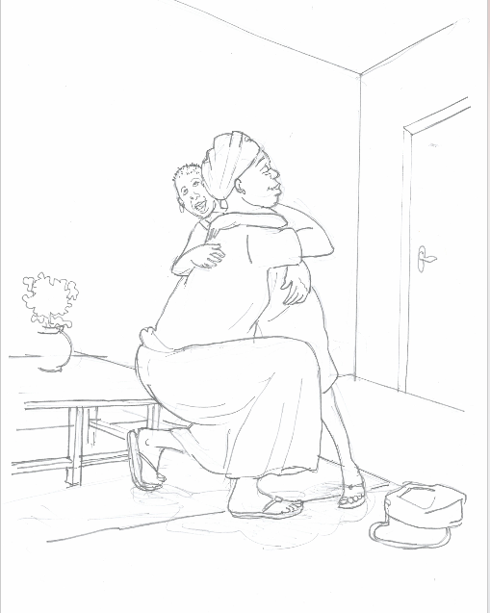
"Being a family means you are a part of something very wonderful. It means you will love and be loved for the rest of your life". - Lisa Weed.
THANK YOU

Slide 46
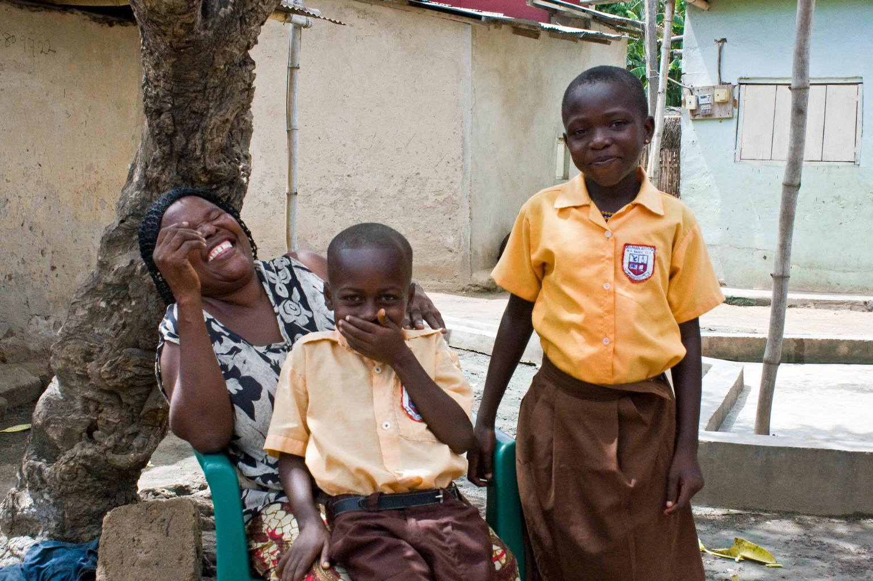
Alternative Care of Children

Slide 47
Objectives
By the end of the day, participants will be able to :
What is Alternative Care
Understand the types of Alternative Care

Slide 48
What is Alternative Care?
It is a care arrangement for children who are not under the custody of their biological parents
Alternative Care Types:
Family-based care – kinship care & foster care
Residential care – Residential Homes for Children (RHCs), orphanages, children’s homes, shelters, children’s villages, transit homes
Adoption- It can be a type of alternative care but is not family-based care as it is a permanent alternative care solution for a child who cannot be with his/ her biological parents.
Formal and Informal Alternative Care:
Informal – kinship care
Formal – foster care, residential care
Notes:
Residential care is defined by certain characteristics:
Unrelated children live in the care of paid adults.
Children are separated from their family and often their community. In many cases, they do not have the opportunity to bond with a caregiver.
Facilities usually run according to workplace routines, instead of responding to individual children’s needs
Mention that Adoption is included under the broad category of Alternative Care but is not part of family-based care as it is a permanent alternative care solution for a child who cannot be with his/ her biological parents. When a child is adopted, the legal relationship with his/her biological parents and birth family is permanently cut. Family-based alternative care is intended to be a temporary option to care for children with the goal of reuniting the children with their families.

Slide 49

Separation of children as last resort
Prevention of separation (e.g family strengthening)
Separation of the child from his/her family as a measure of last resort and for the shortest possible duration
Poverty should never be only justification for the removal of a child from parental care, placement into alternative care, or for preventing his/her reintegration (Article 15 AC Guidelines)
Priority to family-based alternative care and respect for the child’s individual needs
  Maintain the child as close as possible to family
  Prohibit the separation of siblings
© UNICEF/NYHQ2011-0098/NOORANI
Notes:
Best interests and rights of the child (Article 6 AC Guidelines)
Participation of child and families in all decisions affecting the child (Articles 6, 34, 65 AC Guidelines)

Slide 50

Key Principles
State is responsible for the care and protection of children outside of family care (Articles 3, 9, 19, 20 CRC)
Required to monitor, regulate, and oversee the quality and appropriateness of ALL alternative care (Article 3.3 CRC)
Decision-making on alternative care must be based on judicial, administrative or other adequate and recognized procedure (Article 57 AC guidelines)
All agencies and facilities must be registered and authorized to operate by social welfare services or another competent authority (Article 105 AC guidelines)
Notes:
UNI190319.jpg in 'Med-Res' format:Unique identifier: UNI190319In-house Identifier: GHAA2015-00931source name: Nyani QuarmyneTitle: Asset rights: Long Description: A stuffed toy in a baby's cot at the Osu Children's Home in Accra, Ghana in 5 May 2015. The home receives children who require residential care from state organs such as the police, social welfare and the courts, and at the time of this photograph, according to the director, was home to approximately 160 residents ranging in age from babies to young adults.Osu Children's Home, Accra

Slide 51
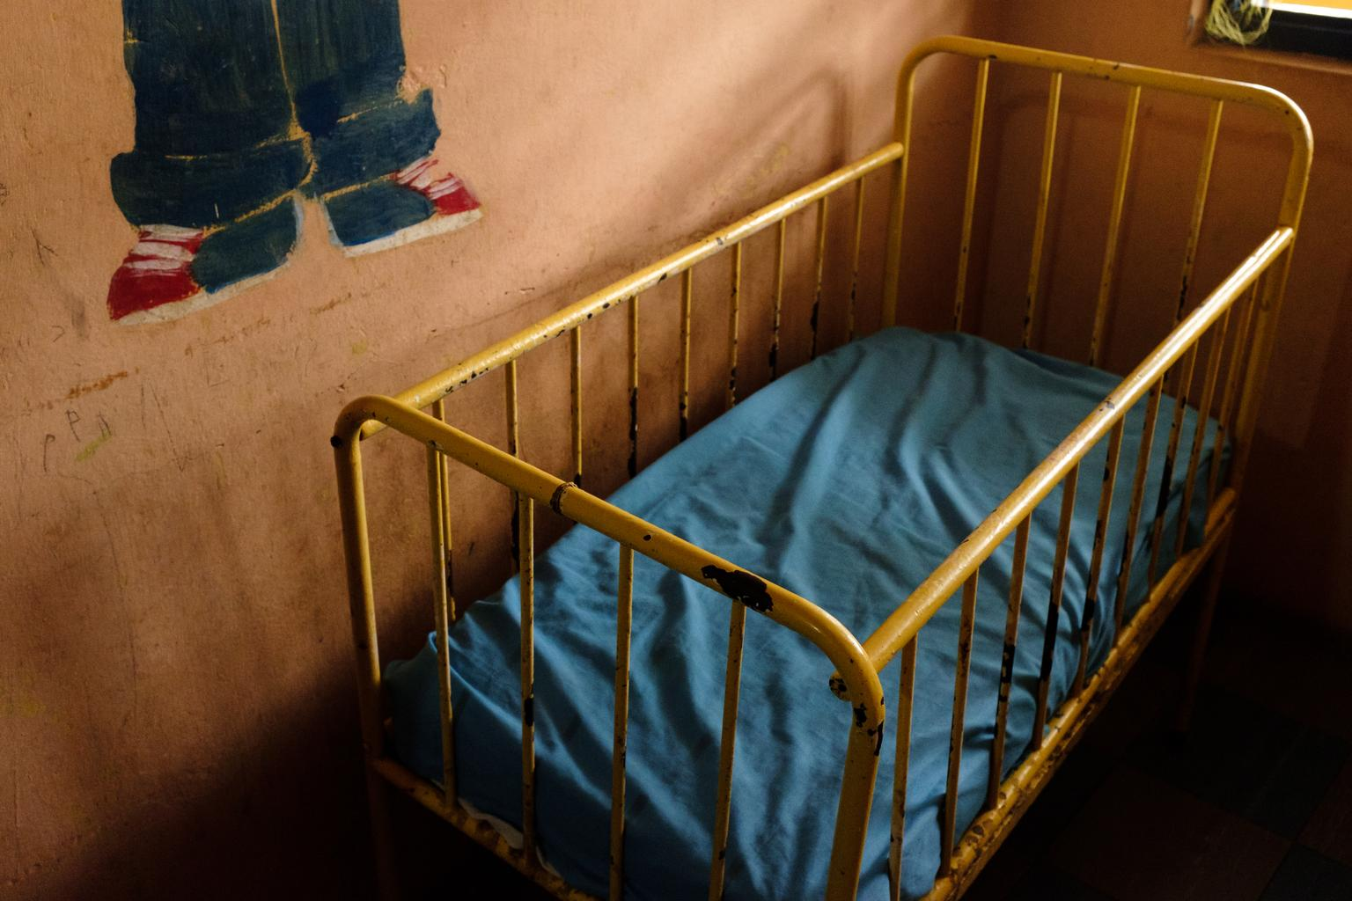
Necessity principle
Discouraging unwarranted recourse to alternative care:
  Consulting with family and child
  Promoting family support and family reintegration
  Preventing avoidable relinquishment/Abandonment
  Stopping unwarranted removal
  Addressing negative societal factors
  Ensuring effective gatekeeping
  Regulating public and private care providers
Notes:
PRINCIPLE OF NECESSITY: preventing the need for unnecessary alternative care (Promoting parental care)
- Preventing situations and conditions that can lead to alternative care: from material poverty, stigmatization and discrimination to reproductive health awareness, parent education and other family support such as provision of day care facilities
- Gatekeeping mechanism: ensuring children are admitted to the alternative care system only if all possible means of keeping them with their parents or wider / extended family: requiring adequate services or community structures to which referrals can be made. The necessity of the placement must be regularly reviewed with consultation with parents and children
Support efforts to preserve or re-establish family unit:
Policies/programs to support families in meeting their responsibilities towards the child and promote the right of the child;
Address the factors creating risks of separation including root causes of abandonment as well to prevent avoidable relinquishment and stopping unwarranted removal;
family strengthening services, supportive social services, youth policies ;
ensure family strengthening and support takes in account issues linked to disabilities (child or caregivers) other discriminatory factors; Addressing negative societal factors;
Reintegration of children separated from their family when in their best interest

Slide 52
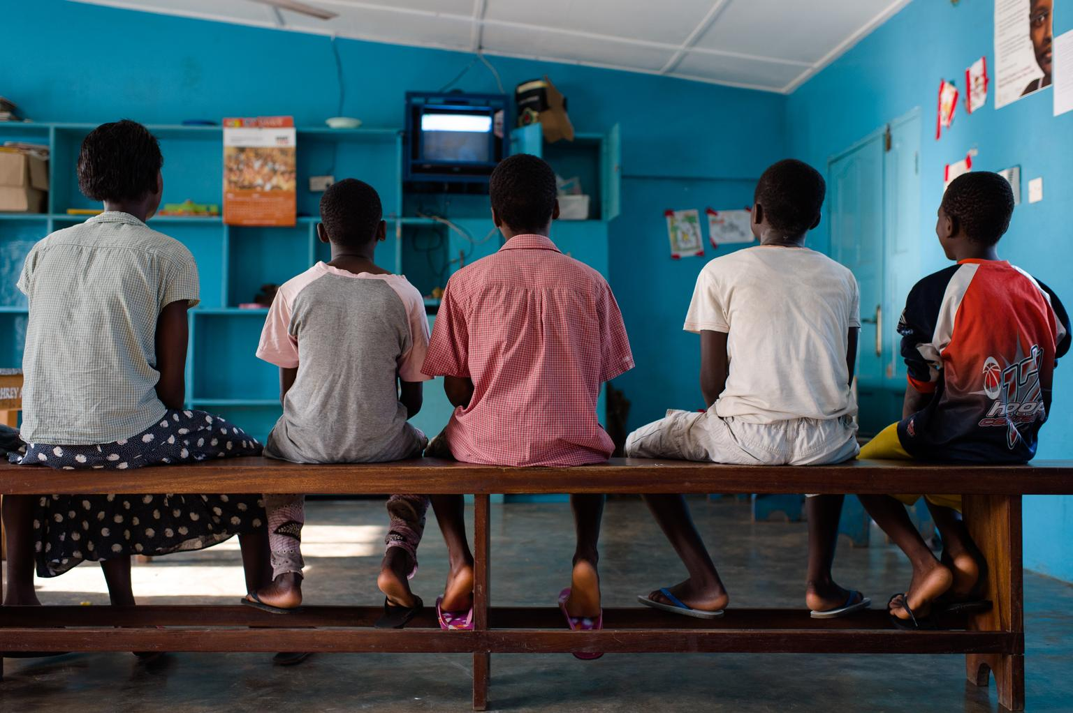
Principle of Suitability
  Range of care options must be available
  Meet the specific needs of the child concerned: case-by-case basis, catering to his/her characteristics and situation, promoting appropriate long-term stable solution(s)
  Minimum standards: human resources; access to basic services; integrated within the community; contact with parents/family; protection from violence/exploitation
  Monitoring and regulation mechanism in place
  Priority given to family and community based solutions
  Every child must have legal guardian or other recognized responsible adult or competent public body at any time.
Notes:
PRINCIPLE OF NECESSITY: preventing the need for unnecessary alternative care (Promoting parental care)
- Preventing situations and conditions that can lead to alternative care: from material poverty, stigmatization and discrimination to reproductive health awareness, parent education and other family support such as provision of day care facilities
- Gatekeeping mechanism: ensuring children are admitted to the alternative care system only if all possible means of keeping them with their parents or wider / extended family: requiring adequate services or community structures to which referrals can be made. The necessity of the placement must be regularly reviewed with consultation with parents and children
Support efforts to preserve or re-establish family unit:
Policies/programs to support families in meeting their responsibilities towards the child and promote the right of the child;
Address the factors creating risks of separation including root causes of abandonment as well to prevent avoidable relinquishment and stopping unwarranted removal;
family strengthening services, supportive social services, youth policies ;
ensure family strengthening and support takes in account issues linked to disabilities (child or caregivers) other discriminatory factors; Addressing negative societal factors;
Reintegration of children separated from their family when in their best interest

Slide 53
Notes:
Necessity principle: is alternative care genuinely needed?
Preventing situations and conditions that can lead to alternative care being required: implement poverty alleviations programs, family support services, etc.
Ensure a robust gatekeeping system with decision making authority to ensure that children are admitted to the alternative care system only if all possible means of keeping them with their parents or family have been examined.
Suitable principle: is the care appropriate for the child?
Ensure care settings meet general minimum standards.
Matching the care setting with the individual child concerned.
Within the range options, priority should clearly be given to family based solutions.

Slide 54
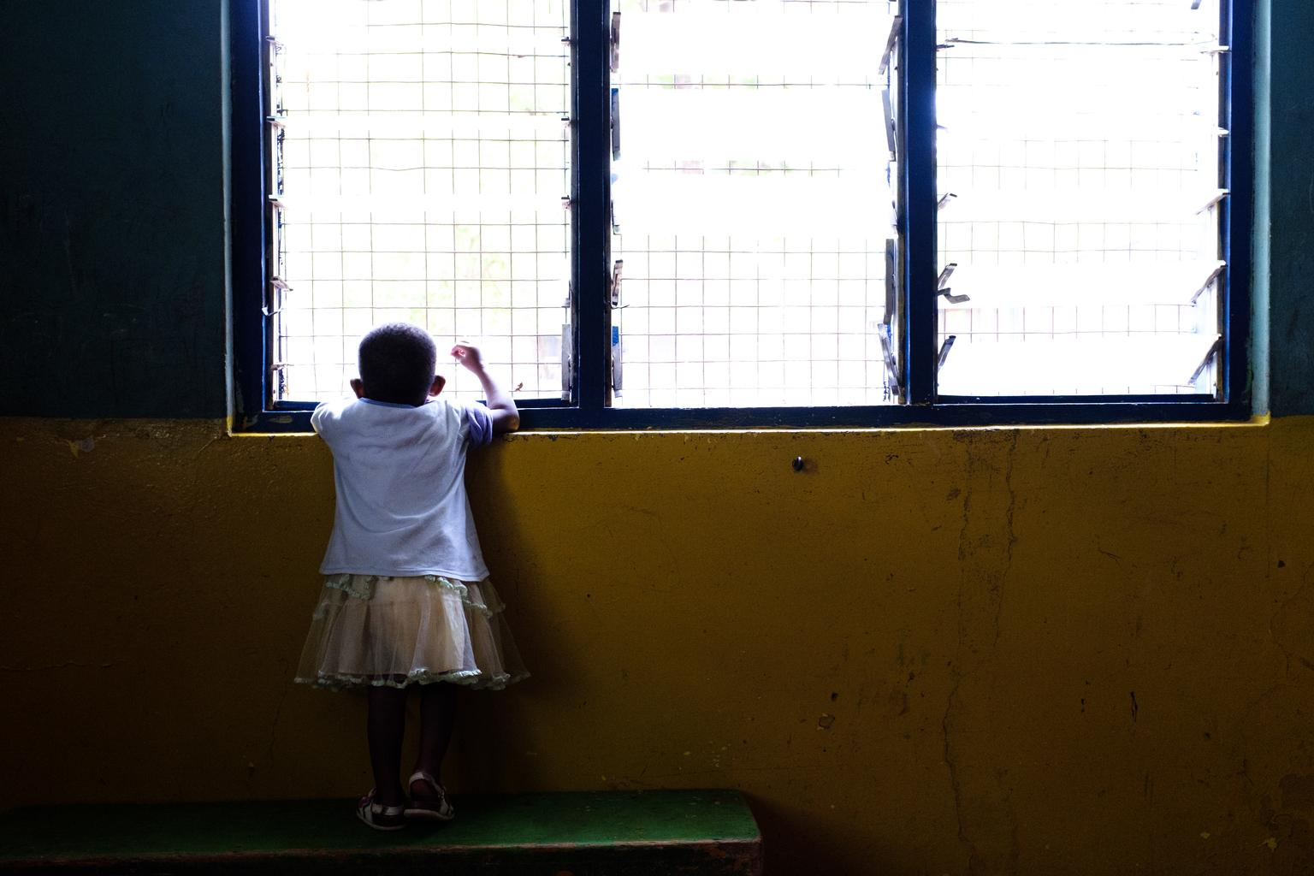
Kinship care (informal care): family-based care within the child’s extended family or with close friends of the family known to the child, whether formal or informal in nature
Foster care: children placed by a competent authority for the purpose of alternative care in the domestic environment of a family other than the children’s own family, that has been selected, qualified, approved, and supervised for providing such care
Residential care: care provided in any non-family-based group setting, such as transit centers in emergency situations and other short and long-term residential care facilities including group homes
Supervised independent living arrangements
Continuum of Care
Notes:
Forms of alternative care as outlined in the Guidelines. Note - the scope of the Guidelines does not extend however to care by adoptive parents from the moment the child concerned is effectively placed in their custody pursuant to a final adoption order. The Guidelines are applicable to pre-adoption or probationary placement of a child with the prospective adoptive parents

Slide 55
Kinship Care
Family-based care within the child’s extended family or with close friends of the family known to the child, whether formal or informal in nature (Article 29 AC Guidelines)
States must ensure the welfare and protection of children in informal care (Art.18 AC Guidelines)
Does not require formalization but encourages carers to notify the authorities so they can receive appropriate support, and, if appropriate, encourage them to formalize arrangements (Art. 56 AC Guidelines)

Slide 56
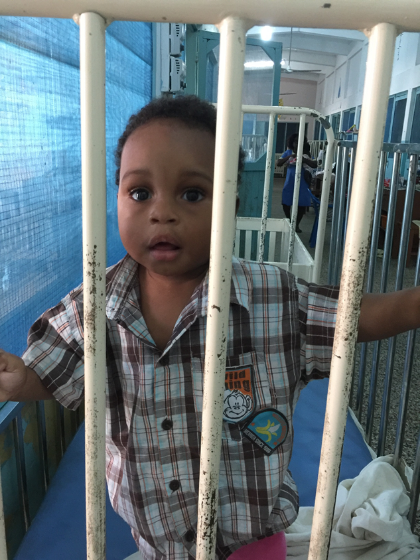
Residential Care
Use of residential care should be limited to cases where such a setting is specifically appropriate, necessary and constructive for the individual child concerned and in his/her best interests (Art. 21). RHCs should comply to standards.
In accordance with the predominant opinion of experts, alternative care for young children, especially those under the age of 3 years, should be provided in family-based settings (Art. 22)
Elimination of large scale institutions and development of alternatives in the context of an overall deinstitutionalisation strategy (Art. 23)

Slide 57
FOSTER CARE
In Ghana, the administrative body in charge of placement of children in foster care is the Department of Social Welfare (DSW).
DSW is mandated by the Children’s Act, 1998, as amended by the Children’s (Amendment) Act, 2016 (Act 937) to receive applications and place children with prospective foster parents.
This Act is backed by the Foster Care Regulations, 2018 (LI 2361).
With support from UNICEF, the DSW has developed the foster care operational manual (2018), Foster parent training manual (2018) , National Standards Foster Care, 2020 to help strengthen formal foster care in Ghana.
All districts should carry out recruitment drives to enable the Dept. train and retain a pool of foster parents.

Slide 58
ADOPTION
Adoption is a legal process that ensures the permanent transfer of parental responsibilities for a child to an adoptive parent.
Adoption therefore is the legal process by which a person (child) becomes a lawful member of a family different from their birth family.
There are two categories of adoption, namely in-country adoption and inter-country adoption.
These are further broken down into in-country relative, in-country non-relative, inter-country relative and inter-country non-relative.

Slide 59
ADOPTION
The adoption law has been amended to give more protection to children. The children’s (Amendment) Act, 2016 (Act 937) and the adoption regulations, 2018, LI 2360 are the laws governing adoption in Ghana.
Age Limitation: For relative adoption, 21 years minimum and 65 years maximum
In-country non-relative – 25 years minimum and 55 years maximum
Inter-country non-relative – 25 years minimum and 50 years maximum.
CASE MANAGEMENT IS KEY IN ALTERNATIVE CARE SYSTEM

Slide 60
"Being a family means you are a part of something very wonderful. It means you will love and be loved for the rest of your life". - Lisa Weed.
THANK YOU

