Slide 1







Social welfare Information Management System (SWIMS)
Training 2022

Slide 2

Training Outline
Introduction to SWIMS/Primero
User Groups
SWIMS Login & Home Page – DSWCD Caseworkers & Managers
Case Management Steps in Primero – DSWCD Caseworkers & Managers
Actions on SWIMS – DSWCD Caseworkers & Managers

Slide 3
What is SWIMS?
Social Welfare Information Management System - to document and report on the provision of social welfare services (child protection, social protection and GBV) based on national standard data collection forms, workflows, referral pathways and standard operating procedures (SOPs).
For use across four broad activities:
Case Management
Family Reunification & Alternative Care
Complaint & Incident Monitoring
Monitoring & Reporting

Slide 4

Primero as SWIMS
SWIMS uses an open-source, free case management software called “Primero”, developed by UNICEF
Adapted to local context and needs – configured for Ghana
Currently in use across countries such as Sierra Leone, Kenya, Jordan, Nepal, Philippines, etc.

Slide 5
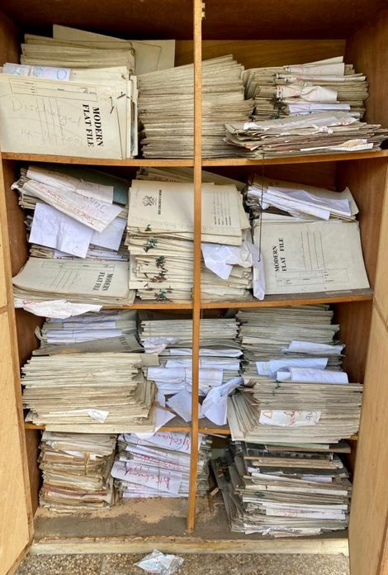
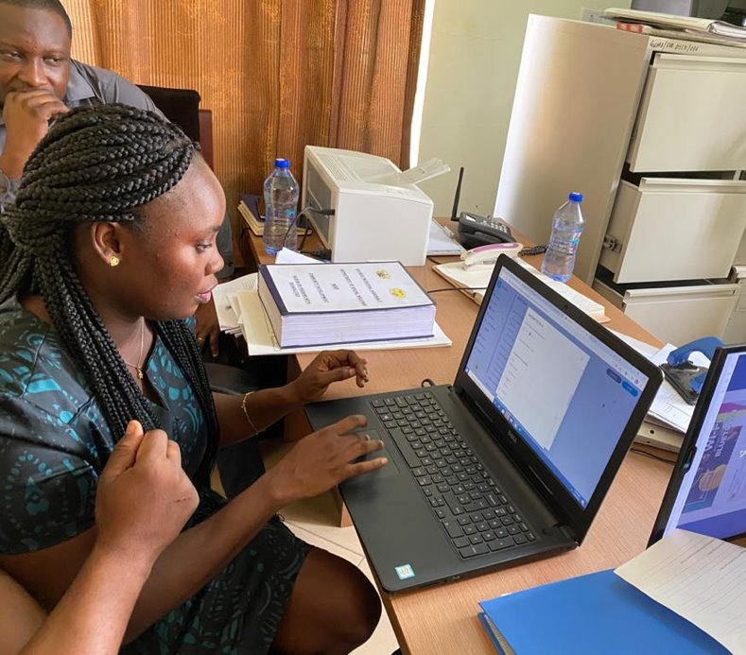
Why would District and Social Workers adopt SWIMS?

Slide 6


Slide 7
Why SWIMS?
For Social Workers
Prioritize work
Flag issues to supervisors
Automatic referral & transfer of cases to other SWIMS users
Online & offline input of data
Mobile and computer access
Evidence of CP implementation >> advocacy for resources
Role-based access
Improved data quality
Reporting and data analysis functions
Real-time analysis of aggregate trends
Interoperability
Fosters intersectoral and interdepartmental collaboration
Open source and free!
Enhanced case management
Accountability
Data Security
Confidentiality
Access on ‘need to know’ basis
Informed consent
Guided by Best interest of Child principle

Slide 8
User Groups
ON SWIMS

Slide 9
DIFFERENT LEVELS OF ACCESS
USER GROUP | CASE ACCESS
District Case Worker | MMDA (cases owned only)
District Case Manager | MMDA (all cases in team)
Regional Case Manager | Region (all cases in region)
National Case Manager | National (all cases in Ghana)
National Protection Officer (Statistics only)
National Administrator

Slide 10
Getting Started
LOGIN & DASHBOARD

Slide 11
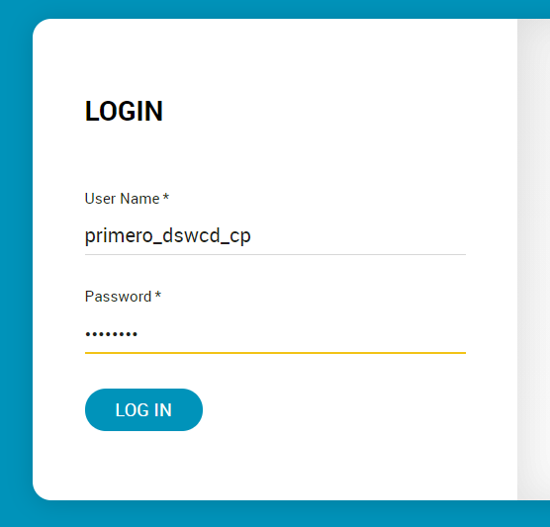
Log In
Username and password is generated for each user by SWIMS system administrators.
Go to https://demo-swims-mogcsp.primero.org/ and enter username and password assigned to you.
Same link and login credentials to access SWIMS on computer and mobile phone.
Based on user group, each user will have a different level of access. User groups are determined by position, level and location.

Slide 12
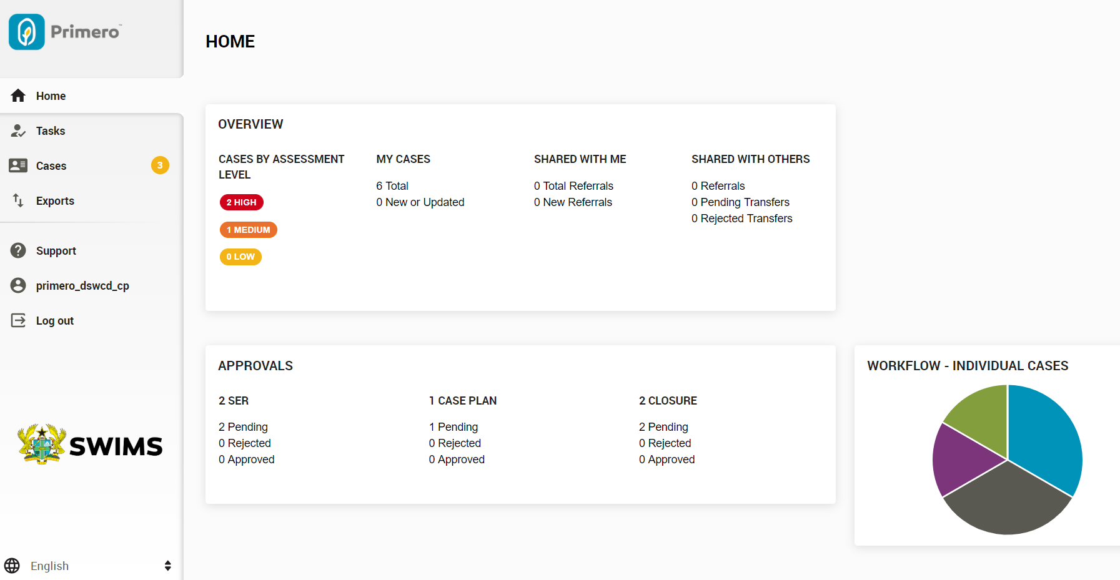
Home Page for Case Workers
The MAIN MENU appears on the right.
TASKS: View upcoming & overdue tasks for all your cases
Case records owned and shared
CASES: View, create and edit cases
Number of cases in each stage of case management
EXPORTS: Downloading forms as PDF to print
SUPPORT: Contact Details of System Administrator
User Profile
Number of cases with pending approvals
Number of forms submitted for approval

Slide 13
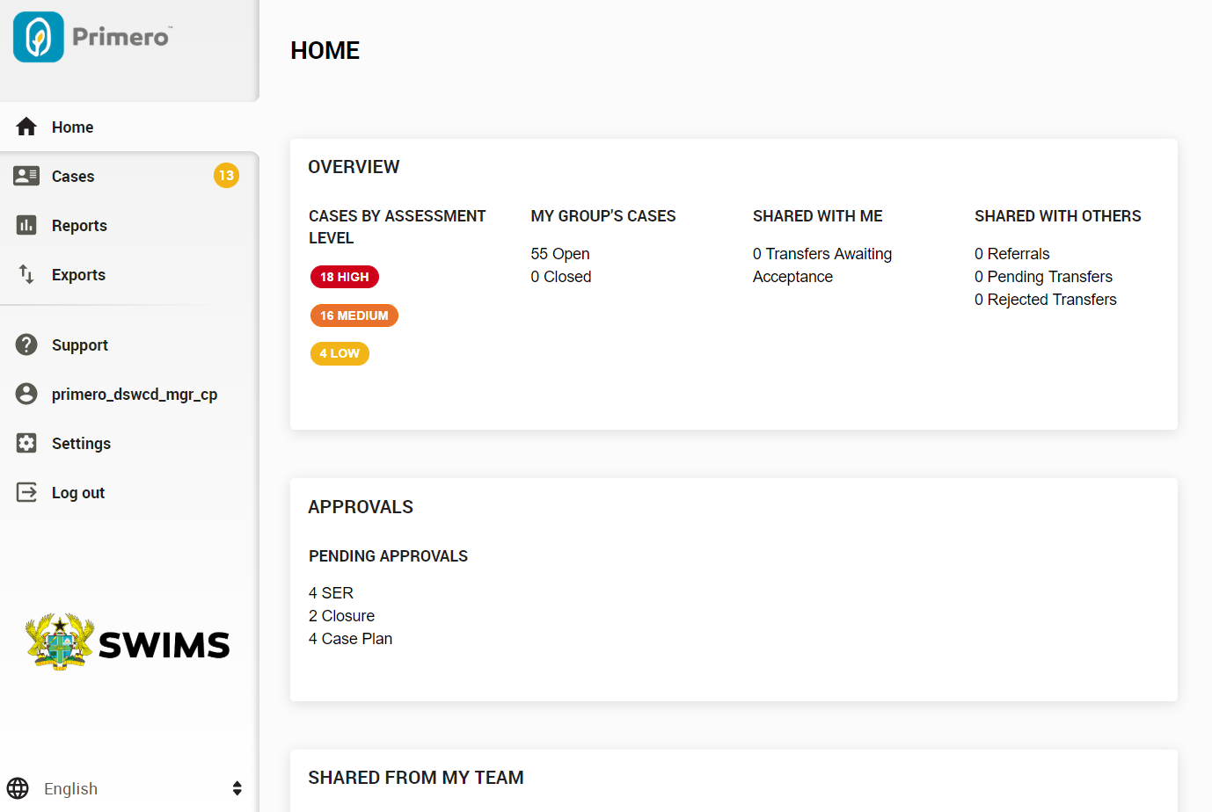
Home Page for Case Managers (1/3)
The MAIN MENU appears on the right. Most elements are the same.
CASES: View all case records owned by you and your team
Reports: View and generate reports for your area

Slide 14
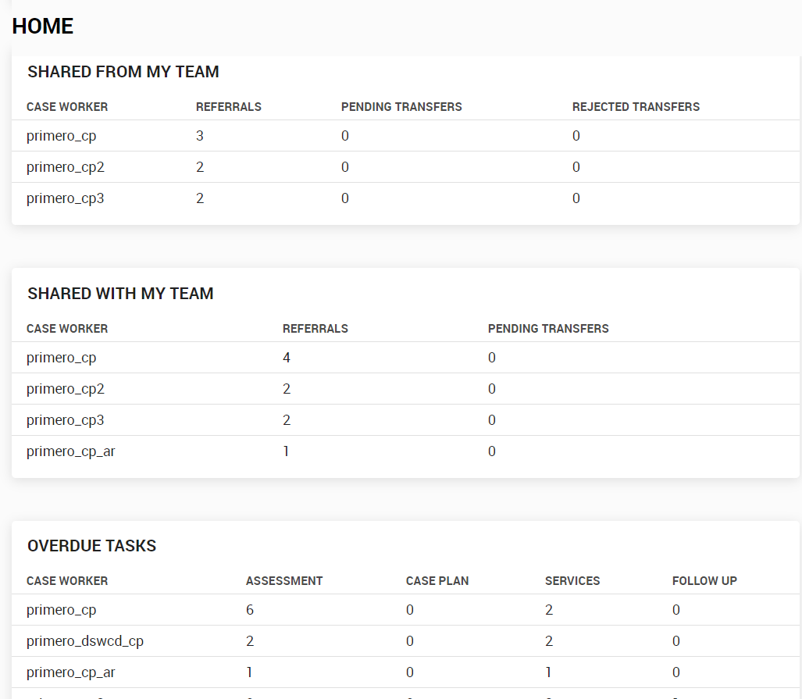
Home Page for Case Managers (2/3)
ADDED FEATURE - Data to help monitor the team and their current workloads.

Slide 15
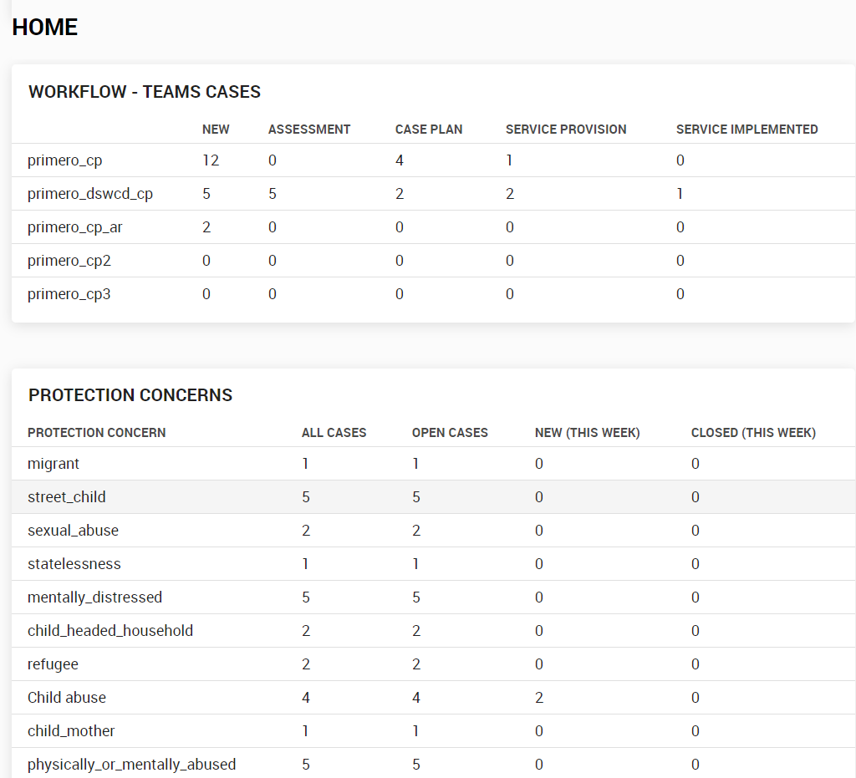
Home Page for Case Managers (3/3)
ADDED FEATURE – Data on type / volume of protection cases in your team.

Slide 16
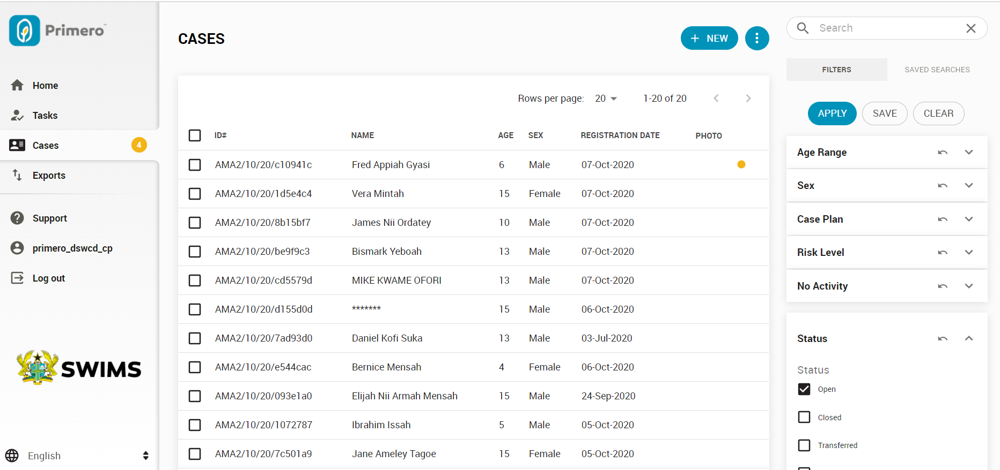
CASES
View all your case records here. This includes:
Case records created by you (for managers, all records owned by your team)
Case records referred/transferred from another user

Slide 17
SEARCH
Enter a case number or client ID number in the search bar.
Apply the Filter system on the right to search by category, status, etc.

Slide 18
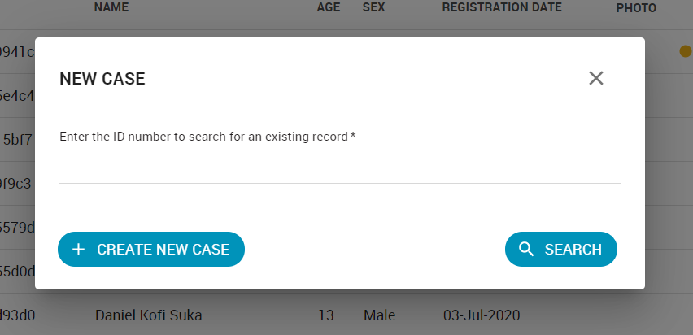
CREATE
To create a case, click on +New.

Slide 19
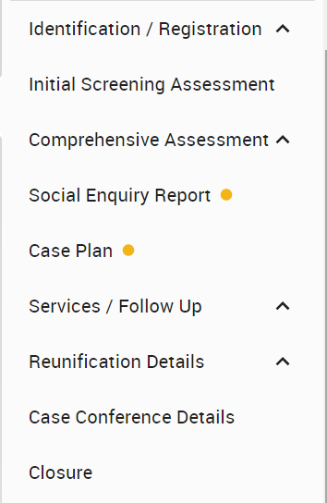
Case Management Steps in SWIMS
To follow the case management steps in SWIMS, fill in the required forms for each stage :
Identification / Registration
Assessment
  Includes Initial Screening, Comprehensive Assessment, SER
Case Plan
Services
  Records services provided including referrals, implementation, case conferences
Follow Up
Case Closure

Slide 20
Protection Concerns – Typology & Definitions FOR CASE WORKERS AND SWIMS USERS
List of Protection Concerns for Case Management and SWIMS .pdf

Slide 21
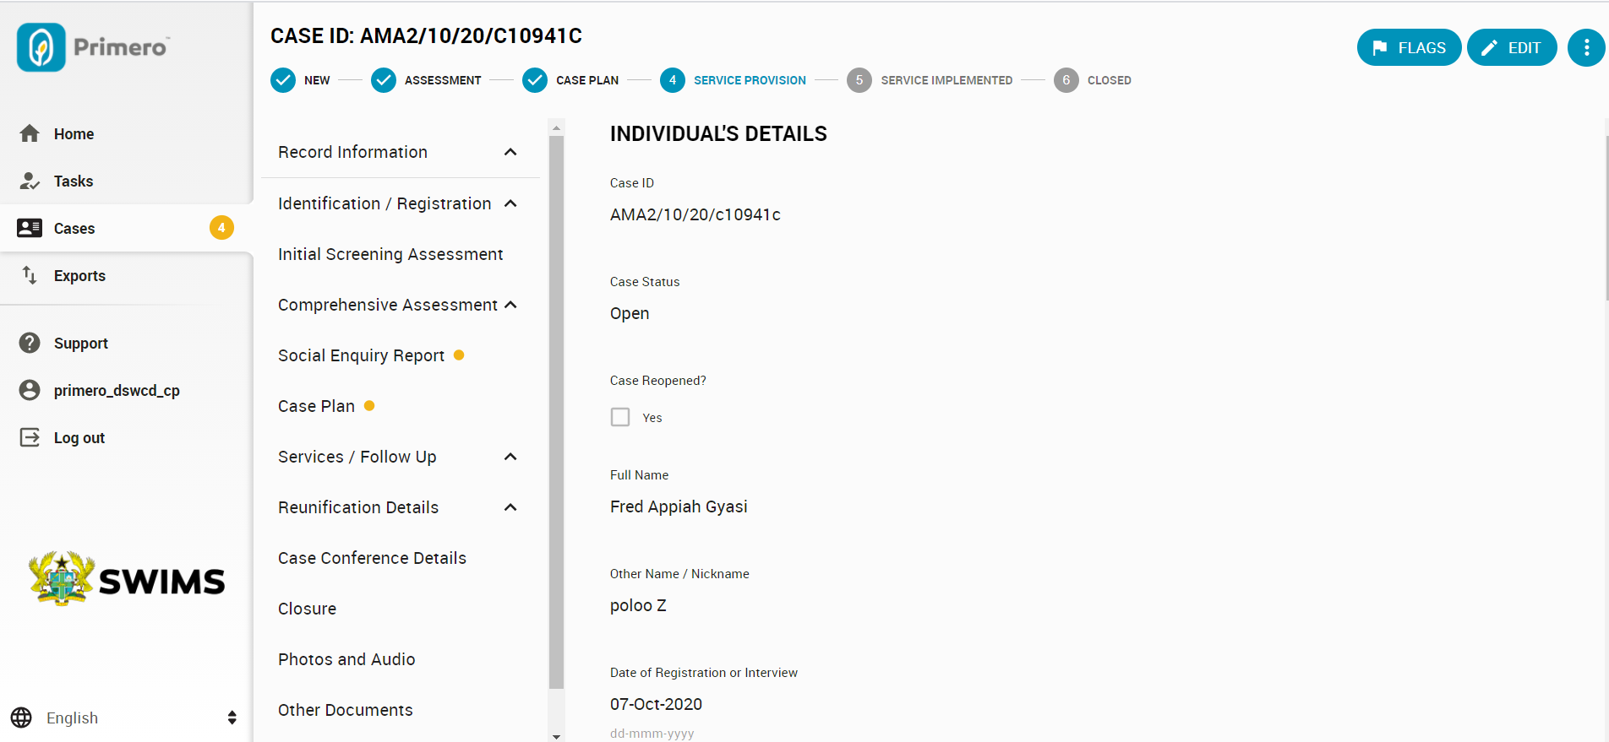
CASE RECORD
This is an individual case record.
Workflow bar (below Case ID) shows the stage of case management.
All SOP forms are available in the center menu.

Slide 22
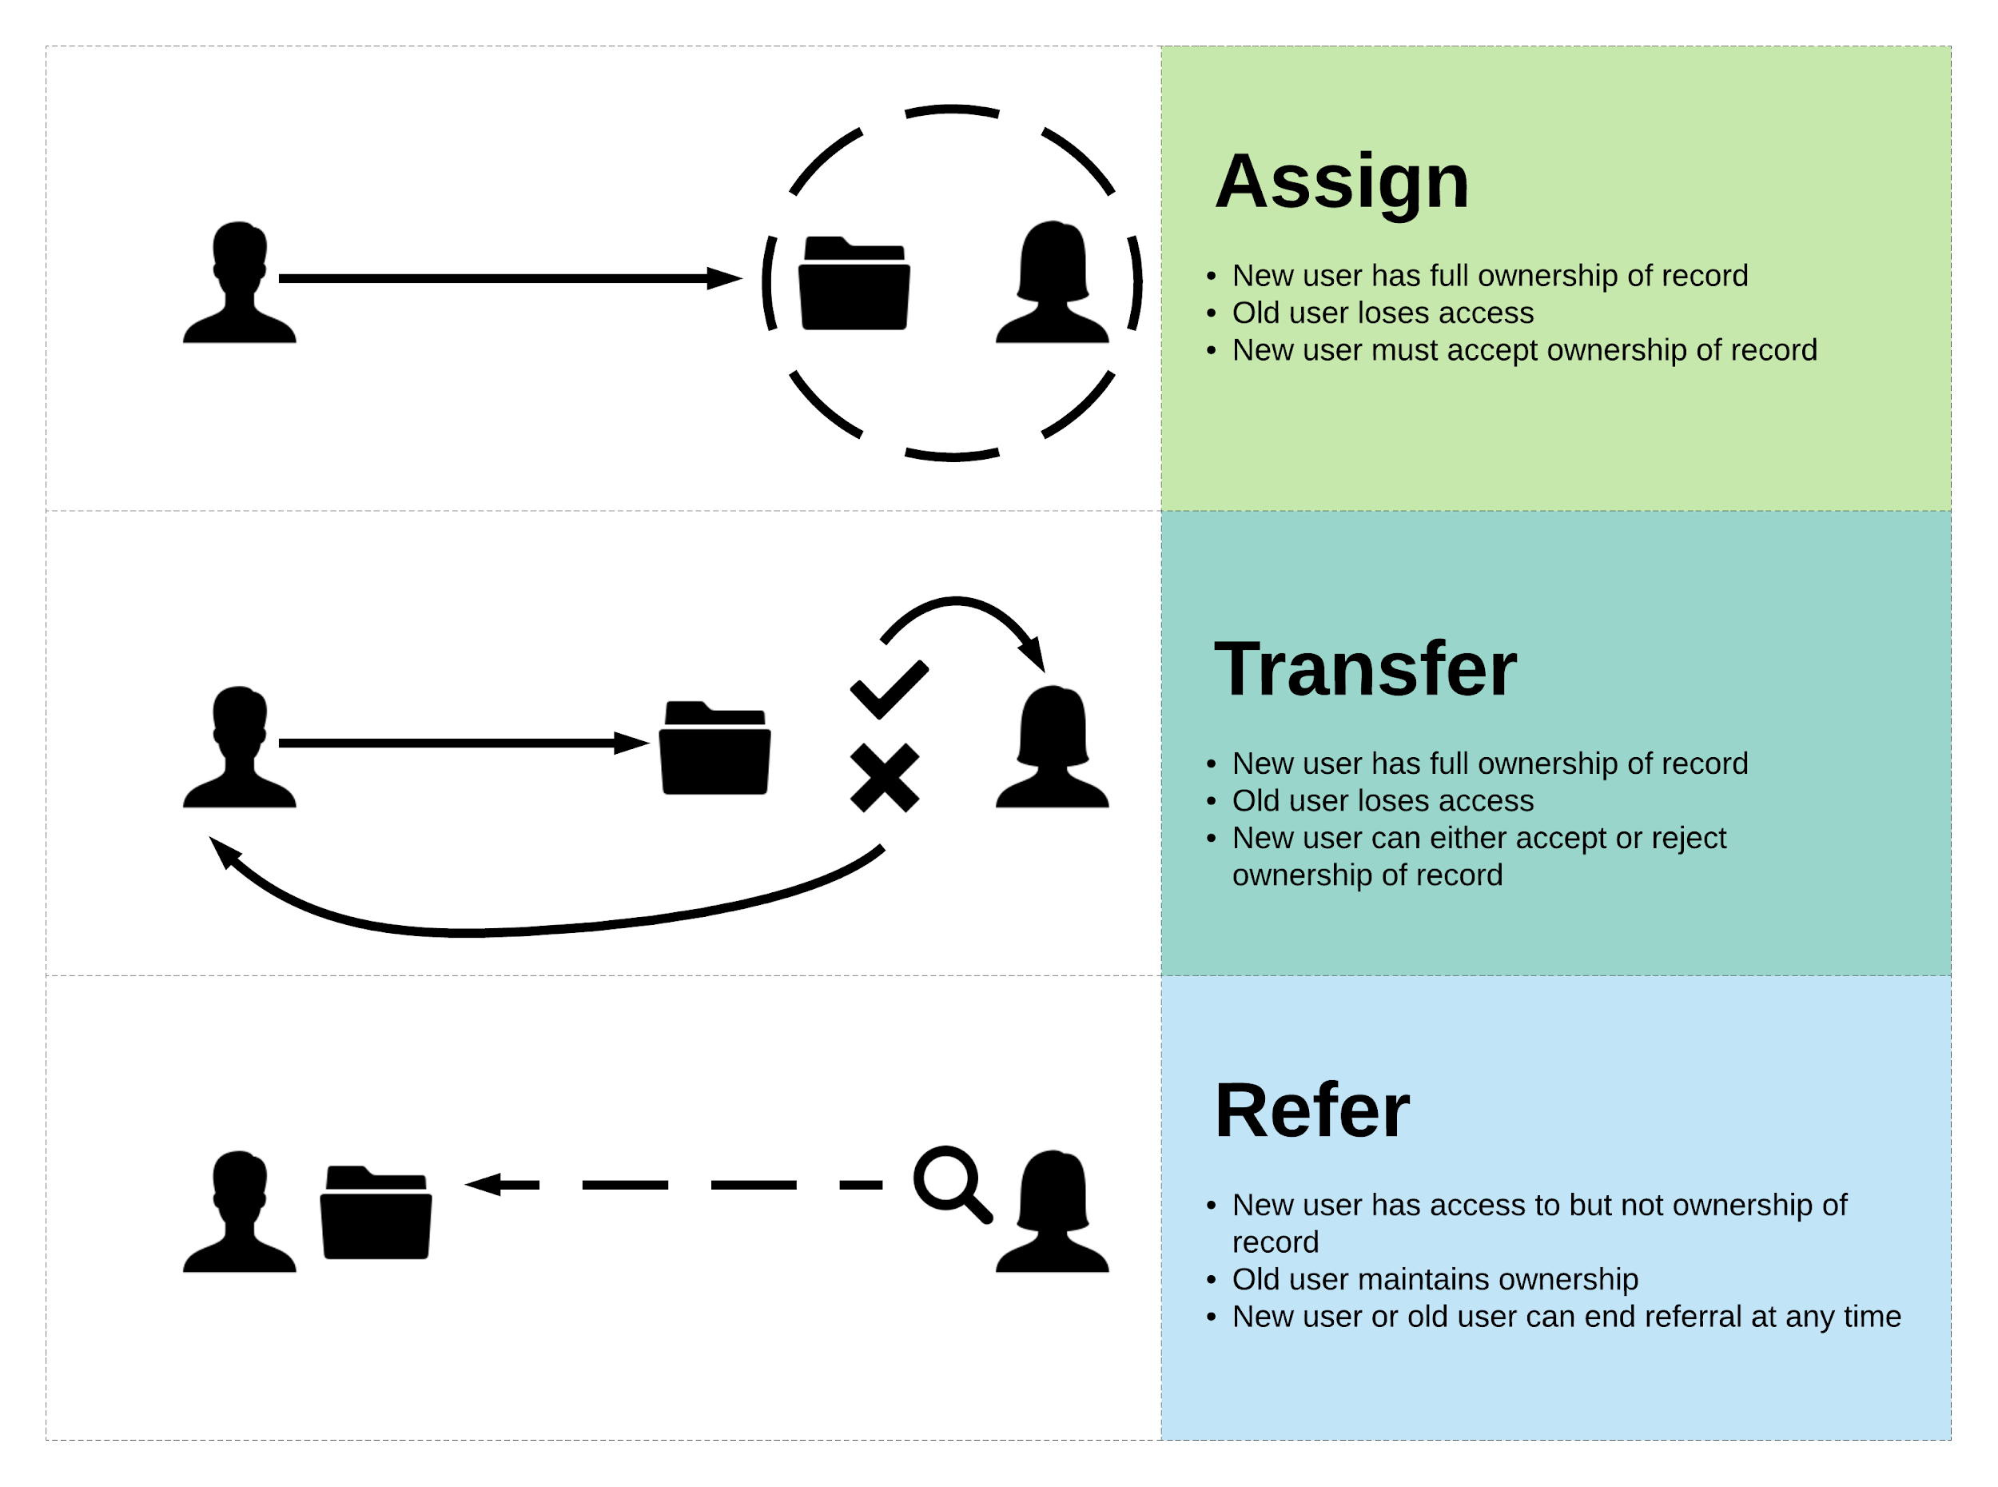
Transferring Cases

Slide 23


Slide 24
Reporting
FOR CASE MANAGERS

Slide 25
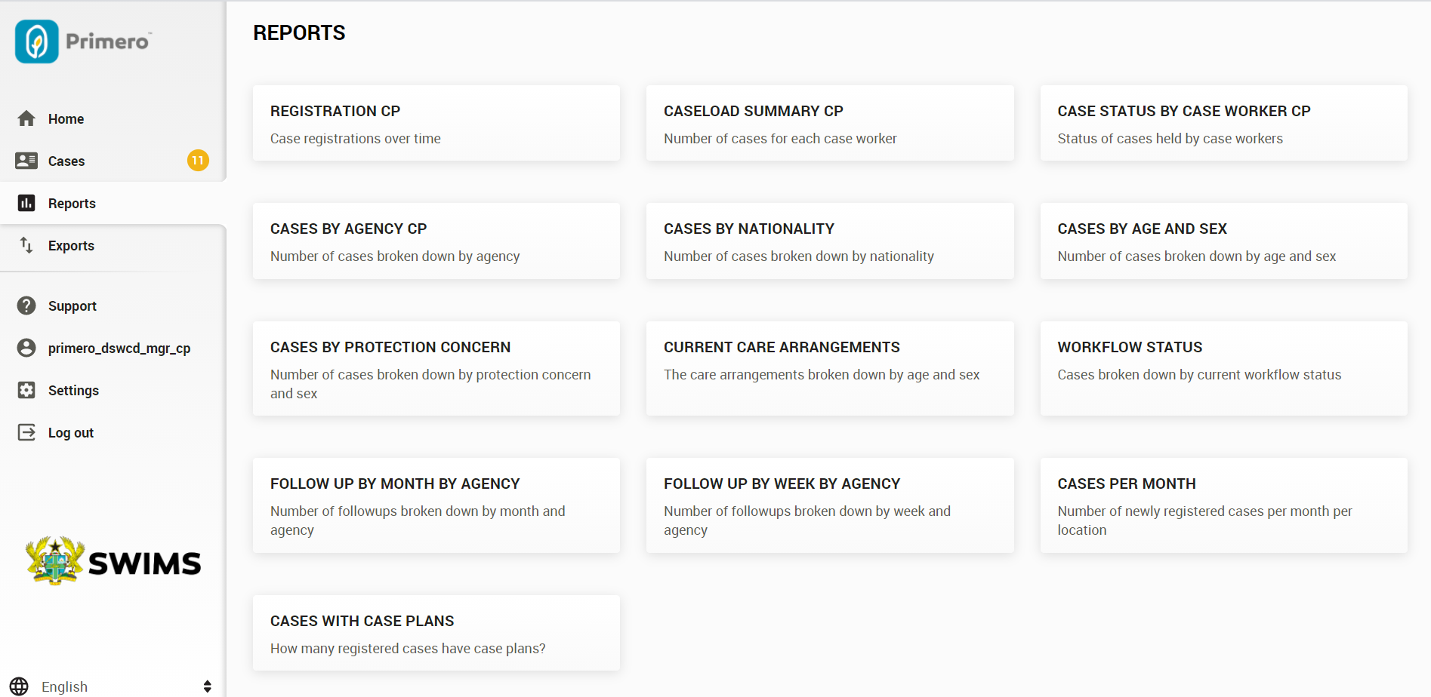
REPORTS
Case Managers can view and generate any of the following related to cases in their MMDA.

Slide 26
Let’s try practicing using SWIMS with some scenarios!

Slide 27

Thank you for your attention!

