Slide 1
OVERVIEW OF THE CP TOOLKIT MONITORING APPLICATION
DEPARTMENT OF CHILDREN

Slide 2
OUTLINE
Objective
Major components
Key element application Captures
Current collated data from the system
Achievement
Challenges
Scale –up process

Slide 3
OBJECTIVE OF THE APP
To obtain real-time data on the use of the toolkit at all levels (National, Regional, District, Community, Institution/organisation and Facilitator)
To determine the reach of the toolkit which includes:
  Geographical (region, district, community)
  Number and type of audience reached
  Frequency of use of each tool
  Issues addressed
  Emerging changes/results
  Challenges
The App facilitates monitoring and reporting on community engagements carried out by both government institutions, NGOs, and other organizations across the country that use the CP toolkits.

Slide 4
Major Components
Mobile Application
Online platform

Slide 5
Features of the APP
User friendly
Easy to use
Simple
Online functionality
Devices: Can be used on mobile, tablet, laptops and Computers etc

Slide 6
FUNCTIONS OF THE APP
Ability to setup all the data access levels (National, Regional, District, Community Facilitator)
Allows the District Officer/Head to access reports from his or her district.
An Online Web Portal dashboard that summaries & aggregate most of the analyzed data from across the country by different levels ( National, Regional, District, Community, Facilitator)

Slide 7
Key Elements to be Captured
Date of the activity
The type of Audience- demographics – E.g. Children/ Adults, Males/Females and audience type including numbers
Location – Region/District/Community/GPS location
Tools used
Topics discussed
Status of the tools
Remarks: Challenges/ Declarations made by audience after the session where necessary/Achievements

Slide 8
USER ROLES
FACILITATOR
ENTERS DATA
DISTRICT DIRECTOR
VERIFIES DATA
GACA SECRETARIAT
COLLATE DATA
REGIONAL DIRECTOR
APPROVES DATA

Slide 9
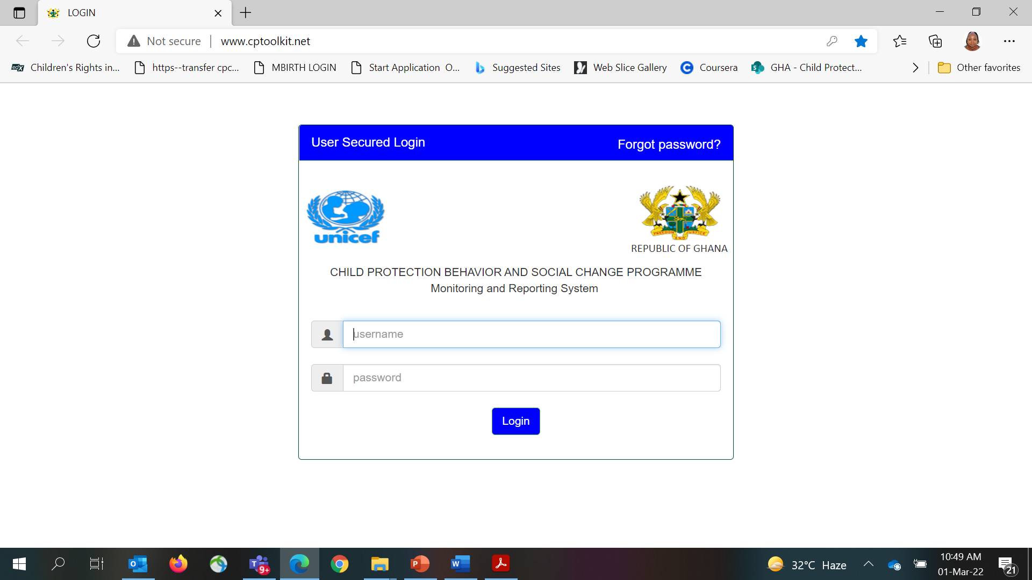
www.cptoolkit.net

Slide 10
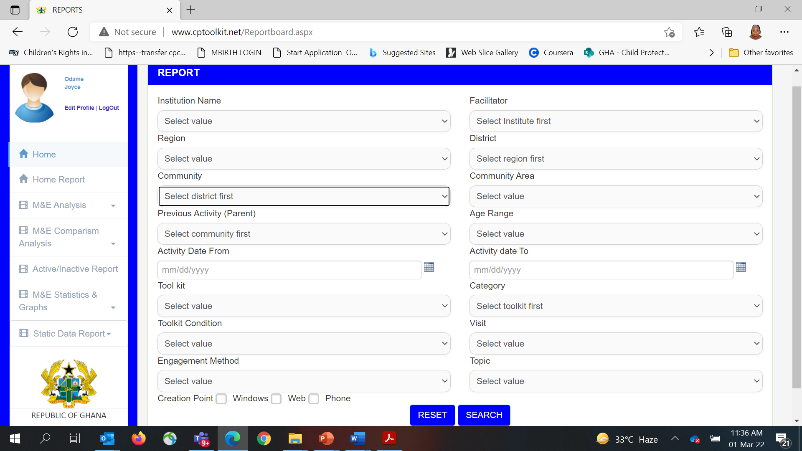
Reporting Interface
Data Entry Page for Facilitators

Slide 11
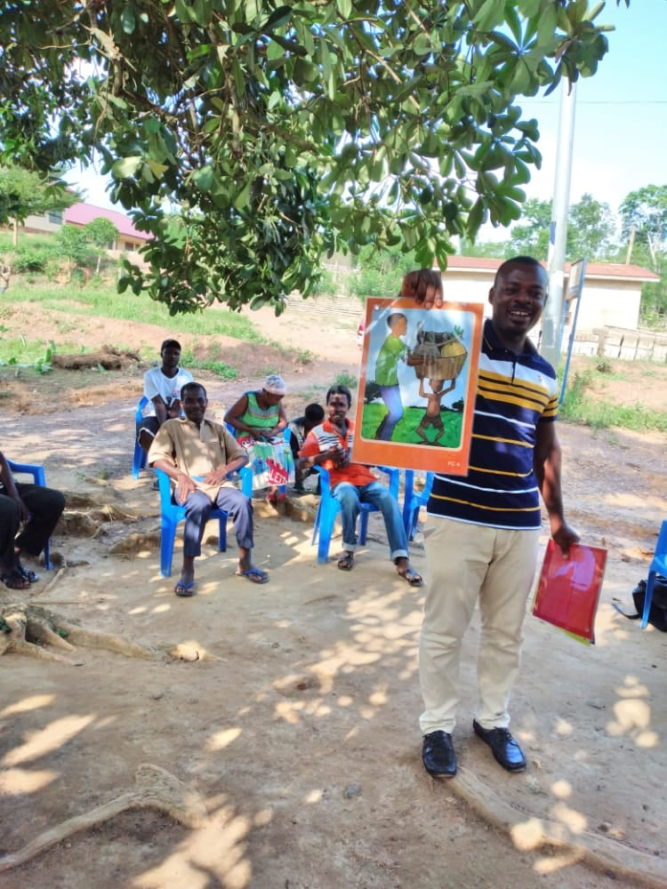
SOME MEDIA ATTACHMENT

Slide 12
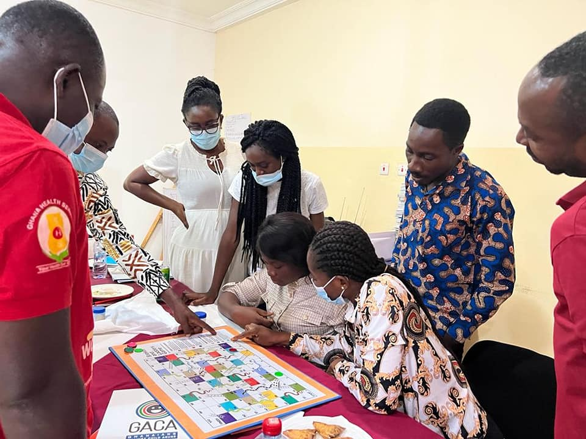
SOME MEDIA ATTACHMENT

Slide 13
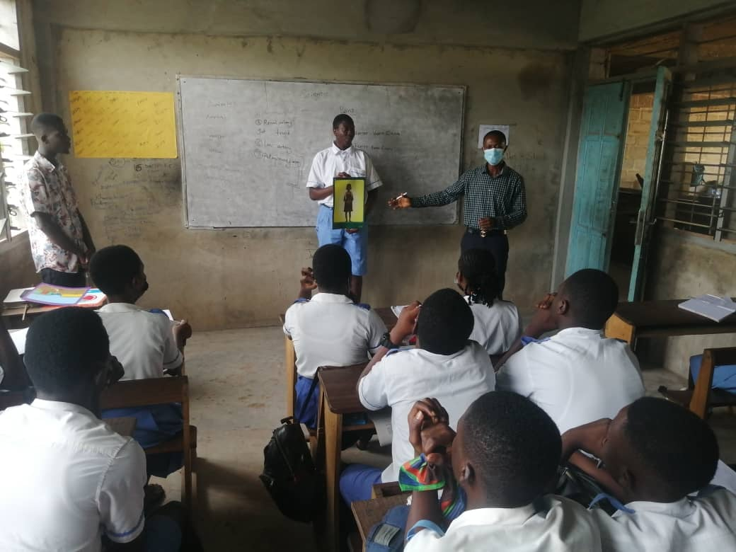
www.Iamgaca.org
Gaca
@gacaghana
THANK YOU
@gacaghana
Gaca

Slide 14
THANK YOU

