Slide 1
PATHWAYS
ISSOP
DEPARTMENT OF CHILDREN

Slide 2
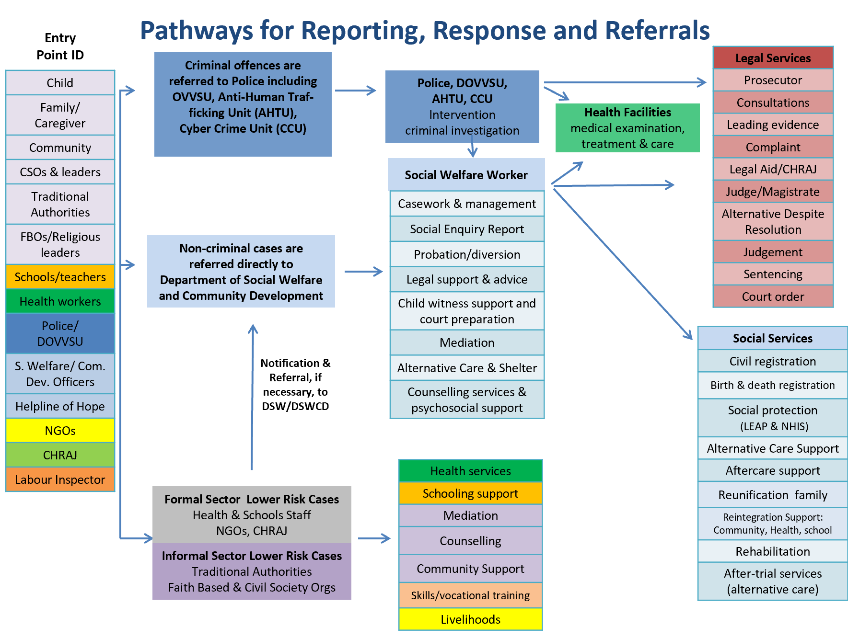
PATHWAYS FOR REPORTING,RESPONSE AND REFERRALS

Slide 3
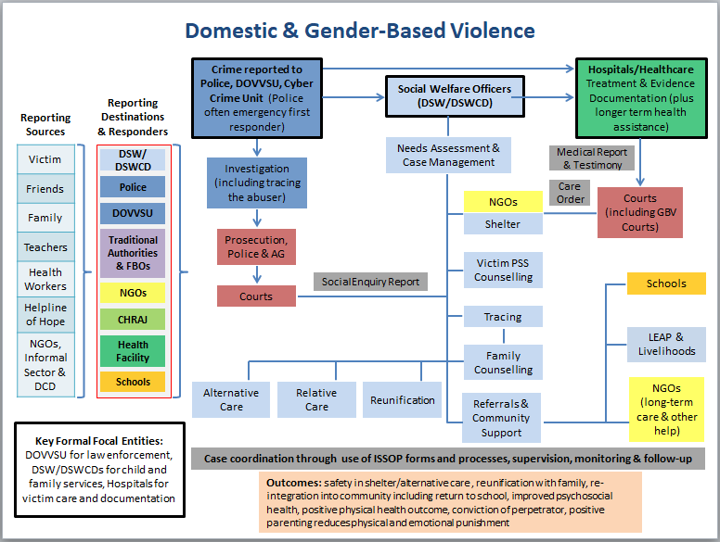
DOMESTIC AND GENDER BASED VIOLENCE

Slide 4
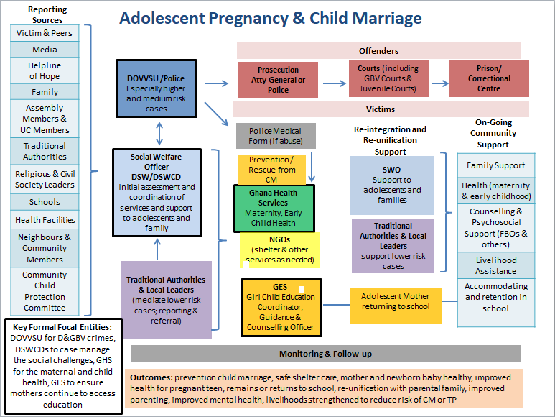
ADOLESCENT PREGNANCY & CHILD MARRIAGE

Slide 5
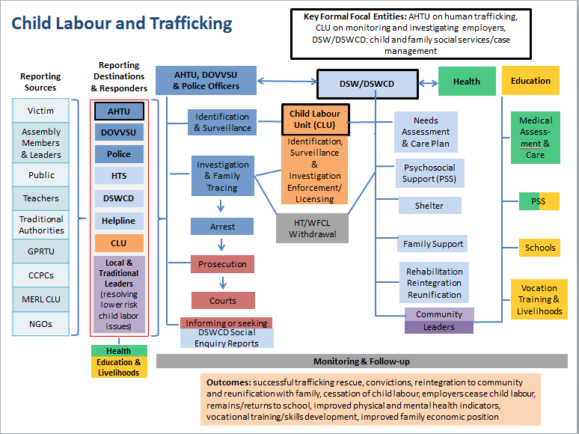
CHILD LABOUR AND TRAFFICKING

Slide 6
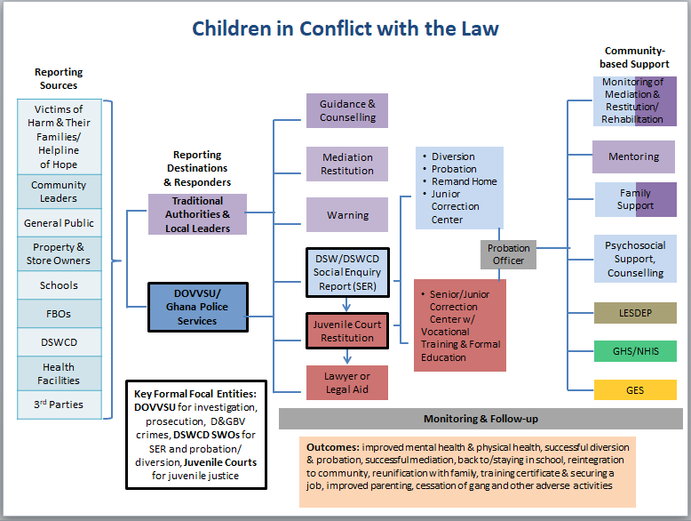
CHILDREN IN CONFLICT WITH THE LAW

Slide 7
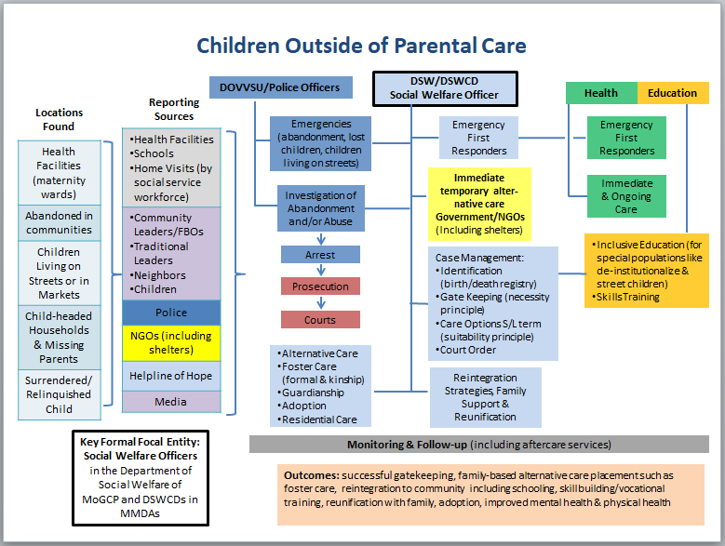
CHILDREN OUTSIDE OF PARENTAL CARE

Slide 8
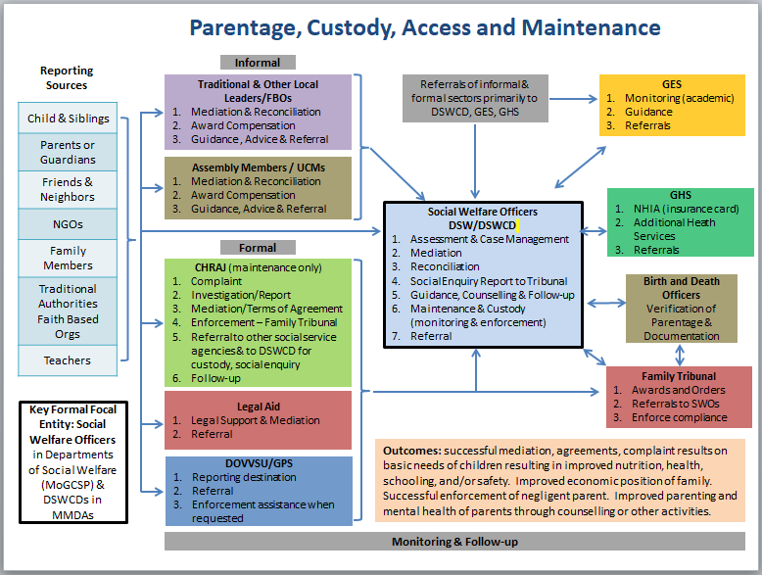
PARENTAGE ,CUSTODY,ACCESS AND MAINTENANCE

Slide 9
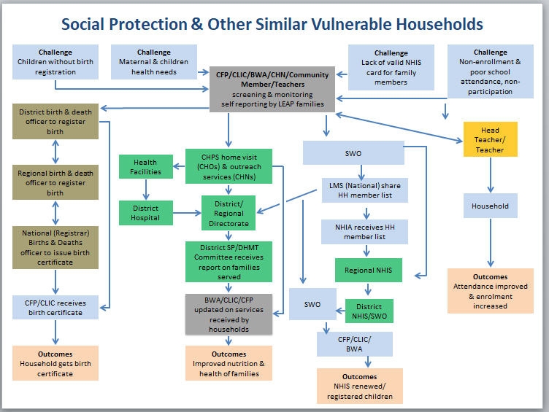
SOCIAL PROTETCION AND OTHER VULNERABLE HOUSEHOLDS

Slide 10
Forms, Tools, Guides and Processes

Slide 11
INTRODUCTION
Five ISSOP forms, tools and guides for hands-on use by service and support providers are described in this chapter.
Tool to prevent risks from escalating through early identification of risk and vulnerability during household visits;
Form to document and notify the government of initiation and updating of casework
Form and process for referrals when additional assistance is needed for a case
Protocol for safeguarding personal data and confidentiality of clients

